Slide 1

CM20315 - Machine Learning
Prof. Simon Prince
8. Performance

Slide 2
Measuring performance
MNIST1D dataset model and performance
Noise, bias, and variance
Reducing variance
Reducing bias & bias-variance trade-off
Double descent
Curse of dimensionality & weird properties of high dimensional space
Choosing hyperparameters

Slide 3
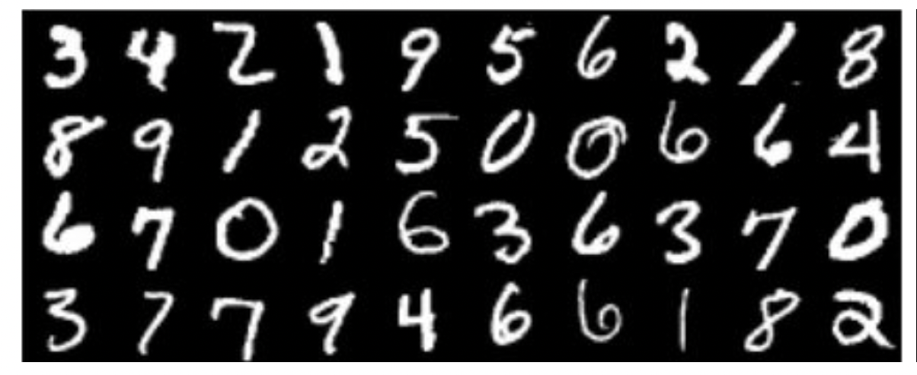
MNIST Dataset

Slide 4
MNIST 1D Dataset

Slide 5
Network
40 inputs
10 outputs
4000 training examples (~400 training examples per class)
Two hidden layers
100 hidden units each
SGD with batch size 100, learning rate 0.1
6000 steps (?? Epochs)

Slide 6
Results

Slide 7
Need to use separate test data

Slide 8
Need to use separate test data
The model has not generalized well to the new data

Slide 9
Measuring performance
MNIST1D dataset model and performance
Noise, bias, and variance
Reducing variance
Reducing bias & bias-variance trade-off
Double descent
Curse of dimensionality & weird properties of high dimensional space
Choosing hyperparameters

Slide 10
Regression example

Slide 11
Toy model
K hidden units
First layer fixed so “joints” divide interval evenly
Second layer trained
But… now linear in h
so convex cost function
can find best soln in closed-form

Slide 12
Noise, bias, and variance
Noise in measurements
Some variables not observed
Data mislabeled

Slide 13
Noise, bias, and variance

Slide 14
Noise, bias, and variance

Slide 15
Noise, bias, and variance
Variance is the uncertainty in fitted model due to choice of training set
Bias is systematic deviation from the mean of the function we are modeling due to limitations in our model
Noise is inherent uncertainty in the true mapping from input to output

Slide 16
Least squares regression only
We can show that:
Expectation over noise in training data
Expectation over
noise in test data
Best possible model if we had infinite data
True function
Actual model

Slide 17
Measuring performance
MNIST1D dataset model and performance
Noise, bias, and variance
Reducing variance
Reducing bias & bias-variance trade-off
Double descent
Curse of dimensionality & weird properties of high dimensional space
Choosing hyperparameters

Slide 18
Variance

Slide 19
Variance

Slide 20
Variance
Can reduce variance by adding more samples

Slide 21
Measuring performance
MNIST1D dataset model and performance
Noise, bias, and variance
Reducing variance
Reducing bias & bias-variance trade-off
Double descent
Curse of dimensionality & weird properties of high dimensional space
Choosing hyperparameters

Slide 22
Reducing bias

Slide 23
Reducing bias

Slide 24
Why does variance increase? Overfitting
Describes the training data better, but not the true underlying function (black curve)

Slide 25
Bias and variance trade-off
Number of datapoints

Slide 26
Measuring performance
MNIST1D dataset model and performance
Noise, bias, and variance
Reducing variance
Reducing bias & bias-variance trade-off
Double descent
Curse of dimensionality & weird properties of high dimensional space
Choosing hyperparameters

Slide 27
Number of datapoints

Slide 28
Double descent

Slide 29
Classical or under-parameterized regime
Modern or over-parameterized regime
Critical regime

Slide 31
Note that train data is very close to zero.
Whatever is happening isn’t happening at training data points
Must be happening between the data points??

Slide 32
Potential explanation:
can make smoother functions with more hidden units
being smooth between the datapoints is a reasonable thing to do
But why?

Slide 33
All of these solutions are equivalent in terms of loss.
Why should the model choose the smooth solution?
Tendency of model to choose one solution over another is inductive bias

Slide 34
Measuring performance
MNIST1D dataset model and performance
Noise, bias, and variance
Reducing variance
Reducing bias & bias-variance trade-off
Double descent
Curse of dimensionality & weird properties of high dimensional space
Choosing hyperparameters

Slide 35
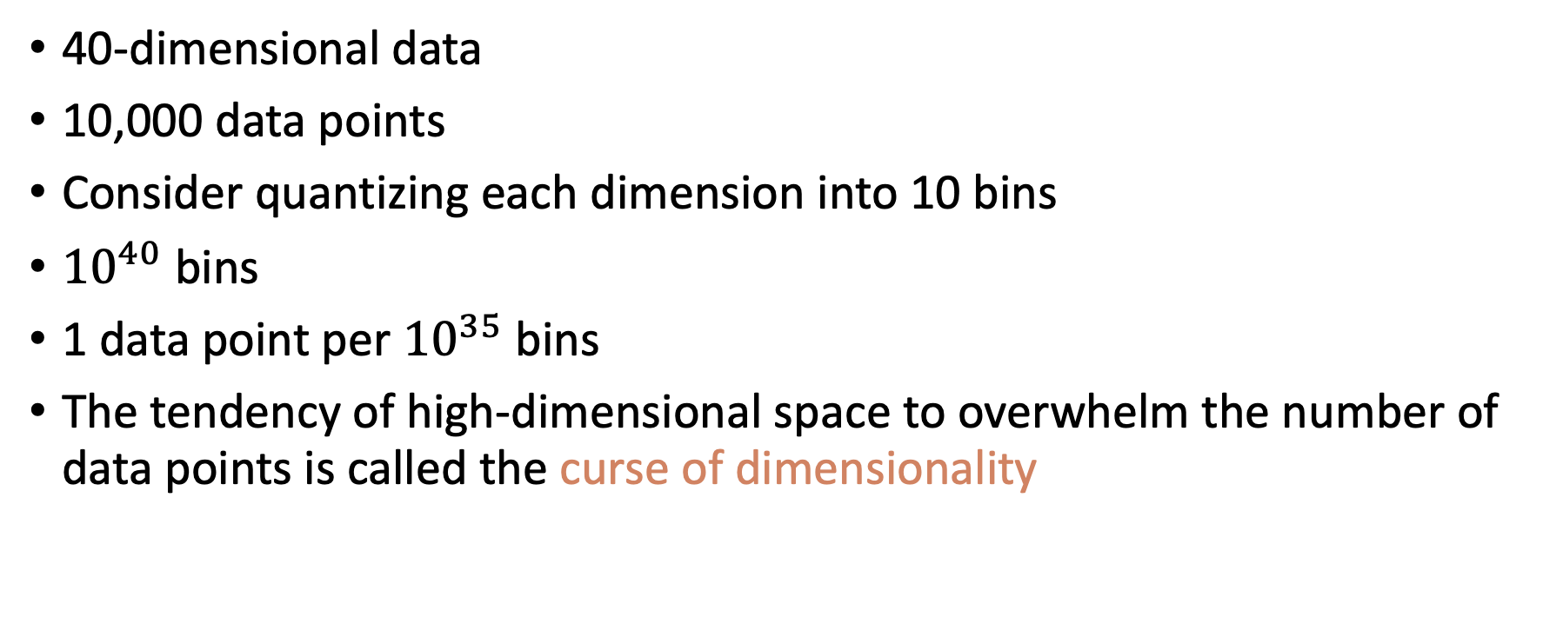
Curse of dimensionality
40-dimensional data
10,000 data points
Consider quantizing each dimension into 10 bins
${10}^{40}$ bins
1 data point per ${10}^{35}$ bins
The tendency of high-dimensional space to overwhelm the number of data points is called the curse of dimensionality

Slide 36
Weird properties of high-dimensional space
Two randomly sampled data points from normal are at right angles to each other with high likelihood
Distance from the origin of random samples is roughly constant

Slide 37
Distance from the origin of random samples is roughly constant

Slide 38
Weird properties of high-dimensional space
Two randomly sampled data points from normal are at right angles to each other with high likelihood
Distance from the origin of random samples is roughly constant
Most of the volume of a high dimensional orange is in the peel not in the pulp
Volume of a diameter one hypersphere becomes zero
Generate random points uniformly in hypercube, ratio of nearest to farthest becomes close to one.

Slide 39
Measuring performance
MNIST1D dataset model and performance
Noise, bias, and variance
Reducing variance
Reducing bias & bias-variance trade-off
Double descent
Curse of dimensionality & weird properties of high dimensional space
Choosing hyperparameters

Slide 40
Choosing hyperparameters
Don’t know bias or variance
Don’t know how much capacity to add
How do we choose capacity in practice?
Or model structure
Or training algorithm
Or learning rate
Third data set – validation set
Train models with different hyperparameters on training set
Choose best hyperparameters with validation set
Test once with test set

Slide 41
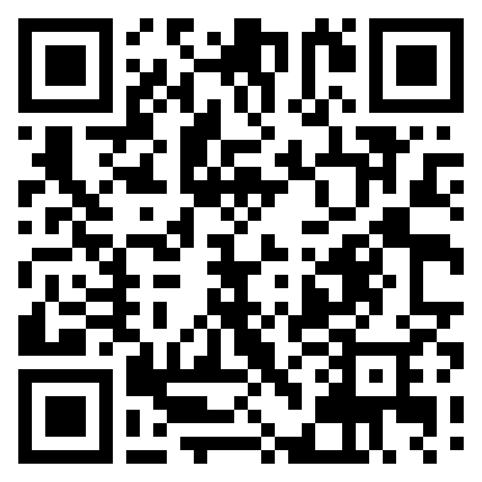
Feedback

