Slide 1
Instructional Tutorial

Slide 2
Proof of concept (Application Under Test)
It consists of multiple pages….
As a user you can select any of these pages
each page has different ui element….
I tried to contain all known and most used ui elements (core components)

Slide 3
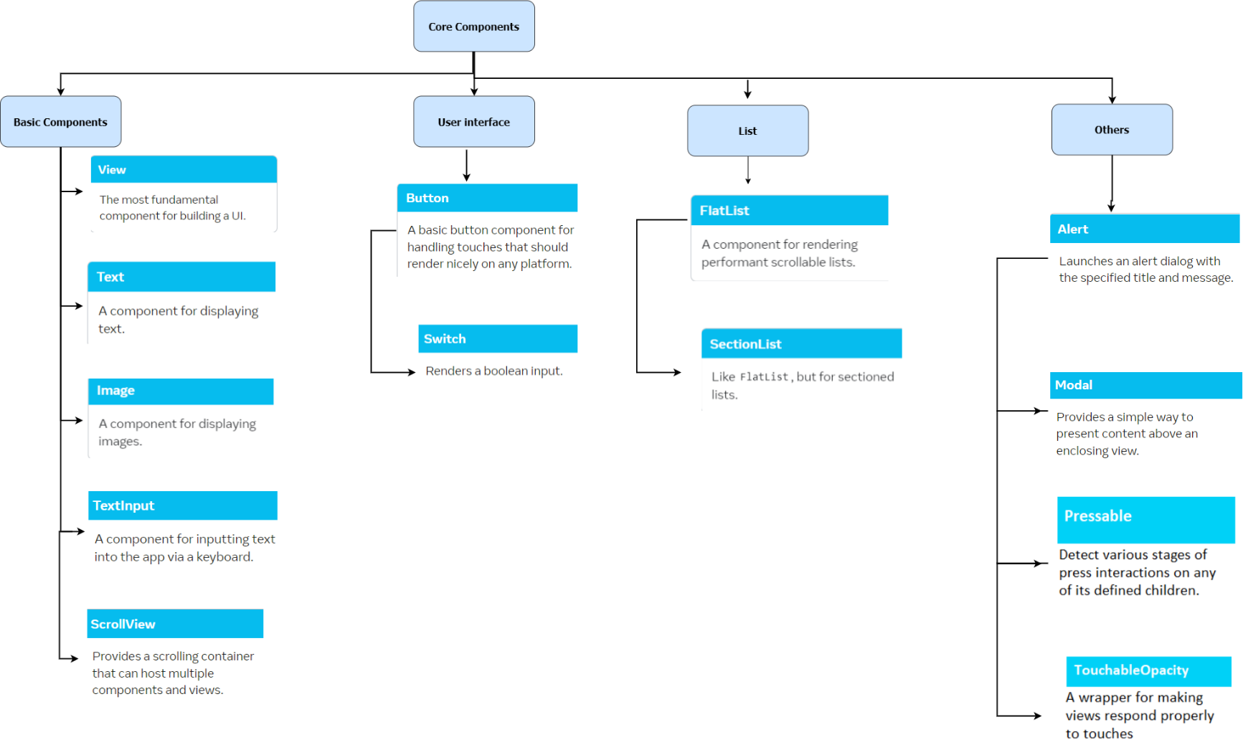
React Native Core components

Slide 4
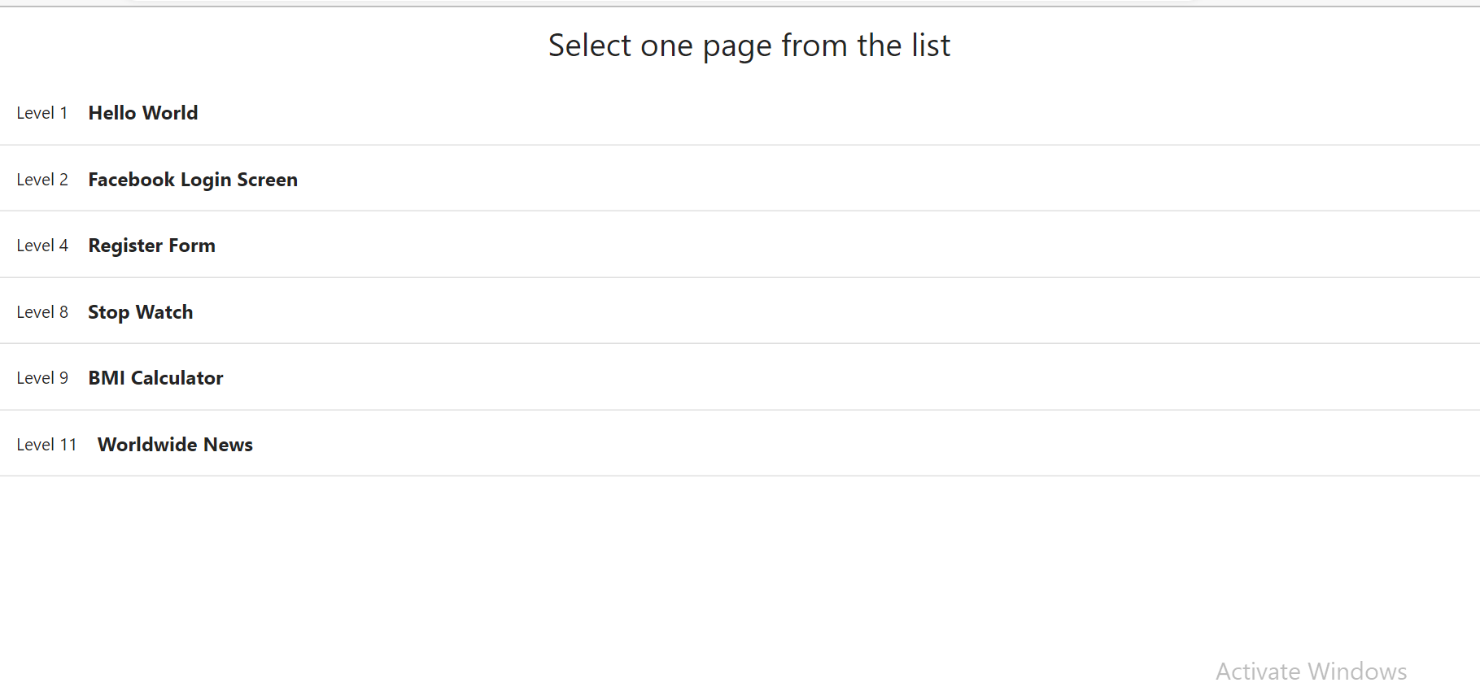
Main page

Slide 5
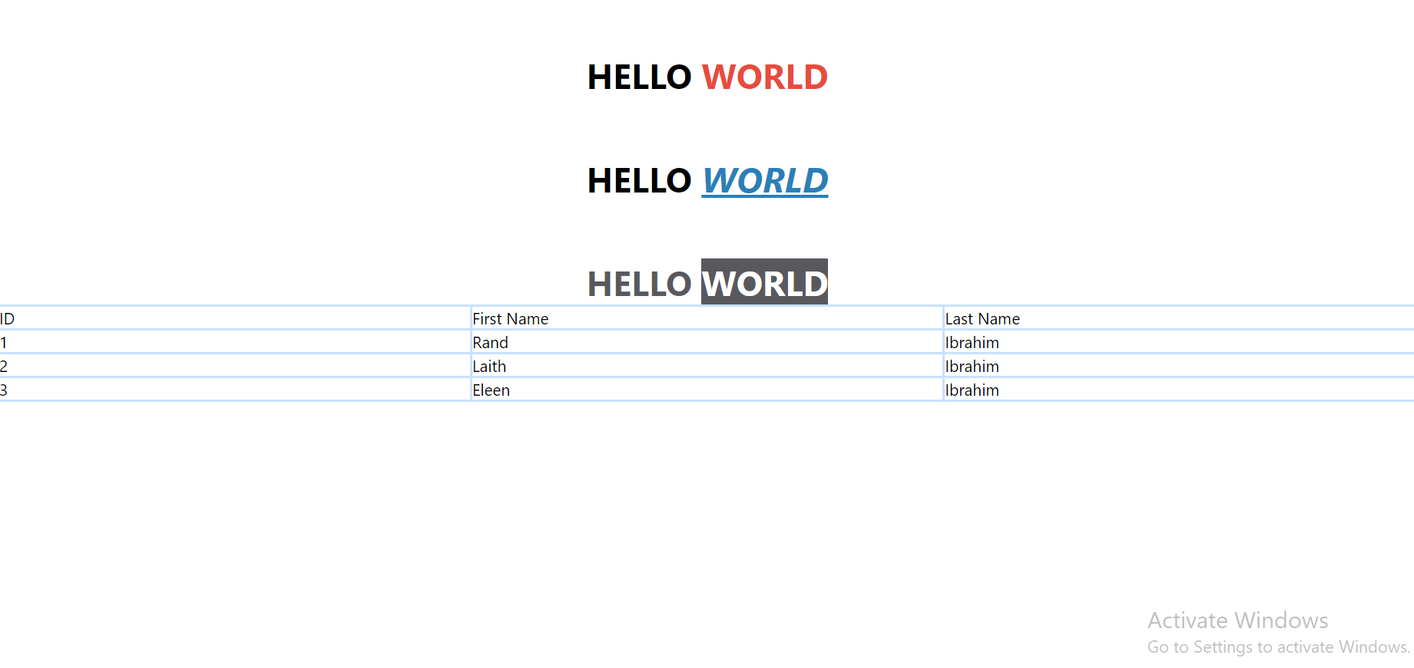
Hello world page Elements: Text Table

Slide 6
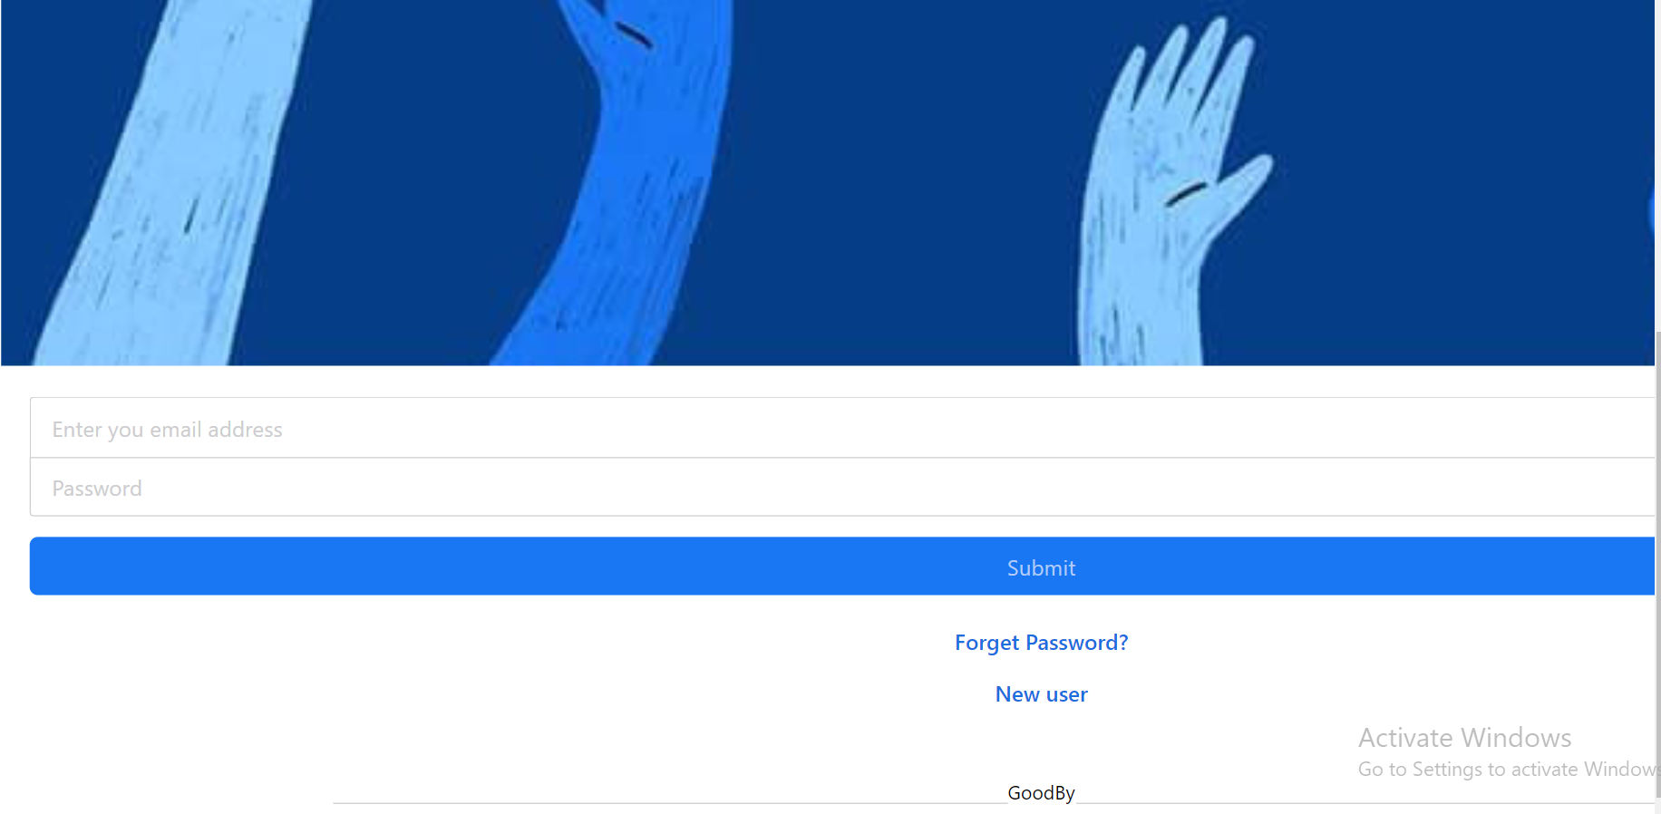
Facebook login screen
Elements:
Input field
password field
Buttons
views

Slide 7
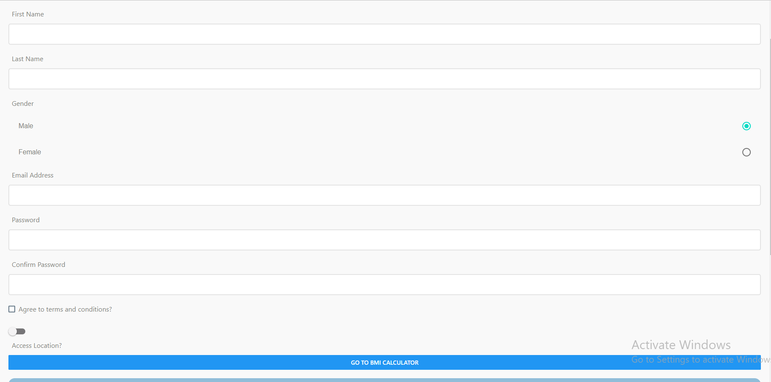
Register form input fields/ radio buttons/ checkbox

Slide 8
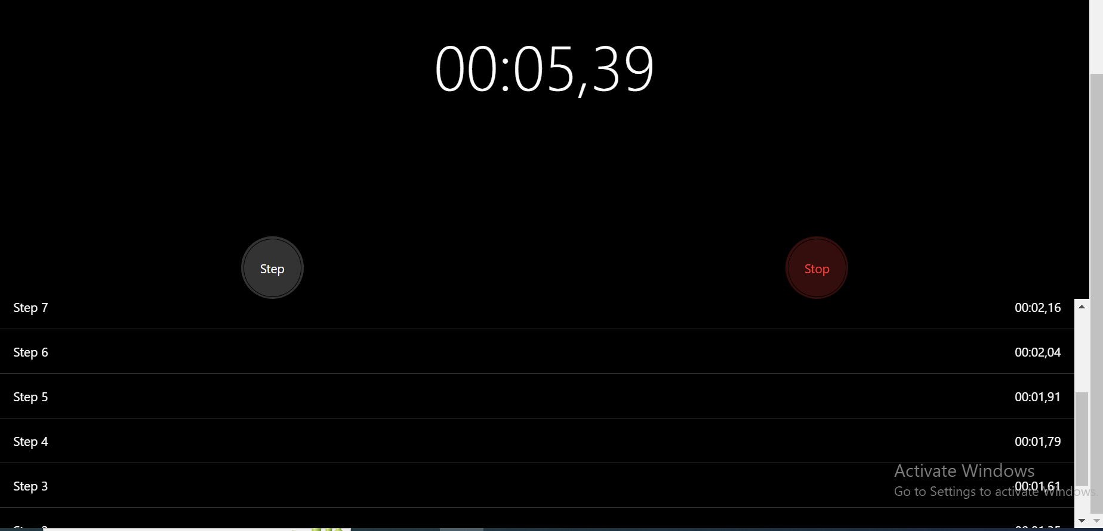
Stop Watch

Slide 9
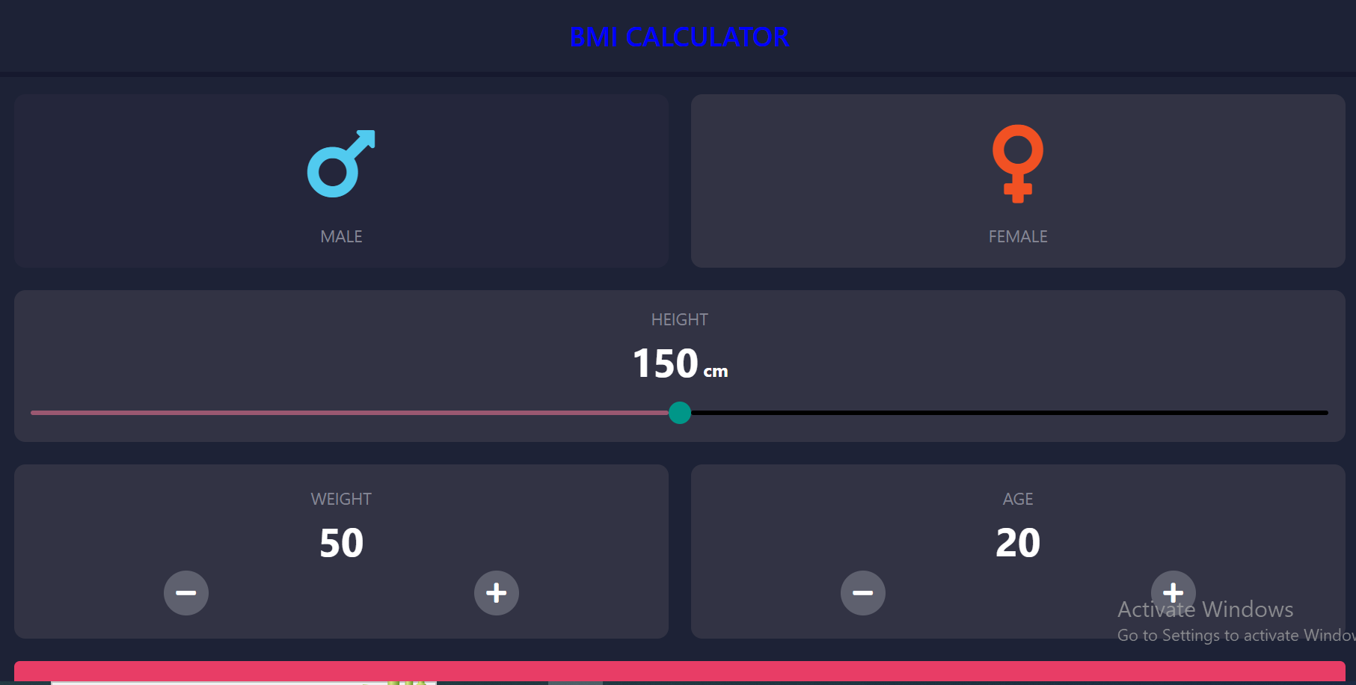
BMI Calculator

Slide 10
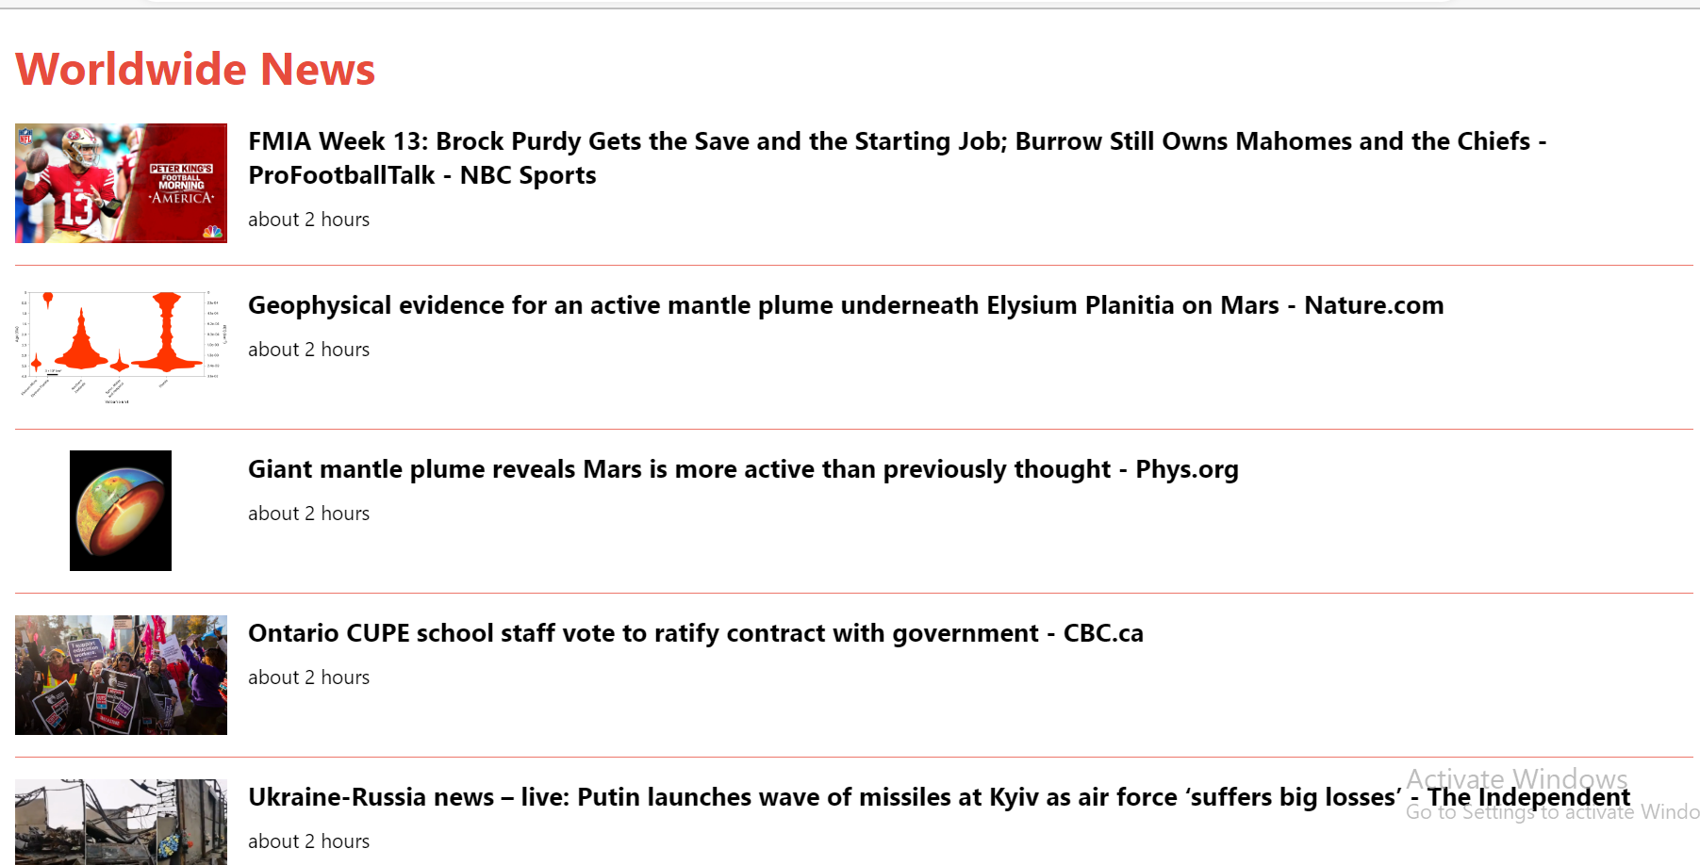
Worldwide news

Slide 11
RN-AST Pruning Framework
Aims to help test engineers in testing react native applications
It parses the code using babel parser (static analysis)
The static analysis produces the AST (Abstract Syntax Tree)
Detect GUI changes between the original source code and updated version of source code by comparing the original AST and Updated AST

Slide 12
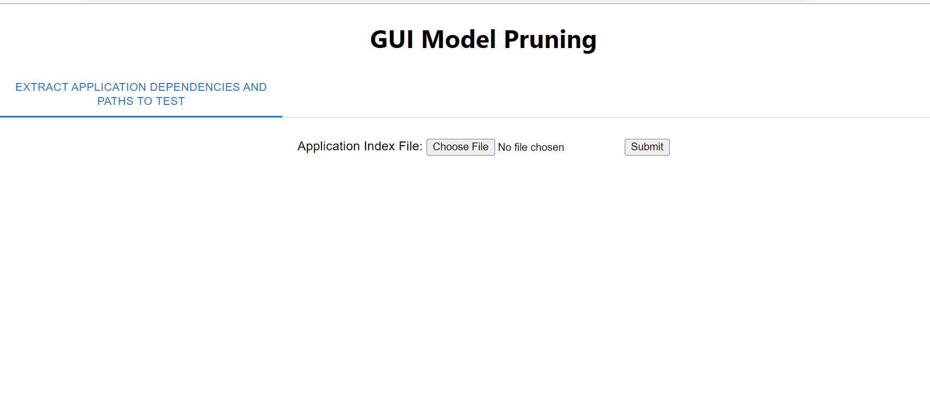
Proposed Framework
Frontend

Slide 13
As a test engineers you are supposed to upload the main file of the updated version of the source code.
The framework produced the AST of the updated version using MADGE API
Then it compares the AST of the updated version with the AST of the original source code
Note: The original version of the application is stored internally in the framework files.
If framework detect changes it categorize these changes into:
Updates : contains the updated elements
Placements: new added elements
Deletion: deleted elements

Slide 14
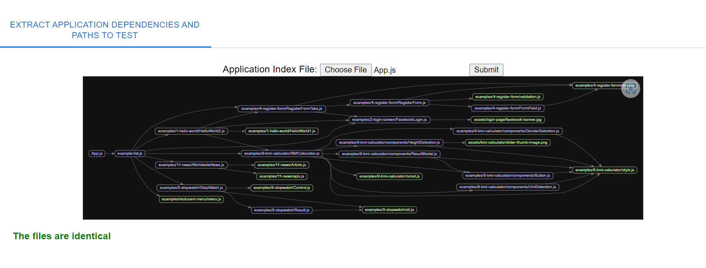
MADGE API output

