Slide 1


Slide 2
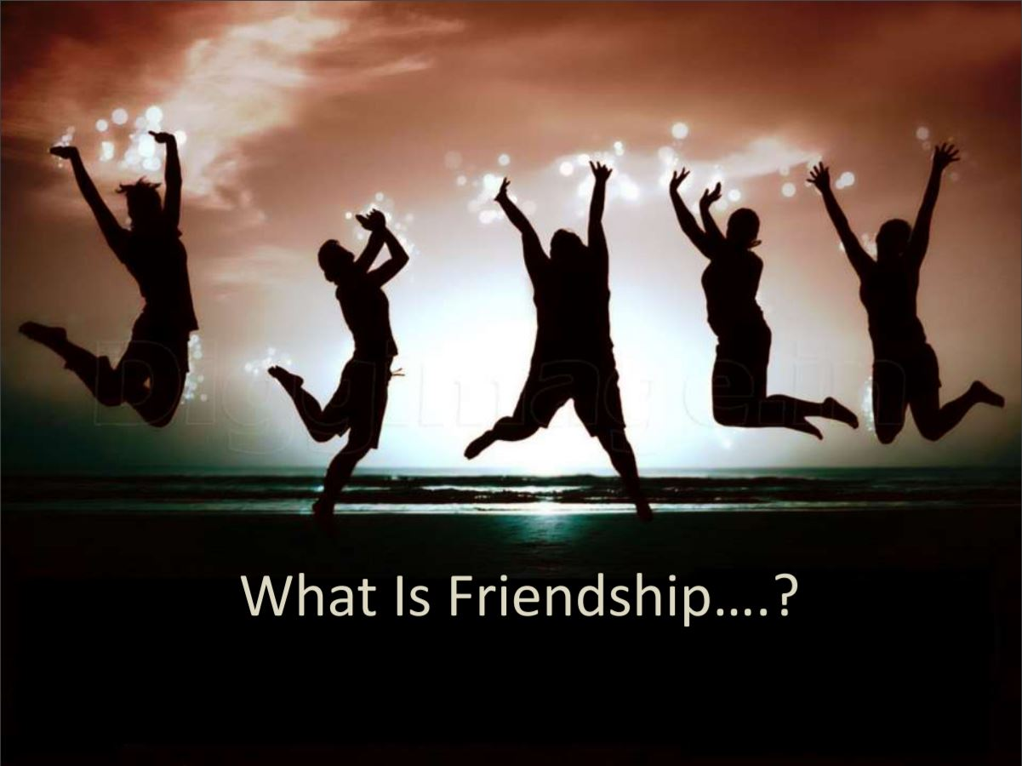

Slide 3

Friendship is a relationship of mutual affection between two or more living things.
Friendship is a stronger form of interpersonal bond than an association.

Slide 4
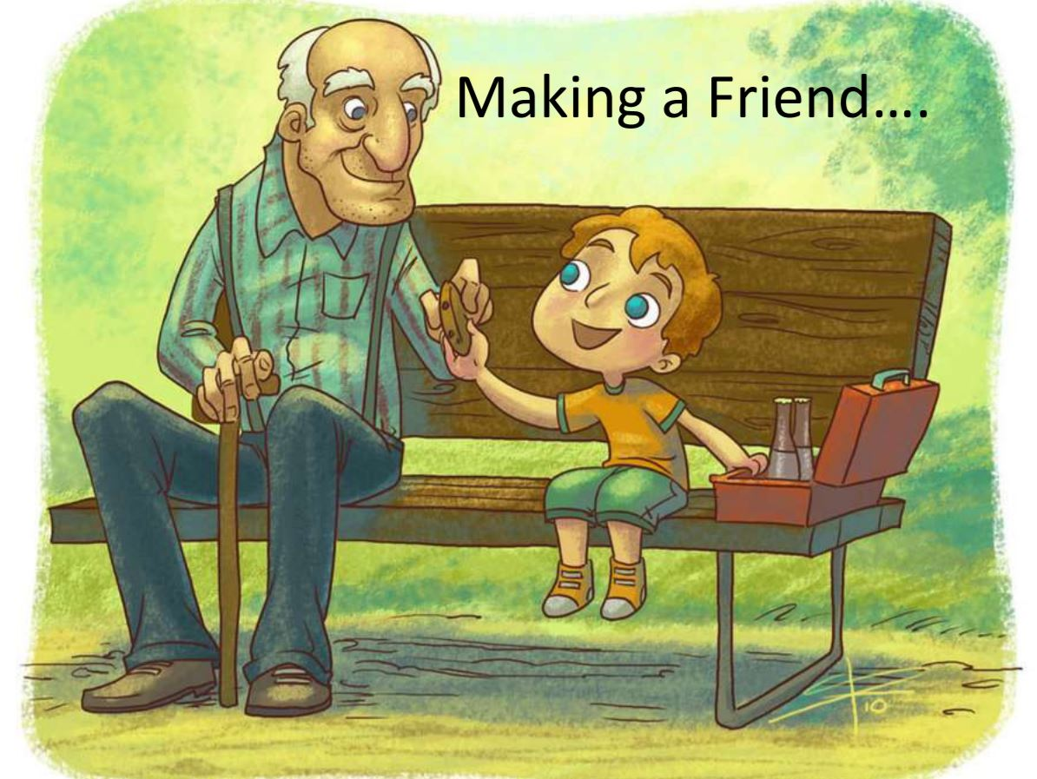

Slide 5

proximity, which means being near enough to see each other or do things together

Slide 6

Opportunities to share ideas and personal feelings with each other

Slide 7
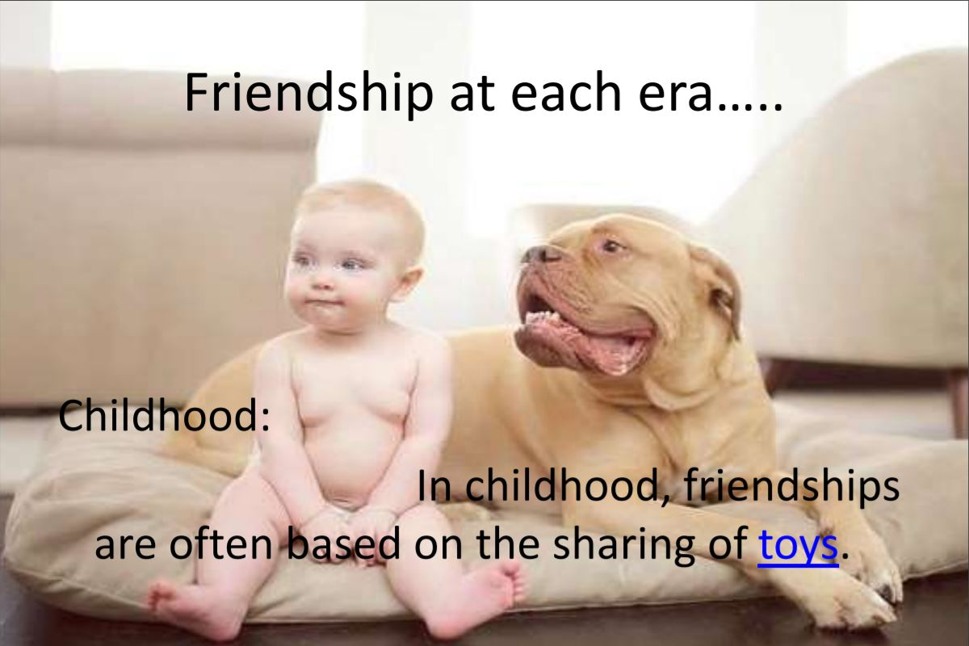

Slide 8

At Adulthood

Slide 9

Old age friendship

Slide 10

Generally, friendship has two dimensions: quality and conflict
The quality of friendship is important for a person's well-being
High quality friendships have good ways of resolving conflict, ultimately leading to stronger and healthier relationships

Slide 11



Friendship based films

Slide 12

"A real friend is one who walks in when the rest of the world walks out.“
"The better part of one's life consists of his friendships.“
"The love of my life is the love between friends."

Slide 13



Slide 14



Slide 15



Slide 16


Slide 17
We conclude that….
Although my friends always make me hurt,
they are still my friends..
I really don't care with my feeling.
I just want my friends happy.
love you all.

Slide 18

A good friend is hard to find,
Hard to lose, and
Impossible to forget

Slide 19


