Slide 1
Fast Circle and Ellipse Detection Using CUDA-based Randomized Hough Transform
Mark Randles
Adviser: Dr. J.K. Jake Lee
Department of Computer Science
Bowling Green State University

Slide 2
Outline
Introduction
  Hough Transform for Lines
  HT for Circles and Ellipses
  LLS-RHT
  CUDA
CUDA LLS-RHT
  Overview
  Results
Conclusion

Slide 3
Introduction
Hough Transform for Lines
Originally proposed by P.V.C. Hough in a 1959 patent filing
Works by accumulating votes for the possible lines that could pass through an edge point.
By iterating through all the edge points in an image, the accumulator array will hold all the possible lines which pass through the image.
Notes:
“The Hough transform was patented as U.S. Patent 3,069,654 in 1962 and assigned to the U.S. Atomic Energy Commission with the name "Method and Means for Recognizing Complex Patterns".”

Slide 4
Introduction
Hough Transform for Lines
Define the possible lines using the normal notation
  This handles vertical lines without a special case
The accumulator array is 2D
  Each cell defines a range of values with θ along one axis and r along the other axis.
  A cell has a range of potential values assigned to it
Notes:
x cos(theta) + y sin(theta) = r
The max size of a accum cell will be the number of edge pixels in the longest line
Most cells in the accum will have a very small count in them

Slide 5
Introduction
Hough Transform for Lines
Voting algorithm
  For each potential point iterate through all the possible θ-values and solve for the r-value of the line that would pass through the point at that θ
  Using the (θ,r) pair the approiate bin in the accumulator array is incremented, this is “casting the vote”
Detecting Lines
  The bin with the most “votes” is the longest detected line
Notes:
Cell sizes which are too small will result in decreased effectiveness
Cell sizes which are too large are inaccurate.
For the most part the largest bin is the line contained in the image. However if there are multiple lines in the image there are multiple local maxima which can be extracted from the accumulator.
For the most part I've not seen lit dealing with methods to detect the local mins of the accum and rather rely on repeated naïve global maximum searches.

Slide 6
Introduction
Hough Transform for Lines
Drawbacks
  Slow – requires a complete iteration through the target image
  Memory inefficient for accurate detection – smaller bins increases detection accuracy, but increases memory usage. Most bins will remain empty.
  Noise/Density in source image – If the source image is too noisy, the target line may not be detected. If there are too few co-linear pixels in the source image it may not detect the line.

Slide 7
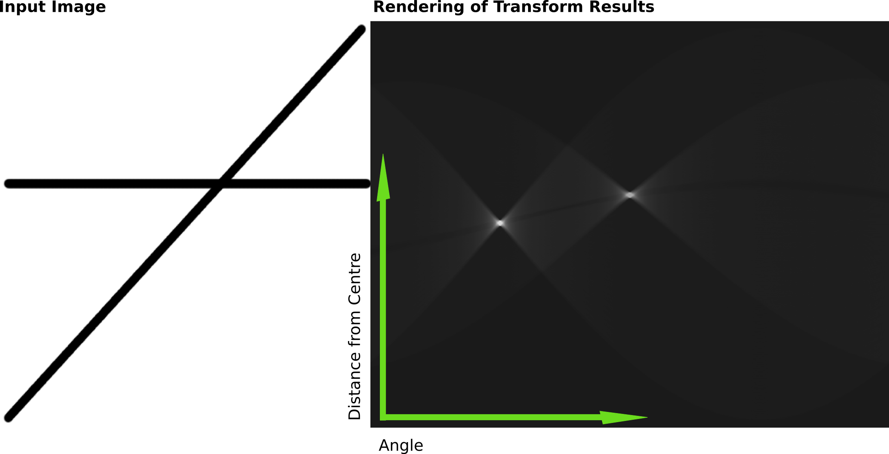
Introduction
Hough Transform for Lines

Slide 8
Introduction
HT for Circle and Ellipses
Ellipse uses a 5D array. (a, b, r0, r1, θ) where a & b are the ellipse center, r0 & r1 are the major and minor axies, and θ is the rotation about the center.
θ can be constrained to 90º
Very inefficient in it's naïve form

Slide 9
Introduction
LLS-RHT
Linear-Least Squared method
  m >= 5 points are randomly selected from the image
  The points are fitted to the quadratic:
  Then the shape invariants are tested to see if they belong to an ellipse or not
  If they do, the parameters of the ellipse are recovered from the fitted quadratic
  RHT is then used to do the voting
${Ax}^{2}+{By}^{2}+Cxy+Dx+Ey+F=0$

Slide 10
Introduction
LLS-RHT
Gather sets of points and then maps them to the parameter space
Stops after enough evidence has been gathered, instead of exhausting the set of available edge points.
Also can improve memory efficincy by reducing the size of the accumulator array.

Slide 11
Introduction
CUDA
Combined Unified Device Architecture
Provides an interface and abstraction for developers to use GPU resources in non-graphics applications

Slide 12
Introduction
CUDA
The primary unit of computation is kernels
Every thread runs a single invocation of a kernel
Threads are organized into homogenious blocks.
Multiple blocks are run concurrently on a multiprocessor
Different kernels can be executed concurrently

Slide 13
Introduction
CUDA
GPU memory is controlled from the host (not from the kernel)
Global memory is dynamically allocated and can be written to from the host.
Every thread has it's own small block of fast local memory.
Threads in a block share a fast memory space

Slide 14
CUDA LLS-RHT
Overview

Slide 15
CUDA LLS-RHT
Results

Slide 16
Sources
P.V.C. Hough, Machine Analysis of Bubble Chamber Pictures, Proc. Int. Conf. High Energy Accelerators and Instrumentation, 1959
http://en.wikipedia.org/wiki/Hough_Transform
http://homepages.inf.ed.ac.uk/rbf/HIPR2/hough.htm
Cao, C., Newman, T. S., and Germany, G. A. 2009. New shape-based auroral oval segmentation driven by LLS-RHT. Pattern Recogn. 42, 5 (May. 2009), 607-618.
http://developer.download.nvidia.com/compute/cuda/3_1/toolkit/docs/NVIDIA_CUDA_C_ProgrammingGuide_3.1.pdf

Slide 17
Thanks
Thanks to Dr. J.K. Jake Lee for his assistance and guidance in the successful completion of this project.
Thanks to Dr. Joseph Chao for giving me time to complete my project when I truly needed it.

