Slide 1
FIT5120 · PROPOSAL TO INDUSTRY MENTOR
An Inclusive and Accessible
Auslan Learning Assistant
Helping Australian families learn practical Auslan through accessible, interactive and personalised learning.
ELEVATOR PITCH
Parents and caregivers of Deaf or hard-of-hearing children often struggle to learn practical Auslan for everyday family communication. Our platform combines guided demonstrations, webcam practice and personalised revision in one accessible learning experience.
TE38 BitDance
01
Notes:
[Sources]
- Project content supplied by the team in the uploaded proposal documents.

Slide 2
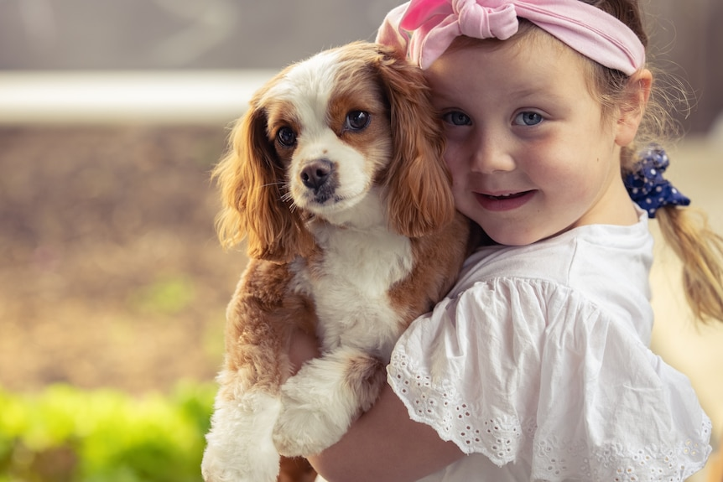
NEWS CONTEXT
A family’s struggle shows why practical Auslan support matters
ABC NEWS · FAMILY CASE
Parents secured funding—but still could not find a suitable Auslan tutor.
ABC News · Sarah Moss · 13 April 2022
WHAT THE ARTICLE SHOWS
WHY THIS ARTICLE
Tilly’s family had NDIS funding but could not find a suitable Auslan tutor.
Funding does not always create access.
Her parents reduced work hours and struggled with lesson cost and format.
Her mother worried that online self-learning could teach incorrect signs.
PROJECT OPPORTUNITY
A flexible platform can give parents short lessons and guided practice at home.
FIT5120 · PROPOSAL TO INDUSTRY MENTOR
02
Notes:
[Sources]
- ABC News, Sarah Moss, 13 April 2022: https://www.abc.net.au/news/2022-04-13/family-pleas-for-auslan-teacher-go-unanswered/100985036

Slide 3
03· THE PROBLEM
Limited access to Auslan creates barriers within families
PROBLEM STATEMENT
WHY IT MATTERS
Parents and caregivers of young Deaf or hard-of-hearing children in Australia often struggle to communicate effectively because they have limited Auslan knowledge and difficulty accessing practical learning support.
Everyday family communication becomes harder
Learning support may be difficult to access
Online resources can be scattered or too fast
This can affect daily communication, emotional expression and strong family relationships.
Most videos cannot confirm practice accuracy
AUSTRALIAN EVIDENCE
Parents’ pleas for an Auslan tutor went unanswered — ABC News
UNSDG CONNECTION
SDG 4 · Quality Education
SDG 10 · Reduced Inequalities
Australian children denied Auslan access — ABC News
Family Communication Experiences of Deaf Australians — Monash University
FIT5120 · PROPOSAL TO INDUSTRY MENTOR
03

Slide 4
03 · PROPOSED SOLUTION
One platform connects learning, practice and feedback
We propose an inclusive Auslan learning assistant that provides visual, interactive and personalised learning experiences.
01
Auslan Dictionary
Search signs and view meanings and visual demonstrations.
02
Step-by-Step Learning
Break gestures into smaller movements; pause, replay and slow down.
03
Interactive Practice
Use a webcam to practise and receive basic feedback.
04
Personalised Revision
Track progress and recommend signs that need more practice.
05
Accessible Experience
Adjust text size, contrast, captions, motion and learning pace.
USER VALUE
Users can learn, practise, receive feedback and review signs within one accessible experience.
FIT5120 · PROPOSAL TO INDUSTRY MENTOR
04
Notes:
[Sources]
- Feature descriptions supplied in Proposal of Sign language learning assistance (2), (3), (6), and (7).docx.

Slide 5
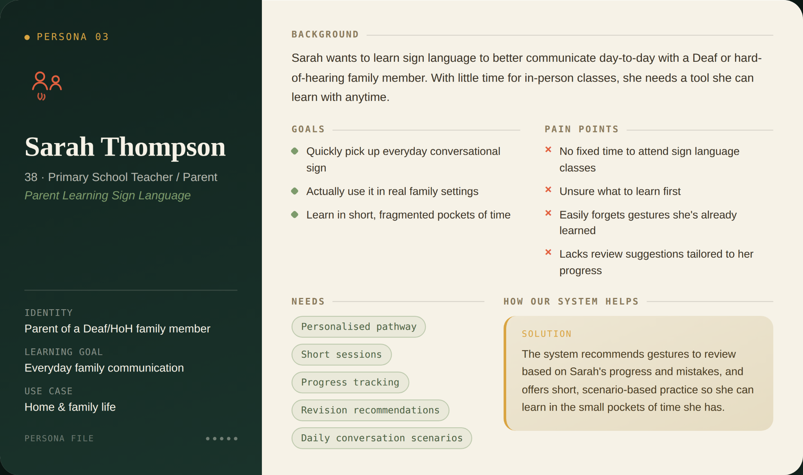
04 · WHO WE DESIGN FOR
The primary audience is parents learning Auslan for family life
PRIMARY TARGET AUDIENCE
Parents and caregivers of young Deaf or hard-of-hearing children in Australia who have limited Auslan knowledge and need flexible support for everyday family communication.
PRIMARY PERSONA · SARAH THOMPSON
38 · Parent and primary school teacher
Goal: everyday family communication
Needs short, flexible learning sessions
Needs progress tracking and revision support
Secondary: Auslan beginners
Secondary: accessibility-focused learners
FIT5120 · PROPOSAL TO INDUSTRY MENTOR
04
Notes:
[Sources]
- Sarah Thompson persona image and details supplied by the project team in Proposal of Sign language learning assistance (1).docx.

Slide 6
06 · EPICS ACROSS THE SOLUTION
Three iterations build from core learning to personalisation
ITERATION 1
ITERATION 2
ITERATION 3
Learn & practise
Improve accessibility
Personalise learning
Epic 1 · Auslan sign library and search
Epic 4 · AI sign recognition & feedback
Epic 6 · Family mode for parent-child signing
Epic 2 · Guided sign learning
Epic 5 · Personalised learning
Epic 7 · Real-life conversation
Epic 3 · Basic quiz & self-check
FIT5120 · PROPOSAL TO INDUSTRY MENTOR
05
Notes:
[Sources]
- Epic draft derived from the team's existing key features; it has not yet been formally approved by the team.

Slide 7
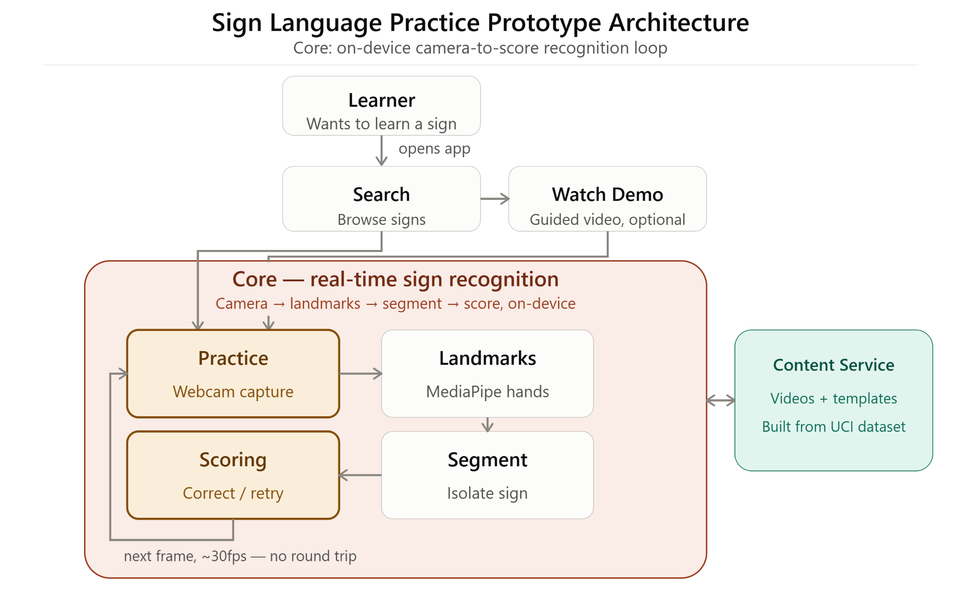
05 · HOW THE SYSTEM WORKS
High-level System Diagram
1
User turns on webcam
2
Performs a sign
Camera Capture grabs the frame
3
MediaPipe extracts hand/pose landmarks
4
5
Rest-Pose Segmentation marks start/end of the sign
DTW Scoring compares against cached reference template
6
7
Overlay renders feedback
06
FIT5120 · PROPOSAL TO INDUSTRY MENTOR
Notes:
[Sources]
- Technical approach supplied in Proposal of Sign language learning assistance (4) and (5).docx.
- UCI Australian Sign Language Signs dataset: https://archive.ics.uci.edu/dataset/115/australian+sign+language+signs+high+quality

Slide 8
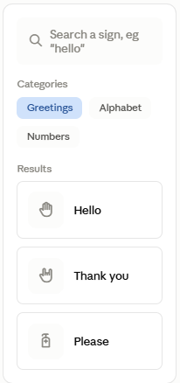
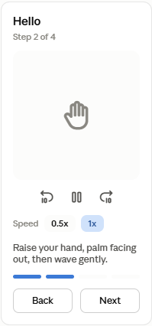
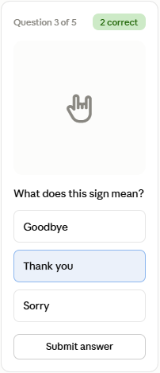
07 · HIGH-LEVEL PROTOTYPE
Iteration 1 follows a simple learn–practise–feedback journey
1 · HOME / SIGN LIBRARY
2 · LEARNING PAGE
3 · Basic Quiz
原型图位置
原型图位置
请放入线框图：演示视频、步骤说明、暂停/回放/慢速。
请放入线框图：摄像头预览、参考手势、隐私提示、开始练习。
SELECT A SIGN
WATCH
QUIZ
FIT5120 · PROPOSAL TO INDUSTRY MENTOR
07
Notes:
[Sources]
- Prototype frames are intentional placeholders based on the required Iteration 1 user journey.

Slide 9
08 · DATA SOURCES & USE
Each source has one job, and a licence that allows it
WHERE THE DATA COMES FROM
HOW WE USE IT
Auslan Signbank
1
Signbank videos are what the learner watches, never what we train on
Monash / Macquarie · CC BY-NC-ND 4.0
Our own recordings
2
Our own recordings are converted into MediaPipe hand keypoints
Filmed with Auslan-fluent signers · consent per signer
3
The classifier is trained on those keypoints, not on raw video
MM-WLAuslan
UQ CV Lab 2024 · research use, terms being confirmed
4
The webcam gives live correct / not-yet feedback during practice
UCI Auslan Signs
Kadous 2002 · CC BY 4.0 · sensor data, no video
5
Every attempt is logged, so the app chooses what to review next
App practice data
Generated in use · stored in PostgreSQL
Raw video never reaches the model. Keypoints are what let recorded training data work on a parent's laptop webcam.
Auslan is a BANZSL language and fingerspells with two hands. ASL datasets such as WLASL or MS-ASL are not substitutes.
We recognise individual signs — we do not translate Auslan.
FIT5120 · PROPOSAL TO INDUSTRY MENTOR
09
Notes:
Where the data comes from: five sources, three jobs. Signbank is the authority on what each sign looks like - we embed and attribute its videos, and because its licence is no-derivatives we never train on them. Our own recordings, made with Auslan-fluent signers, are the actual training data. MM-WLAuslan is the large Auslan video set held for later iterations. The UCI set has no video at all, so it only proves the classifier design before our own data is ready. And the app generates its own practice data as people use it. How we use it: recordings become MediaPipe keypoints, the classifier learns on keypoints, the webcam gives live feedback, and every attempt is logged so the app knows what to review. The point to remember is that raw video never reaches the model - keypoints are what let recorded training data work on a laptop webcam at home.

Slide 10
09 · RISK IDENTIFICATION & MITIGATION
Five project-specific risks, each with a first response
KEY RISKS & MITIGATION
TOP RISK TO RESOLVE FIRST
Auslan dialect variation
Limit v1 to 10-15 nationally common signs and have every demonstration checked by an Auslan user.
Dataset-to-model mismatch
It blocks every practice feature in Iteration 1, so the feasibility spike runs in Week 1 before any classifier work starts.
Open dataset is dated and not maintained
Run a Week 1 spike mapping UCI sensor data to MediaPipe landmarks; if it fails, record our own set.
Recognition fails on real webcams
Use visually distinct one-handed signs; show confidence and a retry hint, not a hard pass/fail.
HOW WE TRACK RISKS
Risk log kept in the team repo
One named owner for each risk
Reviewed at the end of every sprint
Status reported at each iteration demo
Blocking risks escalated to our mentor
Webcam data and privacy compliance
Process frames in-browser, store no video, require no account, publish a plain-language notice.
Hard to reach parents for testing
Recruit early through Deaf community groups and Auslan classes; accept async video or text feedback.
FIT5120 · PROPOSAL TO INDUSTRY MENTOR
11

Slide 11
10 · SOURCES & POTENTIAL SPONSORS
References & Potential Sponsors
REFERENCES
POTENTIAL SPONSORS
1.
ABC News. (2022). Parents’ pleas for an Auslan tutor.
DEAF CHILDREN AUSTRALIA
ABC News. Children denied Auslan access.
Supports Deaf and hard-of-hearing children and their families.
2.
3.
ABC News. Why this whole family is learning Auslan.
• Family programs, Auslan resources and parent support
• Could validate family needs and test the platform with parents and caregivers
4.
Monash University. Family communication experiences of Deaf Australians.
5.
UCI. Australian Sign Language Signs .
EXPRESSION AUSTRALIA
6.
Monash University. Expanded Auslan Corpus Lite.
Provides Auslan education and services for Deaf people and families.
7.
United Nations. Sustainable Development Goals 4 & 10.
• Runs Auslan in the Home and Auslan Storytime
• Could advise on Auslan accuracy, accessibility and culturally appropriate design
。
FIT5120 · PROPOSAL TO INDUSTRY MENTOR
01
Notes:
[Sources]
- Deaf Children Australia: https://www.deafchildrenaustralia.org.au/
- Expression Australia: https://www.expression.com.au/
- ABC News: https://www.abc.net.au/news/2022-04-13/family-pleas-for-auslan-teacher-go-unanswered/100985036
- UCI dataset: https://archive.ics.uci.edu/dataset/115/australian+sign+language+signs+high+quality
- Expanded Auslan Corpus Lite: https://shop.monash.edu/expanded-auslan-corpus-lite.html
- UN SDGs: https://sdgs.un.org/goals

