Slide 1
Machine Learning Project Heart Disease UCI
Tanuja Addanki
Alec Petrack
Matt Randles
Andrew Young

Slide 2
Feature Description – Categorical Features
Feature | Number of Categories | Pre-processing | Description
Sex | 2 | ~ | Gender
CP | 4 | One-Hot | Chest Pain
FBS | 2 | ~ | Fasting Blood Sugar >120 mg/dl
restecg | 3 | One-Hot | Resting Electrocardiogram Results
Exang | 2 | ~ | Exercise Induced Angina
Thal | 3 | One-Hot | Thalassemia
Target | 2 | ~ | Has heart disease or not?

Slide 3
Feature Description – Numerical Features
Feature | Mean | Standard Deviation | Range | Pre-Processing | Description
Age | 54.37 | 9.10 | 29-77 | Z-Score | Age of Patient
Trestbps | 131.62 | 17.54 | 94-200 | Z-Score | Resting Blood Pressure
Chol | 246.26 | 51.83 | 126-564 | Z-Score | Cholesterols
Thalach | 149.65 | 22.91 | 71-202 | Z-Score | Max Heart Rate Achieved
Oldpeak | 1.04 | 1.16 | 0-6.2 | Z-Score | ST Depression Induced by Exercise Relative to Rest
Slope | 1.40 | 0.62 | 0-2 | Z-Score | Slope of the Peak Exercise Relative to Rest
Ca | 0.73 | 1.02 | 0-4 | Z-Score | Number of Major Blood Vessels Colored by Fluoroscopy

Slide 4
Dataset Engineering
Dataset derived from larger dataset by Data Scientists
Most valuable features deduced, 75 -> 13
Observations do not have any null values
Class Balance
165 – 54.5% yes
138 – 45.5% no
Cross-validation
80% training -> 243 observations
20% testing -> 61 observations
Repeated 5 Times for different Sampling

Slide 5
Data Analysis – Model Overview
Un-supervised Methods
Fuzzy K-means Clustering (Tanuja)
Supervised Methods Covered in Class
Multi-variable Logistic Regression, Support Vector Machines (Alec)
Multi-Layer Perceptron (Matt)
Supervised Methods Not Covered in Class
Random Forest, K – Nearest Neighbor (Andrew)

Slide 6
Model Descriptions
K-Nearest Neighbor
Random Forest

Slide 7
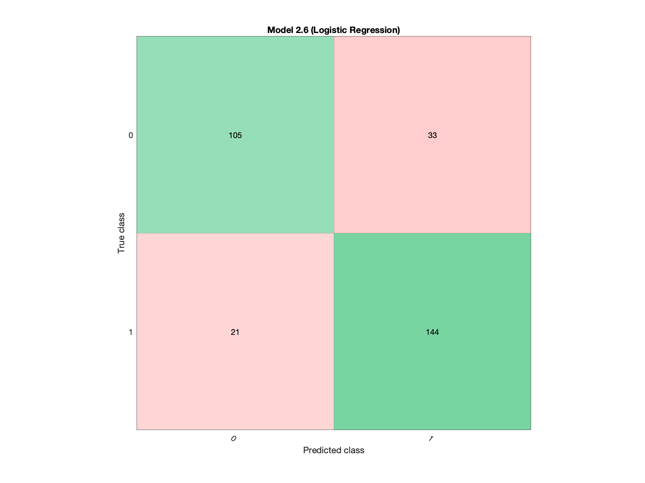
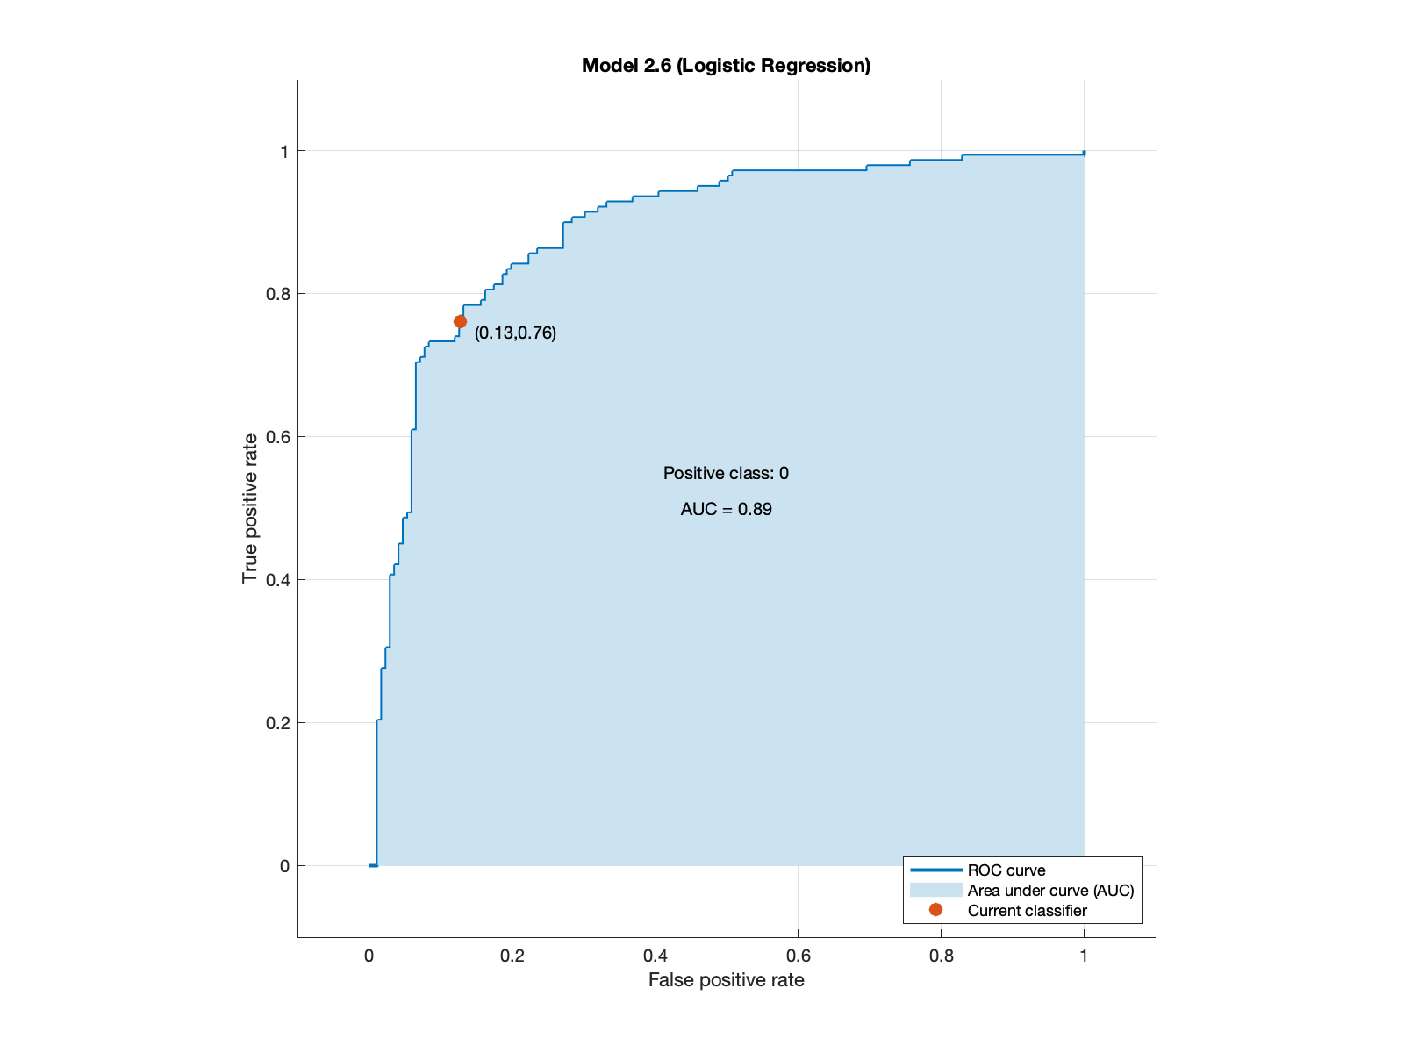
ROC-AUC & Confusion Matrix Logistic Regression

Slide 8

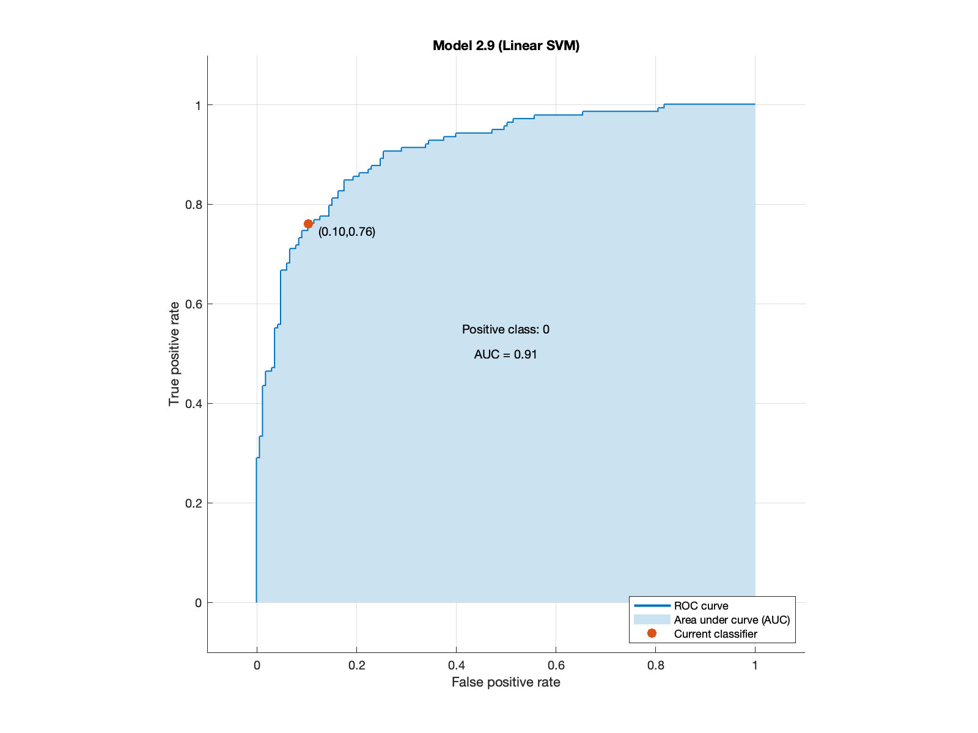
ROC-AUC & Confusion Matrix Support Vector Machine

Slide 9
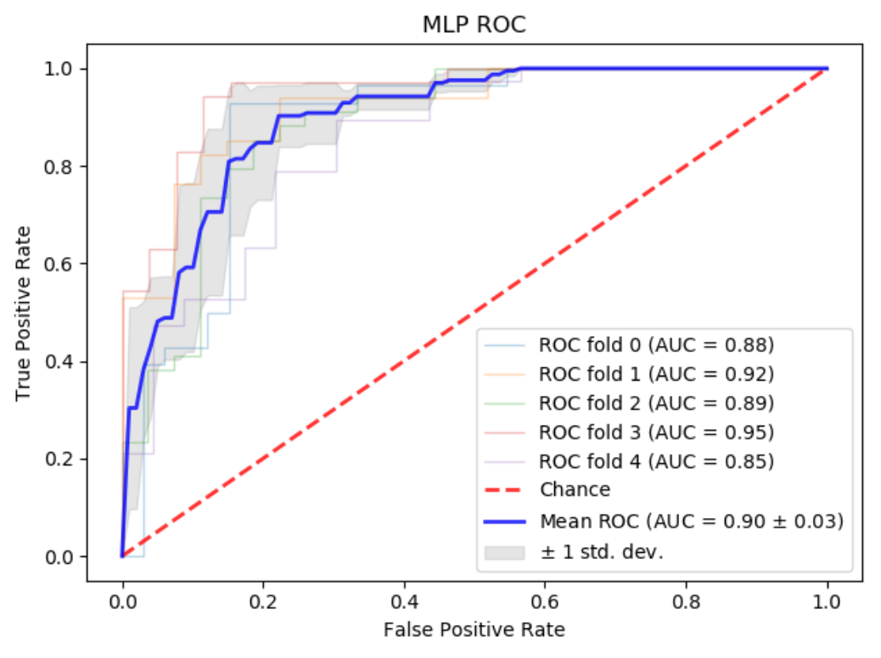
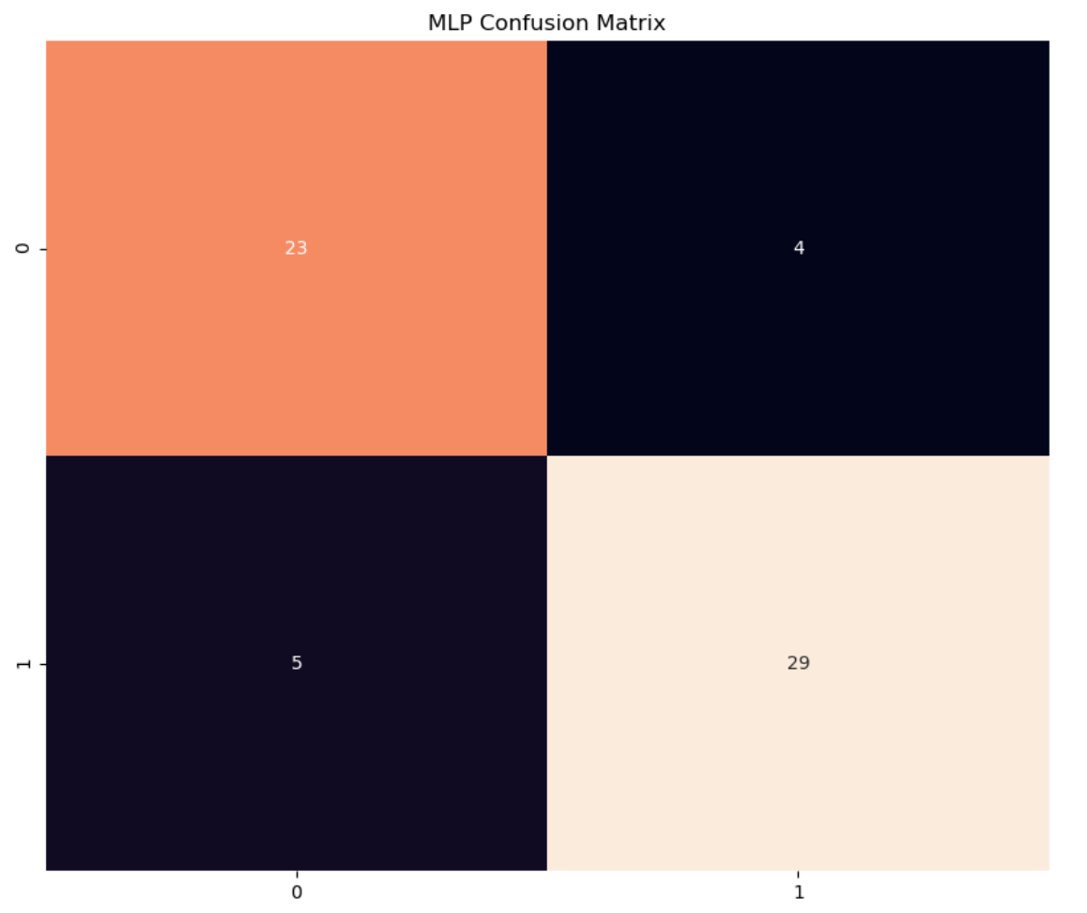
ROC-AUC & Confusion Matrix Multi-Layer Perceptron

Slide 10
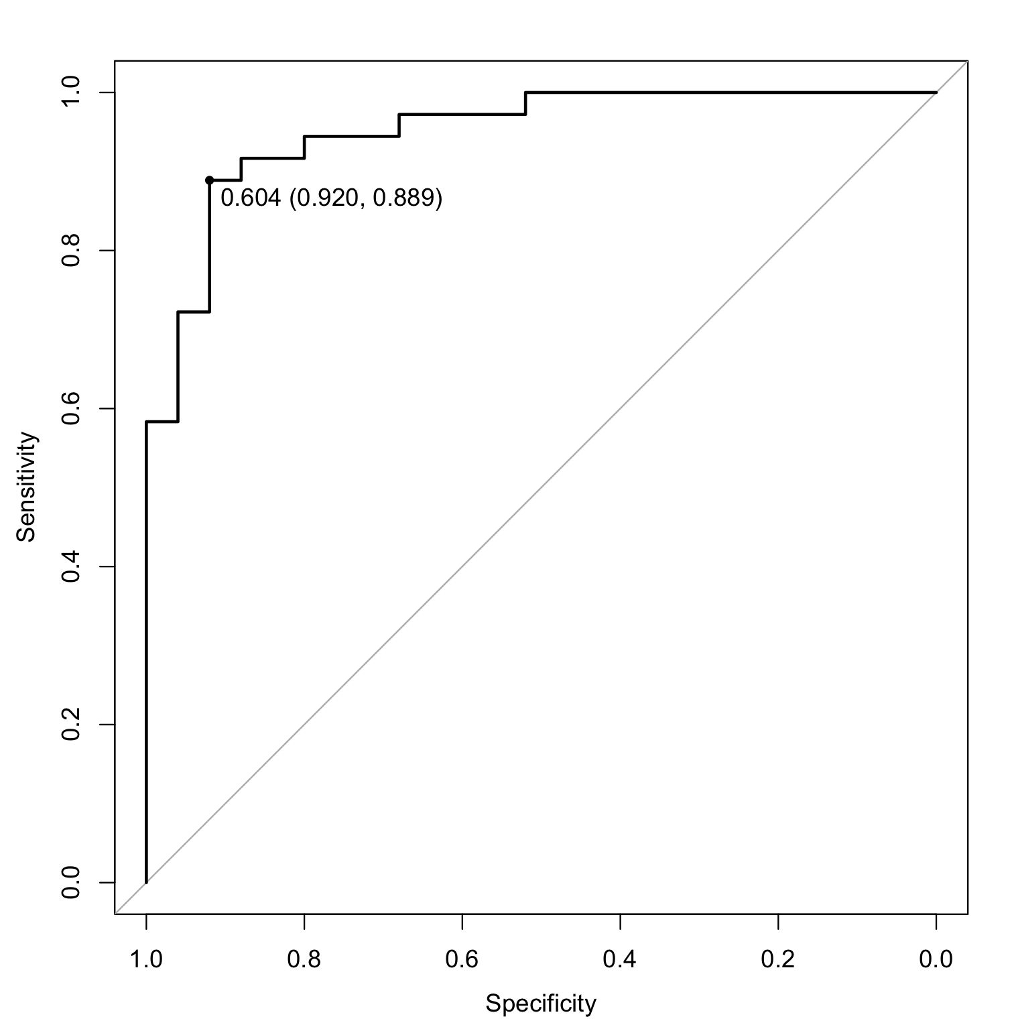
ROC-AUC & Confusion Matrix Random Forest

Slide 11
Results – Best Models
Model | Accuracy | Precision | Specificity | Sensitivity | F1-Score
Fuzzy C Means
Multi-variable Logistic Regression
K – Nearest Neighbor | 0.87 | 0.86 | 0.88 | 0.86 | 0.86
Random Forest | 0.89 | 0.91 | 0.94 | 0.80 | 0.85
Multi-Layer Perceptron | 0.85 | 0.88 | 0.88 | 0.85 | 0.87

Slide 12
Discussion

Slide 13
Limitations and Future Work

Slide 14
Credit and Participation
Tanuja Addanki
Alec Petrack
Matthew Randles
Andrew Young

Slide 15
Citation

