Slide 1
Book Recommender System
for DataSentics
Martin Stárek

Slide 2
Chapter 1 – The Past

Slide 3
Matrix Factorization

Slide 4
Tuning k
k | 1 | 2 | 4 | 8 | 16 | 32 | 64 | 128 | 256 | 384
# | 38 | 38 | 2 | 5 | 0 | 13 | 5 | 5 | 1 | 1
- number of times (out of 100) when model with interaction terms didn’t outperform model with only biases

Slide 5
Planned Hybrid Loss Function

Slide 6
Evaluation Metrics
Agreement with bias-only: On average, the share of the same recommended items for a given user as the bias-only model.
Mean overlap: Expected share of shared items between two random users. My main personalization metric.
Coverage: Total number of distinct recommended books.
Relative log-ARP: How popular (in terms of number of ratings) the recommended items are, on average.
Relative mean rating: Average rating of recommended books / μ
Entropy: How evenly the recommendations are distributed across items.

Slide 7
First Models
Model | RMSE | AWB | MOV | COV | ARP | RMR | ENT
random | 8.03 | 0.001 | 0.001 | 0.981 | -0.66 | 0.99 | 0.99
bias-only | 1.58 | 1 | 0.995 | 0.001 | -0.03 | 1.23 | 0.18
full | 1.58 | 0.755 | 0.801 | 0.014 | 0.05 | 1.23 | 0.23
full_w_beta | 1.77 | 0.001 | 0.035 | 0.158 | 1.26 | 0.98 | 0.64
- full:
- full_w_beta:
- tuned for RMSE

Slide 8
Improved Models
Model | NDCG | RMSE | AWB | MOV | COV | ARP | RMR | ENT
random | 0.000 | 8.03 | 0.001 | 0 | 0.98 | -0.66 | 0.99 | 0.99
bias-only | 0.001 | 1.58 | 1 | 0.96 | 0 | -0.03 | 1.23 | 0.18
full | 0.001 | 1.58 | 0.755 | 0.80 | 0.01 | 0.05 | 1.23 | 0.23
full_w_beta | 0.022 | 1.77 | 0.001 | 0.04 | 0.16 | 1.26 | 0.98 | 0.64
UV-only | 0.040 | 6.04 | 0 | 0.09 | 0.11 | 1.82 | 1.06 | 0.53
- same models, just tuned for NDCG@5

Slide 9
Chapter 2 – The Present

Slide 10
Final Model(s)
Model | NDCG | AWB | MOV | COV | ARP | RMR | ENT
UV-only.1 | 0.043 | 0.001 | 0.07 | 0.16 | 1.68 | 1.059 | 0.57
UV-only.2 | 0.045 | 0.001 | 0.05 | 0.24 | 1.50 | 1.059 | 0.61
UV-only.3 | 0.046 | 0.001 | 0.04 | 0.34 | 1.27 | 1.060 | 0.67
UV-only.4 | 0.046 | 0.002 | 0.02 | 0.45 | 0.99 | 1.060 | 0.72
UV-only.5 | 0.044 | 0.003 | 0.02 | 0.56 | 0.74 | 1.060 | 0.77

Slide 11
Harry Potter Smoke Test
Inputs:
0590353403,Harry Potter and the Sorcerer's Stone (Book 1),J. K. Rowling,1998,Scholastic
0439064864,Harry Potter and the Chamber of Secrets (Book 2),J. K. Rowling,1999,Scholastic
0439136350,Harry Potter and the Prisoner of Azkaban (Book 3),J. K. Rowling,1999,Scholastic
0439139597,Harry Potter and the Goblet of Fire (Book 4),J. K. Rowling,2000,Scholastic
Results:
043935806X, Harry Potter and the Order of the Phoenix (Book 5),J. K. Rowling,2003,Scholastic
059035342X, Harry Potter and the Sorcerer's Stone (Harry Potter (Paperback)),J. K. Rowling,1999,Arthur A. Levine Books
0439139600, Harry Potter and the Goblet of Fire (Book 4),J. K. Rowling,2002,Scholastic Paperbacks
0439064872, Harry Potter and the Chamber of Secrets (Book 2),J. K. Rowling,2000,Scholastic
0439136369, Harry Potter and the Prisoner of Azkaban (Book 3),J. K. Rowling,2001,Scholastic

Slide 12
Chapter 3 – The Future
Embeddings for content-based filtering
Using implicit ratings only (SDG)
Solving the cold-start problem

Slide 13
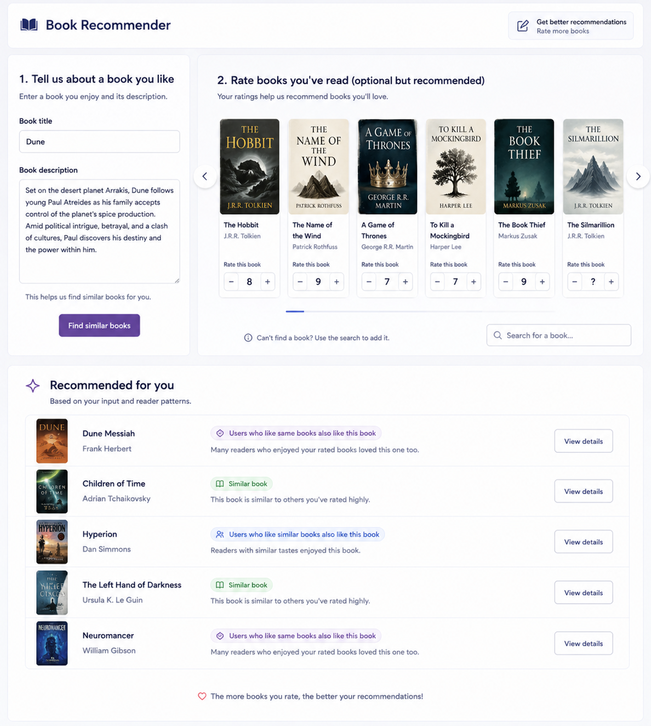
Vision of the UI

Slide 14
Thank you for your attention

