Slide 1
PantryRaid
Group E
Aman Mehta
Nam Nguyen
Kan Yamamoto
Randy Nguyen
Nasser Alsuhaimi
Daryl Blancaflor
Benjamin Guerrero

Slide 2
The Team
Aman Mehta
Project Leader
Kan Yamamoto
Lead Developer
Nasser Alsuhaimi
Assistant UI Design
Nam Nguyen
Quality Control
Randy Nguyen
Database Manager
Benjamin Guerrero
Assistant Developer
James Blancaflor
Lead UI design
Notes:
-Aman

Slide 3

The Issue
Notes:
-Aman

Slide 4
Solution? PantryRaid!
PantryRaid™ is an android application designed to aid users in utilizing the ingredients inside their pantry and refrigerator
It is a database of all food items owned that can be used to facilitate the input and output of food by knowing what food items to get for certain recipes or even just using what food is available to make a meal.
Solve the issue of indecision and lack of cooking knowledge with regards to ingredients in one’s pantry and refrigerator
Discover new recipes to make with the food in one’s pantry
Prevent wasted ingredients by ensuring they are used
Notes:
-Aman

Slide 5
Who PantryRaid is intended for?
People who:
Do not want to waste any food they bought.
Want to know what items are about to be expired.
Want to look up recipes with ingredients they have.
Want their meal planned out for the whole week/month.
Two main types users:
Little to no background in cooking, look up recipes.
Experts in cooking, Keep track of items in their pantry.
Notes:
Nasser
One of the 1st things we discussed in this project is who this app is intended for ?
And we decided that our aim will be on these people :

Slide 6
Main Features
Save ingredients & search for recipes
Recommend meal for the day
Expiration date on food
Meal calendar
Shopping cart
Notes:
Nasser

Slide 8
Agile Development (Scrum)
Manifesto for Agile Development
Individuals and Interactions over processes and tools
Working Software over comprehensive documentation
Customer Collaboration over contract negotiation
Responding to Change over following a plan
Ideal approach for this class
Allows us to adapt to different situations
Ideal approach for app development
Allows for quick changes
Easy removal and addition of features
Notes:
Nam
Emphasis on Working Software over comprehensive documentation
Talk about background: Team has never worked with apps
Yes, we created documents, but it may not be followed exactly

Slide 9
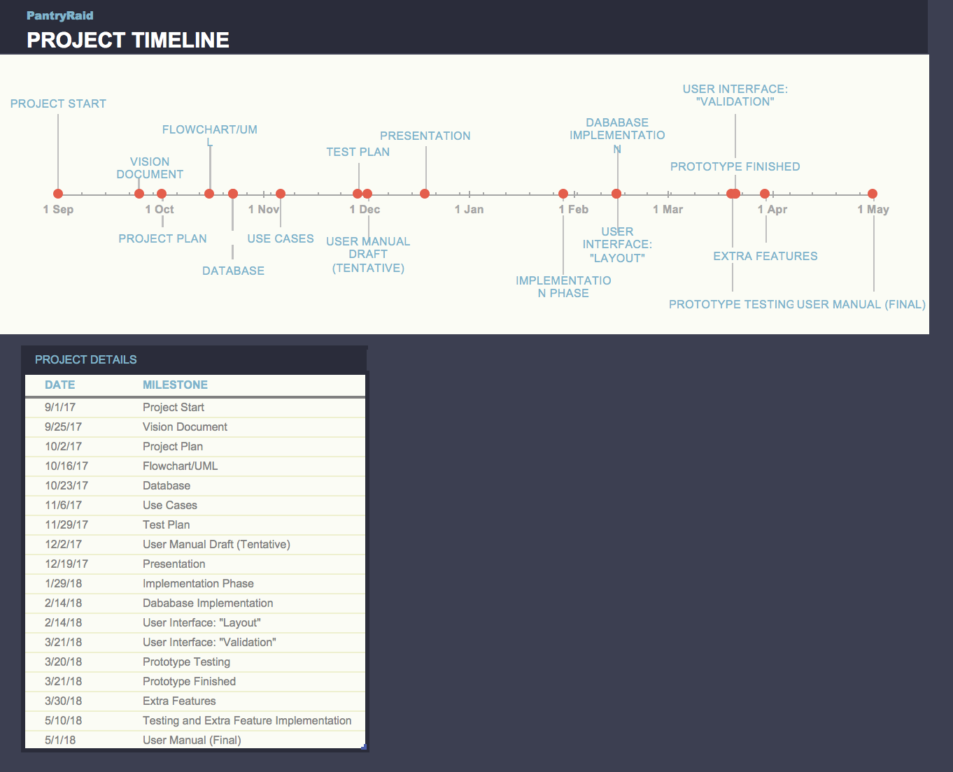
Timeline

Slide 10
Documents
Vision Document
Project Plan
Flowchart/UML
Database
Use Cases
Test Plan
User Manual Draft
Notes:
Nam

Slide 11
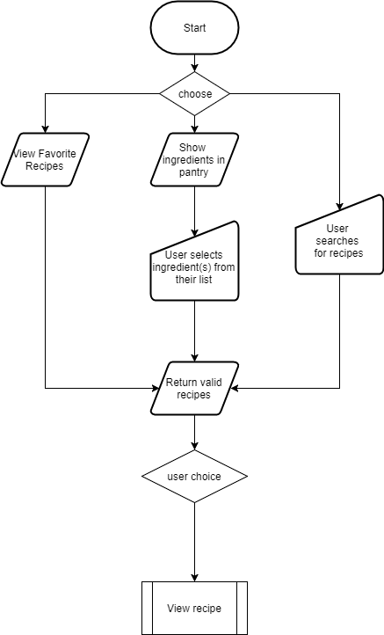
Flowchart/UML
Notes:
nam

Slide 12
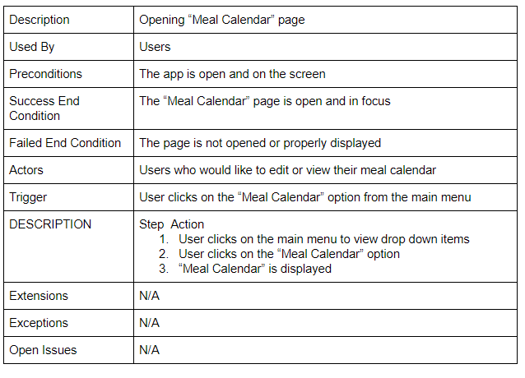
Use Cases
Notes:
nam

Slide 13
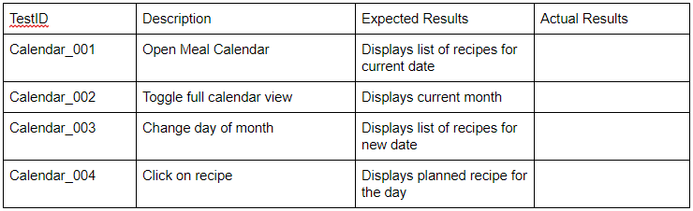
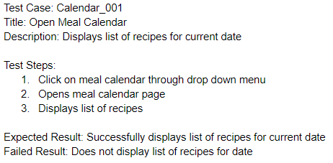
Test Plan
Notes:
nam

Slide 14
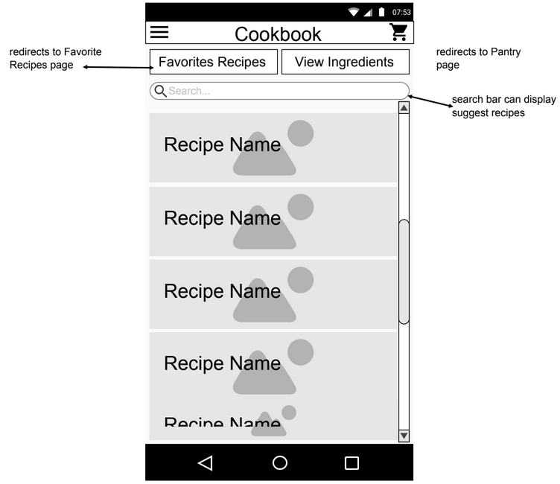
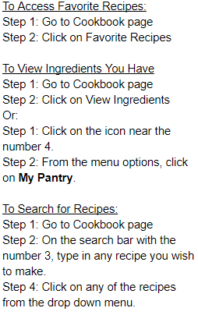
User Manual (Draft)
Notes:
nam

Slide 15
Project Resources
API
Spoonacular
Required Software
Android Studio
Github
Java Development Kit
MySQL
Notes:
-Kan

Slide 16
Spoonacular API
Offers food parsing, matching, and searching technology
Ingredients API
Amounts and conversions
Cooking tips
Mapping to products
Recipes API
Searches recipes by ingredients
Searches recipes from over 20 different cuisines
Takes in allergies/intolerances
Notes:
-Kan
Maximize used ingredients, minimize missing ingredients

Slide 17
Database
Database
API
Check for reference, create one if not found
Requests data
Returns items and recipes
Returns reference data
App/User
Notes:
Randy

Slide 18
Implementation Phase
API Implementation
ETA: January 22nd, 2018 - January 29th, 2018
The time period dedicated to understanding all the tools to be utilized in the app. This includes Spoonacular.
Database Implementation
ETA: January 22nd, 2018 - February 14th, 2018
Implementing the database for storing what is in a user’s refrigerator or pantry.
Database will contain: Favorites, groceries list, ratings
Using MySQL
User Interface: Part One “Layout”
ETA: February 14th, 2018
User interface layout is just the design part. Meaning how the program/game will look like.
User Interface: Part Two “Validation”
ETA: March 21st, 2018
User interface validation is the actual working interface. So we will be able to pull up recipe and use the various functions.
Notes:
Brief - 30 seconds

Slide 19
Implementation Phase cont’d
Prototype Testing
ETA: March 1st, 2018 - March 20th, 2018
Main feature testing
Check for bugs in main features
Prototype Finished
ETA: March 21st, 2018
End-users will be able to perform basic functions in the app, such as pulling up recipes and storing ingredients.
Expected Features: Recipes, Input from users, API must work, expiration date
Extra Features
ETA: March 30th, 2018
Expected Features: Barcode scanner, offline mode and other features.
Depending on time constraints, the team may add one or more extra features to enhance app capabilities
Depending on the progress of project this time maybe waived if behind schedule or used to discuss possible addition of features
Testing and Extra Features Implementation
ETA: April 1st, 2018 - May (Finals day)
Rigorous testing for bugs, security, and make code more robust.
Add extra features if time allows
Notes:
Brief - 30 seconds Ben

Slide 20
Demo

Slide 21
One more thing…

Slide 22

Future Vision of this App
Chef-to-door service
AmazonFresh
Receipt scanner
Notes:
Aman

