Slide 1
Conditional Random Fields applied to Occupancy Grids in Robot Mapping
David Ye
School of Information Technologies
The University of Sydney, Sydney, Australia

Slide 2
Robot Navigation
Map an environment by moving a robot through it
Robot picks up features via sensors
Internal sensors for movement tracking
A Map is typically represented through an occupancy grid
Two dimensional grid
Each cell has a occupancy probability, defaults to 0.5.
Occupancy grid does not provide an exact representation

Slide 3
Problem Statement
Probabilistic representation of the environment
Larger maps decrease accuracy in localisation
Robot needs greater certainty to make accurate inference
Object occlusion
Independency assumptions on cells in the occupancy grid
Limits the information the system can work with
System has no context or adaptability for each environment
Noisy sensor scans
Sensor scans disperse at longer distances

Slide 4
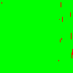


Slide 5
ROS
ROS (Robot Operating System)
ROS provides libraries and tools to interact with a robot
The goal is to create a modular system which ROS can use in its processes
A simulation was created before integration with ROS to test potential algorithms used for inference
Simulation was created so a ground truth could be created for comparison with results

Slide 6
Simulation – probably remove this slide
Ray casting
Discretisation of observations through geometry
Observations are an angle and distance pair
Sensors have a upper bound on range
An occupancy grid is created from compiled observation
Multiple observations of the same area increases the certainty of what is observed
Factors in real life variables such as noise

Slide 7

Conditional Random Fields (CRFs)
Conditional random fields are a tool that allows modeling of dependencies in the occupancy grid
Used for prediction and inference of cells based on existing knowledge on known cells
Pairwise potentials encode influence cells have on each other
Loopy belief propagation allows probabilities in the occupancy grid to propagate throughout all the cells

Slide 8

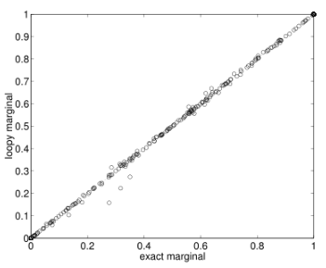
Loopy Belief Propagation
Sum product algorithm
Message Definition:
In graphs with cycles belief propagation is only an approximation [2]
Repeat until convergence

Slide 9
Mean Squared Error and Learning Parameters
Mean squared error (MSE)
Calculated by taking the different between inferred occupancy and ground truth occupancy
Parameters learnt using gradient descent and MSE
Psuedo-likelihood function
Describes probabilities of events occurring
Is a convex function [1]

Slide 10
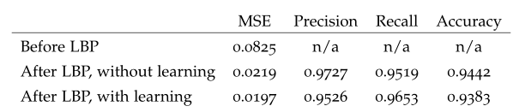
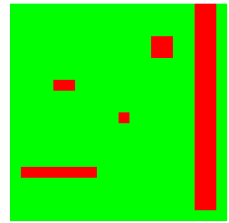
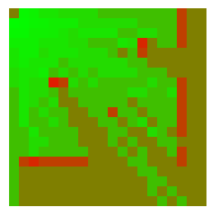
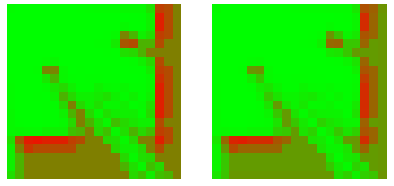
Simulation Results
Precision and recall
Precision = tp / (tp + fp)
Recall = tp / (tp + fn)
Accuracy = (tp + tn) / (tp + tn + fp + fn)
Ground truth
Raw occupancy grid
After LBP, no learning
After LBP, with learning

Slide 11
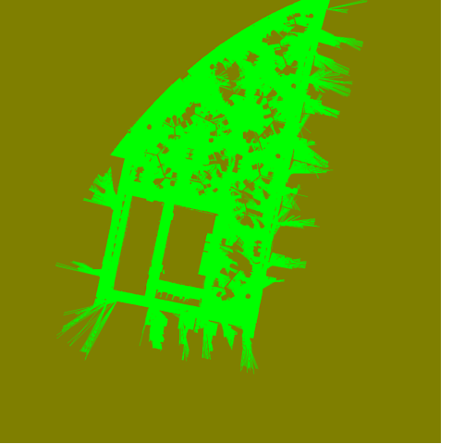
Experimental Results
Random cells in the occupancy grid are removed and run through the CRF
CRF performs inference on the grid with the removed cell

Slide 12

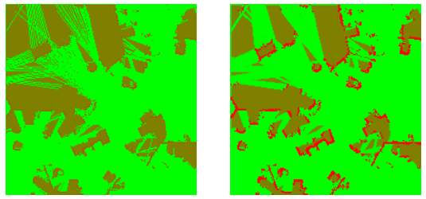
Experimental Results
Raw occupancy grid
After LBP

Slide 13

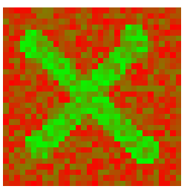
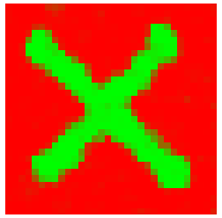
De-noising

Slide 14
Discussion and Analysis
LBP generally improves the accuracy of occupancy grids, this can be verified accurately in simulations with ground truths.
Visually the end result of LBP generates a closer matching occupancy grid
Improved MSE but precision and recall worse, this is because cells which are unknown are not included
Need more here

Slide 15
Future Work
Factoring in more variables into the CRF such as the certainty of scans
Graph cuts
Optimisations to existing CRF to perform better on very large maps
Run in real time on large grids

Slide 16
References
[1] Daphne Koller and Nir Friedman. Probabilistic graphical models: principles and techniques. MIT press, 2009.
[2] Kevin P Murphy, Yair Weiss, and Michael I Jordan. Loopy belief propagation for approximate inference: An empirical study. In Proceedings of the Fifteenth conference on Uncertainty in artificial intelligence,pages 467–475. Morgan Kaufmann Publishers Inc., 1999.

