Slide 1
Predicting Board Game Ranking
Natalie Paley

Slide 2
Problem Statement
Board Game Geek is the most popular resource for people planning to buy their next game.
Getting a higher ranking on boardgamegeek.com will enable more people to see a designer’s game, leading to more purchases of that game.
Notes:
Nicole

Slide 3
End User
Board game designers
BGG tracks metrics on a large variety of features:
BGG Rating
User Rating
Release Year
Number of Ratings
Min players
Max players
Min play time
Max play time
Min age
Complexity
Artist(s)
Publishers
Categories (Genres)
Mechanisms

Slide 4
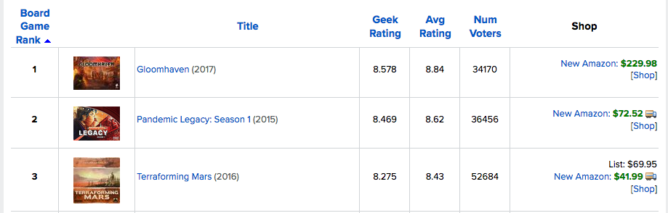
Data Gathering
Scraped 8829 pages of BGG
1162 pages of Ranked board games
7667 individual pages
Notes:
Paul & Erik
HIFLD - Homeland Infrastructure Foundation Level Data
Geopy to find distances, create a lookup table between location & turnstile data, clean up duplicates
Mention that Paul will be back to discuss distance data

Slide 5
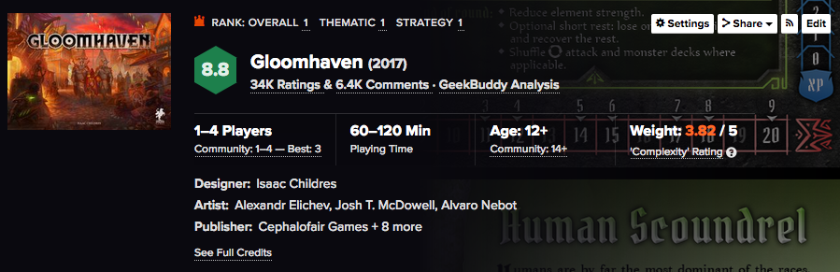
Data Gathering
Notes:
Paul & Erik
HIFLD - Homeland Infrastructure Foundation Level Data
Geopy to find distances, create a lookup table between location & turnstile data, clean up duplicates
Mention that Paul will be back to discuss distance data

Slide 6
Process
 | R^2 Train | R^2 Test
All Features
Linear Regression | 0.74244 | 0.74018
Linear Regression with Polynomials (2) | 0.91846 | 0.91289
Linear Regression with Polynomials (3) | 0.87270 | 0.64241
Designer Features only (min players, complexity, min play time, min age)
Linear Regression | 0.03647 | 0.02996
Linear Regression with Polynomials (2) | 0.05116 | 0.05929
Linear Regression with Polynomials (3) | 0.06057 | 0.02566
Dummy Variables (players, play time, age, complexity)
Terrible across the board

Slide 7
Results - Top Ten Features
Feature | Coefficient
BGG Rating | -57203.20974
BGG Rating^2 | 4585.739281
User Rating | 2157.08032
Complexity | 1264.206467
BGG Rating User Rating | -531.9626727
Min players | -362.8132045
BGG Rating complexity | -165.6045744
Min age | -117.5021748
User Rating^2 | 88.55779934
User Rating complexity | -73.48209437

Slide 8
Extensions and Refinements
Notes:
Natalie

Slide 9
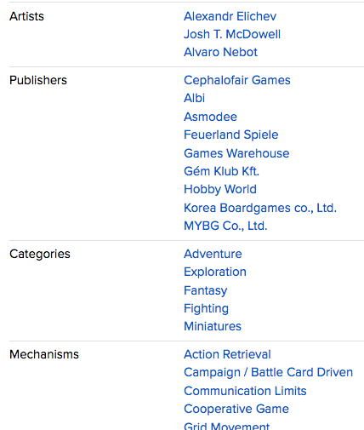
Data Gathering
Additional Features:
Notes:
Paul & Erik
HIFLD - Homeland Infrastructure Foundation Level Data
Geopy to find distances, create a lookup table between location & turnstile data, clean up duplicates
Mention that Paul will be back to discuss distance data

Slide 10
Additional Informational Slides

Slide 11
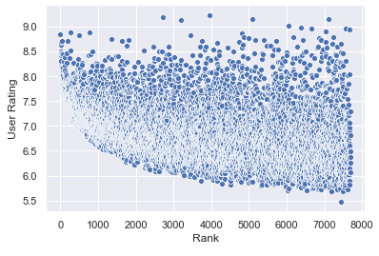
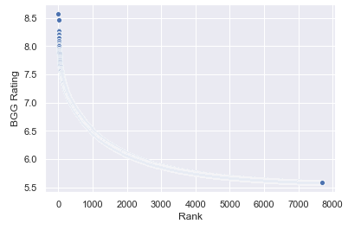
Exploratory Data Analysis

Slide 12
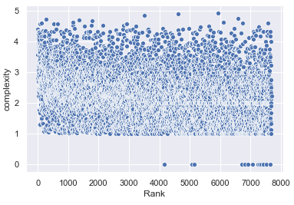
EDA

Slide 13
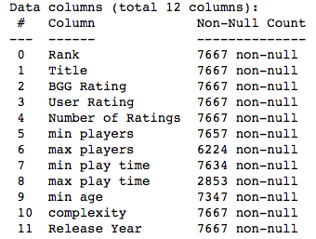
Null Values

Slide 14
Source and Resources
Data Source:
https://www.boardgamegeek.com/
Scraped 1162 pages for the initial data set
Scraped 7667 pages for additional features
Resources:
BeautifulSoup
Selenium
Requests
Pickle
Pandas
Numpy
Matplotlib
Seaborn
Sklearn

Slide 15
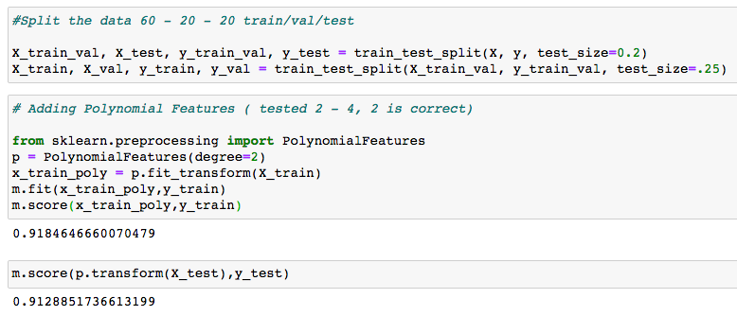
Results

