Slide 1
Introduction to HTML

Slide 2
WHAT IS HTML?
HTML, otherwise known as HyperText Markup Language, is the language used to create Web pages.
"Hypertext" refers to links that connect web pages to one another, either within a single website or between websites.
Using HTML, you can create a Web page with text, graphics, sound, and video.

Slide 3
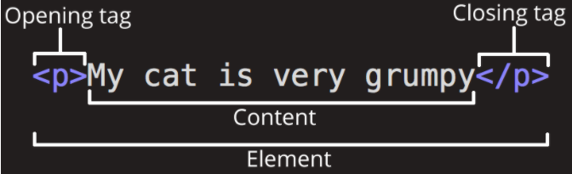
ANATOMY OF AN HTML ELEMENT
The opening tag: This consists of the name of the element (in this example, p for paragraph), wrapped in opening and closing angle brackets. This opening tag marks where the element begins or starts to take effect. In this example, it precedes the start of the paragraph text.
The content: This is the content of the element. In this example, it is the paragraph text.
The closing tag: This is the same as the opening tag, except that it includes a forward slash before the element name. This marks where the element ends. Failing to include a closing tag is a common beginner error that can produce peculiar results.

Slide 4
TAGS
The essence of HTML programming is tags.
A tag is a keyword enclosed by angle brackets ( Example: <i> )
There are opening and closing tags for many but not all tags; The affected text is between the two tags
The opening and closing tags use the same command except the closing tag contains and additional forward slash /
For example, the expression <b> Warning </b> would cause the word ‘Warning’ to appear in bold face on a Web page

Slide 5

ATTRIBUTES
Attributes contain extra information about the element that won't appear in the content. In this example, the class attribute is an identifying name used to target the element with style information.
An attribute should have:
A space between it and the element name. (For an element with more than one attribute, the attributes should be separated by spaces too.)
The attribute name, followed by an equal sign.
An attribute value, wrapped with opening and closing quote marks.

Slide 6
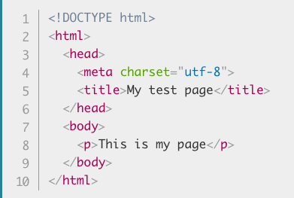
STRUCTURE OF A WEBPAGE
All Web pages share a common structure
All Web pages should contain a pair of <html>, <head>, <title>, and <body> tags.

Slide 7
STRUCTURE OF A WEBPAGE
<!DOCTYPE html>: The doctype. When HTML was young (1991-1992), doctypes were meant to act as links to a set of rules that the HTML page had to follow to be considered good HTML.More recently, the doctype is a historical artifact that needs to be included for everything else to work right. <!DOCTYPE html> is the shortest string of characters that counts as a valid doctype.
<html></html>: The <html> element. This element wraps all the content on the page. It is sometimes known as the root element.
<head></head>: The <head> element. This element acts as a container for everything you want to include on the HTML page, that isn't the content the page will show to viewers. This includes keywords and a page description that would appear in search results, CSS to style content, character set declarations, and more. You'll learn more about this in the next article of the series.
<meta charset="utf-8">: This element specifies the character set for your document to UTF-8, which includes most characters from the vast majority of human written languages. With this setting, the page can now handle any textual content it might contain. There is no reason not to set this, and it can help avoid some problems later.
<title></title>: The <title> element. This sets the title of the page, which is the title that appears in the browser tab the page is loaded in. The page title is also used to describe the page when it is bookmarked.
<body></body>: The <body> element. This contains all the content that displays on the page, including text, images, videos, games, playable audio tracks, or whatever else.

Slide 8
TEXT FORMATTING
Text Formatting Tags
<b> Bold Face </b>
<i> Italics </i>
<u> Underline </u>
<p> New Paragraph </p>
<br> Next Line
Manipulating text in HTML can be tricky; Oftentimes, what you see is NOT what you get
For instance, special HTML tags are needed to create paragraphs, move to the next line, and create headings.

Slide 9
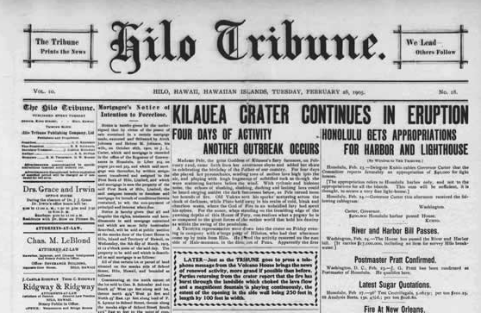
HEADINGS AND PARAGRAPHS
Most structured text consists of headings and paragraphs, whether you are reading a story, a newspaper, a college textbook, a magazine, etc.
Structured content makes the reading experience easier and more enjoyable.

Slide 10
HEADINGS AND PARAGRAPHS
In HTML, each paragraph has to be wrapped in a <p> element, like so:
Each heading has to be wrapped in a heading element:
There are six heading elements: <h1>, <h2>, <h3>, <h4>, <h5>, and <h6>. Each element represents a different level of content in the document; <h1> represents the main heading, <h2> represents subheadings, <h3> represents sub-subheadings, and so on.

Slide 11
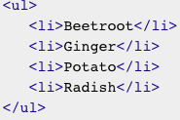
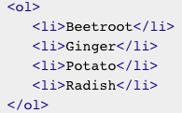
LISTS
UNORDERED LISTS
ORDERED LISTS
Ordered lists are lists in which the order of the items does matter.
The markup structure is the same as for unordered lists, except that you have to wrap the list items in an <ol> element, rather than <ul>
Unordered lists are used to mark up lists of items for which the order of the items doesn't matter.
Every unordered list starts off with a <ul> element—this wraps around all the list items
The last step is to wrap each list item in a <li> (list item) element

Slide 12



INSERTING IMAGES
In order to put a simple image on a webpage, we use the <img> element. This is an empty element (meaning that it has no text content or closing tag) that requires a minimum of one attribute to be useful — src (sometimes spoken as its full title, source). The src attribute contains a path pointing to the image you want to embed in the page, which can be a relative or absolute URL, in the same way as href attribute values in <a> elements.
So for example, if your image is called dinosaur.jpg, and it sits in the same directory as your HTML page, you could embed the image like so:
If the image was in an images subdirectory, which was inside the same directory as the HTML page, then you'd embed it like this:
You could embed the image using its absolute URL, for example:
Some browsers don’t support images. In this case, the ALT attribute can be used to create text that appears instead of the image.

Slide 13
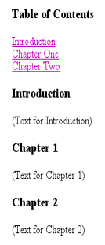
ANCHORS
To create the anchor itself, type <a NAME=“anchor name”>label</a> at the point in the Web page where you want the user to jump to.
To create the link, type <a href=“#anchor name”>label</a> at the point in the text where you want the link to appear.
<a href="#chap2">Chapter Two</a><br>
<a NAME="chap2">Chapter 2 </a>.
Anchor
Link

Slide 14
LINKS
A link lets you move from one page to another, play movies and sound, send email, download files, and more….
ANATOMY OF LINK
A link has three parts: a destination, a label, and a target
To create a link type <a href=“page.html”> label </a>
In the above link, “page.html” is the destination. The destination specifies the address of the Web page or file the user will access when he/she clicks on the link.
The label is the text that will appear underlined or highlighted on the page.

Slide 15
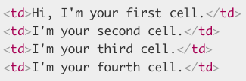
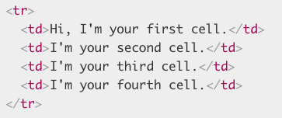
TABLES
Tables can be used to display rows and columns of data, create multi-column text, captions for images, and sidebars.
The <TABLE> tag is used to create a table; the <tr> tag defines the beginning of a row while the <td> tag defines the beginning of a cell.
The smallest container inside a table is a table cell, which is created by a <td> element ('td' stands for 'table data'). Add the following inside your table tags:
If we want a row of four cells, we need to copy these tags three times. Update the contents of your table to look like so:
To stop this row from growing and start placing subsequent cells on a second row, we need to use the <tr> element ('tr' stands for 'table row'). Let's investigate this now.
Place the four cells you've already created inside <tr> tags, like so:
This should result in a table that looks something like the following:

Slide 16
USEFUL RESOURCES
https://developer.mozilla.org/en-US/docs/HTML
https://www.w3schools.com/html/

Slide 17
THANKS!
Do you have any questions?

