Slide 1
Getting started with C++
Week 1: Object Oriented Using C++

Slide 2
Why Learn C++
Ubiquitous
Object Oriented
Easier Large Scale Project
High Performance

Slide 3
C++ Features
Supports data security
Prevents accidents with data
Helps code reuse
Lets you use operators the way you like.
Allows multiple functions/operators with the same name.

Slide 4
C++ Features
Large Projects
System Applications
Graphics
Data Structures
Speed is an issue
Need exceptions and error handling.
Want to speed your scripts

Slide 5
When not to use
C++
Small system programs
Fast prototyping
Web-based applications (Perl/Python)

Slide 6
Important Definitions
Algorithm: Ordered set of actions to accomplish a certain task.
Program: Implementation of algorithms.
Compiler, function, library, bug.
Variables, constants.
Keywords (if, while, for,…)
Data Types. (long, int, …)

Slide 7
Compiling/Running
Programs
Algorithm: Ordered set of actions to accomplish a certain task.
Program: Implementation of algorithms.
Compiler, function, library, bug.
Variables, constants.
Keywords (if, while, for,…)
Data Types. (long, int, …)

Slide 8
Simple.cpp
int main() // Function Declaration // Function body follows { // Block of statements begins. return 0; } // Block ends.

Slide 9
G++ Compilation
preprocessing (to expand macros) - Try “cpp simple.cpp > simple.i”
compilation (from source code to assembly language)
Try “g++ -Wall –S simple.i”
assembly (from assembly language to machine code)
Try “as simple.s -o simple.o”
linking (to create the final executable) Try “gcc simple.o”

Slide 10
C++ is a superset of C
Features present in C are also present in C++
C++ is a object oriented programming language
OOP is about objects which contain data and functions to manipulate that data.
A single unit that contain data and functions that operate on the data is called an object.

Slide 11
Object
Oriented
Programming
Based on concept of objects and classes.
Objects: Represent entities with related state and behaviour Instances of a class
Classes: Define common characteristics of similar objects.

Slide 12
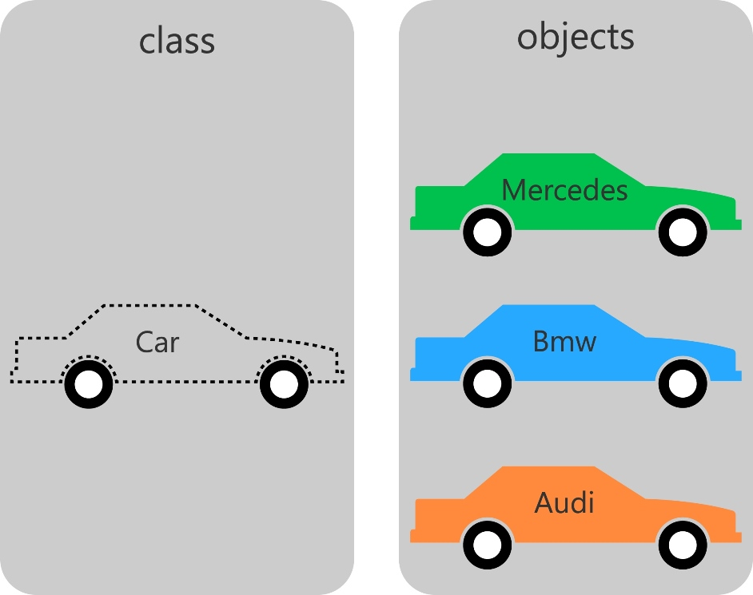
Object / Class Example

Slide 13
Another Object/Class Example
Class Point {
Int _x, _y; //Point Co-ordinates
public: // begin interface section
Void setX(const int value); Void setY(const int value); int getX(){ return _x; } int getY(){ return _y; }
} Point tpoint; //defines an object tpoint

Slide 14
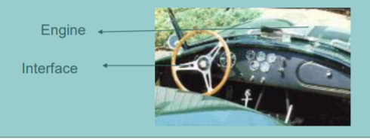
Data Hiding
Object contain information
Only part of the information contained in the object might be presented to the user.
Rest is concealed

Slide 15
Data Abstraction
DA is a programming technique where one separates the interface from the implementation.
Class designer worries about the interface
Programmers implement

Slide 16
Data Encapsulations
Combine lower level elements to form a new higher level entity.
Grouping of attributes and behaviors to form an object.
C++ vector type is an example of both data abstraction and Data encapsulation

Slide 17
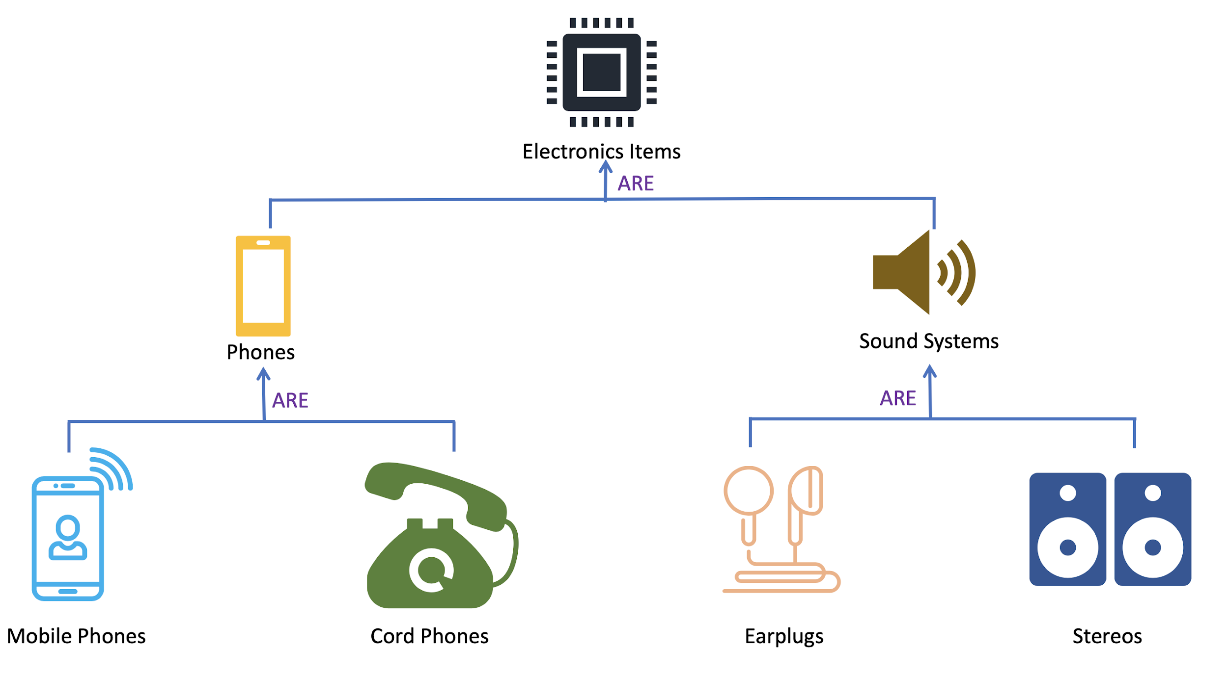
OOP : Inheritance
Many classes have common attributes
These classes can be arranged in hierarchy
Inheritance enables you to reuse code and add data and functionality without making any changes to the existing code.
For example, Object can inherit characteristics from other objects.

Slide 18
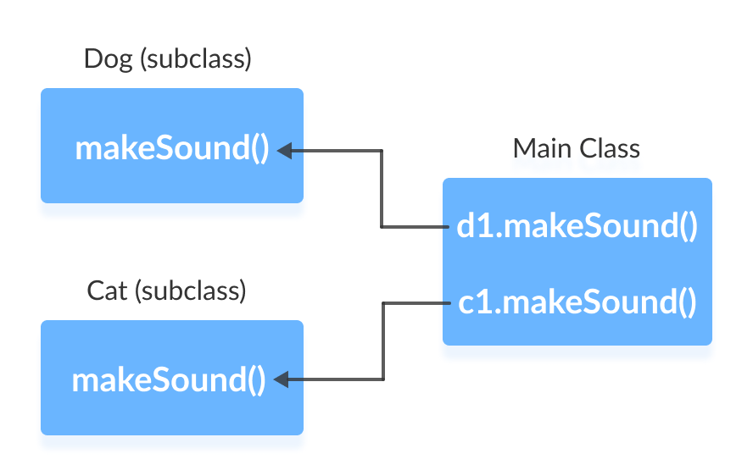
Polymorphism
Base Class Dog and Cat Classes establishes the common interface to anything inherited from Main Class

Slide 19
Polymorphism
Overriding: When a child class extends the functionality of its parent class.
Using operators and functions in different ways depending on what they are operating on is called polymorphism. (i) Static (ii) Dynamic.
These concepts builds upon encapsulation and inheritance

Slide 20
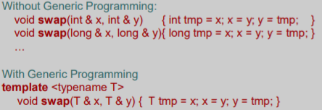
Generic Programming
Type independent code
Write code for one generic type and use it for multiple types.

