Slide 1
Answer Key - Part 1: Questions 1-10
Use after students have attempted this set.
Q1 B
Q6 A
Q2 C
Q7 B
Q3 C
Q8 C
Q4 D
Q9 B
Q5 A
Q10 B
Cambridge AS Economics 9708 Paper 1 - difficult MCQ review

Slide 2
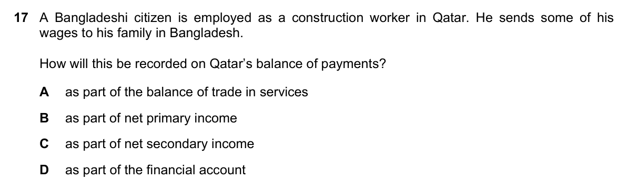
Question 1: Remittances in the Balance of Payments / 国际收支中的汇款
Part 1 | Q1-10
Source: 9708_s23_13 Q17 | Correct: 6%
Answer: B
B: the Bangladeshi citizen earns wages in Qatar, counted as Qatar's primary income. Sending money home is recorded as an outflow.
B：这名孟加拉公民在卡塔尔工作，工资属于卡塔尔初次收入。寄回部分工资记作卡塔尔国际收支净流出。

Slide 3
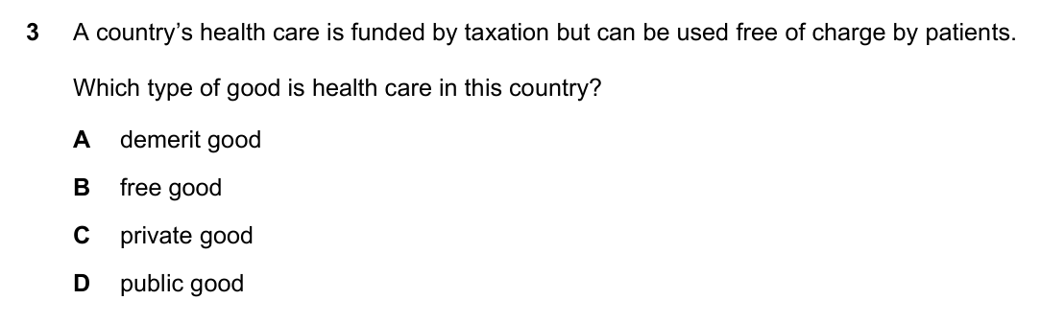
Question 2: Government Health Care as a Good / 政府医疗服务的物品属性
Part 1 | Q1-10
Source: 9708_w23_11 Q3 | Correct: 7%
Answer: C
C: Health care is rival and excludable because doctors, beds, and medicines are limited. Even if government-funded, it remains a private-type good.
C：医疗服务有竞争性和排他性：医生、床位、药物有限，即使政府资助，仍属于私人物品。

Slide 4
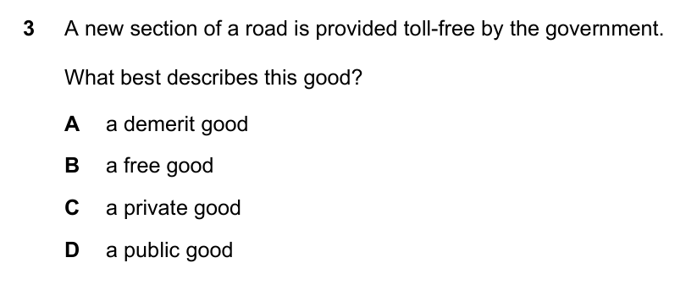
Question 3: Free Roads and Private Goods / 免费道路与私人物品
Part 1 | Q1-10
Source: 9708_w23_12 Q3 | Correct: 8%
Answer: C
C: Toll-free roads use scarce resources and may be congested; opportunity cost makes them private-type goods.
C：免费道路仍需稀缺资源，可能拥堵，机会成本决定其为私人物品。

Slide 5
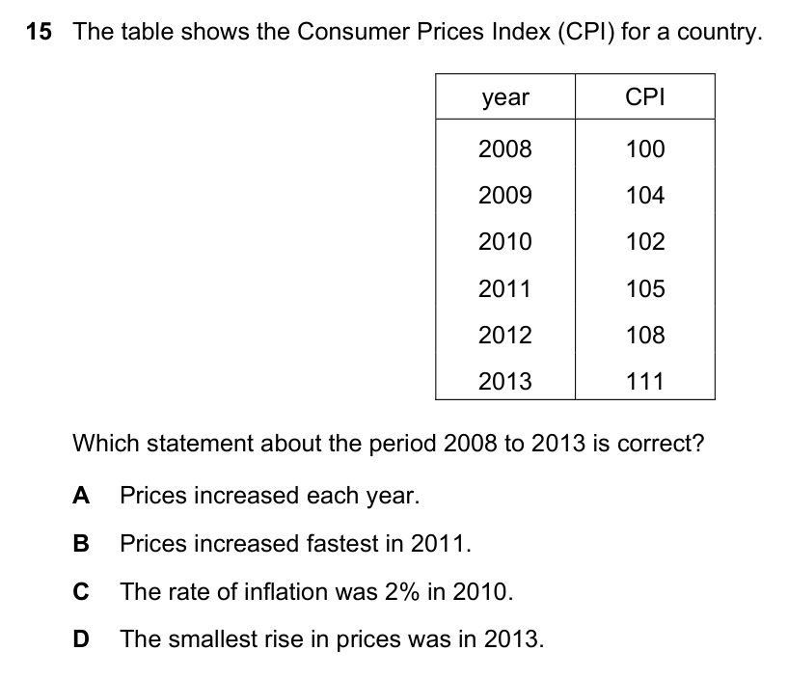
Question 4: CPI and Inflation Rates / CPI与通货膨胀率
Part 1 | Q1-10
Source: 9708_w24_11 Q15 | Correct: <10%
Answer: D
D: Inflation = % change in CPI. From 108 to 111: (111-108)/108 is about 2.8%.
D：通货膨胀率 = CPI百分比变化。108到111：约2.8%。

Slide 6
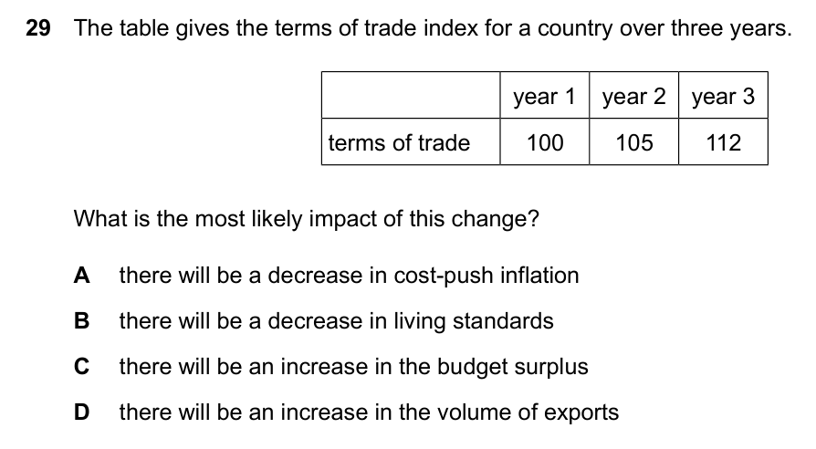
Question 5: Terms of Trade and Imported Inflation / 贸易条件与输入型通胀
Part 1 | Q1-10
Source: 9708_s25_13 Q29 | Correct: <1 in 7
Answer: A
A: Terms of trade improve if export prices rise faster than import prices. Cheaper imports reduce imported cost-push inflation.
A：出口价格上升快于进口价格，贸易条件改善，进口便宜可降低输入型成本推动的通胀。

Slide 7
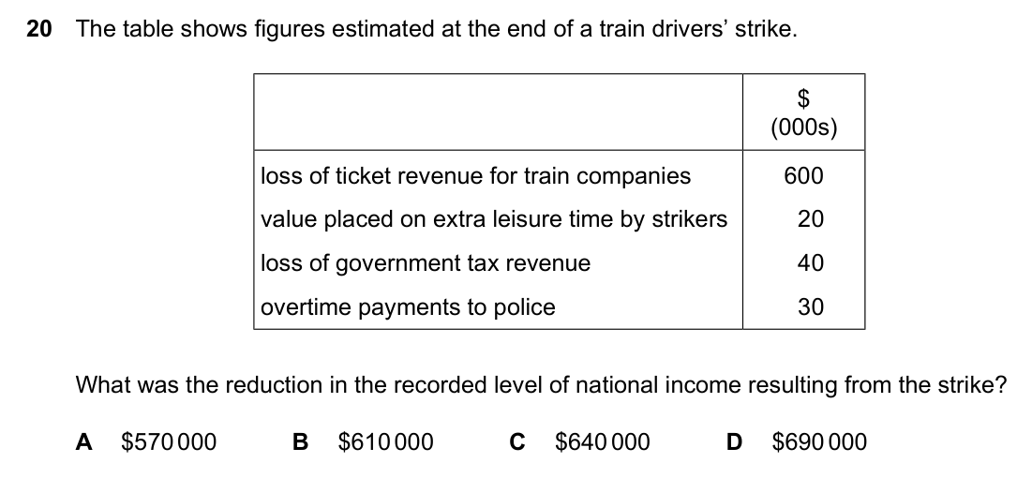
Question 6: National Income and Actual Output / 国民收入与实际产出
Part 1 | Q1-10
Source: 9708_s25_12 Q20 | Correct: <15%
Answer: A
A: National income counts actual output. Lost train output minus extra policing counts; leisure and tax losses are excluded.
A：国民收入记录实际产出。火车服务减少产出减去额外警务产出；罢工者休闲和税收损失不计。

Slide 8
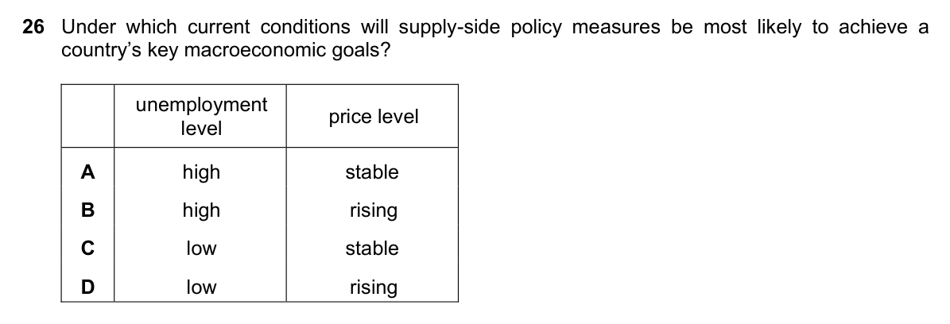
Question 7: Supply-Side Policy and AS/AD / 供给侧政策与AS/AD
Part 1 | Q1-10
Source: 9708_m23_12 Q26 | Correct: 18%
Answer: B
B: Rightward shift of AS increases output, lowers unemployment, and reduces inflationary pressure.
B：总供给右移可提高产出、降低失业，并缓解通胀压力。

Slide 9
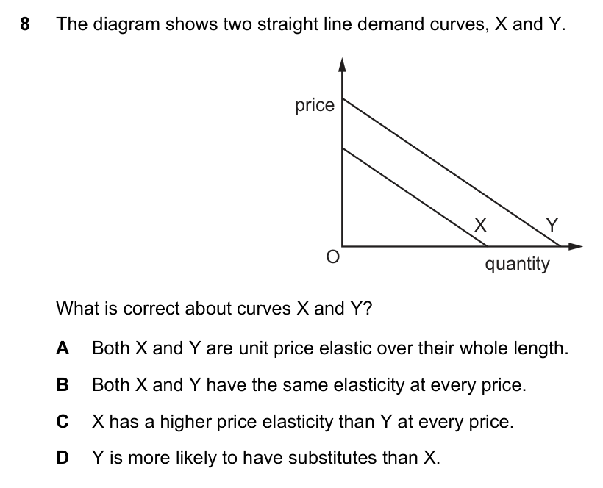
Question 8: Elasticity on Demand Curves / 需求曲线上的弹性
Part 1 | Q1-10
Source: 9708_m24_12 Q8 | Correct: 19%
Answer: C
C: X has larger quantity at same price → P/Q smaller → less elastic than Y.
C：X在同一价格下数量更大，P/Q较小 → 弹性小于Y。

Slide 10
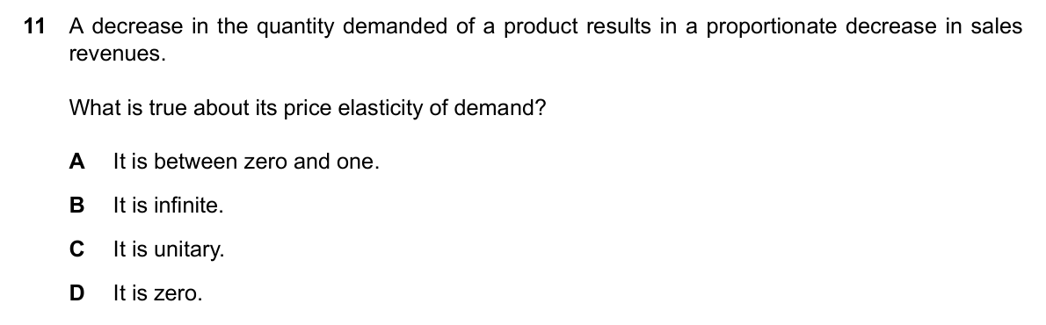
Question 9: Demand Elasticity and Sales Revenue / 需求弹性与销售收入
Part 1 | Q1-10
Source: 9708_m25_12 Q11 | Correct: <1 in 5
Answer: B
B: Revenue falls proportionally to quantity; price unchanged means horizontal demand, so PED is infinite.
B：销售收入按需求量比例下降，价格不变，说明需求曲线水平，需求弹性无穷大。

Slide 11
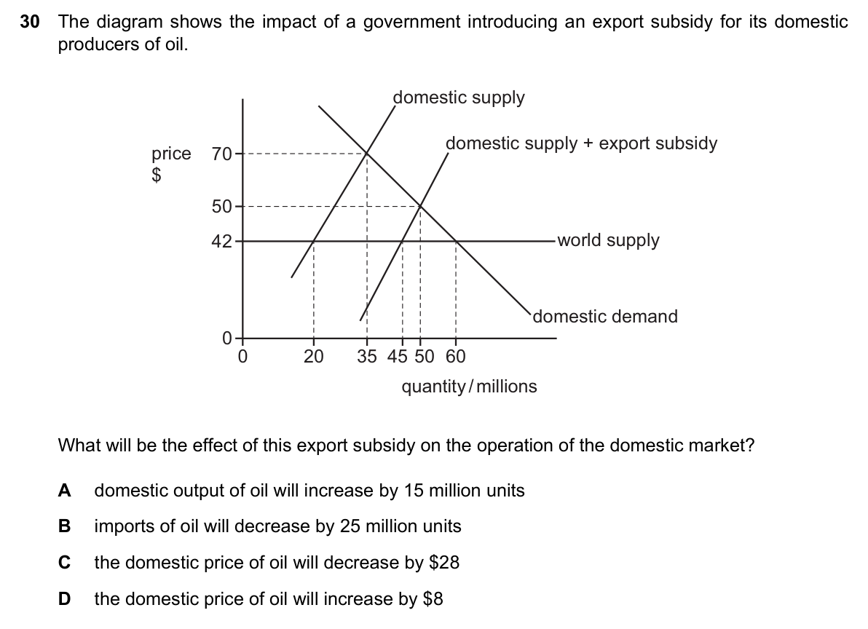
Question 10: Export Subsidy and Import Volumes / 出口补贴与进口量
Part 1 | Q1-10
Source: 9708_m25_12 Q30 | Correct: <1 in 5
Answer: B
B: Domestic supply rises 20 to 45m; demand is 60m. Imports become 15m, down from 40m, a fall of 25m.
B：国内供给2000万到4500万，需求6000万，进口变为1500万，原为4000万，减少2500万。

Slide 12
Answer Key - Part 2: Questions 11-20
Use after students have attempted this set.
Q11 A
Q16 B
Q12 C
Q17 D
Q13 D
Q18 A
Q14 D
Q19 C
Q15 A
Q20 C
Cambridge AS Economics 9708 Paper 1 - difficult MCQ review

Slide 13
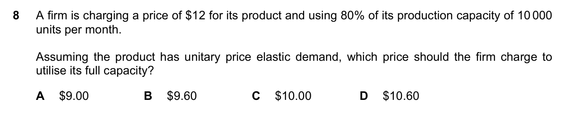
Question 11: Unitary PED and Capacity Use / 单位弹性与产能利用
Part 2 | Q11-20
Source: 9708_s24_13 Q8 | Correct: <20%
Answer: A
A: Output must rise from 8000 to 10000, a 25% increase. With unitary elasticity, price must fall 25%, from 12 to 9.
A：产量从8000增至10000，增加25%。单位弹性下，价格需下降25%，从12降到9。

Slide 14
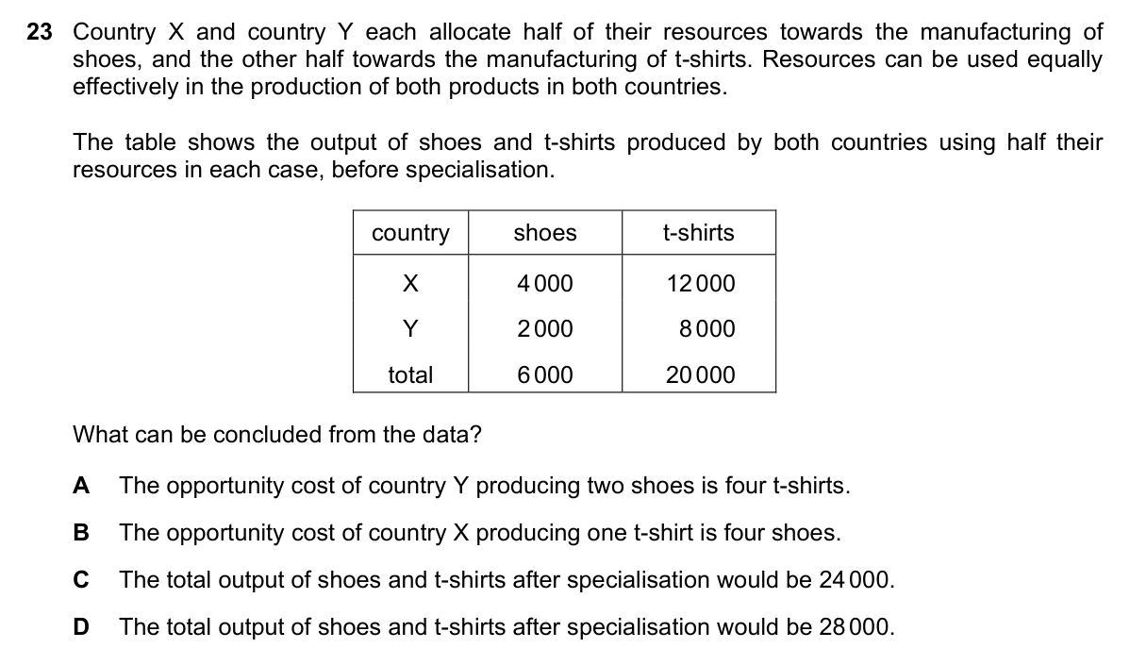
Question 12: Comparative Advantage / 比较优势
Part 2 | Q11-20
Source: 9708_s23_13 Q23 | Correct: 20%
Answer: C
C: Opportunity cost determines which country specializes in which good. After specialization, compare world output with original totals.
C：根据机会成本决定各国专业化生产哪种商品。专业化后计算世界总产出并与原总量比较。

Slide 15
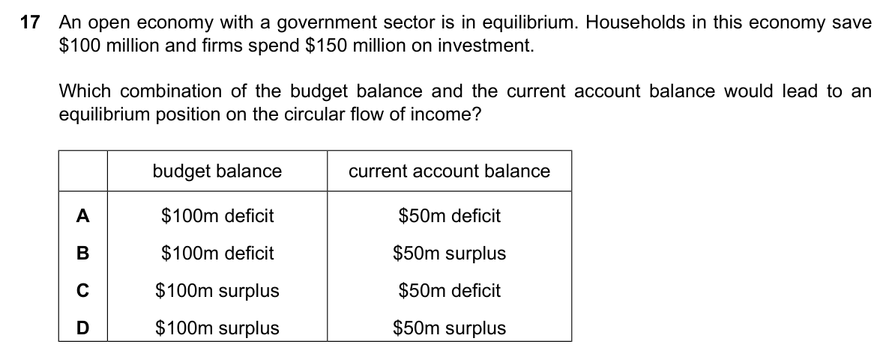
Question 13: Circular Flow Equilibrium / 循环流量均衡
Part 2 | Q11-20
Source: 9708_s25_11 Q17 | Correct: 20%
Answer: D
D: Investment is $50m greater than saving. Current account surplus and budget surplus offset the difference.
D：投资比储蓄多5000万美元。经常账户盈余和预算盈余抵消差额。

Slide 16
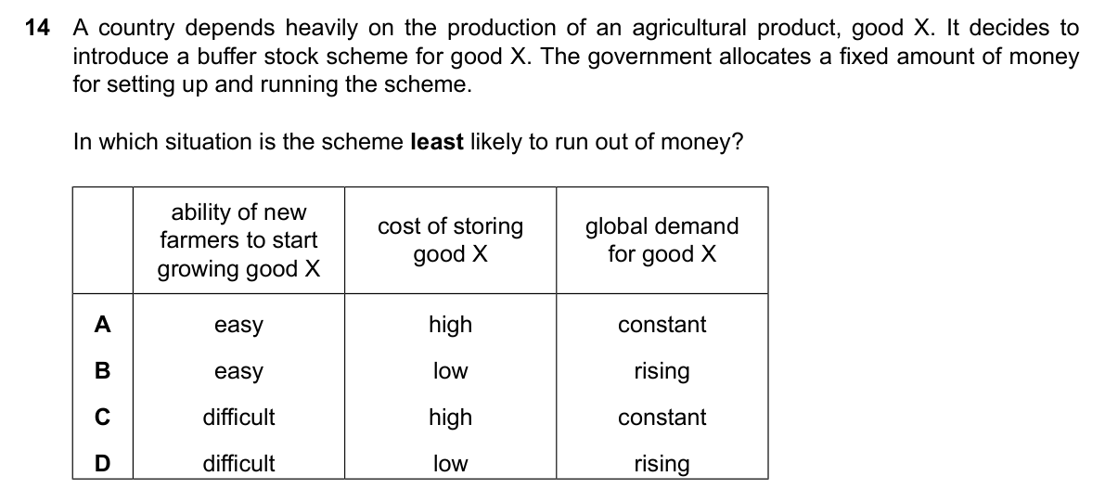
Question 14: Buffer Stock Finance Risk / 缓冲库存的资金风险
Part 2 | Q11-20
Source: 9708_s25_13 Q14 | Correct: just over 20%
Answer: D
D: Difficult entry for new farmers and rising demand reduce persistent excess supply risk.
D：新农民进入困难且需求上升，减少长期过剩供给风险。

Slide 17
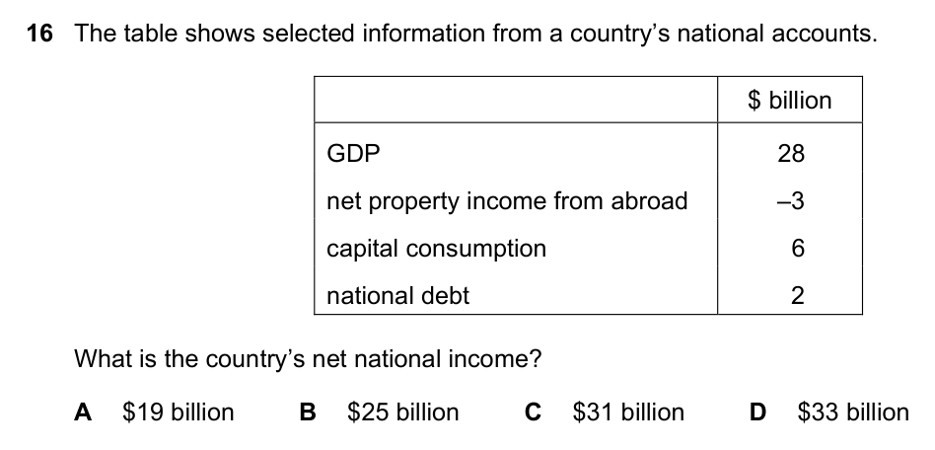
Question 15: Net National Income Calculation / 国民净收入计算
Part 2 | Q11-20
Source: 9708_m23_12 Q16 | Correct: 21%
Answer: A
A: NNI adjusts GDP for net property income from abroad and capital consumption.
A：国民净收入=GDP调整国外净财产收入和折旧。

Slide 18
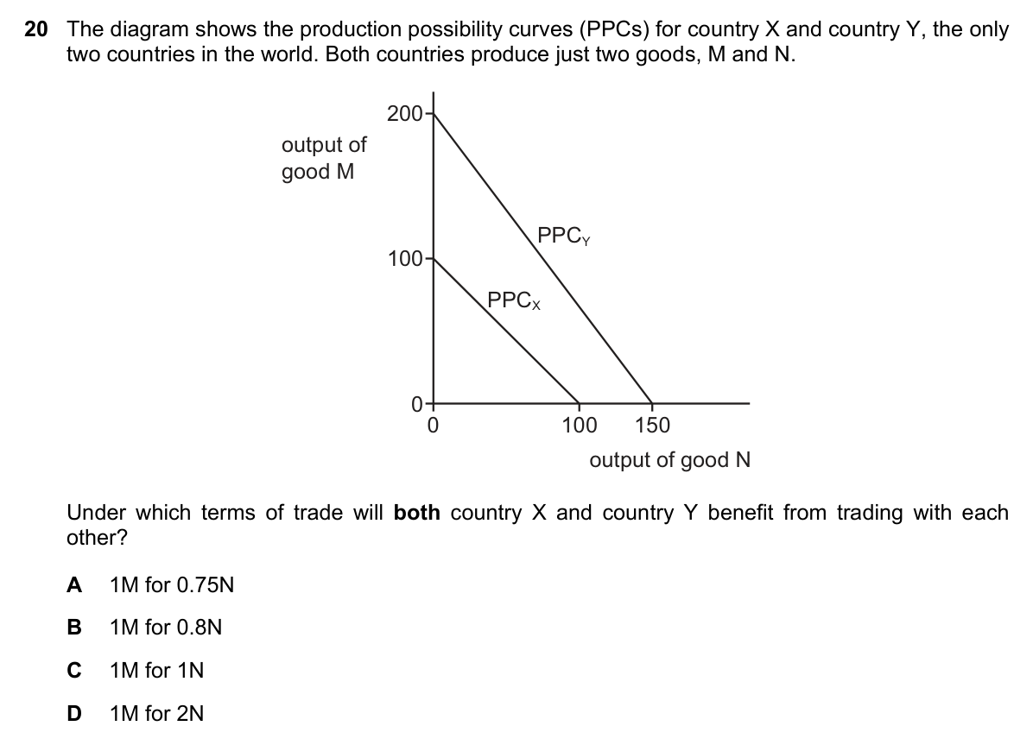
Question 16: PPC and Acceptable Terms of Trade / PPC与可接受贸易条件
Part 2 | Q11-20
Source: 9708_w23_11 Q20 | Correct: 21%
Answer: B
B: Only a terms-of-trade ratio between the two countries' opportunity costs allows both to gain.
B：贸易条件必须位于两国机会成本之间，才能让双方获益。

Slide 19
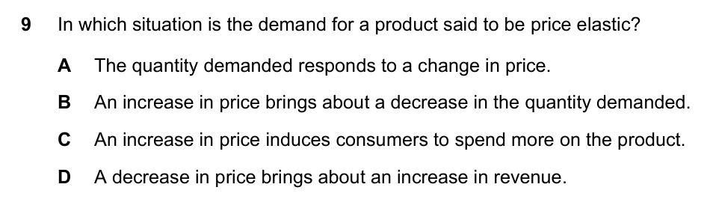
Question 17: PED and Total Revenue / 需求弹性与总收益
Part 2 | Q11-20
Source: 9708_s23_11 Q9 | Correct: 24%
Answer: D
D: When demand is elastic, % increase in quantity is greater than % fall in price, so total revenue rises.
D：需求有弹性时，需求量增加百分比大于价格下降百分比，总收益上升。

Slide 20
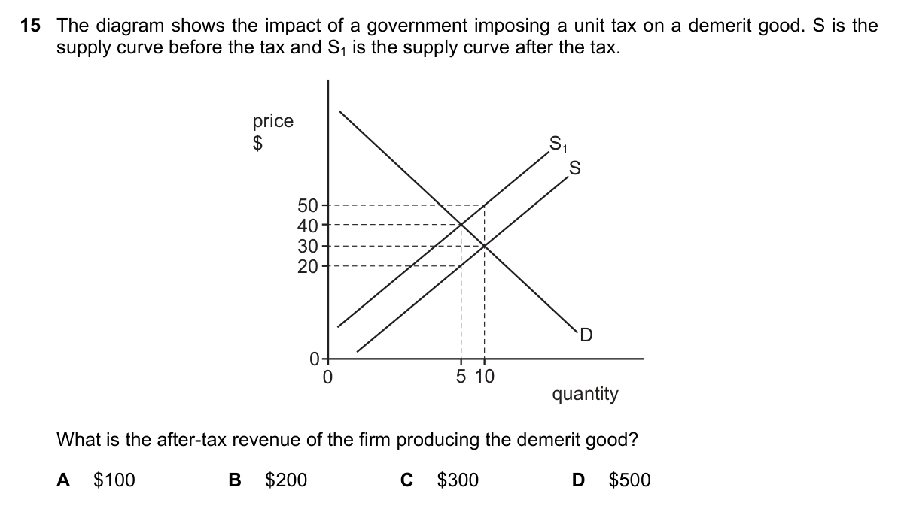
Question 18: Unit Tax and After-Tax Revenue / 单位税与税后收入
Part 2 | Q11-20
Source: 9708_s23_13 Q15 | Correct: 24%
Answer: A
A: Firm after-tax revenue uses the new quantity and net price after tax, not the full consumer price.
A：企业税后收入按新数量和税后价格计算，而非消费者支付总价。

Slide 21
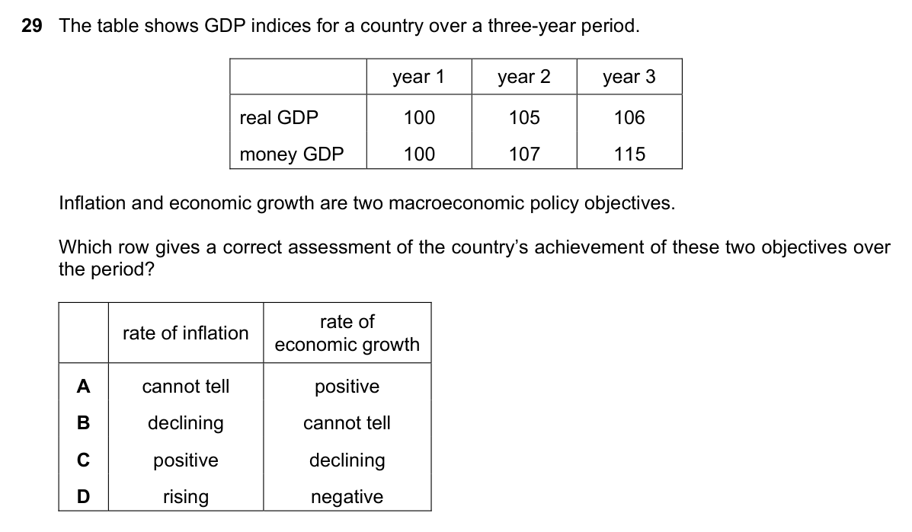
Question 19: Money GDP and Real GDP / 名义GDP与实际GDP
Part 2 | Q11-20
Source: 9708_m23_12 Q29 | Correct: 25%
Answer: C
C: Real GDP rises slowly, money GDP rises faster, so prices increase. Positive economic growth continues.
C：实际GDP缓慢上升，名义GDP上升快，所以价格上涨。经济仍正增长。

Slide 22
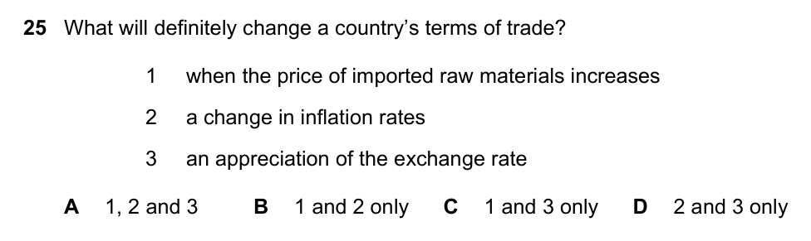
Question 20: What Changes Terms of Trade / 什么会改变贸易条件
Part 2 | Q11-20
Source: 9708_s23_12 Q25 | Correct: 25%
Answer: C
C: Imported raw material prices and exchange-rate changes directly affect the export/import price relationship.
C：进口原材料价格和汇率变动会直接影响出口与进口价格关系。

Slide 23
Answer Key - Part 3: Questions 21-30
Use after students have attempted this set.
Q21 D
Q26 C
Q22 A
Q27 D
Q23 B
Q28 A
Q24 D
Q29 C
Q25 D
Q30 B
Cambridge AS Economics 9708 Paper 1 - difficult MCQ review

Slide 24
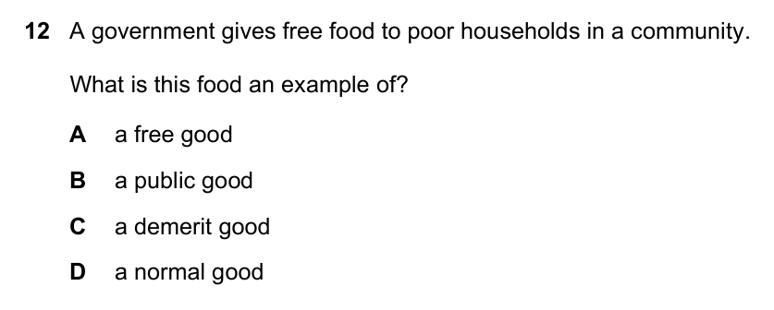
Question 21: Free Food and Good Classification / 免费食物与物品分类
Part 3 | Q21-30
Source: 9708_s24_11 Q12 | Correct: a quarter
Answer: D
D: Food has opportunity cost and is rival. Free distribution does not change its private-good nature.
D：食物有机会成本，消费有竞争性。免费发放不改变其私人物品属性。

Slide 25
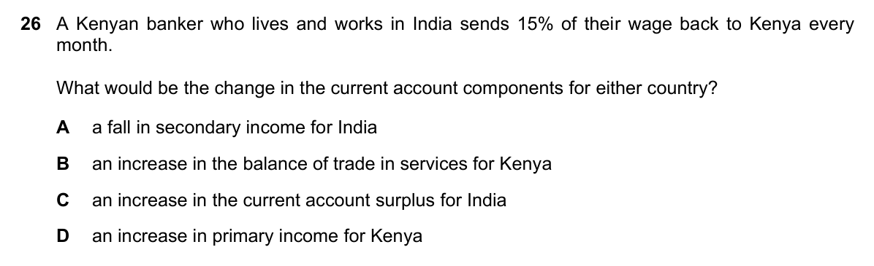
Question 22: Residence and Remittances / 居民身份与汇款
Part 3 | Q21-30
Source: 9708_w23_11 Q26 | Correct: 25%
Answer: A
A: The Kenyan banker lives and works in India, so remittance to Kenya is a secondary income outflow for India.
A：肯尼亚银行家居住并工作在印度，向肯尼亚汇款为印度的二次收入流出。

Slide 26
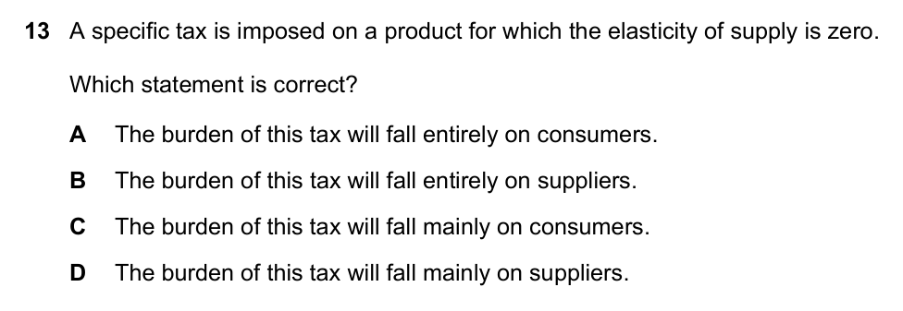
Question 23: Perfectly Inelastic Supply and Tax / 完全无弹性供给与税负
Part 3 | Q21-30
Source: 9708_w24_11 Q13 | Correct: a quarter
Answer: B
B: Zero supply elasticity means a vertical supply curve. Unit tax does not reduce quantity, so suppliers bear tax.
B：供给弹性为零，即供给曲线垂直；单位税不减少供给量，税负由供给者承担。

Slide 27
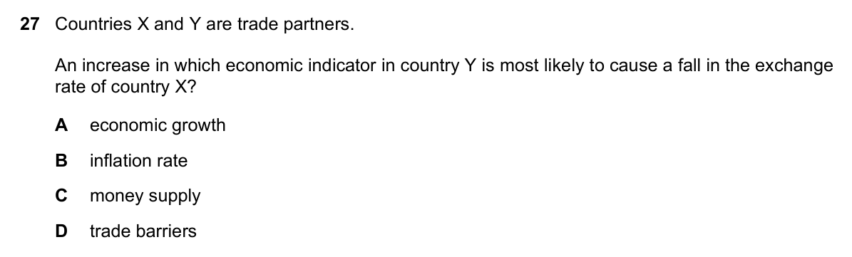
Question 24: Exchange Rate Reciprocity / 汇率的相互关系
Part 3 | Q21-30
Source: 9708_w24_11 Q27 | Correct: a quarter
Answer: D
D: Higher trade barriers in country Y reduce imports, causing Y's currency to appreciate and X/Y exchange rate to fall.
D：Y国提高贸易壁垒减少进口，Y货币升值，X相对Y汇率下降。

Slide 28
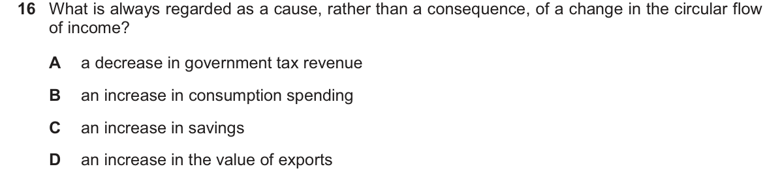
Question 25: Injections in the Circular Flow / 循环流量中的注入
Part 3 | Q21-30
Source: 9708_s25_14 Q16 | Correct: just over a quarter
Answer: D
D: Exports are injections: foreign spending enters the domestic circular flow, increasing income.
D：出口是注入：来自海外支出进入国内循环流量，增加收入。

Slide 29
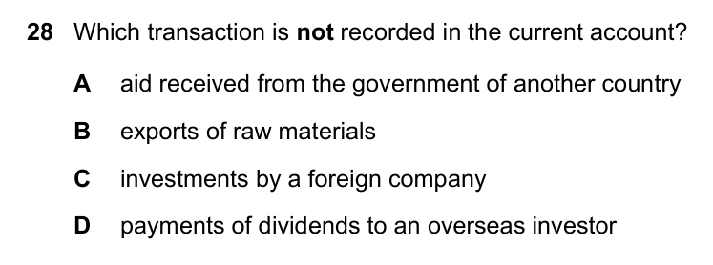
Question 26: Current Account Components / 经常账户组成
Part 3 | Q21-30
Source: 9708_w24_11 Q28 | Correct: just over a quarter
Answer: C
C: Foreign investment is recorded in the financial account; the question asks which is not in the current account.
C：外国投资属于金融账户，本题问哪项不计入经常账户。

Slide 30
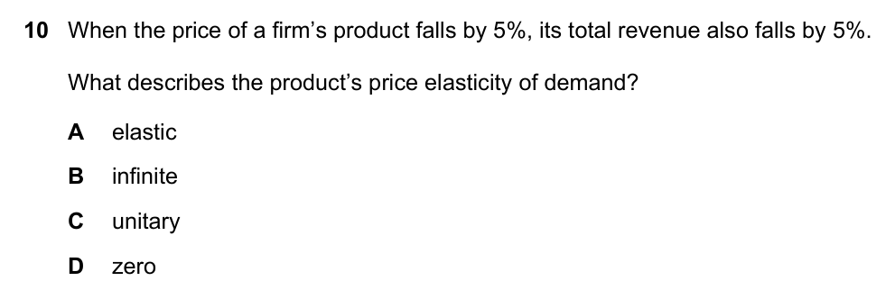
Question 27: Zero PED and Total Revenue / 零需求弹性与总收益
Part 3 | Q21-30
Source: 9708_s23_13 Q10 | Correct: 27%
Answer: D
D: Price falls 5% and total revenue falls 5%. Quantity is unchanged, so PED = 0.
D：价格下降5%，总收益下降5%，数量不变，所以需求弹性为零。

Slide 31
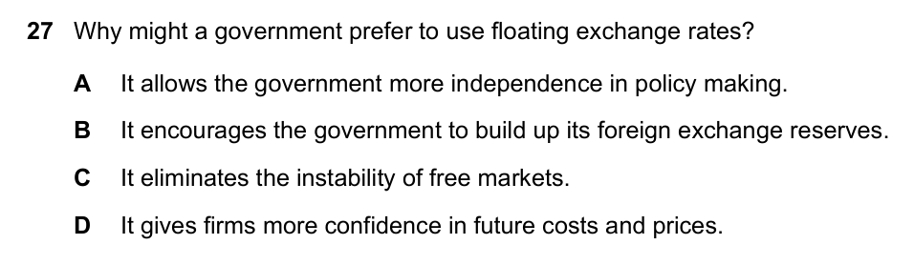
Question 28: Floating Exchange Rate Benefits / 浮动汇率的好处
Part 3 | Q21-30
Source: 9708_m23_12 Q27 | Correct: 28%
Answer: A
A: A floating exchange rate gives policy independence; no need to defend a fixed rate with reserves or interest rates.
A：浮动汇率让政府政策独立，无需用储备或利率维持固定汇率。

Slide 32
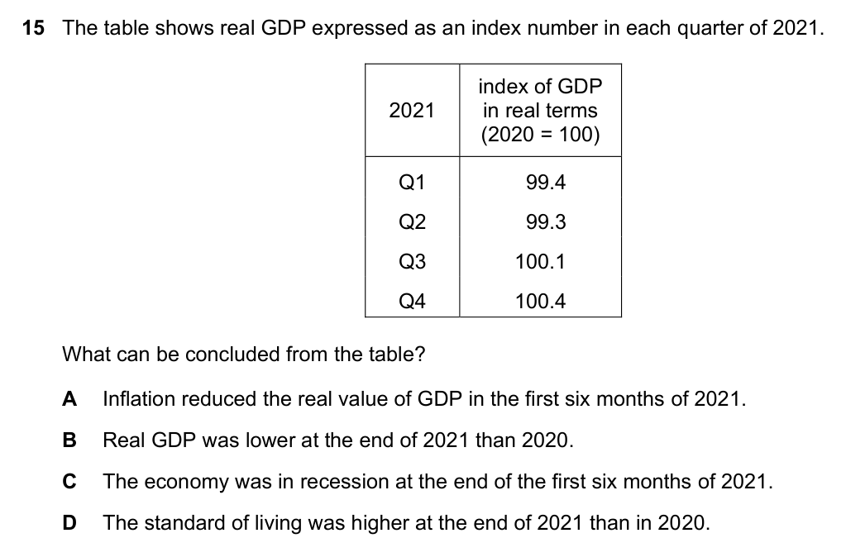
Question 29: Real GDP Index and Recession / 实际GDP指数与衰退
Part 3 | Q21-30
Source: 9708_m24_12 Q15 | Correct: 29%
Answer: C
C: Real GDP falls in two consecutive quarters, indicating a technical recession.
C：实际GDP连续两个季度下降，表示技术性衰退。

Slide 33
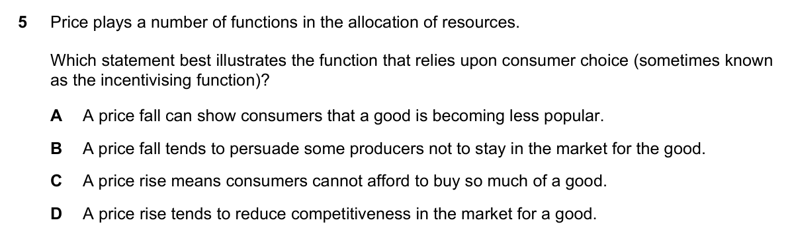
Question 30: Incentivising Function of Price / 价格的激励功能
Part 3 | Q21-30
Source: 9708_s23_12 Q5 | Correct: 29%
Answer: B
B: Price falls reduce producer rewards, so some producers leave the market.
B：价格下降降低生产者回报，部分生产者退出市场。

Slide 34
Answer Key - Part 4: Questions 31-40
Use after students have attempted this set.
Q31 D
Q36 B
Q32 B
Q37 C
Q33 D
Q38 D
Q34 B
Q39 C
Q35 C
Q40 D
Cambridge AS Economics 9708 Paper 1 - difficult MCQ review

Slide 35
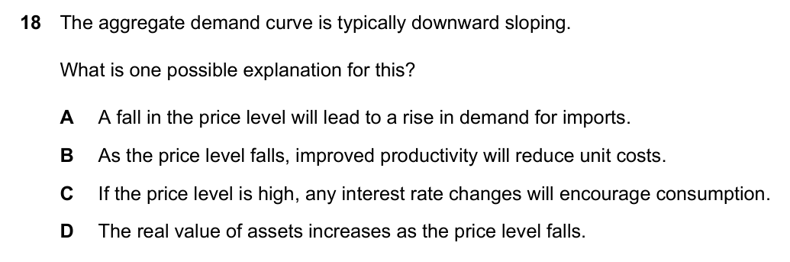
Question 31: Why AD Slopes Downward / 总需求曲线为何向下倾斜
Part 4 | Q31-40
Source: 9708_s25_12 Q18 | Correct: <30%
Answer: D
D: Wealth effect: a lower price level raises the real value of assets, increasing spending and AD.
D：财富效应：价格下降提高资产实际价值，促进消费，总需求增加。

Slide 36
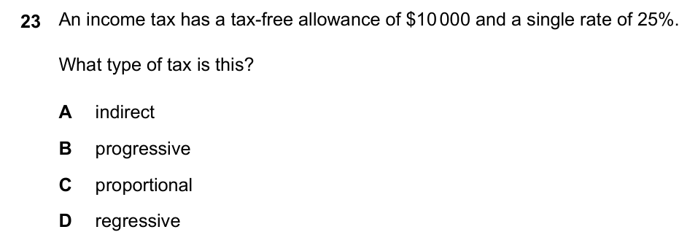
Question 32: Tax-Free Allowance and Progressivity / 免税额与累进税
Part 4 | Q31-40
Source: 9708_s25_12 Q23 | Correct: <30%
Answer: B
B: A tax-free allowance gives low earners a lower average tax rate; average tax rises with income, so it is progressive.
B：免税额使低收入者平均税率低，收入上升平均税率升，所以是累进税。

Slide 37
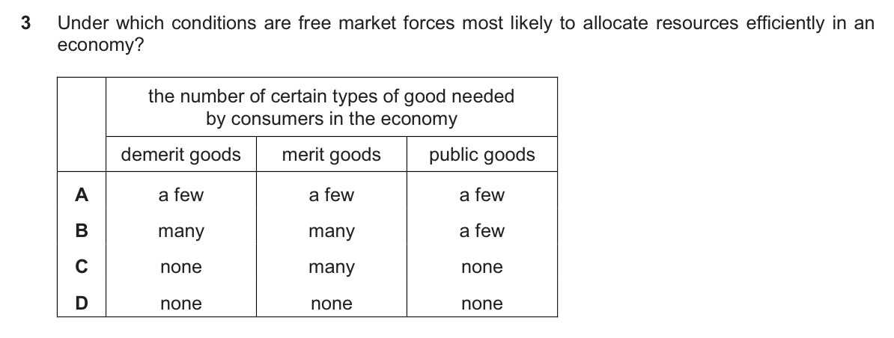
Question 33: Free Markets and Market Failure / 自由市场与市场失灵
Part 4 | Q31-40
Source: 9708_s25_14 Q3 | Correct: <30%
Answer: D
D: Free markets allocate efficiently when no public, merit, or demerit goods cause market failure.
D：自由市场在不存在公共物品、优效品或有害品导致市场失灵时最有效配置资源。

Slide 38
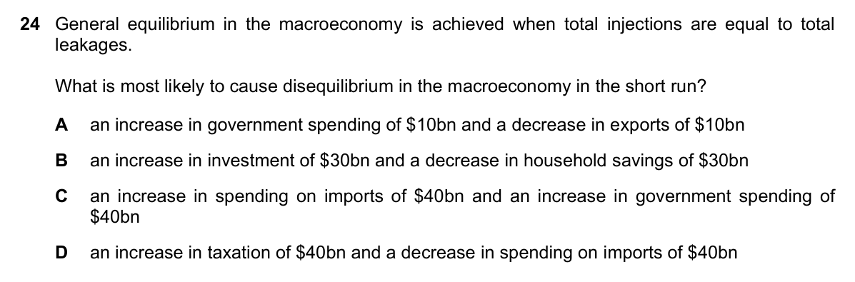
Question 34: Injections vs Withdrawals / 注入与漏出
Part 4 | Q31-40
Source: 9708_w23_11 Q24 | Correct: 30%
Answer: B
B: Investment is an injection, saving is a withdrawal. Higher investment and lower saving create the largest disequilibrium.
B：投资为注入，储蓄为漏出；投资增加、储蓄减少造成最大失衡。

Slide 39
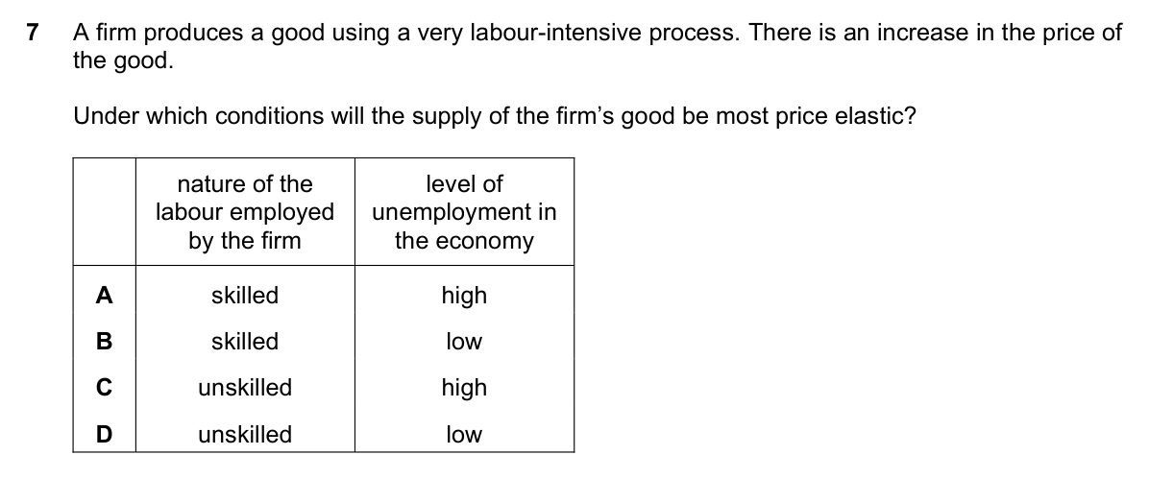
Question 35: Elastic Supply & Labour / 弹性供给与劳动力
Part 4 | Q31-40
Source: 9708_w24_12 Q7 | Correct: <=30%
Answer: C
C: Unskilled labour and high unemployment let a labour-intensive firm hire extra workers quickly when price rises.
C：非熟练劳动力和高失业率使劳动密集型企业在价格上涨时快速增加工人和产量。

Slide 40
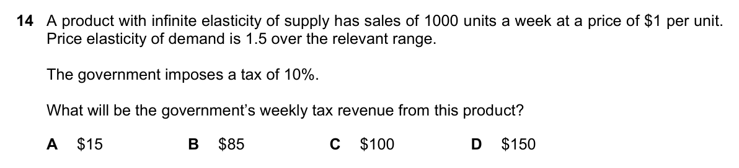
Question 36: Tax Revenue with Elastic Supply / 弹性供给下的税收收入
Part 4 | Q31-40
Source: 9708_w24_12 Q14 | Correct: <=30%
Answer: B
B: Tax is $0.10 per unit; demand falls to 850 units, so tax revenue is $85.
B：税额0.10美元/单位，需求降至850，所以税收收入为85美元。

Slide 41
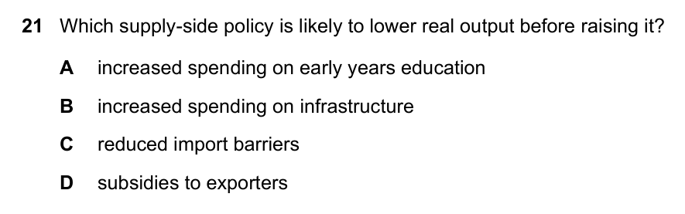
Question 37: Supply-Side Policy Effects / 供给侧政策影响
Part 4 | Q31-40
Source: 9708_w24_12 Q21 | Correct: <=30%
Answer: C
C: Reducing import barriers raises imports short term, lowering AD, but improves efficiency and supply potential long term.
C：降低进口壁垒短期提高进口、减少总需求，长期提高效率和供给潜力。

Slide 42
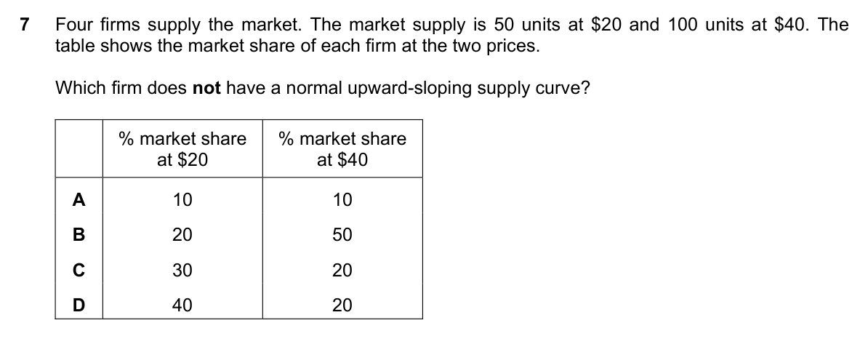
Question 38: Supply Schedule and Vertical Supply / 供给表与垂直供给
Part 4 | Q31-40
Source: 9708_s24_11 Q7 | Correct: 31%
Answer: D
D: Firm D supplies 20 units at both prices, so its supply curve is vertical.
D：D企业两个价格下供给均为20，所以供给曲线垂直。

Slide 43
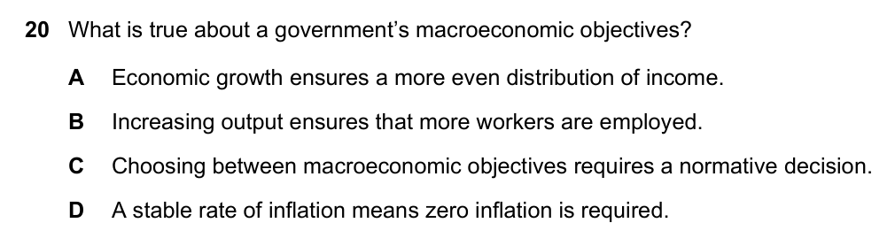
Question 39: Macroeconomic Trade-Offs / 宏观目标权衡
Part 4 | Q31-40
Source: 9708_s24_12 Q20 | Correct: 31%
Answer: C
C: Governments must choose between objectives such as growth, inflation, unemployment, and distribution.
C：政府需在增长、通胀、失业和分配等目标之间取舍。

Slide 44
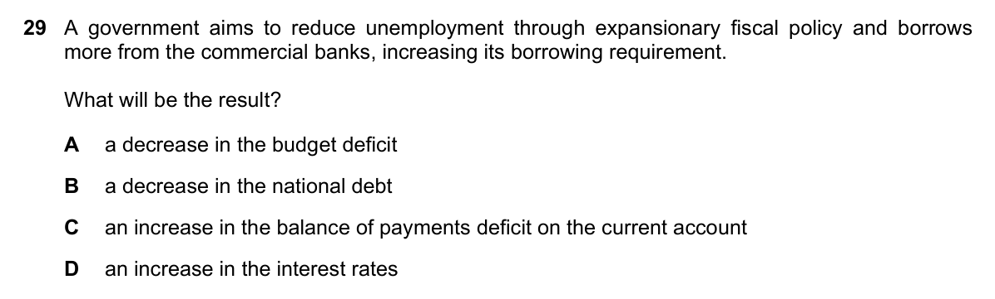
Question 40: Government Borrowing and Interest Rates / 政府借款与利率
Part 4 | Q31-40
Source: 9708_w23_13 Q29 | Correct: 31%
Answer: D
D: Higher government borrowing means more bonds, lower bond prices, and higher interest rates or yields.
D：政府借款增加，发行更多债券，债券价格下降，利率或收益率上升。

Slide 45
Answer Key - Part 5: Questions 41-50
Use after students have attempted this set.
Q41 C
Q46 A
Q42 C
Q47 D
Q43 D
Q48 B
Q44 A
Q49 D
Q45 C
Q50 C
Cambridge AS Economics 9708 Paper 1 - difficult MCQ review

Slide 46
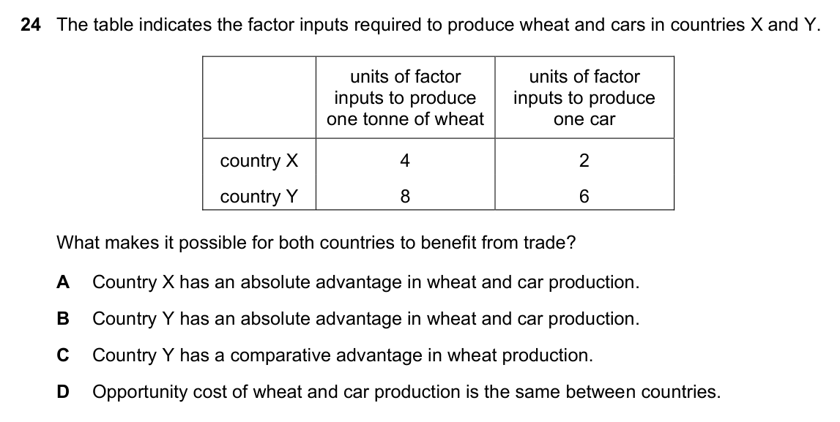
Question 41: Comparative vs Absolute Advantage / 比较与绝对优势
Part 5 | Q41-50
Source: 9708_m24_12 Q24 | Correct: 32%
Answer: C
C: Country Y is relatively less inefficient at wheat than cars, so it has comparative advantage in wheat.
C：Y国生产小麦相对不那么低效，所以在小麦上有比较优势。

Slide 47
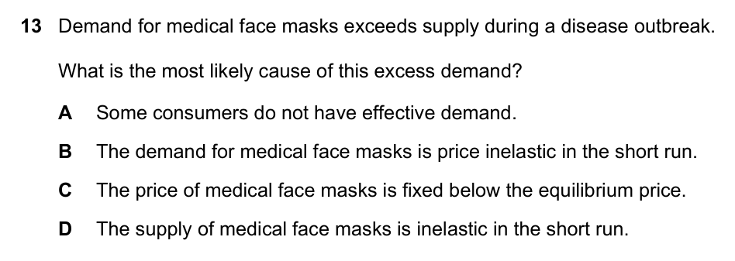
Question 42: Excess Demand and Disequilibrium / 超额需求与失衡
Part 5 | Q41-50
Source: 9708_s23_11 Q13 | Correct: 32%
Answer: C
C: Excess demand occurs when price is below equilibrium, so quantity demanded is greater than quantity supplied.
C：价格低于均衡时，需求量大于供给量，出现超额需求。

Slide 48
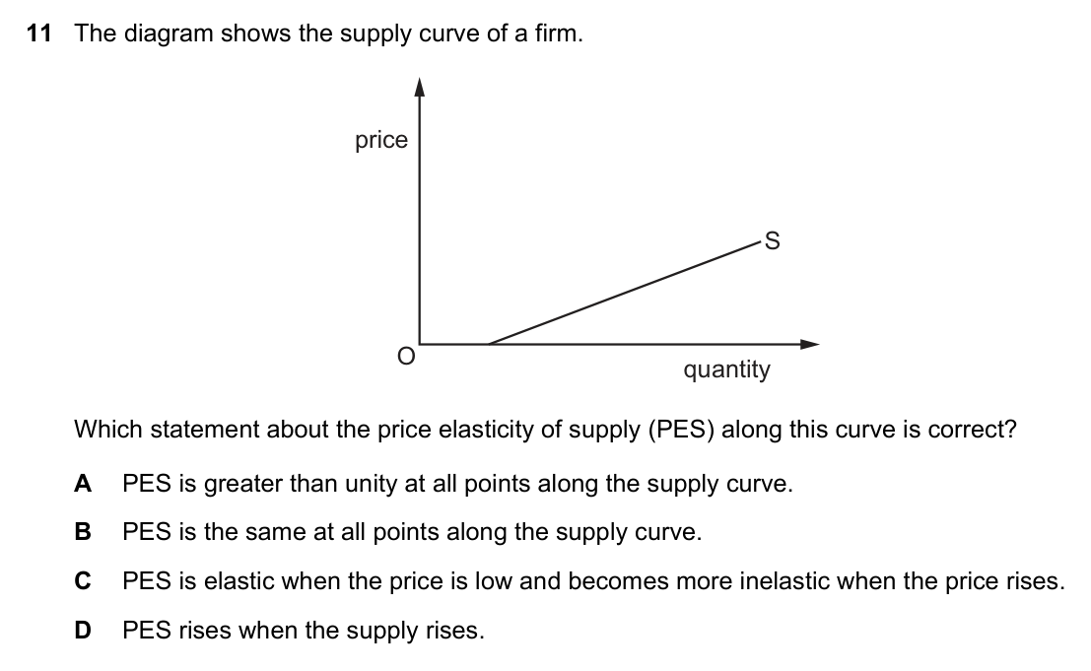
Question 43: PES Along a Supply Curve / 供给曲线上的PES
Part 5 | Q41-50
Source: 9708_s23_12 Q11 | Correct: 33%
Answer: D
D: The shape and intercept of the supply curve affect PES as price rises; do not generalize from upward slope alone.
D：供给曲线形状和截距影响价格上升时PES变化，不能只看上升倾斜。

Slide 49
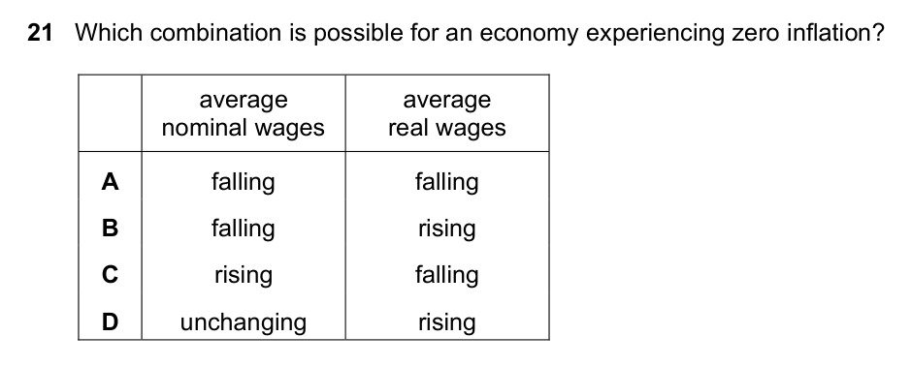
Question 44: Real vs Nominal Wages / 实际与名义工资
Part 5 | Q41-50
Source: 9708_w23_12 Q21 | Correct: 33%
Answer: A
A: If the price level is unchanged, a fall in nominal wages is also a fall in real wages.
A：价格水平不变时，名义工资下降也就是实际工资下降。

Slide 50
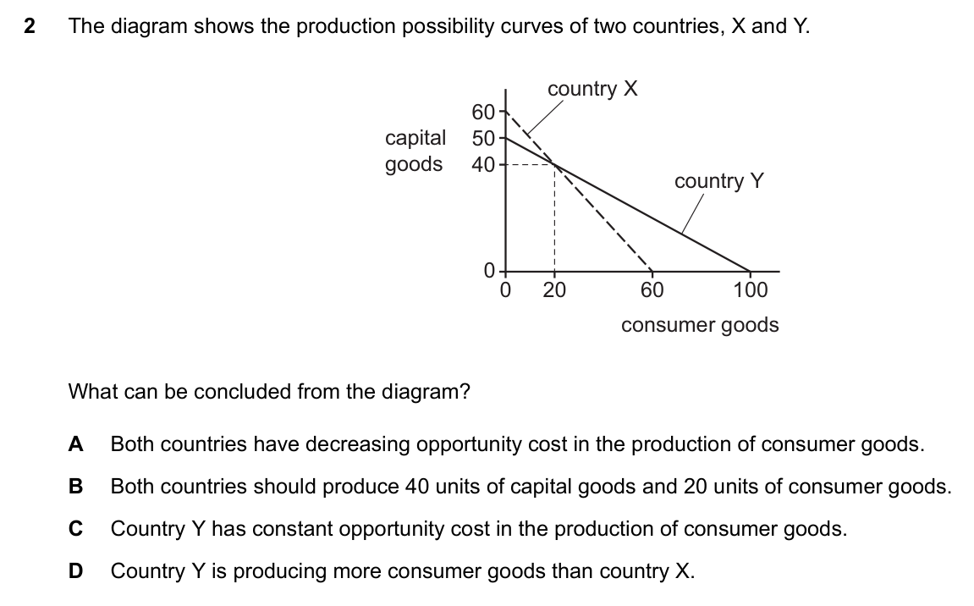
Question 45: Reading a PPC Correctly / 正确解读PPC
Part 5 | Q41-50
Source: 9708_s25_11 Q2 | Correct: <1/3
Answer: C
C: A straight-line PPC means constant opportunity cost; it shows what a country can produce, not what it will produce.
C：直线PPC表示机会成本恒定，显示国家能生产什么，不表示一定会生产什么。

Slide 51
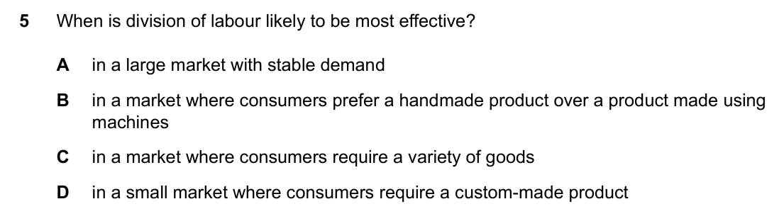
Question 46: When Division of Labour Works / 分工何时最有效
Part 5 | Q41-50
Source: 9708_m25_12 Q5 | Correct: a third
Answer: A
A: A large, stable market allows repeated specialized tasks, making division of labour most effective.
A：大而稳定的市场支持重复、专业化任务，使分工最有效。

Slide 52
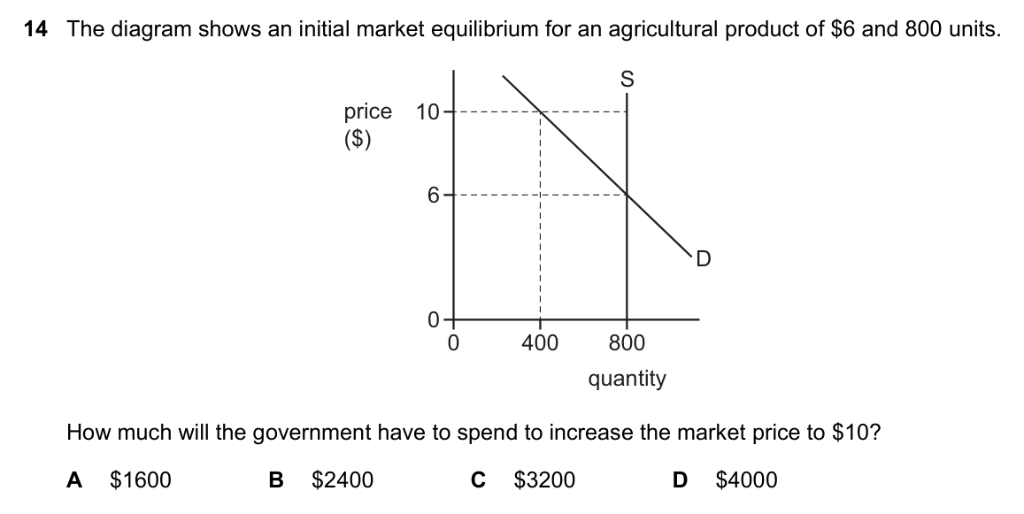
Question 47: Government Purchases to Raise Price / 政府购买以提高价格
Part 5 | Q41-50
Source: 9708_s24_12 Q14 | Correct: a third
Answer: D
D: Government buys enough output to reach the target equilibrium; expenditure = target price times units purchased.
D：政府购买足够产量达到目标均衡；支出=目标价格乘以购买量。

Slide 53
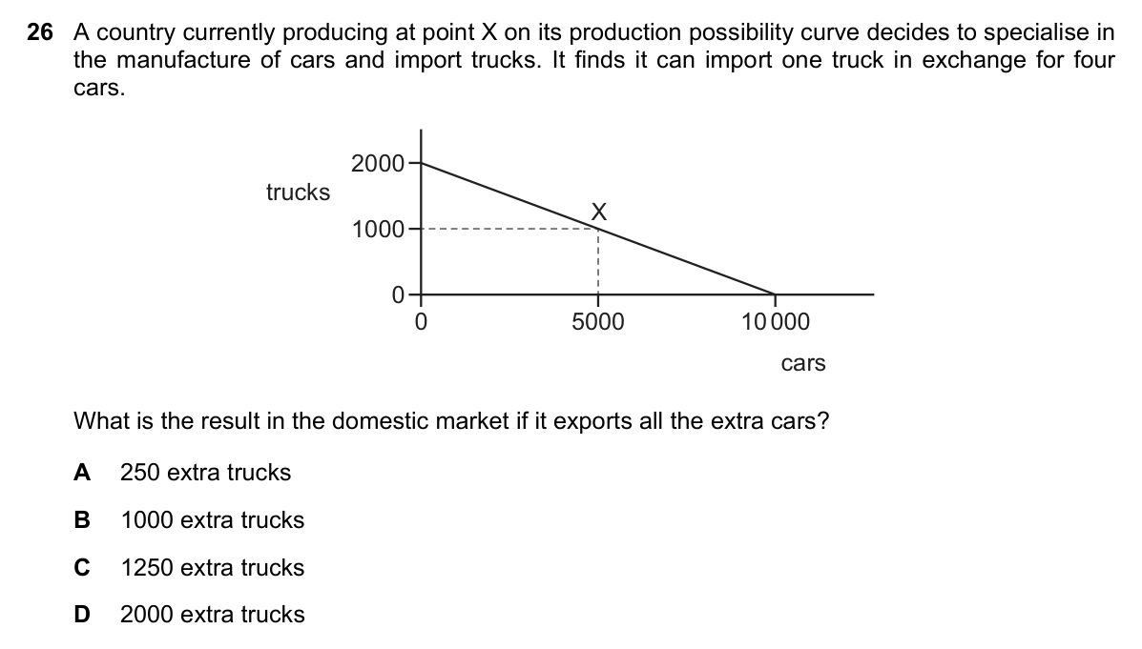
Question 48: Specialisation and Extra Imports / 专业化与额外进口
Part 5 | Q41-50
Source: 9708_w24_13 Q26 | Correct: a third
Answer: B
B: After specializing and trading, X receives 1250 trucks but gave up 1000, so the extra gain is 250.
B：专业化并贸易后X国得到1250辆卡车，但放弃1000辆，所以额外获得250辆。

Slide 54
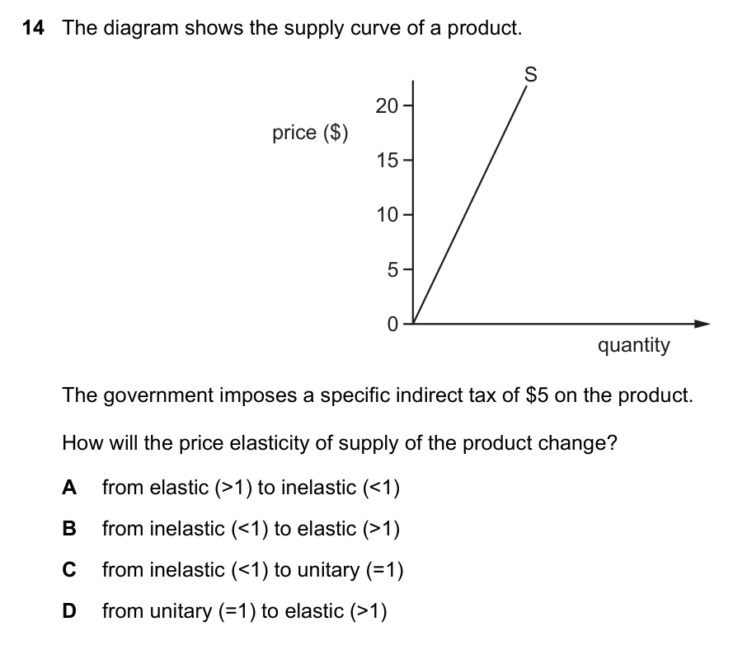
Question 49: Indirect Tax and PES Change / 间接税与PES变化
Part 5 | Q41-50
Source: 9708_s24_13 Q14 | Correct: just over a third
Answer: D
D: A straight-line supply curve through the origin has unitary PES; a specific tax shifts the curve, changing elasticity.
D：通过原点的直线供给曲线为单位弹性；单位税使曲线移动，弹性关系变化。

Slide 55
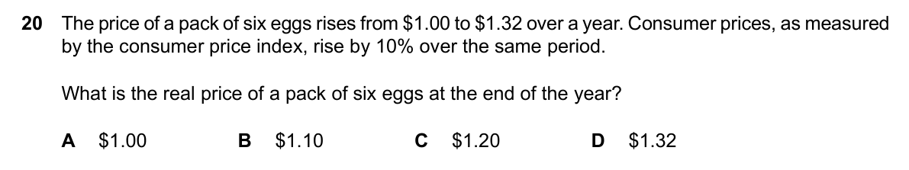
Question 50: Real Price and CPI Deflator / 实际价格与CPI平减
Part 5 | Q41-50
Source: 9708_s25_11 Q20 | Correct: just over a third
Answer: C
C: Nominal price rises to $1.32 while general prices rise 10%, so real price = 1.32/1.10 = $1.20.
C：名义价格涨至1.32美元，总体价格上涨10%，所以实际价格=1.32/1.10=1.20美元。

Slide 56
Answer Key - Part 2: Questions 11-20
Use after students have attempted this set.
Q11 A
Q16 B
Q12 C
Q17 D
Q13 D
Q18 A
Q14 D
Q19 C
Q15 A
Q20 C
Cambridge AS Economics 9708 Paper 1 - difficult MCQ review

Slide 57
Answer Key - Part 3: Questions 21-30
Use after students have attempted this set.
Q21 D
Q26 C
Q22 A
Q27 D
Q23 B
Q28 A
Q24 D
Q29 C
Q25 D
Q30 B
Cambridge AS Economics 9708 Paper 1 - difficult MCQ review

Slide 58
Answer Key - Part 4: Questions 31-40
Use after students have attempted this set.
Q31 D
Q36 B
Q32 B
Q37 C
Q33 D
Q38 D
Q34 B
Q39 C
Q35 C
Q40 D
Cambridge AS Economics 9708 Paper 1 - difficult MCQ review

