Slide 1
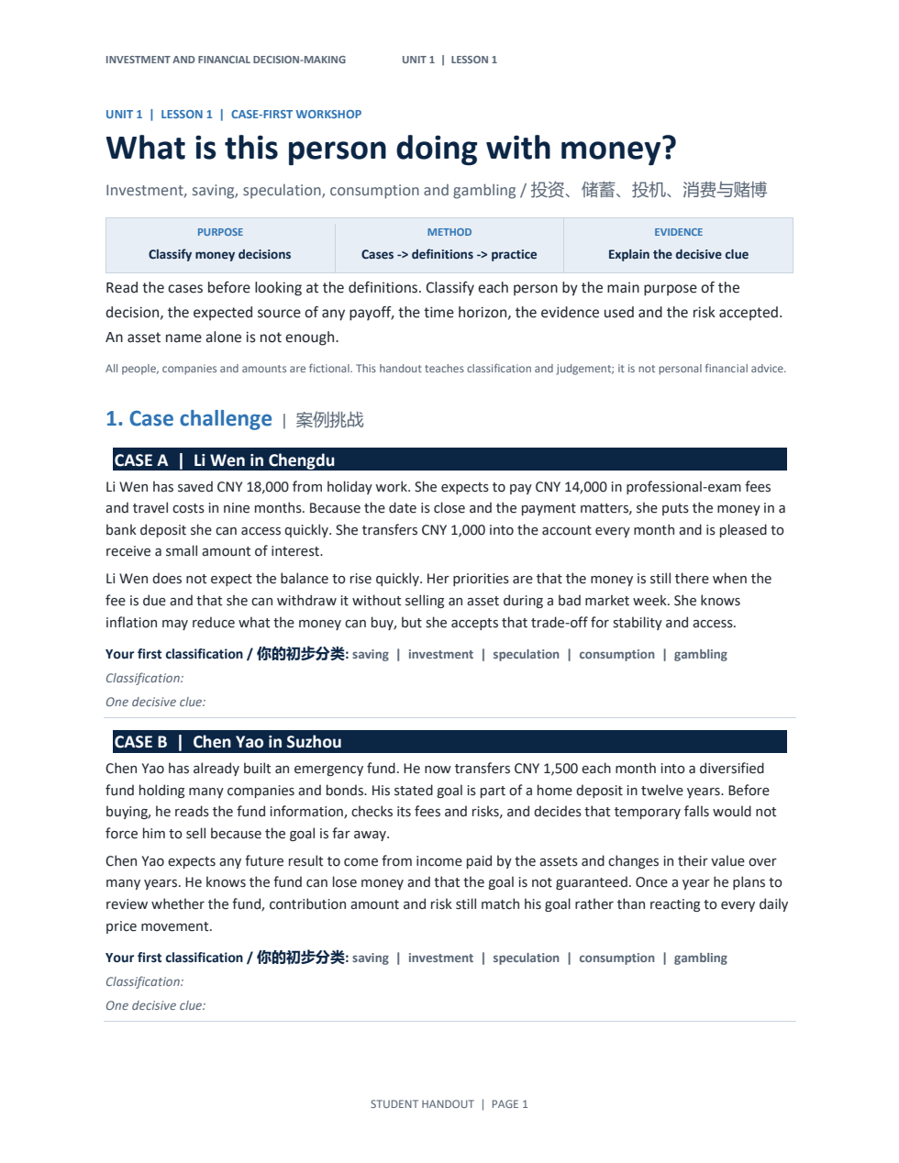
INVESTMENT COURSE · UNIT 1 · LESSON 1
What is this person
doing with money?
这个人在如何使用金钱？
A case-first lesson on saving, investment, speculation, consumption and gambling
GRADE 9 · HANDOUT-CENTERED WORKSHOP
Notes:
Suggested time: 1 minute. Hand out the worksheet before revealing any definitions. Ask students to keep the first page open. The lesson question is the same as the handout title.
[Sources]
- file:///C:/Users/oehle/Documents/oehler-huang-platform/apps/library/investment-analysis/handouts/unit-1-lesson-1-money-decisions-handout.docx

Slide 2
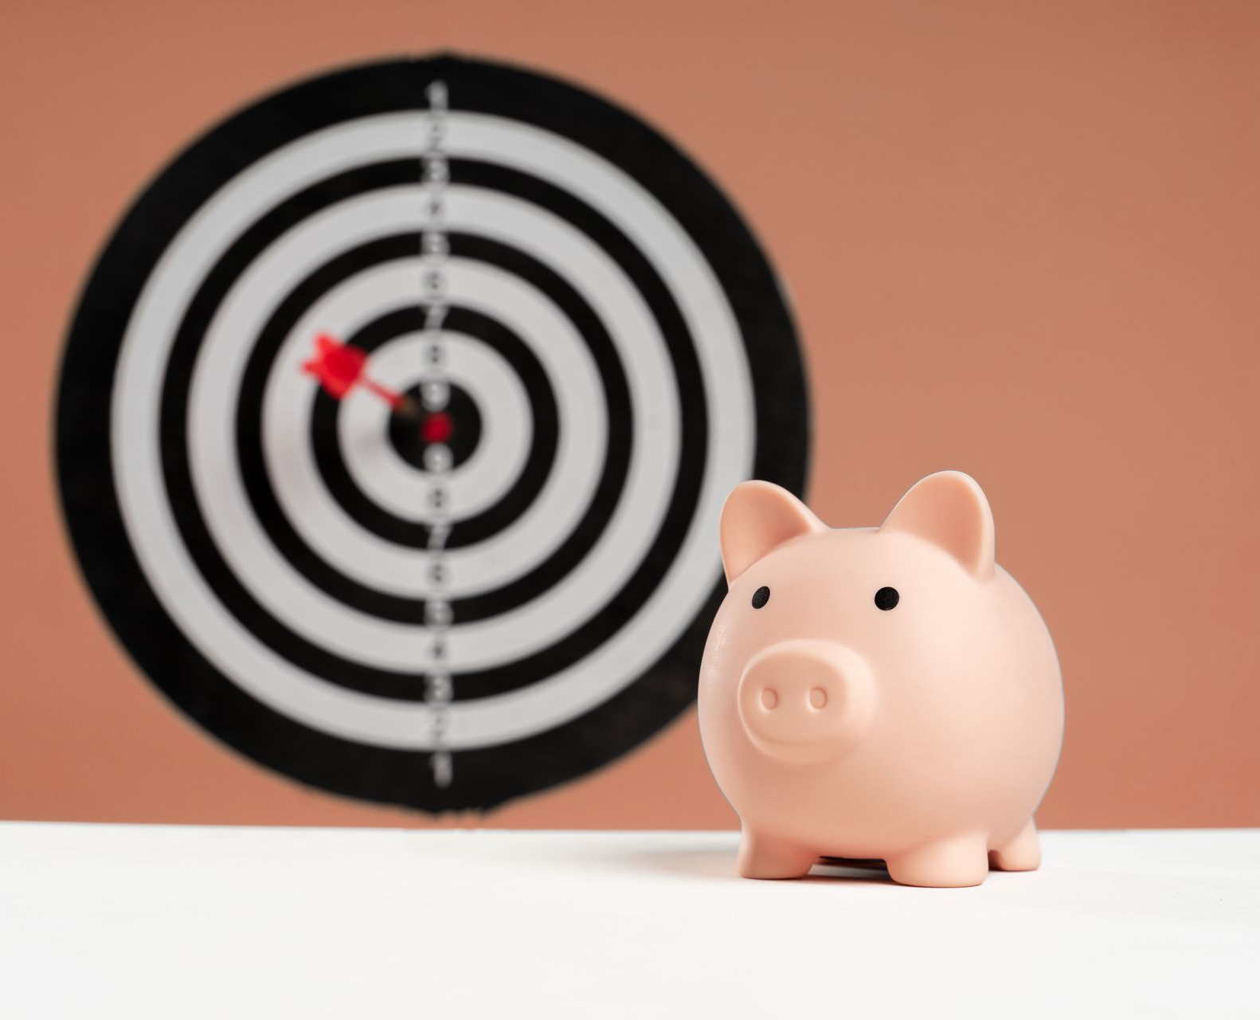
HOOK · 先判断
One action. Five possible purposes.
同一个“花钱”动作，可能有五种目的
A student puts CNY 1,000 aside.
What extra information would you need before you classify the decision?
01
purpose / 目的
02
time / 时间
03
payoff source / 回报来源
04
risk / 风险
INVESTMENT & FINANCIAL DECISION-MAKING
02
Notes:
Suggested time: 3 minutes. Think-pair-share. Do not accept 'saving' yet unless the student states what information would make that classification strong. Collect the four information types shown.
[Sources]
- file:///C:/Users/oehle/Documents/oehler-huang-platform/apps/library/investment-analysis/handouts/unit-1-lesson-1-money-decisions-handout.docx
- https://www.pexels.com/photo/a-piggy-bank-on-the-table-12357524/

Slide 3
TODAY'S TARGETS · 学习目标
By the end, you can…
本课结束时，你能够……
01
Classify / 分类
identify the main type of money decision from a case
02
Explain / 解释
use a decisive clue about purpose, payoff, time, evidence or risk
03
Compare / 比较
show why a nearby category is weaker—even when the asset is the same
INVESTMENT & FINANCIAL DECISION-MAKING
03
Notes:
Suggested time: 2 minutes. Read the three objectives only. Tell students that every written answer today must include a classification and evidence.
[Sources]
- file:///C:/Users/oehle/Documents/oehler-huang-platform/apps/library/investment-analysis/handouts/unit-1-lesson-1-money-decisions-handout.docx

Slide 4
RETRIEVAL · 先写后说
Write first. Then compare.
先独立写，再比较
01
What makes a goal usable?
什么使财务目标可用于决策？
02
Where can an investment return come from?
投资回报可能来自哪里？
03
Why can a loss matter more for one person than another?
为什么同样的损失对不同的人影响不同？
Use the handout margin. No definitions yet.
在讲义空白处作答；先不要看定义。
INVESTMENT & FINANCIAL DECISION-MAKING
04
Notes:
Suggested time: 2 minutes. Accept partial recall. Return to these questions after the five-question classifier. Useful answers: a goal states use, amount, priority and time; return can come from income and/or value change; loss matters relative to the goal and the person's risk capacity.
[Sources]
- file:///C:/Users/oehle/Documents/oehler-huang-platform/apps/library/investment-analysis/handouts/unit-1-lesson-1-money-decisions-handout.docx

Slide 5
CASE A · TRY FIRST · 先判断
Li Wen in Chengdu
成都的李雯
HANDOUT PAGE 1 · WRITE ONE DECISIVE CLUE
CNY 18,000 saved; CNY 14,000 needed in nine months
Money stays in a bank deposit that is easy to access
Small interest is welcome, but stability and access matter most
She accepts inflation risk to avoid a shortfall at the payment date
Your classification / 你的分类
saving
investment
speculation
consumption
gambling
储蓄
投资
投机
消费
赌博
INVESTMENT & FINANCIAL DECISION-MAKING
05
Notes:
Suggested time: 3 minutes. Students classify individually on page 1, then compare one clue with a partner. Do not reveal the label until several clues have been heard. Strong clues: money needed soon, access required, principal preservation is the main purpose.
[Sources]
- file:///C:/Users/oehle/Documents/oehler-huang-platform/apps/library/investment-analysis/handouts/unit-1-lesson-1-money-decisions-handout.docx

Slide 6
CASE A · REVEAL · 解释
Saving is the strongest classification.
最强分类：储蓄
Income set aside for future use, usually in cash or a liquid, relatively low-risk product. The main purpose is access and principal preservation—not a large uncertain return.
SAVING
储蓄
DECISIVE CLUE / 决定性线索
EXAMPLES / 例子
The payment is near, important and must remain available.
1. emergency cash / 应急现金
2. fees due in nine months / 九个月后到期的费用
3. near-term travel fund / 近期旅行资金
INVESTMENT & FINANCIAL DECISION-MAKING
06
Notes:
Suggested time: 3 minutes. Model judgement: 'Li Wen's decision is mainly saving because she needs the money in nine months and keeps it accessible. The benefit is stability plus small interest. It is not mainly investment because she is not accepting market risk to seek a larger future return.' Mention inflation as a remaining risk.
[Sources]
- file:///C:/Users/oehle/Documents/oehler-huang-platform/apps/library/investment-analysis/handouts/unit-1-lesson-1-money-decisions-handout.docx
- https://www.investor.gov/

Slide 7
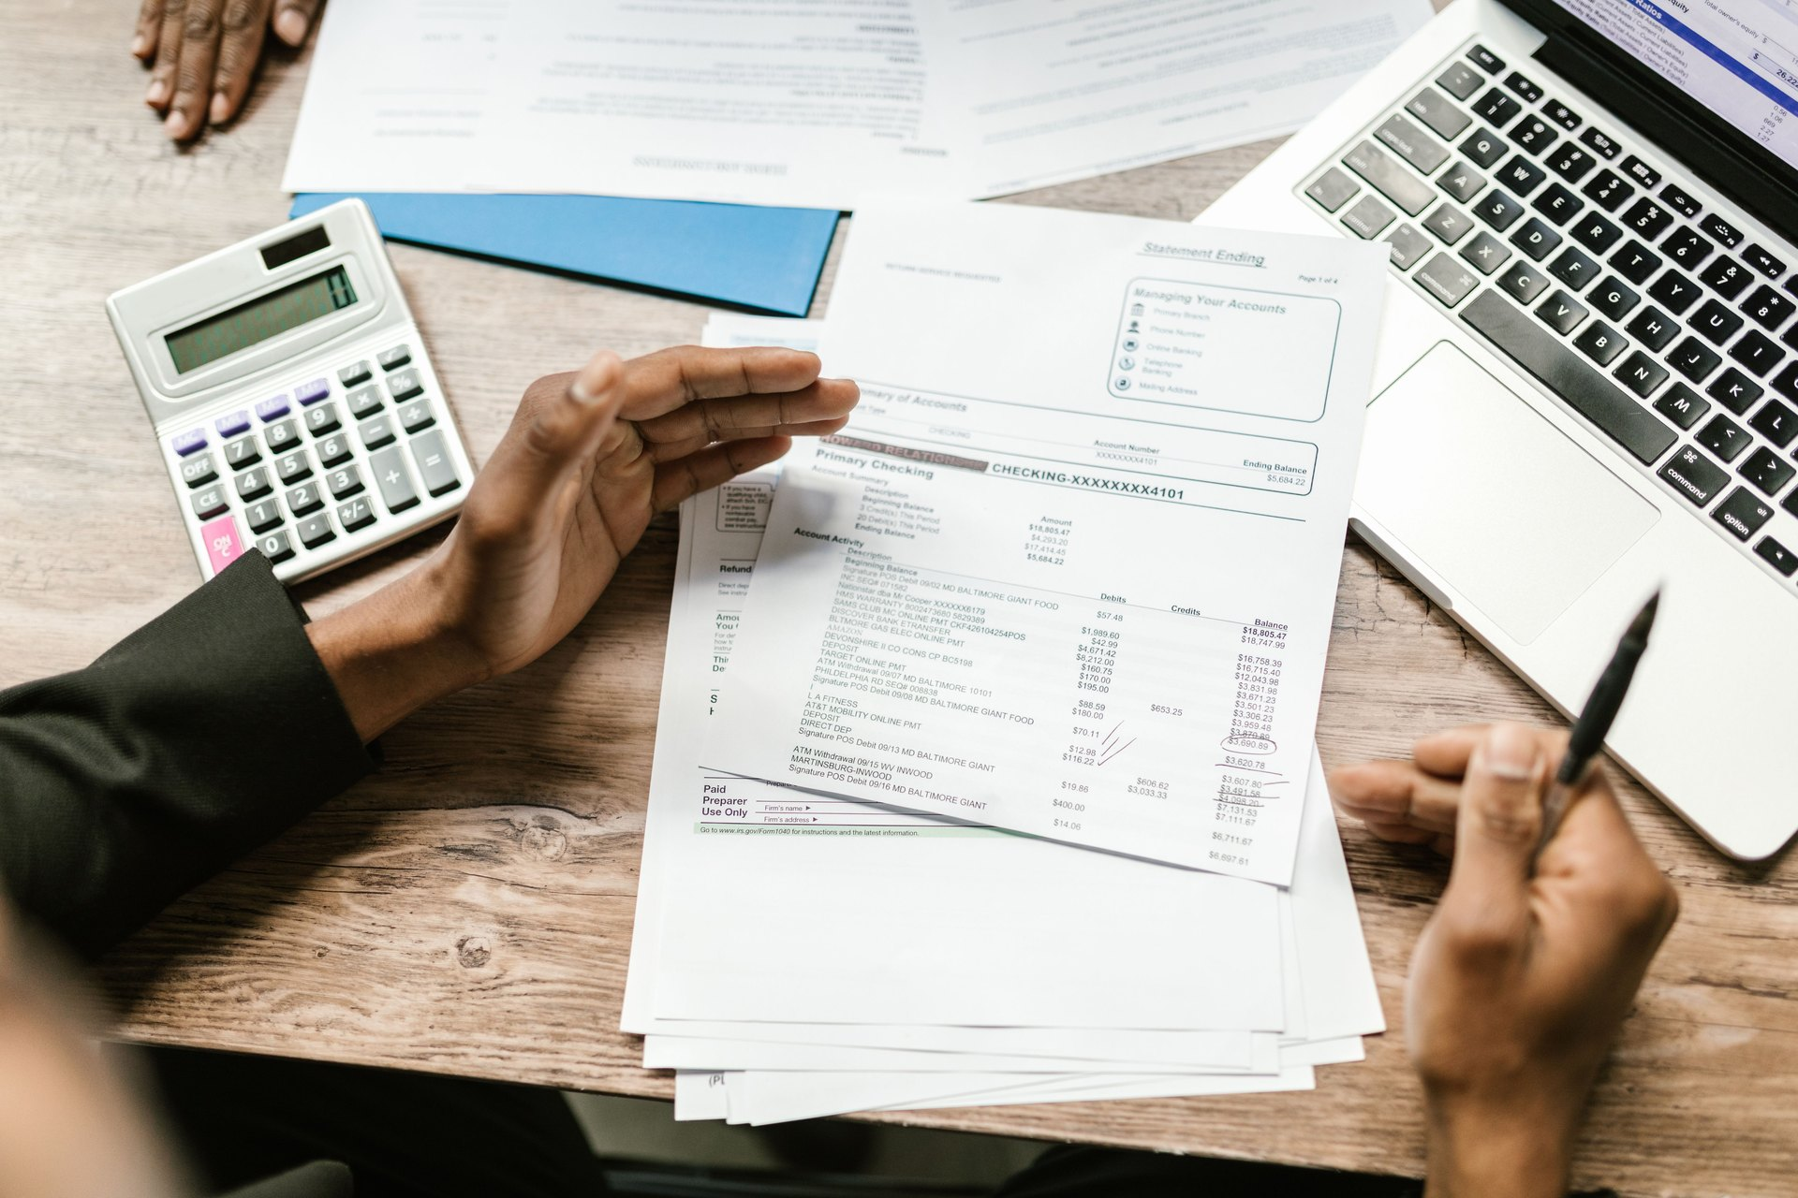
CASE B · TRY FIRST · 先判断
Chen Yao in Suzhou
苏州的陈尧
CNY 1,500 each month into a diversified fund
Home-deposit goal in twelve years
Checks fees, risks and fund information
Accepts temporary falls; return may come from income and value change
Which clue is decisive—not merely the fund name?
决定性线索是什么，而不是产品名称？
INVESTMENT & FINANCIAL DECISION-MAKING
07
Notes:
Suggested time: 3 minutes. Students classify and underline two clues on page 1. Ask what return Chen expects and why the twelve-year horizon matters.
[Sources]
- file:///C:/Users/oehle/Documents/oehler-huang-platform/apps/library/investment-analysis/handouts/unit-1-lesson-1-money-decisions-handout.docx
- https://www.pexels.com/photo/white-papers-on-the-table-7821708/

Slide 8
CASE B · REVEAL · 解释
Investment is the strongest classification.
最强分类：投资
Money put into an asset to seek future return while accepting uncertainty and possible loss. Return can come from income and/or a change in the asset's value.
INVESTMENT
投资
DECISIVE CLUE / 决定性线索
EXAMPLES / 例子
A real asset, a long goal, evidence, and accepted possible loss.
1. diversified fund for a 12-year goal / 十二年目标的分散基金
2. bond held for interest / 为利息持有债券
3. shares analysed for long-run growth / 分析后长期持股
INVESTMENT & FINANCIAL DECISION-MAKING
08
Notes:
Suggested time: 3 minutes. Model judgement: 'Chen Yao's decision is mainly investment because he buys a diversified asset for a twelve-year goal after checking risk and fees. Return is expected from asset income and long-run value change. It is not mainly speculation because the plan does not depend on a rapid price prediction.'
[Sources]
- file:///C:/Users/oehle/Documents/oehler-huang-platform/apps/library/investment-analysis/handouts/unit-1-lesson-1-money-decisions-handout.docx
- https://www.investor.gov/introduction-investing

Slide 9
BOUNDARY · 比较
Saving is not investment.
储蓄并不等于投资
SAVING / 储蓄
INVESTMENT / 投资
MAIN PURPOSE
preserve + access
MAIN PURPOSE
seek future return
TYPICAL HORIZON
nearer needs
TYPICAL HORIZON
often longer goals
ACCESS
usually high
ACCESS
may require selling
RISK PATTERN
inflation still matters
RISK PATTERN
value can rise or fall
PAYOFF SOURCE
interest, if any
PAYOFF SOURCE
income + value change
INVESTMENT & FINANCIAL DECISION-MAKING
09
Notes:
Suggested time: 3 minutes. Students explain which side better matches Li Wen and Chen Yao. Stress that saving can earn interest and investment can be cautious; the classification follows the main purpose and risk pattern.
[Sources]
- file:///C:/Users/oehle/Documents/oehler-huang-platform/apps/library/investment-analysis/handouts/unit-1-lesson-1-money-decisions-handout.docx
- https://www.investor.gov/

Slide 10
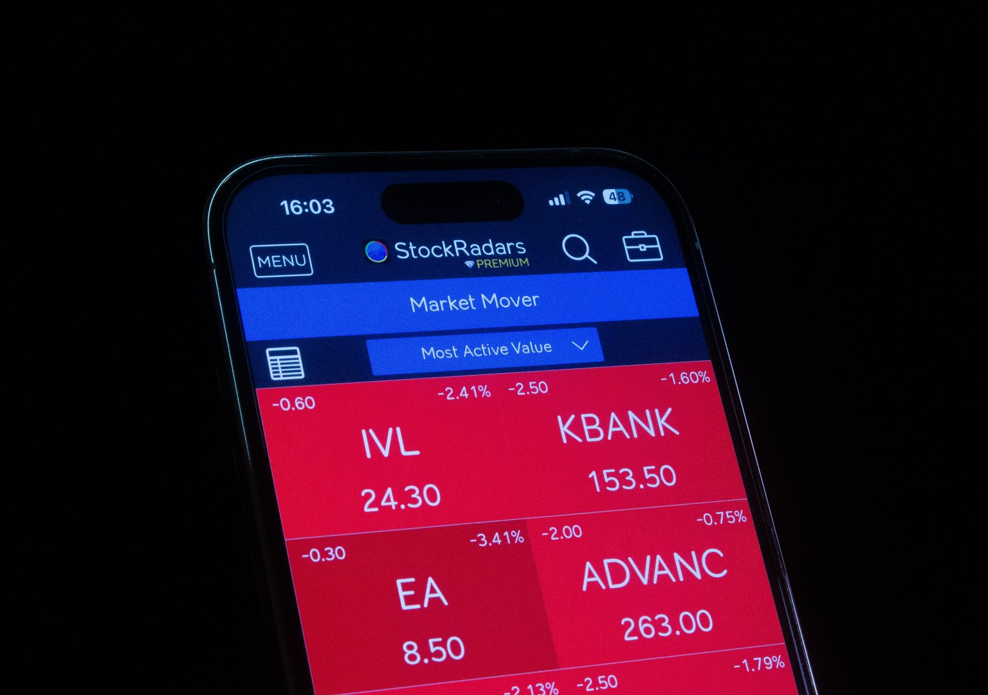
CASE C · TRY FIRST · 先判断
Peng Jie in Wuhan
武汉的彭杰
Unverified livestream rumour about a secret contract
Borrows CNY 20,000 and buys one small technology company
Plans to sell within days if other buyers push the price higher
A loss could make loan repayment difficult
What is the hoped-for payoff actually depending on?
预期回报实际上取决于什么？
INVESTMENT & FINANCIAL DECISION-MAKING
10
Notes:
Suggested time: 2 minutes. Students classify on the handout before discussing. Push past 'he bought shares' to the price-prediction mechanism, weak evidence, borrowing, concentration and scale of possible loss.
[Sources]
- file:///C:/Users/oehle/Documents/oehler-huang-platform/apps/library/investment-analysis/handouts/unit-1-lesson-1-money-decisions-handout.docx
- https://www.pexels.com/photo/smartphone-display-of-stock-market-application-28682350/

Slide 11
CASE C · REVEAL · 解释
Speculation is the strongest classification.
最强分类：投机
Substantial risk taken mainly in hope of profiting from an anticipated price move or uncertain event. Common clues include a short horizon, concentration, leverage and weak evidence.
SPECULATION
投机
DECISIVE CLUE / 决定性线索
EXAMPLES / 例子
The hoped-for gain depends mainly on a rapid price prediction under high uncertainty.
1. borrowed-money rumour trade / 借钱听传言交易
2. one-day price bet / 一天的价格押注
3. concentrated position without research / 无研究的集中持仓
INVESTMENT & FINANCIAL DECISION-MAKING
11
Notes:
Suggested time: 3 minutes. Model judgement: 'Peng Jie's decision is mainly speculation because borrowed money and an unverified rumour support a concentrated short-term price bet. The hoped-for return comes from other buyers pushing the price higher. It is not mainly investment because the decision is not grounded in a long-term goal or business evidence.'
[Sources]
- file:///C:/Users/oehle/Documents/oehler-huang-platform/apps/library/investment-analysis/handouts/unit-1-lesson-1-money-decisions-handout.docx
- https://www.finra.org/rules-guidance/notices/18-24
- https://www.cftc.gov/LearnAndProtect/AdvisoriesAndArticles/CFTCGlossary/index.htm

Slide 12
CASES D + E · TRY FIRST · 先判断
Two purchases. Two very different benefits.
两次购买，两种完全不同的收益
CASE D · Lin Xia
CASE E · Zhou Ming
案例 D · 林霞
案例 E · 周明
CNY 8,000 camera for a family trip
CNY 200 sports-lottery tickets
Main benefit: personal use and enjoyment
Prize follows match outcomes and lottery rules
No clients, business plan or profit intention
No ownership of a team, business or productive asset
Classification + clue / 分类 + 线索?
Classification + clue / 分类 + 线索?
INVESTMENT & FINANCIAL DECISION-MAKING
12
Notes:
Suggested time: 3 minutes. Pairs divide the cases, then teach each other. Require the source of benefit or payoff—not simply the purchased item.
[Sources]
- file:///C:/Users/oehle/Documents/oehler-huang-platform/apps/library/investment-analysis/handouts/unit-1-lesson-1-money-decisions-handout.docx

Slide 13
CASES D + E · REVEAL · 解释
Consumption uses. Gambling stakes.
消费用于当下；赌博押注结果
CONSUMPTION / 消费
GAMBLING / 赌博
Money spent mainly for present use, need or enjoyment—not future financial return.
Money or value staked on a game, event or lottery for a possible prize governed by rules and odds.
EXAMPLES / 例子
EXAMPLES / 例子
1. camera for family photos / 家庭摄影相机
1. sports lottery / 体育彩票
2. school running shoes / 校队跑鞋
2. roulette stake / 轮盘赌注
3. meal or transport / 餐饮或交通
3. paid prize draw / 付费抽奖
INVESTMENT & FINANCIAL DECISION-MAKING
13
Notes:
Suggested time: 3 minutes. Model D: consumption because the camera's main benefit is personal use. Model E: gambling because the ticket offers a rule-based chance at a prize and no ownership claim. Clarify that careful shopping does not turn consumption into investment, and studying past results does not create productive-asset ownership.
[Sources]
- file:///C:/Users/oehle/Documents/oehler-huang-platform/apps/library/investment-analysis/handouts/unit-1-lesson-1-money-decisions-handout.docx
- https://www.gamblingcommission.gov.uk/public-and-players/guide/page/what-is-gambling

Slide 14
HINGE · 同一资产，不同目的
The asset name is not the classification.
资产名称并不决定分类
LIU FANG
same fictional shares
MA JUN
same fictional shares
part of a diversified portfolio
borrows after a group-chat tip
retirement goal in 20 years
plans to sell within hours
reads reports; limits position size
does not check the company
expects dividends + business growth
loss could damage loan repayment
Classify the decision—not only the product. / 判断决策，而不只是判断产品。
INVESTMENT & FINANCIAL DECISION-MAKING
14
Notes:
Suggested time: 3 minutes. Students vote: Liu Fang = investment; Ma Jun = speculation. Ask for two contrasting dimensions: goal/horizon, evidence, borrowing, expected return source or risk scale.
[Sources]
- file:///C:/Users/oehle/Documents/oehler-huang-platform/apps/library/investment-analysis/handouts/unit-1-lesson-1-money-decisions-handout.docx

Slide 15
TOOL · 五问分类法
Classify with five questions.
用五个问题进行分类
01
Purpose
Preserve, grow, use, wager—or reduce debt?
目的
02
What is received?
Asset, accessible cash, good/service, chance, or smaller liability?
得到什么
03
Payoff source
Asset income/value, short-term price prediction, or game odds?
回报来源
04
Time + access
When is the money needed? Must it remain available?
时间与流动性
05
Loss + evidence
What could be lost? What supports the decision? Could loss damage the goal?
损失与证据
INVESTMENT & FINANCIAL DECISION-MAKING
15
Notes:
Suggested time: 3 minutes. Return to the retrieval diagnostic: a usable goal and the source of return now sit inside the classifier. Students should use these questions in Exercises 1 and 2.
[Sources]
- file:///C:/Users/oehle/Documents/oehler-huang-platform/apps/library/investment-analysis/handouts/unit-1-lesson-1-money-decisions-handout.docx

Slide 16
HANDOUT EXERCISE 1 · 讲义练习一
Revisit all five cases.
重新判断五个案例
COMPLETE THE GRID
For A–E, write:
1
best classification / 最强分类
2
one decisive clue / 一个决定性线索
3
why a nearby category is weaker / 为什么相近分类较弱
Pairs: challenge one answer with a classifier question.
INVESTMENT & FINANCIAL DECISION-MAKING
16
Notes:
Suggested time: 5 minutes. Students complete the Exercise 1 grid. Pair-check protocol: partner asks one classifier question before agreeing. Answers: A saving, B investment, C speculation, D consumption, E gambling. Accept other boundaries only if the strongest classification is justified.
[Sources]
- file:///C:/Users/oehle/Documents/oehler-huang-platform/apps/library/investment-analysis/handouts/unit-1-lesson-1-money-decisions-handout.docx

Slide 17
HANDOUT EXERCISE 2 · TRY · 边界练习
Choose the strongest pattern.
选择最强的分类模式
1
Mei keeps three months of expenses in an accessible bank account for emergencies.
3
Ruo uses margin to trade the same fund during one afternoon after a social-media signal.
classification + decisive clue / 分类 + 线索
classification + decisive clue / 分类 + 线索
4
Lili buys running shoes for school training and expects no financial payoff.
5
Kai pays CNY 20 for a lottery ticket whose prize depends on the draw.
classification + decisive clue / 分类 + 线索
classification + decisive clue / 分类 + 线索
INVESTMENT & FINANCIAL DECISION-MAKING
17
Notes:
Suggested time: 4 minutes. Students answer the four selected rows from Exercise 2. Insist on a reason even when the label seems obvious. Do not reveal until all four are attempted.
[Sources]
- file:///C:/Users/oehle/Documents/oehler-huang-platform/apps/library/investment-analysis/handouts/unit-1-lesson-1-money-decisions-handout.docx

Slide 18
HANDOUT EXERCISE 2 · REVEAL · 核对
Answers need labels and evidence.
答案需要分类与证据
1
SAVING / 储蓄
purpose is emergency access
3
SPECULATION / 投机
margin + one-afternoon price signal
4
CONSUMPTION / 消费
benefit is school use, not financial return
5
GAMBLING / 赌博
prize depends on draw rules and odds
Nearby categories can share features. The main purpose still decides.
INVESTMENT & FINANCIAL DECISION-MAKING
18
Notes:
Suggested time: 3 minutes. Ask students to correct in a different colour. For Ruo, the fund name does not make the decision investment; margin, horizon and price-signal dependence are decisive.
[Sources]
- file:///C:/Users/oehle/Documents/oehler-huang-platform/apps/library/investment-analysis/handouts/unit-1-lesson-1-money-decisions-handout.docx

Slide 19
HINGE CHECK · 关键检查
Which difference matters most?
哪个差异最重要？
Two people buy the same fund. What most clearly could make one decision investment and the other speculation?
两个人购买同一只基金，什么差异最可能使一个是投资，另一个是投机？
A
The fund has the same name in both accounts.
B
Their goals, horizons, evidence, borrowing and expected-return sources differ.
C
Both press the same buy button.
D
The market opens at the same time for both.
INVESTMENT & FINANCIAL DECISION-MAKING
19
Notes:
Suggested time: 2 minutes. Students show A/B/C/D. Correct answer: B. If fewer than about 80% choose B, revisit slide 14 and the five-question classifier before proceeding.
[Sources]
- file:///C:/Users/oehle/Documents/oehler-huang-platform/apps/library/investment-analysis/handouts/unit-1-lesson-1-money-decisions-handout.docx

Slide 20
OUTPUT REHEARSAL · 表达练习
Repair the reasoning.
改进推理
01
“It is investment because shares were bought.”
Add goal, return source, horizon and possible loss.
02
“Saving is safe, so it has no risk.”
Add the purpose of saving and one remaining risk.
03
“Speculation is always the same as gambling.”
Add one similarity and one difference.
INVESTMENT & FINANCIAL DECISION-MAKING
20
Notes:
Suggested time: 4 minutes. Students choose one weak claim and rewrite it in Exercise 5. Sample repairs: shares alone do not determine classification; saving still faces inflation risk; speculation and gambling both involve uncertainty, but speculation can involve asset ownership while gambling payoff follows game/event rules.
[Sources]
- file:///C:/Users/oehle/Documents/oehler-huang-platform/apps/library/investment-analysis/handouts/unit-1-lesson-1-money-decisions-handout.docx

Slide 21
EXIT TICKET · 课堂小结
Make one four-part judgement.
写出一个四部分判断
[Name]’s decision is mainly __________
because ____________________________________.
The expected benefit or return comes from
____________________________________________.
It is not mainly __________ because ______________________.
Choose one case from today. Use the exact sentence frame in the handout.
从今天的案例中任选一个，使用讲义中的完整句型。
INVESTMENT & FINANCIAL DECISION-MAKING
21
Notes:
Suggested time: 3 minutes. Collect or spot-check. Success criteria: strongest label, decisive evidence, payoff/benefit source, and rejection of a nearby category. Use responses to decide whether the follow-up quiz is independent homework or next-lesson retrieval.
[Sources]
- file:///C:/Users/oehle/Documents/oehler-huang-platform/apps/library/investment-analysis/handouts/unit-1-lesson-1-money-decisions-handout.docx

Slide 22
FOLLOW-UP QUIZ · 课后检查
Three questions before the next lesson.
下节课前完成三道题
Which definition includes seeking future return while accepting possible loss?
1
saving · investment · consumption
Why is saving not completely risk-free?
2
inflation · shares · price forecasting
Why is Peng Jie's decision speculation?
3
location · share purchase · borrowed rumour-driven price bet
Then complete Handout Exercise 3, Questions 1–10.
INVESTMENT & FINANCIAL DECISION-MAKING
22
Notes:
Suggested use: independent follow-up or next-lesson retrieval. Answers: 1 investment; 2 inflation can reduce purchasing power; 3 borrowed money plus an unverified rumour supports a concentrated short-term price bet. The full ten-question quiz is in Handout Exercise 3.
[Sources]
- file:///C:/Users/oehle/Documents/oehler-huang-platform/apps/library/investment-analysis/handouts/unit-1-lesson-1-money-decisions-handout.docx

