Slide 1
DB2
Lesson 2: Basics of SQL

Slide 2
Lesson Objectives
To understand the following topics:
SQL, rules for SQL Statements, standard SQL Statement groups
SPUFI- DB2 Interactive function

Slide 3
2.1: SQL What is SQL?
SQL:
SQL stands for Structured Query Language.
SQL is used to communicate with a database.
Statements are used to perform tasks such as update data on a database, or retrieve data from a database.
Benefits of SQL are:
It is a Non-Procedural Language.
It is a language for all users.
It is a unified language.
Notes:
What is SQL?
SQL stands for Structured Query Language.
SQL is a set of commands that allows you to access a Relational Database.
SQL is an ANSI standard computer language.
SQL can execute queries against a database.
SQL can retrieve data from a database.
SQL can insert new records in a database.
SQL can delete records from a database.
SQL can update records in a database.
SQL is easy to learn.
Almost all modern Relational Database Management Systems like MS SQL Server, Microsoft Access, MSDE, Oracle, DB2, Sybase, MySQL, Postgres, and Informix use SQL as standard database language.
However, although all those RDBMS use SQL, they use different SQL dialects.
For example: MS SQL Server specific version of the SQL is called T-SQL, Oracle version of SQL is called PL/SQL which also supports Procedural Language features, MS Access version of SQL is called JET SQL, etc.
SQL is a non-procedural, English-like language that processes data in “groups of records” rather than processing one record at a time.
SQL provides automatic navigation to the data.

Slide 4
2.2: Rules for SQL Statements Explanation
Rules for SQL statements:
SQL keywords are not case sensitive. However, normally all commands (SELECT, UPDATE, etc) are upper-cased.
“Variable” and “parameter” names are displayed as lower-case.
New-line characters are ignored in SQL.
Many DBMS systems terminate SQL statements with a semi-colon character.
“Character strings” and “date values” are enclosed in single quotation marks while using them in WHERE clause or otherwise.

Slide 5
2.3: Standard SQL Statement Groups Tabular Representation
Given below are the standard SQL statement groups:
Groups | Statements | Description
DQL | SELECT | DATA QUERY LANGUAGE – It is used to get data from the database and impose ordering upon it.
DML | DELETE INSERT UPDATE | DATA MANIPULATION LANGUAGE – It is used to change database data.
DDL | DROP CREATE ALTER | DATA DEFINITION LANGUAGE – It is used to manipulate database structures and definitions.
TCL | COMMIT ROLLBACK | TCL statements are used to manage the transactions.
DCL (Rights) | REVOKE GRANT | They are used to remove and provide access rights to database objects.
Notes:
Standard SQL Statement groups:
“SQL commands” are “instructions” used to communicate with the database to perform “specific tasks” that work with data.
A database is a collection of structures with appropriately defined authorizations and accesses. The tables, indexes are structures in the database and are called as “objects” in the database.
The names of tables, indexes, and those of columns are called “identifiers”.
SQL commands can be used not only for searching the database, but also to perform various other functions.
For example: You can create tables, add data to tables, or modify data, drop the table, set permissions for users, etc.

Slide 6
Notes:
Standard SQL Statement groups (contd.)
SQL commands are grouped into four major categories depending on their functionality:
Data Definition Language (DDL): These SQL commands are used for creating, modifying, and dropping the structure of database objects. These SQL statements define the structure of a database, including rows, columns, tables, indexes, and database specifics such as file locations, etc. The commands are CREATE, ALTER, DROP,etc
A CREATE statement in SQL creates an object inside a Relational Database Management System (RDBMS) such as table, index, constraints, etc. The types of objects that can be created depend on which RDBMS is being used. However, most support creation of Tables, Indexes, Users, and Databases.
An ALTER statement in SQL changes the properties of an object inside a Relational Database Management System (RDBMS).
Data Manipulation Language (DML): These SQL commands are used for storing, retrieving, modifying, and deleting data. These commands are SELECT, INSERT, UPDATE, and DELETE.
Transaction Control Language (TCL): These SQL commands are used for managing changes that affect the data. These commands are COMMIT, ROLLBACK.
Data Control Language (DCL): These SQL commands are used for providing security to database objects. These commands are GRANT and REVOKE.
GRANT is used to allow specified users to perform specified tasks.
REVOKE is used to cancel previously granted or denied permissions.

Slide 7
2.1: DB2 Interactive Interface (DB2I) Introduction
The DB2 Interactive interface (DB2i) provides the following:
Ability to execute SQL statements interactively
Ability to invoke prewritten application programs
Ability to issue operator commands
Ability to invoke database utilities
Ability to prepare application programs for execution

Slide 8
2.1: DB2 Interactive Interface (DB2I) Invoking DB2
Log on to TSO and enter ISPF.
From ISPF menu, select DB2I. The DB2I main menu will offer following options.
SPUFI
DCLGEN
Program preparation
Precompile
Bind/rebind/free
Run
DB2 commands
Utilities

Slide 9
2.2: SPUFI Concept of SPUFI
SPUFI supports the interactive execution of SQL statements from a TSO terminal.
You can create a text file containing one or more SQL statements (using the ISPF editor), then execute that file via SPUFI. Subsequently, you can use “ISP Browse” to browse through the results of those statements (which will have been written to another text file).
It is intended primarily for application programmers who wish to test the SQL portions of their programs.
Notes:
SPUFI stands for SQL processing using file input

Slide 10
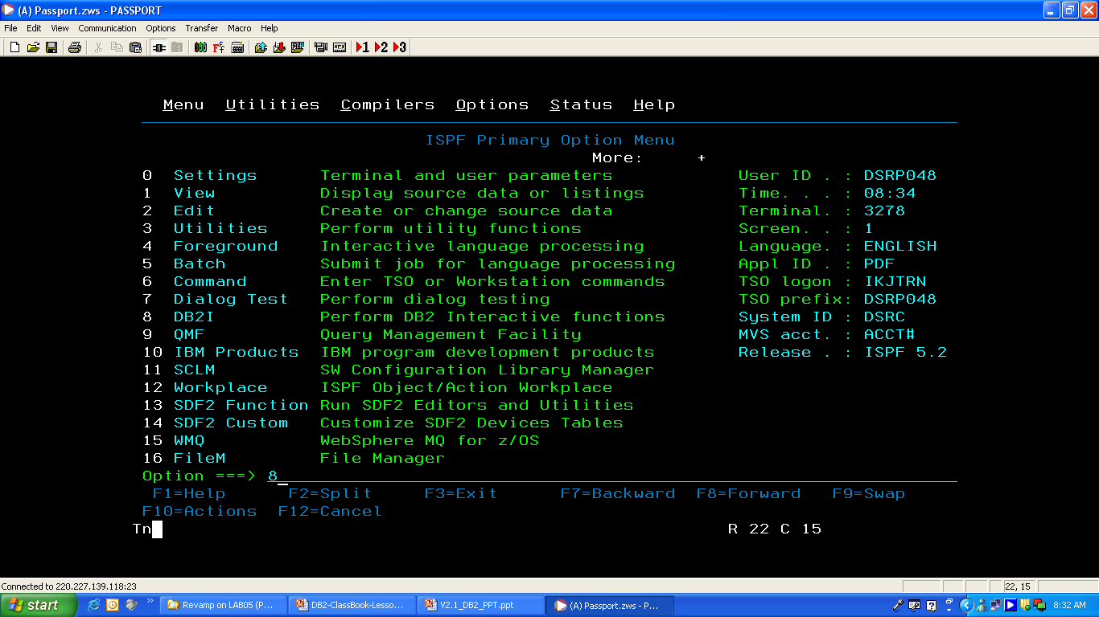
2.2: SPUFI Using SPUFI
Notes:
Note: In ISPF primary option menu, select option 8, that is DB2I.

Slide 11
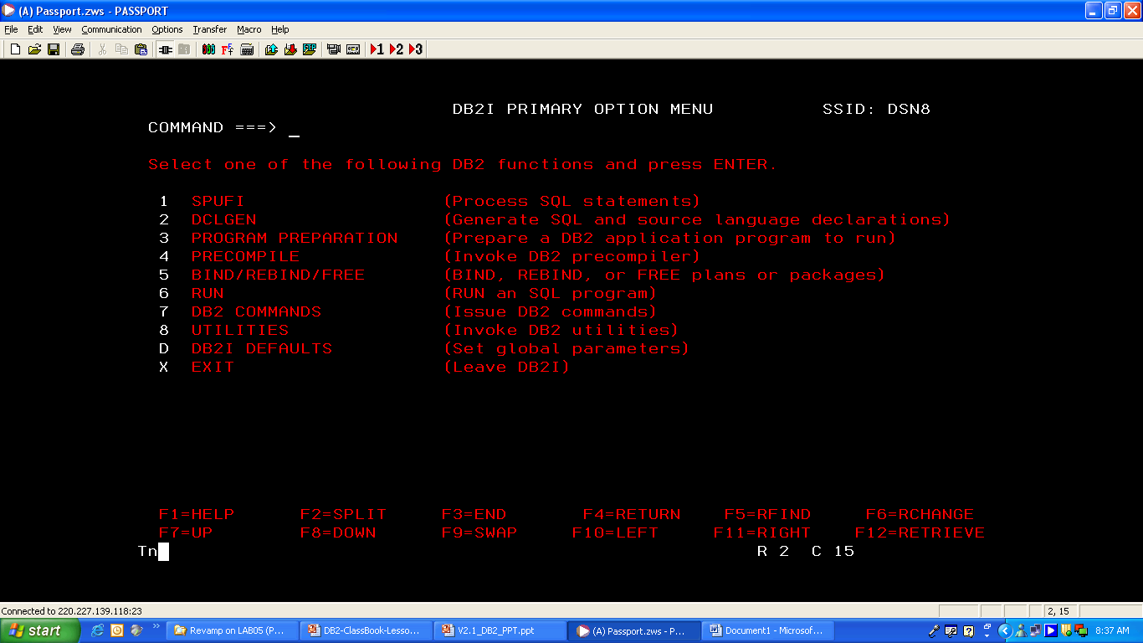
2.2: SPUFI Using SPUFI
Notes:
Note: In DB2I primary option menu, select option 1, that is SPUFI.
On SPUFI screen, enter the input data set name (Can be sequential or partitioned)
Specify processing options.
Write a query and enter ‘END’ command to execute.

Slide 12
Summary
In this lesson, you have learnt:
What is SQL?
Rules for SQL statements
Standard SQL statement groups
SPUFI-DB2 Interactive function

Slide 13
Review Question
Question 1: SQL ___.
Option 1: cannot execute queries against a database.
Option 2: can manipulate data from a database.
Option 3: cannot retrieve data from a database.
Option 4: can insert new records in a database.
Option 5: can delete records from a database.

Slide 14
Review Question
Question 2: SQL categories are ___.
Option 1: DDL
Option 2: DML
Option 3: DSL
Option 4: DQL
Option 5: TCL
Option 6: TDL

