Slide 1
DB2
Lesson 16: Concurrency and Locking

Slide 2
Lesson Objectives
In this lesson, you will learn about:
Concurrency problems:
Lost update problem.
Uncommitted dependency problem.
Inconsistent analysis problem.
How DB2 solves these problems.
Deadlocks

Slide 3
Database Transaction
Transaction is also know as unit of work
It is a recoverable sequence of one or more SQL operations, grouped together as a single unit, usually within an application process.
In single-user environments, each transaction runs serially and doesn't interfere to other transactions.
In multi-user environments, transactions can (and often do) run simultaneously. As a result, each transaction has the potential to interfere with other active transactions.

Slide 4
Database Transaction
Problems with multiple user environments
Lost Update: This occurs when two transactions read and then attempt to update the same data, and one of the updates is lost.
Uncommitted Read: This occurs when a transaction reads data that has not yet been committed.
Non-repeatable Read: This occurs when a transaction reads the same row of data twice, but gets different data values each time.
Phantom Read: This occurs when a row of data that matches search criteria is not seen initially, but then seen in a later read operation.

Slide 5
Isolation levels to maintain concurrency
Maintaining database consistency and data integrity, while allowing more than one application to access the same data at the same time, is known as concurrency.
DB2 attempts to enforce concurrency is through the use of given four isolation levels, which determine how data used in one transaction is locked or isolated from other transactions while the first transaction works with it.
Repeatable read
Read stability
Cursor stability
Uncommitted read

Slide 6
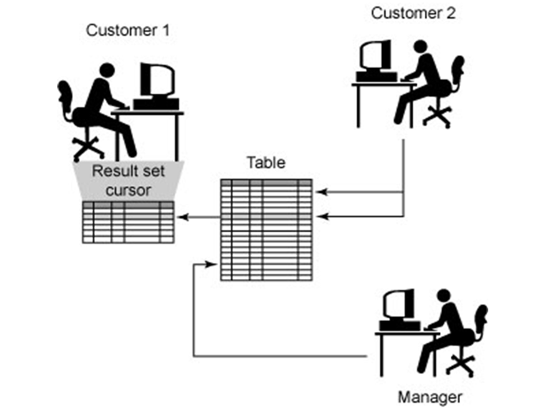
Uncommitted Read (UR)

Slide 7
Uncommitted Read (UR)
Least restrictive isolation level available.
Allows an application to access uncommitted changes of other applications.
When this isolation level is used, rows retrieved by a transaction are only locked if the transaction modifies data associated with one or more rows retrieved or if another transaction drop or alter the table the rows were retrieved from.
When this isolation level is used, dirty reads, non-repeatable reads, and phantoms can occur.
Use it if you're executing queries on read-only tables/views/databases or if it doesn't matter whether a query returns uncommitted data values.

Slide 8
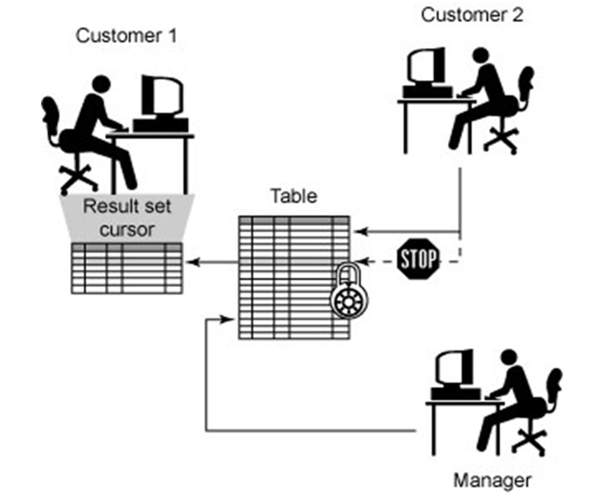
Cursor Stability(CS)

Slide 9
Cursor Stability(CS)
Default isolation level.
This isolation level only locks the row that is currently referenced by a cursor that was declared and opened by the owning transaction. The lock remains in effect until next row is fetched or transaction is terminated.
When this isolation level is used, lost updates and dirty reads cannot occur; non-repeatable reads and phantoms can and may be seen.
Use the Cursor Stability isolation level when you want maximum concurrency between applications, yet you don't want queries to see uncommitted data.

Slide 10
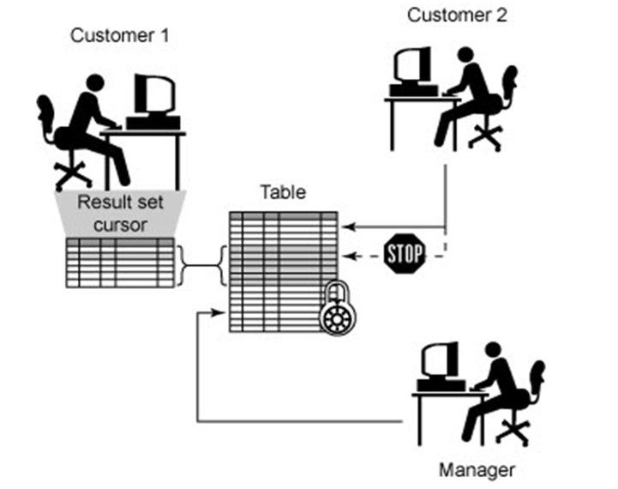
Read Stability(RS)

Slide 11
Read Stability(RS)
When this isolation level is used, only rows that are actually retrieved or modified by the owning transaction are locked.
When this isolation level is used, lost updates, dirty reads, and non-repeatable reads cannot occur; phantoms, however, can and may be seen.
Use the Read Stability isolation level when you want some level of concurrency between applications, yet you also want qualified rows to remain stable for the duration of an individual transaction.

Slide 12
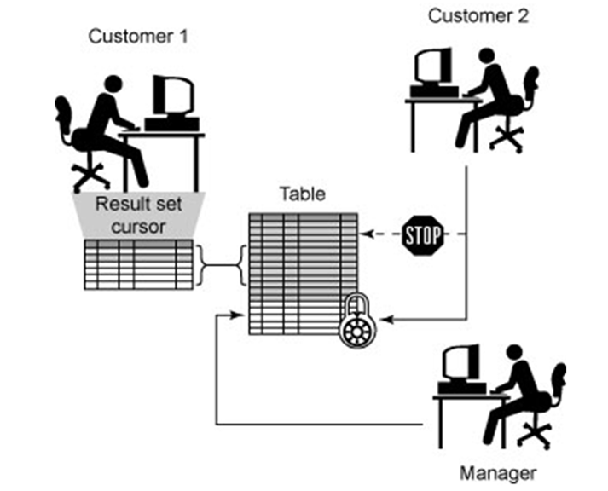
Repeatable Read(RR)

Slide 13
Repeatable Read(RR)
Most restrictive isolation level available
If an entire table or view is scanned in response to a query, the entire table or all table rows referenced by the view are locked. This greatly reduces concurrency, especially when large tables are used.
Lost updates, dirty reads, non-repeatable reads, and phantoms cannot occur.
Use the Repeatable Read isolation level if you're executing large queries and you don't want concurrent transactions to have the ability to make changes that could cause the query to return different results if run more than once.

Slide 14
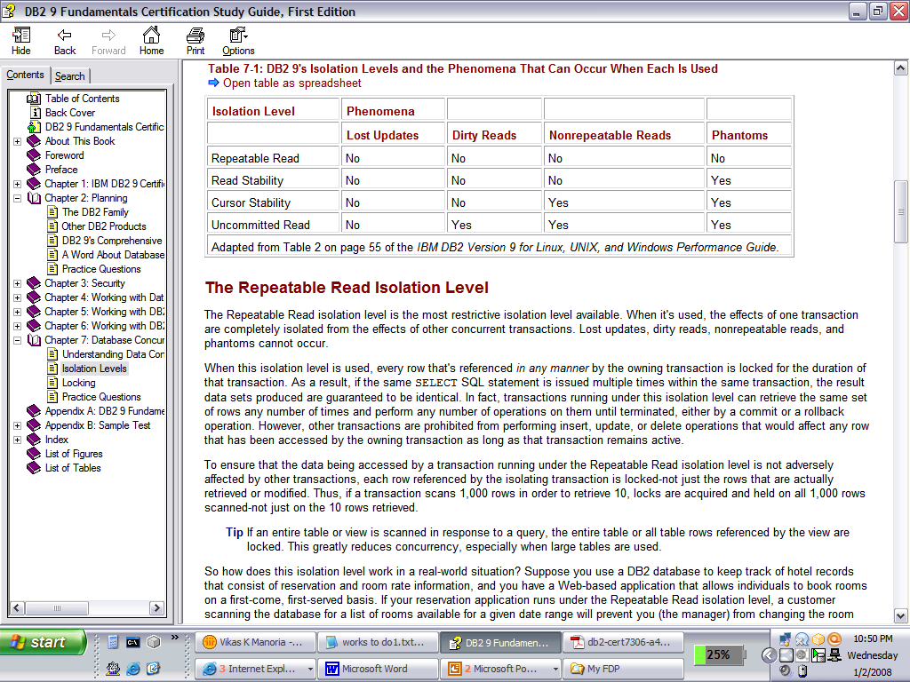
Using isolation levels with queries
Specifying isolation levels with queries
Syntax:
SELECT statement to set a specific query's isolation level to Repeatable Read (RR), Read Stability (RS), Cursor Stability (CS), or Uncommitted Read (UR).
Example:
SELECT * FROM employee WHERE empid = 109124 WITH RR

Slide 15
Locking
DB2’s concurrency control mechanism is based on a technique called locking.
When a transaction needs assurance that the object it is interested does not change in some unpredictable manner during execution, it acquires a lock on that object to prevent it from changing.
A lock is a mechanism that is used to associate a data resource with a single transaction, for the sole purpose of controlling how other transactions interact with that resource while it is associated with the transaction that has it locked.
Notes:
DB2’s concurrency control mechanism is based on a technique called locking. The basic idea of locking is simple: when a transaction needs and assurance that some of the object it is interested in typically a database row - will not change in some unpredictable manner while its back is turned , it acquires a lock on that object and there by to prevent them from changing it. The first transaction is thus able to carry out its processing in the certain knowledge that the object in question will remain in stable state for as long as that transaction wishes it to
The two types of locks that can be placed are shared lock(S) and exclusive lock (X). We assume that if a transaction requests a lock that is currently not available , the transaction simply waits until it is. In practice, the installation can specify a maximum wait time ; then if any transaction ever reaches this threshold in waiting for a lock, it “times out” and the lock request fails ( a negative SQLCODE is returned)

Slide 16
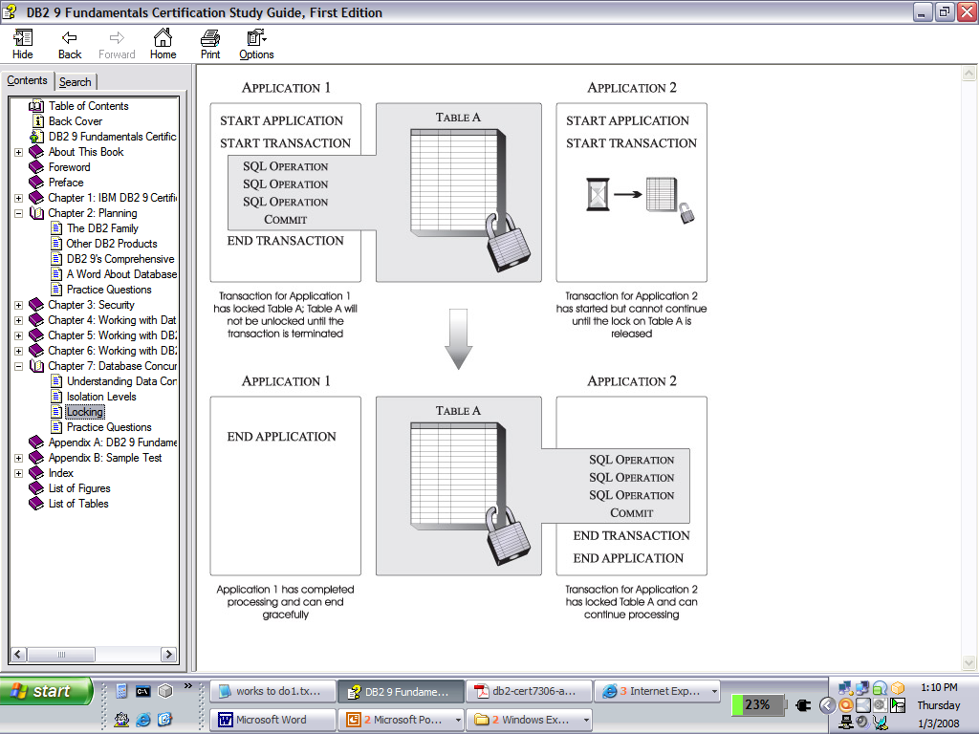
Locking

Slide 17
16.2: How Does DB2 Solve the Three Concurrency Problems? Explanation: Locking
The effect of the lock is to lock other transactions out of the object and thereby prevent it from changing.
Important locks are
Shared locks (S locks)
Exclusive locks (X locks)
Shared locks (S locks)
Exclusive locks (X locks)

Slide 18
16.2: How Does DB2 Solve the Three Concurrency Problems? Explanation: Locking
An application pgm may access a row in a db2 table in order to perform an update.
Application pgm takes a period of time to process the row information, move new values to columns to be updated, issue the statement to update the database and commit the data.
While data is changed, but not yet committed, DB2 places a lock on the data in the table.

Slide 19
16.2: How Does DB2 Solve the Three Concurrency Problems? Explanation: Compatibility Matrix
A
B X S
X N N
S N Y
Notes:
From the compatibility matrix , two inferences can be drawn:
If transaction A holds an X lock on row R , then a request from transaction B for a lock of either type on R causes B to go into a wait state. B will wait until A’s lock is released.
If transaction A hold a shared lock (S) lock on row R , then A request from transaction B for an X lock on R causes B to go into a wait state (and B will wait until A’s lock is released).
A request from transaction B for an S lock on R is granted (that is , B also holds an S lock on R).
Transaction requests for row locks are always implicit. When a transaction successfully fetches a row , it automatically acquires an S lock on that row. When a transaction successfully updates a row, it automatically acquires and X lock on that row. If it already holds an S lock on that row, as it will in FETCH/UPDATE or FETCH/DELETE SEQUENCE, then the update or delete “promotes the S lock to X level.

Slide 20
16.2: How Does DB2 Solve the Three Concurrency Problems? Handling Lost Update Problem
TRAN A TIME TRAN B
- -
FETCH R T1 -
(acquires S lock on R) - -
- -
- T2 FETCH R
- (acquires S lock On R)
-
UPDATE R T3 -
(request X lock on R) -
-
Wait
Wait UPDATE R
T4 (request for X lock on R)
Wait
Wait
Notes:
The above figure shows what would happen to the interleaved execution under the locking mechanism of DB2. As one can see, transaction A’s update at time t3 is not accepted because it is an implicit request for an X lock on R, and such a request conflicts with the S lock already held by transaction B; so A goes into a wait state. For analogous reasons , B goes into a wait state at time t4. Now both transaction are unable to proceed, so there is no question of any update being lost.DB2 thus solves the lost update problem by reducing it to another problem but at least it does solve the original problem. This problem is called the deadlock problem, discussed later.

Slide 21
16.2: How Does DB2 Solve the Three Concurrency Problems? Handling Uncommitted Dependency Problem
TRAN A TIME TRAN B
- -
- T1 UPDATE R
- (X lock on R)
- -
FETCH R -
(request for S lock on R) T2 -
-
Wait
`
Wait SYNCPOINT
T3 (Release X lock
Wait on R)
resume : FETCH R T4
(X lock on R)`
Notes:
Transaction A’s operation at time t2 is not accepted , because it is an implicit request for a lock on R, and such a request conflicts with the X lock already held by B; so A goes into a wait state and remains so until B reaches a synchpoint (either commit or rollback), when B’s lock is released and A is able to proceed; and at that point A sees a committed value (either the pre – B value, if B terminates and with a ROLLBACK , or the post – b value otherwise. Either way, A is no longer dependent on an uncommitted update.

Slide 22
16.3: Deadlock Explanation
TRAN. A TIME TRAN. B
- -
- -
Lock R1 in X mode T1 -
-
- T2 R2 IN X
-
-
R2 IN X T3 -
Wait
Wait
Wait
Wait T4 R1 IN X
Wait Wait
Wait

Slide 23
16.2: Deadlock Explanation
If a deadlock occurs, the system detects and break it.
To break a deadlock, choose one of the deadlocked transactions as the victim by either rolling it back automatically or requesting it to roll itself back.
Either way, the transaction releases its lock and allows some other transaction to proceed.
Notes:
A 'deadlock' occurs when program A locks page X exclusively and attempts to lock page Y, while program B has already locked page Y exclusively and attempts to lock page X. Neither program can continue without the required lock. DB2 cancels one of the processes (the one with the fewest log records) with a time out code. To avoid this situation, you can:
Use the same sequence of update. Both programs should advance along the tables in ascending key order; this makes it less likely that they will cross each other's paths and attempt to lock the same page. Both programs should access various tables in the same sequence, for the same reason.
Avoid clashing updates through different paths (if possible). The problem with such updates can be exemplified as follows:
User A is updating page 1 using index X for access to the data.
User B is updating page 2 using index Y for access to the data.

Slide 24
Notes:
However, each index also references the data on the other page (i.e., Index X references data on page 2 and index Y references data on page 1).
Therefore, after the data is reached by means of one index, and after that data is updated, each query must modify the other index so it would reflect the new, updated data. However, that other index is still locked by the other query.
Such deadlocks are hard to avoid. You may watch out for some conditions which make this situation more likely:
Large number of indexes on a table, with frequent deletes or updates.
Multi-row updates and deletes.
Large value used for SUBPAGES for the index.
Use frequent COMMITs. The chance that a page needed by program A will already be held by program B is thereby reduced.
Use cursor with FOR UPDATE OF ... This technique locks with INTENT UPDATE, ahead of time, all the pages which you will need. This is a more relaxed lock than an exclusive lock, but it still prevents other programs from locking one of your pages exclusively. Thus, less contention, fewer deadlocks and fewer time outs will occur.

Slide 25
16.3: Deadlock Explanation
In general, any executable SQL operation may be rejected with a negative SQLCODE.
This indicates that the transaction has just been selected as the victim in a deadlock situation.
It has either been rolled back or is requested to do so.
Application programs may need to include explicit code to deal with the problem of deadlock if it arises.

Slide 26
Lock Attributes
Resource being locked is called object.
Objects which can be explicitly locked are databases, tables and table spaces.
Objects which can be implicitly locked are rows, index keys, tables. Implicit locks are acquired by DB2 according to isolation level and processing situations.
Object being locked represents granularity of lock.
Length of time a lock is held is called duration and is affected by isolation level.

Slide 27
How locks are acquired
DB2 provides certain explicit facilities such as:
LOCK TABLE (SQL statement),
Isolation parameter ON BIND command
Tablespace LOCKSIZE parameter
Acquire or release parameters ON BIND

Slide 28
16.3: Lock Table Explanation
Depending on the versions, this command either locks a table or an entire table space.
Syntax
Here “mode” is SHARE or EXCLUSIVE and “table” must designate a base table and not a view.
Once a lock is acquired no other transaction is able to access any part of the table in any way - until the original lock is released
LOCK TABLE table IN mode MODE

Slide 29
16.3: Lock Table Explanation
Time, the original lock is released depends on the RELEASE parameter on BIND.
Lock table statement can be used to control locks from within a DB2 application program.
Every individual page lock uses system resources during storage and processing.
A single table lock reduces storage and processing time required by many small locks.
Thus system resources are saved.

Slide 30
16.3: The LOCKSIZE Parameter Explanation
Physically, DB2 locks data in terms of pages or tables or table spaces, depending on what was specified as the LOCKSIZE for the relevant tablespace in the CREATE or ALTER TABLESPACE operation.
For a given table space, the LOCKSIZE can be specified as PAGE, TABLE, TABLESPACE or ANY

Slide 31
16.3: The LOCKSIZE Parameter Explanation
TABLESPACE
All locks acquired on data in the tablespace are at the tablespace level.
TABLE
Locks acquired on data in the tablespace are at the table level.
PAGE
Locks acquired on data in the tablespace are at the page level whenever possible.
ANY
(Which is the default) DB2 itself decides the appropriate physical unit of locking for the tablespace for each plan.
Defaults to a page lock
If the number of locked pages exceeds an installation default, DB2 does a lock escalation and automatically locks a larger unit.

Slide 32
16.3: Acquire/Release Parameters on Bind Explanation
While Binding, DB2 allows us to specify transaction-level lock acquiring and releasing parameters.
ACQUIRE
ACQUIRE (use):
Tells DB2 to take locks at the time of SQL statements execution. This is the DB2 default.
ACQUIRE(allocate):
Tells DB2 to take all necessary locks at the start of the transaction.

Slide 33
16.3: Acquire/Release Parameters on Bind Explanation
RELEASE: Similar to the DB2 acquire parameters, there are 2 release parameters:
Release (commit):
Tells DB2 to release all locks of transaction commit time. This is the DB2 default.
Release(deallocate):
Tells DB2 to release all locks only when the program ends (i.e. the thread is de-allocated).

Slide 34
16.3: Acquire/Release Parameters on Bind Explanation
ACQUIRE and RELEASE:
All combinations except ACQUIRE (Allocate) and RELEASE (commit) are allowed.
For more concurrency, use ACQUIRE (use) and RELEASE (commit). This is the DB2 default.
For better performance, use ACQUIRE (ALLOCATE) and RELEASE (DEALLOCATE).

Slide 35
Review Questions
Question 1: What should be isolation level parameter so that other transactions could change the data which your transaction has already read?
Option 1: RR
Option 2: CS
Option 3: SS
Question 2: Which of the combinations should be used for better performance?
Option 1: ACQUIRE (ALLOCATE) and RELEASE (DEALLOCATE)
Option 2: ACQUIRE (Allocate) and RELEASE (commit)
Option 3: ACQUIRE (use) and RELEASE (commit)
Notes:
.

