Slide 1
DB2
Lesson 18: Tools and Utilities for DB2

Slide 2
Lesson Objectives
In this lesson, you will learn about:
Loading of DB2 tables
Unloading of DB2 tables
File Aid for DB2
File manager for DB2

Slide 3
18.1: Utilities for Db2 UnLoading DB2 tables
The Unload utility is used to unload data from a table to a sequential data set.
To use the Unload utility, the definitions of the tablespace and tables must be available on the system.
The data set used for the unload operation can be saved both on disk and tape.
Unload work only with tables, and cannot be used with views.
We can use the unloaded data sets to create a backup database using either an existing database or creating a new database with a new database schema prefix.

Slide 4
18.2: Utilities for DB2 Loading DB2 tables
The Load utility is used to load data into a table of a tablespace.
It enables you to load records into the tables and builds or extends any indexes defined on them.
If the table space already contains data, you can either add the new data, or replace the existing data with the new data.
Because the Load utility operates at a table space level, to run it you must have the required authority for all the tables of the table space.
The data set used for the Load utility can be read from both disk and tape.
Load work only with tables, and cannot be used with views.

Slide 5
18.2: Utilities for DB2 What are COPY and CHECK Pending?
COPY PENDING and CHECK PENDING status on the table space restricts any updates on table space.
If you LOAD or REORG the table space with the option LOG NO, then the table space get into COPY PENDING status. The meaning is, an image copy is needed on table space.
If LOAD the table space with ENFORCE NO option, then the table space get into CHECK PENDING status. The meaning is table space is loaded without enforcing constraints.
CHECK utility needs to be run on the table space.
Notes:
COPY utility-it is used to create image copy backup dataset for a complete table space or a single partition of a table space. It can be of type FULL OR incremental.
CHECK utility-these are data consistency utilities. They are used to monitor, control and administer data consistency errors.

Slide 6
18.3: Tools for DB2 File Manager for DB2
File manager for DB2 provides a comprehensive, user-friendly set of tools for working with DB2 data.
These tools include the familiar view, edit, copy and print utilities found in ISPF, enhanced to meet the needs of application developers.
It also provides utilities for listing DB2 objects, managing DB2 privileges, generating JCL to run DB2 standalone utilities, exporting and importing DB2 tables to or from VSAM data sets, creating data to populate DB2 tables, and prototyping SQL SELECT statements.
FM/DB2 uses templates to provide a formatted view of your data, enabling you to view, edit, and manipulate data according to the columns and data types in the table you are working with.
Notes:
An FM/DB2 template is a collection of information that you can use to select and
format tables and columns in a DB2 object. If you use an FM/DB2 function that
interfaces with non-DB2 data, the corresponding template describes the records
and fields in the data set.

Slide 7
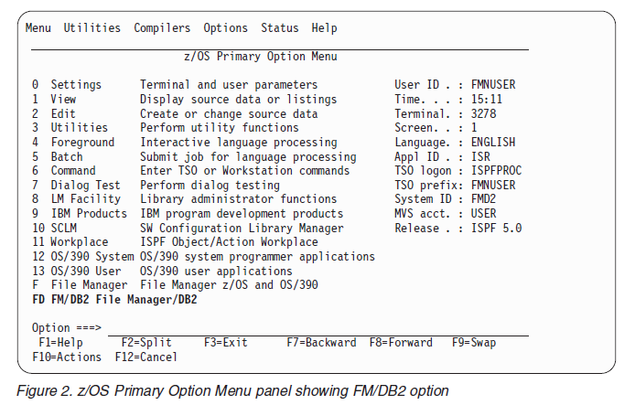
18.3: Tools for DB2 Starting and exiting FM/DB2

Slide 8
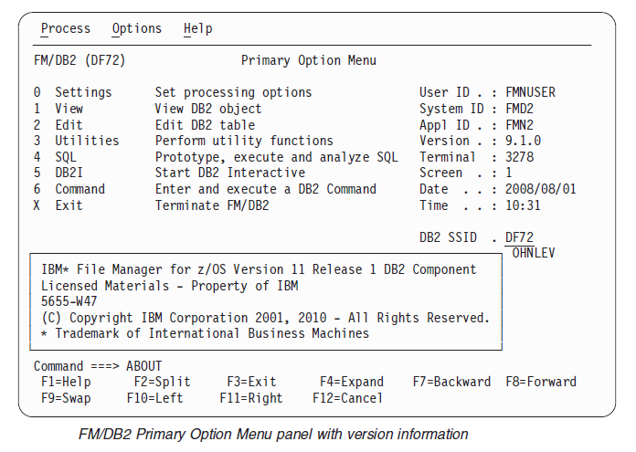
18.3: Tools for DB2 Starting and exiting FM/DB2

Slide 9
18.3: Tools for DB2 Starting and exiting FM/DB2
Exiting from FM/DB2
You can exit from FM/DB2 from the Primary Options Menu panel in any of the
following ways:
Press the Exit function key (F3).
Enter X (or EXIT or END) on the command line.
Select Process> Exit FM/DB2 from the Action Bar.
To exit the application from a panel within FM/DB2:
Enter =X on the command line.

Slide 10
18.4: Tools for DB2 File Aid for DB2
File-AID for DB2 makes browsing and editing table data as simple as working with data under ISPF.
Developers can edit an entire table or build selection criteria that can be saved and reused to:
select specific columns
determine the order in which columns are displayed
specify the sort order of the data in each column
select rows based on WHERE clauses
select data using pre-existing SQL statements.
File-AID for DB2 always maintains the integrity of your database.

Slide 11
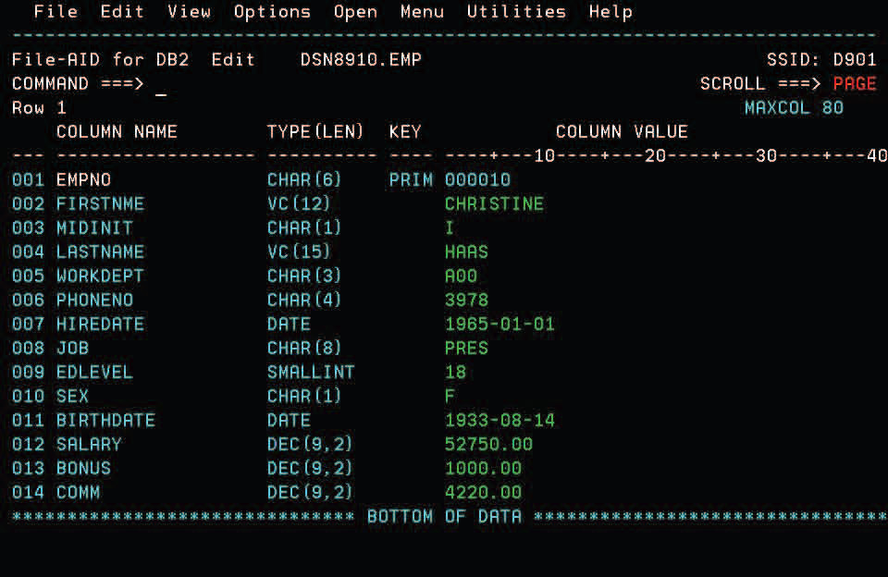
18.4: Tools for DB2 File Aid for DB2
The File-AID for DB2 EDIT function lets developers view data in either
row or table mode.

Slide 12
18.4: Tools for DB2 File Aid for DB2
With File-AID for DB2, developers can create, populate, customize, refresh and, where appropriate, authorize DB2 objects.
File-AID for DB2 creates an effective DB2 environment — without coding SQL
File-AID for DB2 gets into the test cycle faster, letting developers validate and explain program SQL before beginning the compile and bind process.
File-AID for DB2 supports new features incorporated into recent DB2 releases. These include: Distinct Type, Stored Procedures, Triggers, Identity Column, ROWID and User Defined Functions.

Slide 13
18.4: Tools for DB2 File Aid for DB2
The CREATE/DROP/ALTER DB2 OBJECTS function creates a table using ISPF-like screens instead of coding DDL statements.
By modeling the table after one created by a DBA, developers can quickly set up their own test tables.
With File-AID for DB2, tables are populated by:
copying data from an existing table
cutting and pasting data

Slide 14
Review Questions
Question 1:________ utility is used to load data into a table of a tablespace.
Option 1: RECOVER
Option 2: LOAD
Option 3: CHECK
Question 2: _________ uses templates to provide a formatted view of your data, enabling you to view, edit, and manipulate data according to the columns and data types in the table you are working with.
Notes:
.

