Slide 1
DATA STRUCTURES MINI PROJECT
1.Raj Kishan(1914100) 6. Pratyush Reddy Alla(1914119)
2.Pratik Gupta(1914117) 7.Milind Kumar(1914141)
3.Shubham Kumar(1914175) 8.Archisman Jana(1914109)
4.Saurabh Pareek(1914120) 9.Robins Anand(1914124)
5. Jahanvi Gupta(1914091) 10.Bhukya Santosh kumar(1914152)

Slide 2
MAZE PATHFINDER

Slide 3
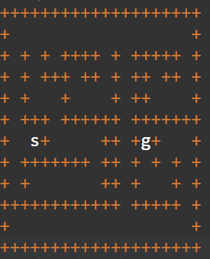
MAZE BLUEPRINT

Slide 4
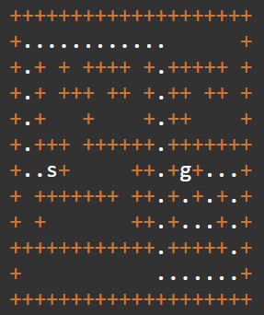
PATH TO THE GOAL

Slide 5
CODE EXPLANATION
IN COMPILER

Slide 6
Depth-First Search (DFS)
Not discovered
white
u
x
Discovered,
adjacent white nodes
gray
v
y
Discovered,
no adjacent white nodes
black
w
z

Slide 7
Depth-First Search (DFS)
Not discovered
u
x
Discovered
adjacent white nodes
d /
v
y
Discovered
no adjacent white nodes
d / f
w
z

Slide 8
Depth-First Search (DFS)
u
x
v
y
w
z

Slide 9
Depth-First Search (DFS)
u
1/
x
v
y
w
z

Slide 10
Depth-First Search (DFS)
u
1/
x
v
2/
y
w
z

Slide 11
Depth-First Search (DFS)
u
1/
x
v
2/
3/
y
w
z

Slide 12
Depth-First Search (DFS)
u
1/
4/
x
v
2/
3/
y
w
z

Slide 13
Depth-First Search (DFS)
u
1/
4/5
x
v
2/
3/
y
w
z

Slide 14
Depth-First Search (DFS)
u
1/
4/5
x
v
2/
3/6
y
w
z

Slide 15
Depth-First Search (DFS)
u
1/
4/5
x
v
2/7
3/6
y
w
z

Slide 16
Depth-First Search (DFS)
u
1/8
4/5
x
v
2/7
3/6
y
w
z

Slide 17
Depth-First Search (DFS)
u
1/8
4/5
x
v
2/7
3/6
y
w
9/
z

Slide 18
Depth-First Search (DFS)
u
1/8
4/5
x
v
2/7
3/6
y
w
9/
10/
z

Slide 19
Depth-First Search (DFS)
u
1/8
4/5
x
v
2/7
3/6
y
w
9/
10/11
z

Slide 20
Depth-First Search (DFS)
u
1/8
4/5
x
v
2/7
3/6
y
w
9/12
10/11
z

Slide 21
Depth-First Search (DFS)
u
1/8
4/5
x
v
2/7
3/6
y
w
9/12
10/11
z

Slide 22
Depth-First Search (DFS)
u
1/8
4/5
x
v
2/7
3/6
y
w
9/12
10/11
z

Slide 23
DFS CODE IN C
int dfs(int row, int col)
{
int* current = &visited [row][col];
if (*current == goal){
return 1;
}
if (*current == empty) {
*current = wall;
if (dfs(row, col - 1)){
*current = crumb;
return 1;
}
if (dfs(row + 1, col)){
*current = crumb;
return 1;
}
if (dfs(row, col + 1)){
*current = crumb;
return 1;
}
if (dfs(row - 1, col)){
*current = crumb;
return 1;
}
}
return 0;
}
 |  |  |  |  |  |  | G
S

Slide 24
THANK YOU

