Slide 1
Introduction To Data Science

Slide 2
What is Data Science?
Process of using data to understand the world.
Scientific methods to create meaning from raw data.
Umbrella term in which many scientific methods apply.

Slide 3
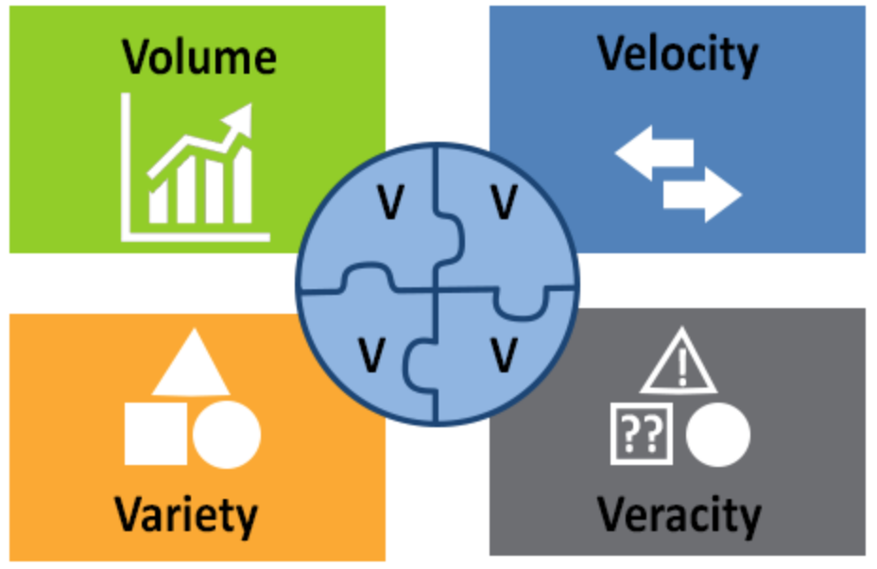
Why is Data Science so relevant today?
Tons of data is available.
We have algorithms.
Softwares are open source.
Storage comes at fraction of cost

Slide 4
Types of
Descriptive Analytics
Diagnostic Analytics
Predictive Analytics
Prescriptive Analytics
Analytics

Slide 5
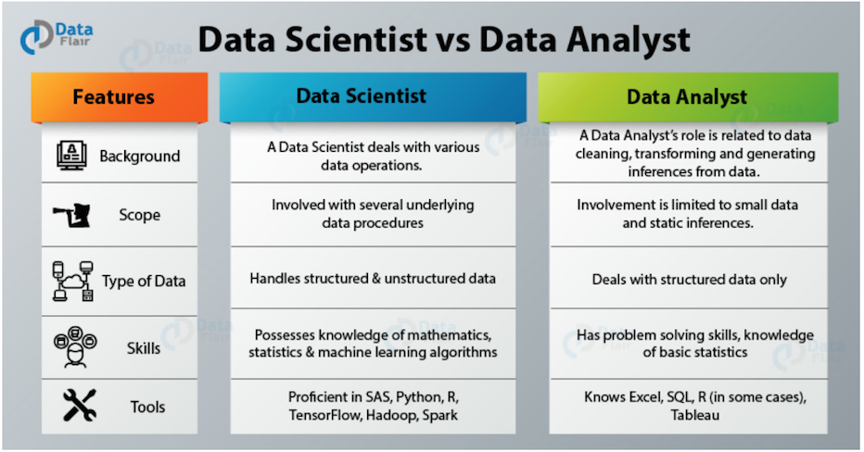
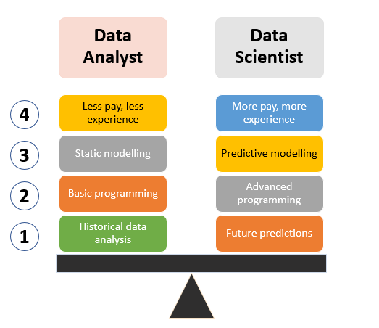
Data Science
Data Analytics
Data Transformation & Cleaning
Utilizing machine learning for predictions
Optimizes and tunes ML models
Basic level of data science
Performs descriptive & inferential statistics
Do not deal with predictive modelling.

Slide 6
Data Science Lifecycle
Gather data from relevant sources
Real world data doesn’t come by so easily
Reasons for arduous task
Find patterns/anomalies using statistical methods
Summarizing main characteristics of data visually
Understand strengths and weaknesses of trained model
Requires understanding of domain
OBTAIN
SCRUB
EXPLORE
MODEL
INTERPRET
Clean data to machine understandable formats.
Almost 70% time is spent
Unglamorous but MOST important step
Construct models to predict and forecast
Begin to use ML Algos here

Slide 7
Environment Set Up
Anaconda distribution of python
All-in-one install
Jupyter Notebook

Slide 8
Why Python?
It uses the elegant syntax, hence the programs are easier to read.
The large standard library and community support.
The interactive mode of Python makes its simple to test codes.
It is free software in a couple of categories. It does not cost anything to use or download Pythons or to add it to the application.
It offers access to a wide variety of data analysis and data science libraries. These include, pandas, NumPy, SciPy, StatsModels, and scikit-learn.
It comes with many visualization options

Slide 9
Thank You!

