Slide 1
Feedback-directed Random Test Generation
Carlos Pacheco Shuvendu Lahiri
Michael Ernst Thomas Ball
MIT Microsoft Research
January 19, 2007

Slide 2
Software testing
Software testing consists of
  Select a set of inputs to a program (“test inputs”)
  Determine if the program behaves correctly on each test input
Random testing
  Select test inputs at random from the input space

Slide 3
Random testing works
An attractive error-detection technique
  Easy to implement and use
  Yields lots of test inputs
  Finds errors
    Miller et al. 1990: Unix utilities
    Kropp et al.1998: OS services
    Forrester et al. 2000: GUI applications
    Claessen et al. 2000: functional programs
    Csallner et al. 2005, Pacheco et al. 2005: object-oriented programs
    Groce et al. 2007: flash memory, file systems

Slide 4
Evaluations of random testing
Theoretical work suggests that random testing is as effective as more systematic techniques
    Duran 1984, Hamlet 1990
Previous empirical studies suggest the opposite:
    Ferguson et al. 1996: compare with chaining
    Marinov et al. 2003: compare with bounded exhaustive
    Visser et al. 2006: compare with model checking and symbolic execution
  But these studies all compare against undirected random test generation
Notes:
Note that random can be systematic too; define terminology

Slide 5
Contributions
We propose a new feedback-directed random test generation technique
  Creation of new tests is guided by feedback about the execution of previous tests, to avoid redundant and illegal tests
Empirical evaluation
  Evaluate error-detection ability on a large number of widely-used, well-tested libraries
  Experimentally compare against systematic techniques
  Experimentally compare against undirected random test generation

Slide 6
Conclusions (more details later)
Feedback-directed random test generation:
  Is effective in finding errors
    Discovered several errors in widely-used, well-tested code (JDK, .NET framework core libraries)
  Can outperform systematic testing
    On their own benchmarks and metrics (coverage), and
    On a much larger corpus of subjects (780KLOC), measuring error detection
  Can outperform undirected random test generation

Slide 7
Outline
Random testing pitfalls
Feedback-directed random test generation
Evaluation:
  Randoop: a tool for Java and .NET
  Coverage
  Error detection
Current and future directions for Randoop

Slide 8
Random testing: pitfalls
1. Useful test
Set t = new HashSet();
s.add(“hi”);
assertTrue(s.equals(s));
2. Redundant test
Set t = new HashSet();
s.add(“hi”);
s.isEmpty();
assertTrue(s.equals(s));
3. Useful test
Date d = new Date(2006, 2, 14);
assertTrue(d.equals(d));
4. Illegal test
Date d = new Date(2006, 2, 14);
d.setMonth(-1);
assertTrue(d.equals(d));
5. Illegal test
Date d = new Date(2006, 2, 14);
d.setMonth(-1);
d.setDay(5);
assertTrue(d.equals(d));

Slide 9
Random testing: pitfalls
1. Useful test
Set t = new HashSet();
s.add(“hi”);
assertTrue(s.equals(s));
2. Redundant test
Set t = new HashSet();
s.add(“hi”);
s.isEmpty();
assertTrue(s.equals(s));
3. Useful test
Date d = new Date(2006, 2, 14);
assertTrue(d.equals(d));
4. Illegal test
Date d = new Date(2006, 2, 14);
d.setMonth(-1);
assertTrue(d.equals(d));
5. Illegal test
Date d = new Date(2006, 2, 14);
d.setMonth(-1);
d.setDay(5);
assertTrue(d.equals(d));
do not output

Slide 10
Random testing: pitfalls
1. Useful test
Set t = new HashSet();
s.add(“hi”);
assertTrue(s.equals(s));
2. Redundant test
Set t = new HashSet();
s.add(“hi”);
s.isEmpty();
assertTrue(s.equals(s));
3. Useful test
Date d = new Date(2006, 2, 14);
assertTrue(d.equals(d));
4. Illegal test
Date d = new Date(2006, 2, 14);
d.setMonth(-1);
assertTrue(d.equals(d));
5. Illegal test
Date d = new Date(2006, 2, 14);
d.setMonth(-1);
d.setDay(5);
assertTrue(d.equals(d));
do not output
do not even create

Slide 11
Outline
Random testing pitfalls
Feedback-directed random test generation
Evaluation:
  Randoop: a tool for Java and .NET
  Coverage
  Error detection
Current and future directions for Randoop

Slide 12
Feedback-directed random test generation
Build test inputs incrementally
  New test inputs extend previous ones
  In our context, a test input is a method sequence
As soon as a test is created, execute it
Use execution results to guide the search
  away from redundant or illegal method sequences
  towards sequences that create new object states

Slide 13
Technique input/output
Input:
  classes under test
  time limit
  set of contracts
    Method contracts (e.g. “o.hashCode() throws no exception”)
    Object invariants (e.g. “o.equals(o) == true”)
Output: contract-violating test cases
HashMap h = new HashMap();
Collection c = h.values();
Object[] a = c.toArray();
LinkedList l = new LinkedList();
l.addFirst(a);
TreeSet t = new TreeSet(l);
Set u = Collections.unmodifiableSet(t);
assertTrue(u.equals(u));
no contracts
violated
up to last
method call
fails when executed

Slide 14
Technique
Seed components
    components = { ... }
Do until time limit expires:
  Create a new sequence
  Classify the sequence
    Execute sequence and check contracts
    Based on execution results do one of the following:
      output sequence as test case (if execution leads to a contract violation)
      add sequence to components (no contract violations, sequence is not redundant)
      discard sequence (no contract violations, sequence is redundant)
int i = 0;
boolean b = false;

Slide 15
Creating a sequence
Each sequence “constructs” several objects, available after the last method call is executed:
  < result, receiver, param₁, ..., param_{n} > of last method call
Example:
    sequence constructs two objects:
    < LinkedList, HashSet >
To create a new sequence:
  Randomly pick a method call m(T₁...T_{k})/T_{ret} from a tested class
  For each input parameter of type T_{i}, randomly pick a sequence S_{i} that constructs an object of type T_{i}
  Create new sequence S_{new} = S₁• ... • S_{k} • T_{ret} v_{new} = m(v₁...v_{k});
  if S_{new} was previously created (lexically), go to i
LinkedList l = new LinkedList();
Set h = new HashSet();
l.addFirst(h);

Slide 16
Technique
Seed components
    components = { ... }
Do until time limit expires:
  Create a new sequence
  Classify the sequence
    Execute S_{new} and check contracts
    Based on execution results do one of the following:
      output S_{new} as test case (if execution leads to a contract violation)
      add S_{new} to components (no contract violations, sequence is not redundant)
      discard S_{new} (no contract violations, sequence is redundant)
int i = 0;
boolean b = false;

Slide 17
Classifying a sequence
execute and
check
contracts
contract
violated?
minimize
sequence
yes
start
no
components
sequence
redundant?
no
contract-
violating
test case
yes
discard
sequence

Slide 18
Redundant sequences
During generation, maintain a set of all objects created.
A sequence is redundant if all the objects created during its execution are members of the above set (using equals to compare)
Marinov et al. [2004] use a similar heuristic to detect redundant tests in an existing test suite.
  We incorporate redundancy checking as part of the generation process.

Slide 19
Recap: classifying a sequence
execute and
check
contracts
contract
violated?
minimize
sequence
yes
start
no
components
sequence
redundant?
no
contract-
violating
test case
yes
discard
sequence

Slide 20
Outline
Random testing pitfalls
Feedback-directed random test generation
Evaluation:
  Randoop: a tool for Java and .NET
  Coverage
  Error detection
Current and future directions for Randoop

Slide 21
Randoop
Implements feedback-directed random test generation
Input:
  An assembly (for .NET) or a list of classes (for Java)
  Generation time limit
  Optional: a set of contracts to augment default contracts
Output: a test suite (Junit or Nunit) containing
  Contract-violating test cases
  Normal-behavior test cases

Slide 22
Randoop outputs oracles
Oracle for contract-violating test case:
Object o = new Object();
LinkedList l = new LinkedList();
l.addFirst(o);
TreeSet t = new TreeSet(l);
Set u = Collections.unmodifiableSet(t);
assertTrue(u.equals(u));
Oracle for normal-behavior test case:
Object o = new Object();
LinkedList l = new LinkedList();
l.addFirst(o);
l.add(o);
assertEquals(2, l.size());
assertEquals(false, l.isEmpty());
Randoop uses observer methods to capture object state

Slide 23
Some Randoop options
Avoid use of null
Bias random selection
  Favor smaller sequences
  Favor methods that have been less covered
  Use constants mined from source code
statically…
…and dynamically
Object o = new Object();
LinkedList l = new LinkedList();
l.add(null);
Object o = returnNull();
LinkedList l = new LinkedList();
l.add(o);

Slide 24
Outline
Random testing pitfalls
Feedback-directed random test generation
Evaluation:
  Randoop: a tool for Java and .NET
  Coverage
  Error detection
Current and future directions for Randoop

Slide 25
Coverage
Seven data structures (stack, bounded stack, list, bst, heap, rbt, binomial heap)
Used in previous research
  Bounded exhaustive testing [ Marinov 2003 ]
  Symbolic execution [ Xie 2005 ]
  Exhaustive method sequence generation [Xie 2004 ]
All above techniques achieve high coverage in seconds
Tools not publicly available

Slide 26
Coverage achieved by Randoop
Comparable with exhaustive/symbolic techniques
data structure | time (s) | branch cov.
Bounded stack (30 LOC) | 1 | 100%
Unbounded stack (59 LOC) | 1 | 100%
BS Tree (91 LOC) | 1 | 96%
Binomial heap (309 LOC) | 1 | 84%
Linked list (253 LOC) | 1 | 100%
Tree map (370 LOC) | 1 | 81%
Heap array (71 LOC) | 1 | 100%

Slide 27
Visser containers
Visser et al. (2006) compares several systematic input generation techniques
  Model checking with state matching
  Model checking with abstract state matching
  Symbolic execution
  Symbolic execution with abstract state matching
  Undirected random testing
Comparison in terms of branch and predicate coverage
Four container data structures
Experimental framework and tool available

Slide 28
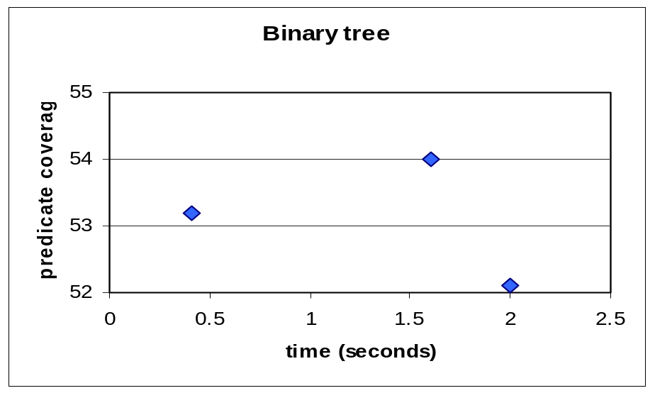
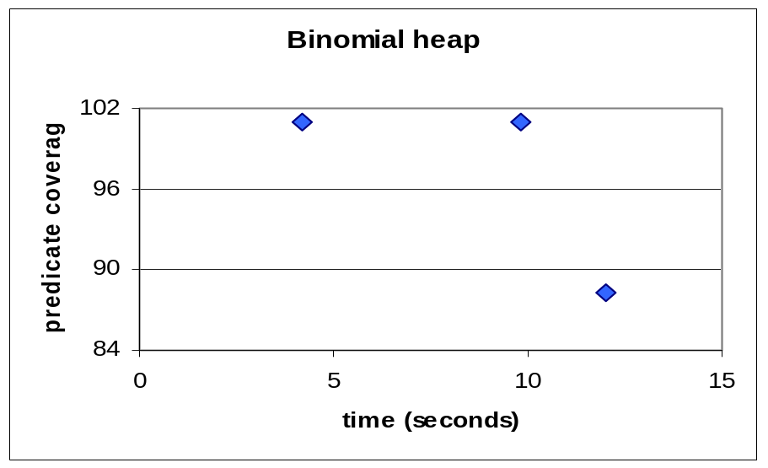
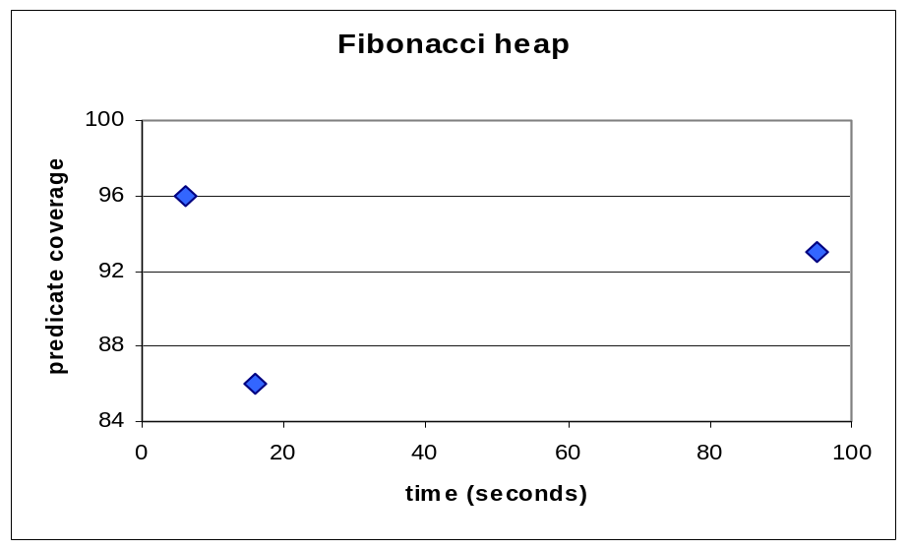
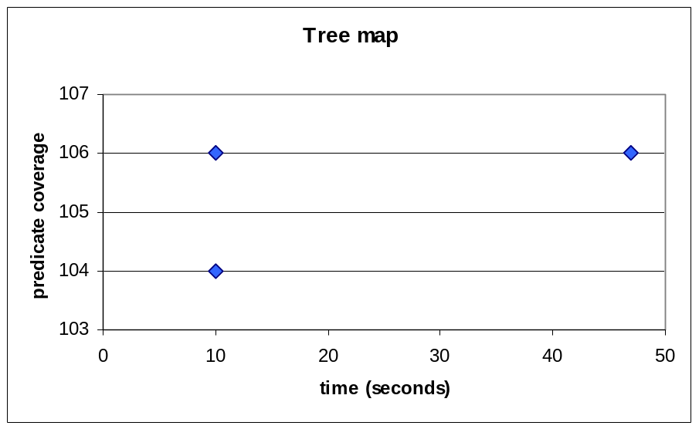
Predicate coverage: Visser containers
randoop
randoop
best systematic
best systematic
undirected random
undirected random
randoop
randoop
best systematic
best systematic
undirected random
undirected random
Notes:
On binary tree and fibonacci heap, randoop achieves higher coverage than both systematic and undirected generation. On binomial heap and tree map, randoop achieves the same coverage as systematic generation, but does so faster.

Slide 29
Outline
Random testing pitfalls
Feedback-directed random test generation
Evaluation:
  Randoop: a tool for Java and .NET
  Coverage
  Error detection
Current and future directions for Randoop

Slide 30
Subjects
 | LOC | Classes
JDK (2 libraries) (java.util, javax.xml) | 53K | 272
Apache commons (5 libraries) (logging, primitives, chain jelly, math, collections) | 114K | 974
.Net framework (5 libraries) | 582K | 3330

Slide 31
Methodology
Ran Randoop for 2 minutes on each library
Contracts:
    o.equals(o)==true
    o.equals(o) throws no exception
    o.hashCode() throws no exception
    o.toString() throw no exception
    No null inputs and:
      Java: No NPEs
      .NET: No NPEs, out-of-bounds, of illegal state exceptions

Slide 32
Results
 | test cases | violating methods | bugs
JDK | 25 | 13 | 5
Apache commons | 124 | 71 | 5
.Net framework | 528 | 206 | 183
Total | 677 | 290 | 193

Slide 33
Errors found: examples
JDK Collections classes have 4 methods that create objects violating o.equals(o) contract
Javax.xml creates objects that cause hashCode and toString to crash, even though objects are well-formed XML constructs
Apache libraries have constructors that leave fields unset, leading to NPE on calls of equals, hashCode and toString (this only counts as one bug)
Many Apache classes require a call of an init() method before object is legal—led to many false positives
.Net framework has at least 175 methods that throw an exception forbidden by the library specification (NPE, out-of-bounds, of illegal state exception)
.Net framework has 8 methods that violate o.equals(o)
.Net framework loops forever on a legal but unexpected input

Slide 34
JPF
Used JPF to generate test inputs for the Java libraries (JDK and Apache)
  Breadth-first search (suggested strategy)
  max sequence length of 10
JPF ran out of memory without finding errors
  After 32 seconds on average
  Spent most of its time systematically exploring a very localized portion of the space
For large libraries, sparse sampling (e.g. Randoop) appears more effective

Slide 35
Undirected random testing
JCrasher implements undirected random test generation
Creates random method call sequences
  Does not use feedback from execution
Reports sequences that throw exceptions
Found 1 error on Java libraries
  Reported 595 false positives

Slide 36
Regression testing
Object o = new Object();
LinkedList l = new LinkedList();
l.addFirst(o);
l.add(o);
assertEquals(2, l.size());
assertEquals(false, l.isEmpty());
Randoop can create regression oracles
Randoop generated test cases using JDK 1.5
  Generated 41K test cases
Ran resulting test cases on
  JDK 1.6 Beta
    25 test cases failed
  Sun’s implementation of the JDK
    73 test caes failed
  Failing test cases pointed to 12 distinct errors
  These errors were not found by the extensive compliance test suite that Sun provides to JDK developers

Slide 37
Outline
Random testing pitfalls
Feedback-directed random test generation
Evaluation:
  Randoop: a tool for Java and .NET
  Coverage
  Error detection
Current and future directions for Randoop

Slide 38
Tech transfer
Randoop is currently being maintained by a product group at Microsoft
  Spent an internship doing the tech transfer
    How will a test team actually use the tool?
        Push-button at first, desire more control later
    Will the tool be cost-effective?
      Yes
      Immediately found a few errors
      With more control, found more errors
      Pointed to blind spots in
        existing test suites
        Existing automated testing tools
    Which heuristics will be most useful?
      The simplest ones: uniform selection,
      Heuristic guidance is often best left to the user of the tool

Slide 39
Future directions
Combining random and systematic
  DART (Godefroid 2005) combines random and systematic generation of test data
  How to combine random and systematic generation of sequences?
Using Randoop for reliability estimation
  Random sampling amenable to statistical analysis
  Are programs that Randoop finds more problems with more error-prone?
Better oracles
  To date, we have used a very basic set of contracts
  Will better contracts lead to more errors?

Slide 40
Conclusion
Feedback-directed random test generation
  Finds bugs in widely-used, well-tested libraries
  Can outperform systematic test generation
  Can outperform undirected test generation
Randoop:
  Easy to use—just point at a set of classes
  Has found many errors in well-tested, widely-used libraries
  Has real clients: used by product groups at Microsoft

