Slide 1

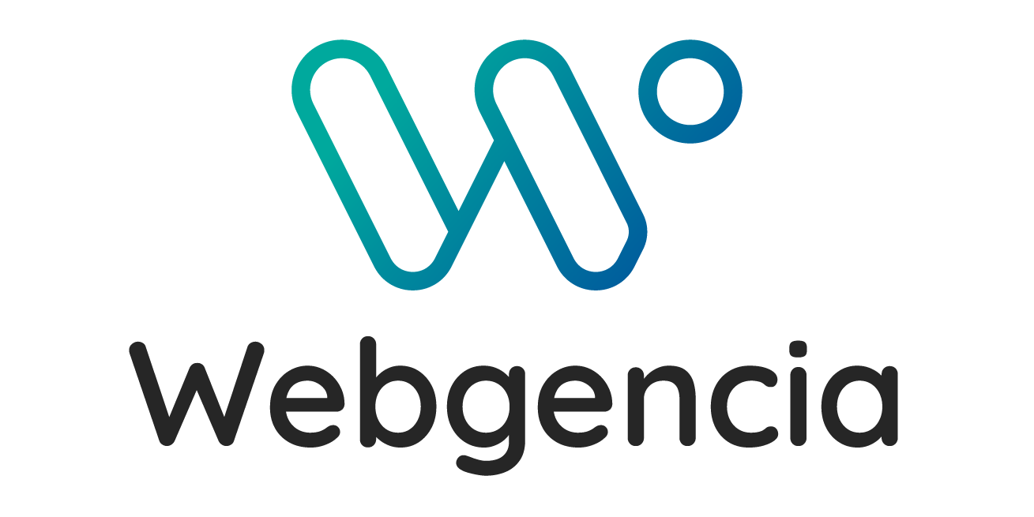
Menu Maker by Qwenta
Project Presentation
Rand Rahim
Frontend Developer
Jan 28, 2025

Slide 2
Table of Contents
Project Context
Overview of the Prototype
Methodology Used
Kanban Board
Technical Specifications
Conclusion
Questions

Slide 3
Project Context
The client company QWENTA wants to develop a website that allows restaurant owners to create and design their menus.
The website aims to:
Enable menu creation
Allow menu sharing on Deliveroo
Allow Instagram sharing
Allow exporting menus as PDF
Enable menu customization, including branding elements
Target Audience:
restaurant owners and small businesses.

Slide 4
Main Objectives
Facilitate personalized menu creation:
Users can easily add dishes, choose categories, customize the design (font, colors), and see changes in real time through a preview.
Share menus on online platforms:
Menu Maker integrates API connections to share menus directly on Instagram and Deliveroo, maximizing restaurant visibility.
Simplify physical menu printing:
With a PDF export feature, restaurant owners can print high-quality menus for in-house use.
Centralize menu management:
Through an intuitive dashboard, users can create, share, and print menus with just a few clicks while maintaining a history of modifications.

Slide 5
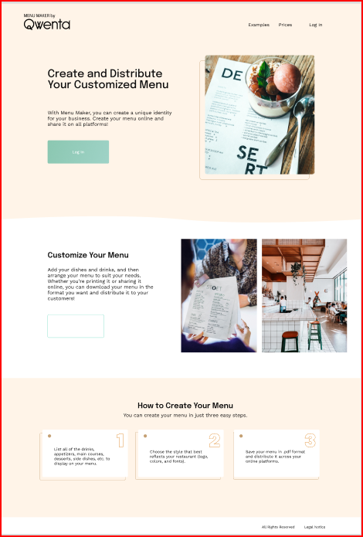
Mockup Overview – Landing Page
The homepage allows users to easily access different sections of the site through an intuitive navigation system.
A "Sign In" button invites users to access their personal space for menu creation and customization.
The homepage sections highlight the service's benefits and include a three-step guide to explain how to create a professional menu.

Slide 6
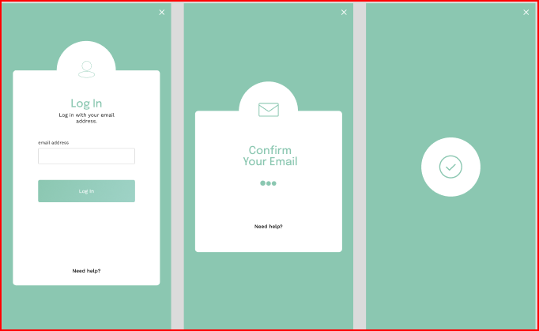
Mockup Overview – Login Modal
The login modal allows users to authenticate via their email address.
Once the email is confirmed, the user is redirected to their dashboard.

Slide 7
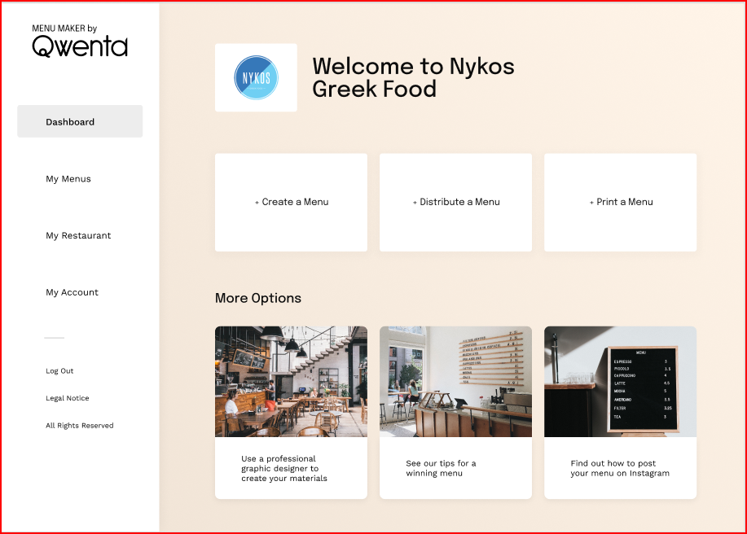
Mockup Overview – Dashboard
The dashboard serves as the central hub for users, offering an overview of their activities and available features.
At the center, three main buttons highlight key actions:
Create a Menu: Redirects to the menu creation page.
Share a Menu: Allows sharing menus on platforms like Instagram and Deliveroo.
Print a Menu: Provides an option to print menus in the desired format.

Slide 8
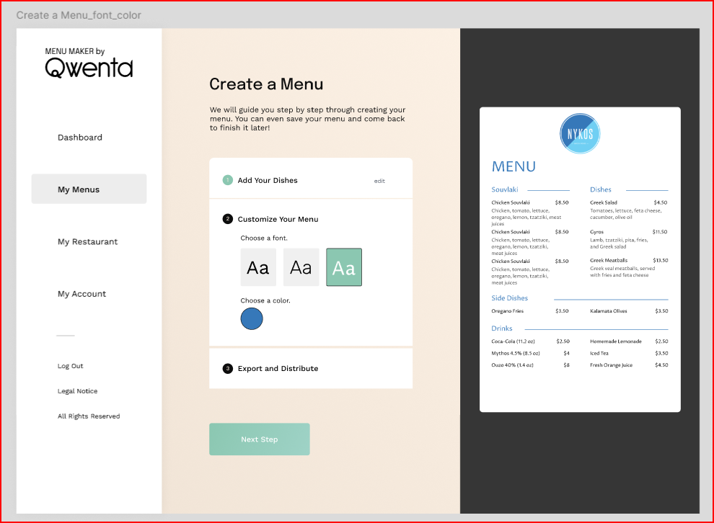
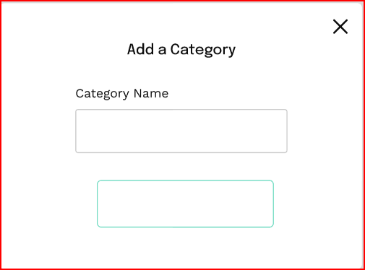
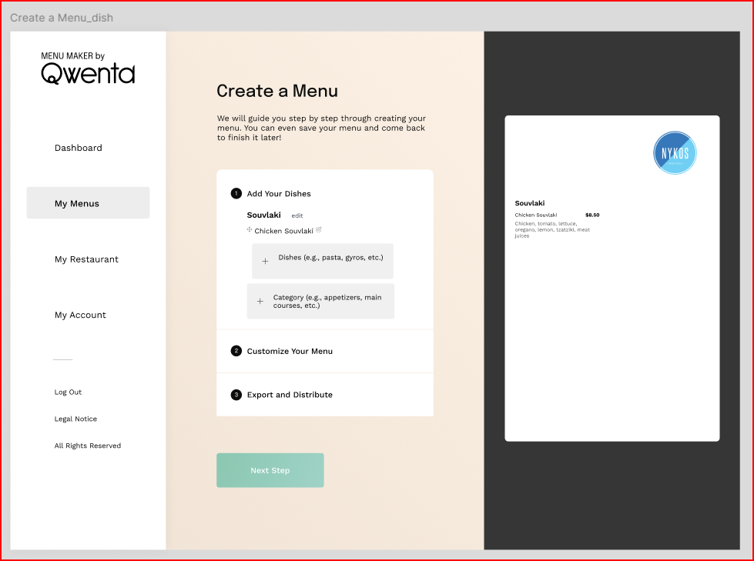
Mockup Overview – Menu Creation Steps
Add a dish Category:
The user selects a category (such as main dish, starter, dessert, etc.).
2: Add your dish
Clicking the "+ Dishes" button opens a modal where users can add dishes.
3. Customize your menu:
Users can choose typography and color palettes for their menu.

Slide 9
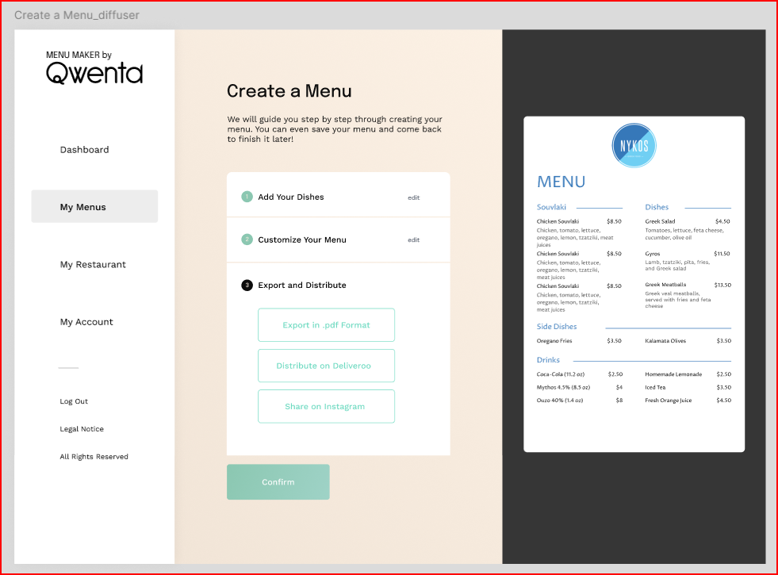
Mockup Overview – Export & Share
At the final step, the user has three options:
Export as .pdf: Downloads a PDF file of the menu.
Share on Deliveroo: Publishes the menu directly on the platform.
Post on Instagram: Shares the menu on Instagram.

Slide 10
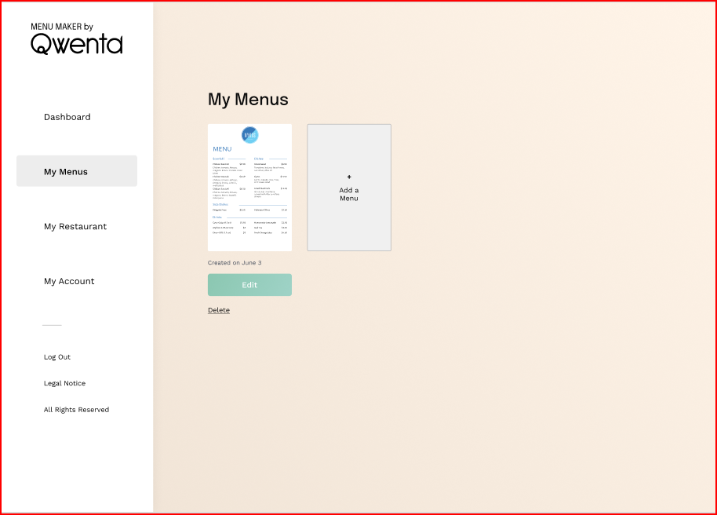
Mockup Overview – My Menus
The "My Menus" page displays an overview of the user’s created menus.
It offers a clear and intuitive interface, allowing restaurant owners to efficiently manage their creations.
Mockup Link

Slide 11
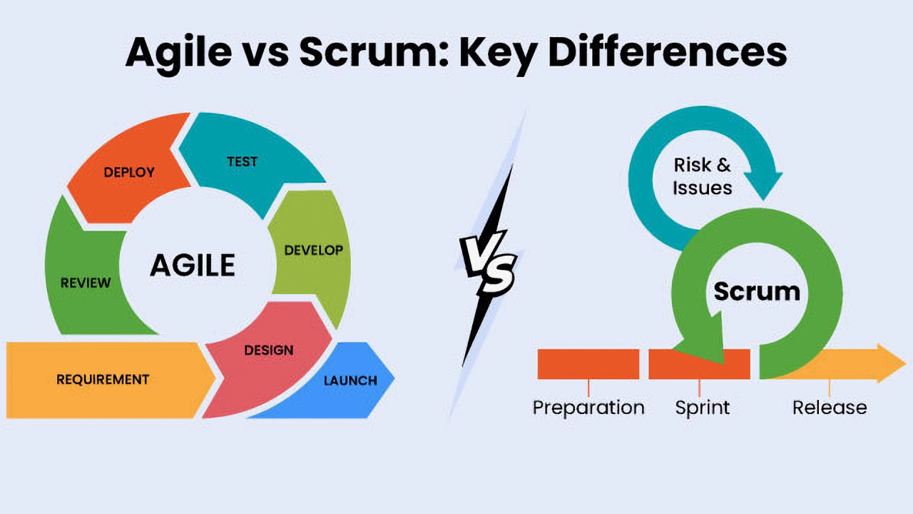
Agile & Scrum Methodology
Introduction to Agile Methodology
Agile is a project management approach that prioritizes flexibility, collaboration, and adaptability.
It enables quick responses to changing customer needs by emphasizing frequent deliveries of high-quality features.
Agile focuses on open communication, constant feedback, and short iterations.
What is Scrum?
Scrum is an Agile framework that structures development into iterations called sprints (lasting 2-3 weeks).
Each sprint focuses on specific tasks and delivers a functional product increment at the end of each cycle.

Slide 12
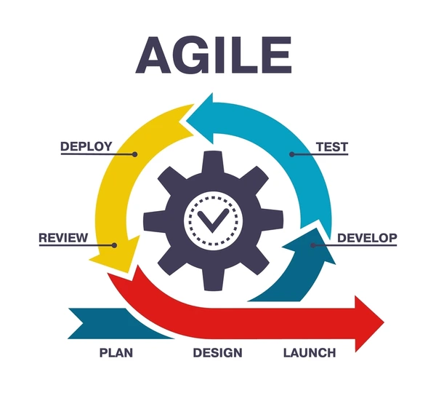
Benefits of Agile/Scrum for Menu Maker
Flexibility: Easily adapts to changing client needs.
Frequent Deliveries: Encourages short iterations and regular feedback.
Collaboration: Enhances teamwork and communication.
Constant Feedback: Ensures the final product meets expectations.
Short Iterations: Allows quick modifications and improvements.

Slide 13
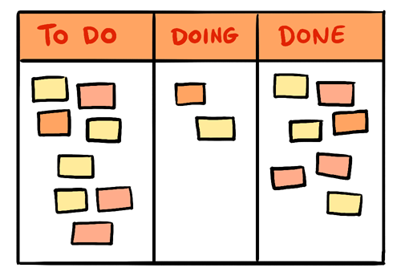
Project Tracking with Kanban
The Kanban board is an essential tool used to track project progress in a visual and organized manner. It allows the team to efficiently manage tasks and ensure a smooth workflow. The board consists of four primary columns:
To Do: Tasks that have been identified but not yet started.
In Progress: Tasks that are currently being worked on.
To Test: Tasks that have been completed but need verification before deployment.
Completed: Tasks that have been successfully tested and finalized.
Each task on the board includes key details such as the title, assigned developer, priority level, and expected completion date. The Kanban system ensures that all team members can track progress in real-time and stay aligned with project deadlines.

Slide 14
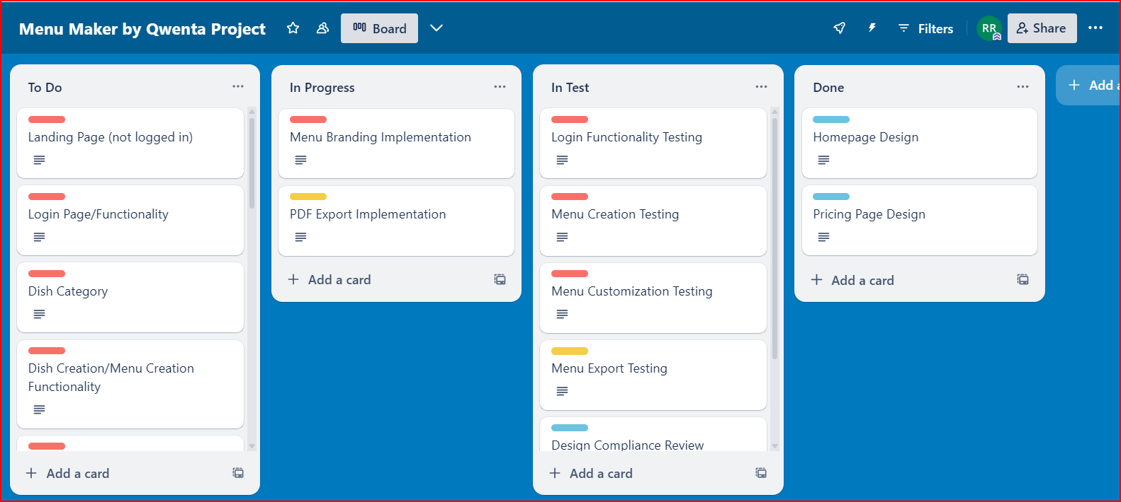
Project Tracking with Kanban
What is a User Story?
A User Story is a simple, concise description of a feature from the end-user’s perspective. It typically follows this format:
"As a [user type], I want to [goal] so that [benefit]."
The Kanban board is a visual tool that efficiently manages tasks and ensures optimal team coordination.
Organizing User Stories and tasks clearly helps prioritize ongoing work.
Real-time updates allow the team to adapt quickly to changes.

Slide 15
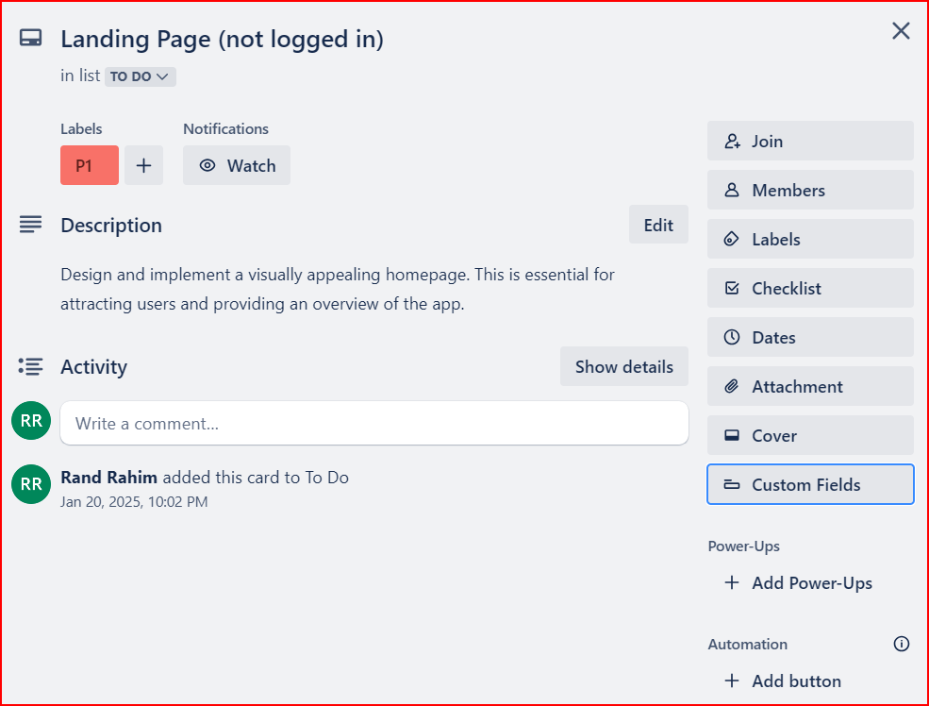
Tracking with Kanban – Board Details
Each Kanban card includes:
Type (Story/Frontend/Backend)
Sprint Phase (P1/P2/P3)
Associated Role (Frontend Dev, Backend Dev)
Status (To Do/In Progress/Done)
Task Description
Story Point
Success: Summarizes results achieved versus set objectives.
Future: Focuses on potential improvements and future project evolutions.
The Kanban board Link.

Slide 16
Technical Specifications
Technology Choices:
Functional Requirements & Solutions
Backend Integration
Hosting & Domain Recommendations
Accessibility Considerations
Security Guidelines
Site Maintenance & Future Updates
Branding and UI Design

Slide 17
Conclusion
Menu Maker aims to provide an intuitive and powerful platform for restaurant owners to create, customize, and share their menus online.
The project followed an Agile/Scrum approach, ensuring a structured workflow with quick iterations and efficient task management via the Kanban board.
Technical specifications focused on technology choices, accessibility, security, and hosting, ensuring a coherent and stable solution.
The project architecture integrates client-side, backend, database, and third-party APIs (Deliveroo, Instagram) for a seamless experience.

Slide 18
QUESTIONS?

