Slide 1


Artificial Portfolio Expert with Focus on Knowledge Graph

Slide 2
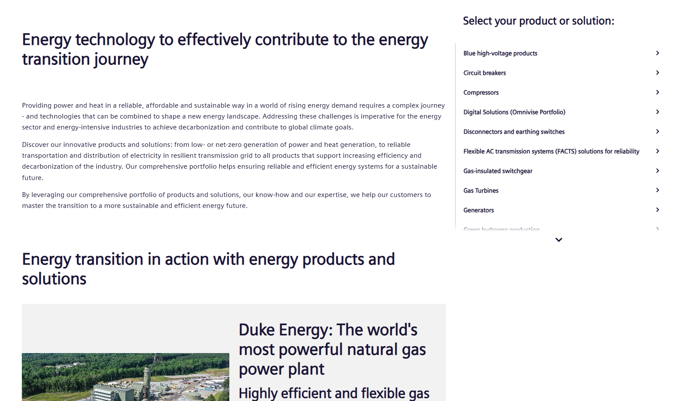
Artificial Portfolio Expert
Search: Siemens Energy Portfolio
Descriptions of Products and Solutions
PDFs, Presentations
A lot of organized information

Slide 3
Artificial Portfolio Expert
Artificial Portfolio Expert Goal
Build and present a model that understands the websites, associated, documents, and general engineering knowledge.
Portfolio Assistant: Create an agent capable of receiving and understanding relevant industrial products, and services, and what problems they can help solve.
Agent is tasked to answer relevant technical and conceptual questions about products and services, with special tailoring by industry, and use case. Agent should be able to converse at different levels of technical detail & proficiency, from curious children to expert level professionals without misrepresentation.

Slide 4
Artificial Portfolio Expert
Artificial Portfolio Expert Goal
Agent should reference source material point to appropriate source material; and direct to an appropriate publicly listed contact when needed.
Agent should focus extensively on publicly available data, and other general and trustworthy sources (e.g. Relevant curated Wikipedia pages to answer questions about the function of a turbine or switchgear.).

