Slide 1
Esp32 Audio
or
It’s Hip To Be Square Wave

Slide 2
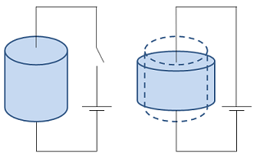
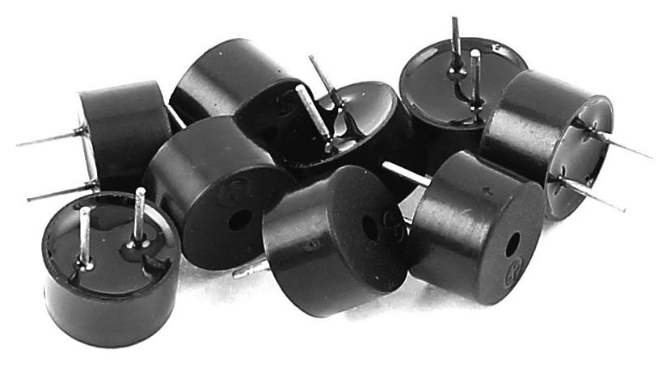
The Piezoelectric Effect

Slide 3
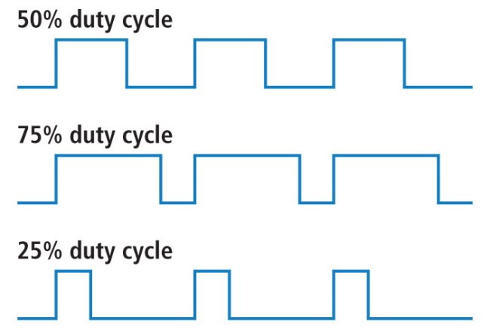
Pulse Width Modulation

Slide 4
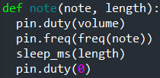
Beep Boop

Slide 5
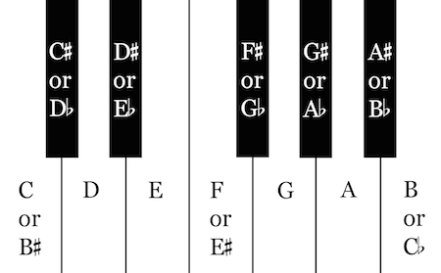
From sounds to music

Slide 6
What’s the Frequency, Kenneth?
A * B^{N}
A = ???
B = ???
N = number of tones up or down

Slide 7
What’s the Frequency, Kenneth?
A * B^{N}
A = 440 Hz for A4 (don’t ask)
B = ???
N = number of tones up or down

Slide 8
What’s the Frequency, Kenneth?
A * B^{N}
A = 440 Hz for A4 (don’t ask)
B = 2^{1/12}, or about 1.0595
N = number of tones up or down

Slide 9
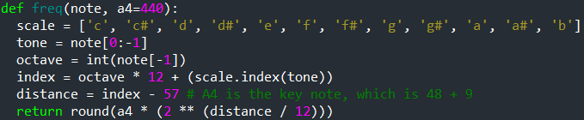
In Python

Slide 10
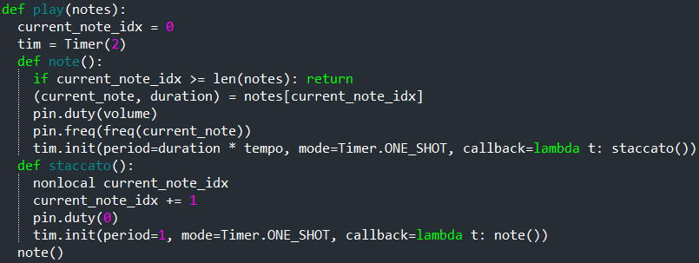
In Python

Slide 11
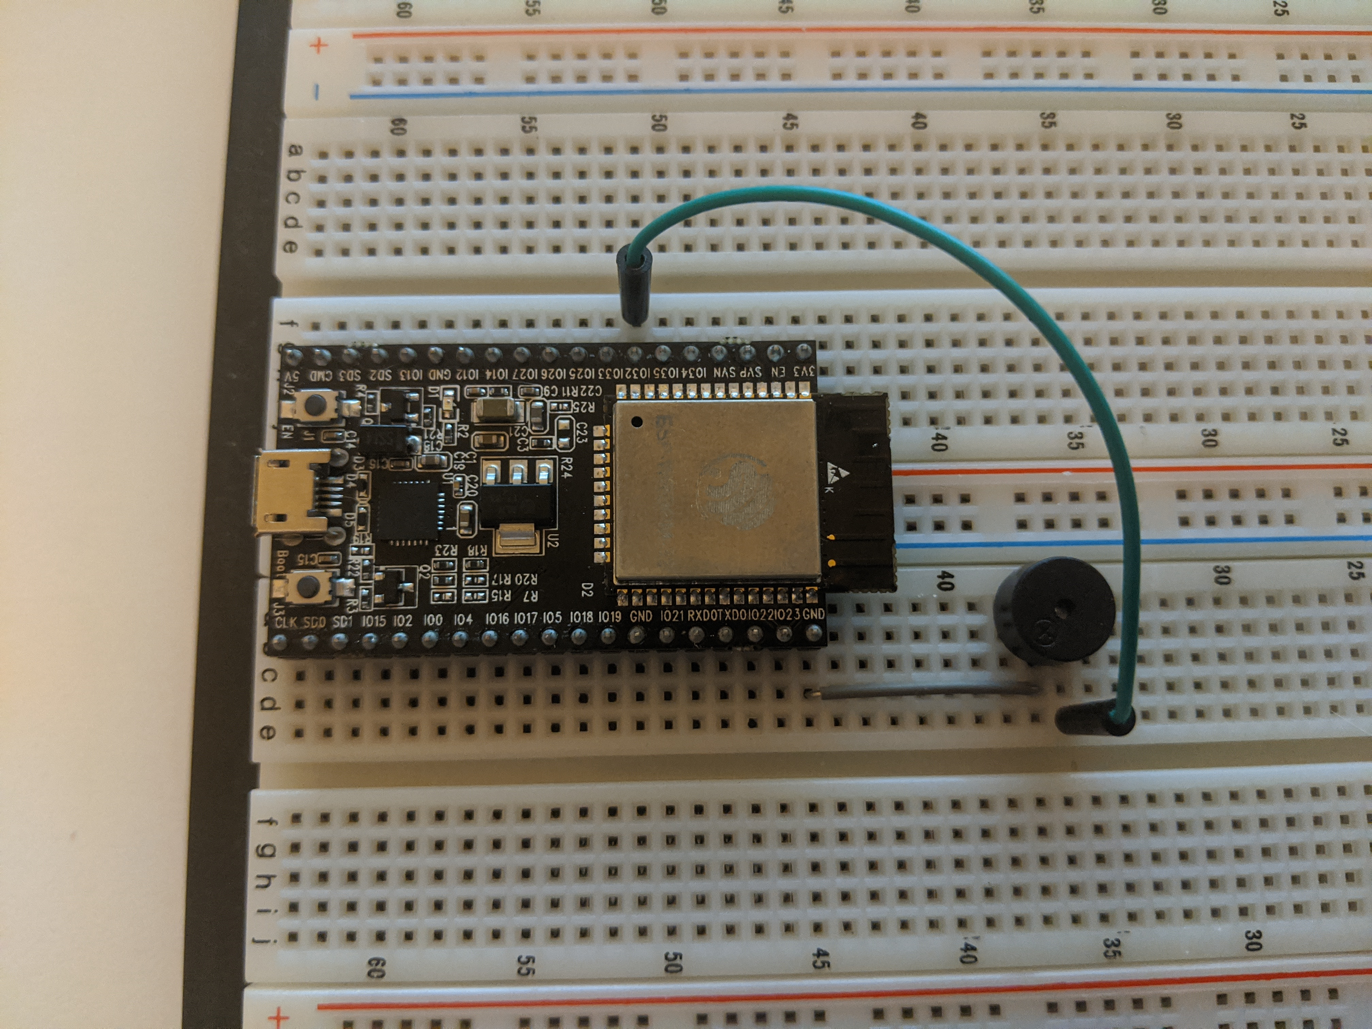
In Wires

Slide 12
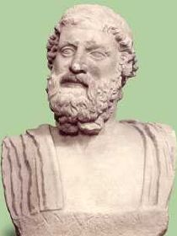
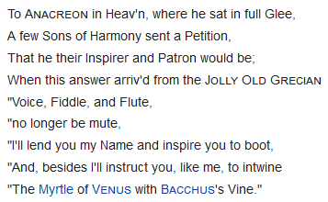
Anacreon in Heav’n

