Slide 1


slices-ri.eu
Introduction of SLICES (and SILECS)
Slides merged from C. Perez (LIP/JCAD’21) & A. Lebre (LS2N/LabClass’22)
Richard Randriatoamanana @LS2N
CC 11/2/2022

Slide 2
Sources
Feuille de route ESFRI 2021
https://www.esfri.eu/latest-esfri-news/new-ris-roadmap-2021
Talks
https://jcad2021.sciencesconf.org/data/silecs_slices_JCAD_2021.pdf
https://indico.mathrice.fr/event/313/contribution/0/material/slides/0.pdf
https://www.silecs.net/wp-content/uploads/2018/04/Desprez-SILECS.pdf

Slide 3
Convergence of Computation and Communication

Slide 4
Motivations
CISCO predicted ~29,3 billion networked devices by 2023, up from 18.4 billion in 2018.
~60% growth in 6 years!
Exponential improvement of
Electronics (energy consumption, size, cost)
Capacity of networks (WAN, wireless, new technologies)
Exponential growth of applications near users
Smartphones, tablets, connected devices, sensors, ...
Large variety of applications and large community
Large number of Cloud facilities to cope with generated data
Many platforms and infrastructures available around the world
Several offers for IaaS, PaaS, and SaaS platforms
Public, private, community, and hybrid clouds
Going toward distributed Clouds (Fog, Edge, extreme Edge)

Slide 5
Validation in (Computer) Science
Two classical approaches for validation :
Formal : equations, proofs, etc.
Experimental: on a scientific instrument
Often a mix of both :
In Physics, Chemistry, Biology, etc.
In Computer Science

Slide 6
SILECS (French Level) https://silecs.net
Wireless – Internet Of Things
Proving Internet players access to a variety of fixed and mobile technologies and services, thus accelerating the design of advanced technologies for the Future Internet
4 key technologies and a single control point: FIT-IoTLab (connected objects & sensors, mobility), CorteXlab (Cognitive Radio), R2Lab wireless (anechoic chamber), Network Operations Center, Advanced Cloud technology including OpenStack
9 sites (Paris, Evry, Rocquencourt, Lille, Strasbourg, Lyon, Grenoble, Sophia Antipolis)
Grid’5000 (https://www.grid5000.fr)
A scientific instrument for experimental research on large future infrastructures: Clouds, datacenters, HPC exascale, Big Data infrastructures, networks, etc.
10 sites (dont Nantes), service nodes, >8000 cores, with a large variety of network connectivity and storage access, dedicated interconnection network granted and managed by RENATER
On the feuille de route nationale des Infra de recherche since 2018
SILECS explained in vidéo https://vimeo.com/521314225

Slide 7
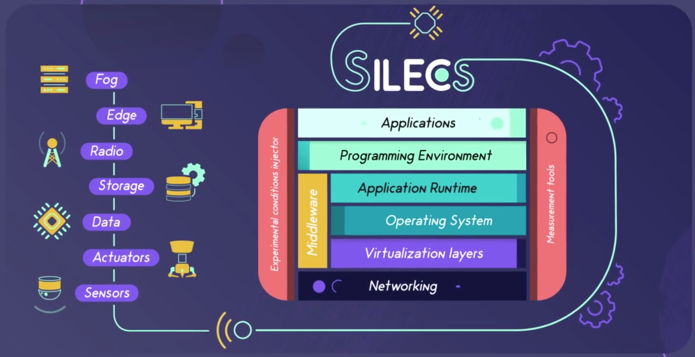
FIT
GRID’5000

Slide 8
SLICES (European Level) https://slices-ri.eu
Flexible platform designed to support large­scale, experimental research focused on
Networking protocols
Radio technologies
Services
Data collection
Parallel and Distributed Computing and in particular
Cloud and Edge-­based Computing architectures and services.
The first European the first Research Infrastructure in computer science
Announced as an ESFRI Project 2021
25 Participants from 15 countries (France project-leader)

Slide 9
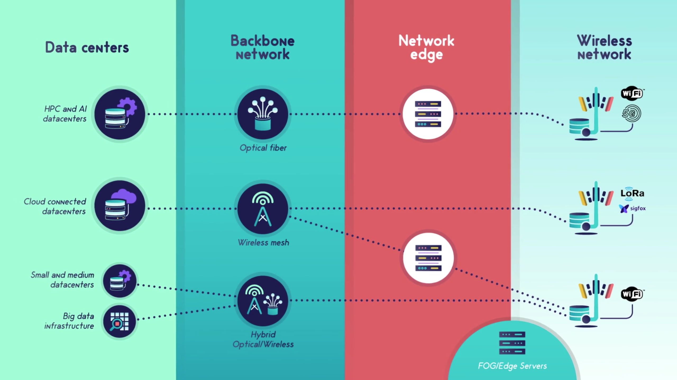
GRID’5000
FIT
SLICES/SILECS

Slide 10
In summary
SLICES: ESFRI Research infrastructure for experimental computer science and future services in Europe. Experiment on a single infrastructure, from edge to cloud
SILECS: French Research infrastructure based on existing instruments (FIT and Grid’5000)
Challenges
Design a software stack that will allow experiments mixing both kinds of resources while keeping reproducibility level high
Keep the existing infrastructures up while designing and deploying the new one
Keep the aim of previous platforms (their core scientific issues addressed)
Scalability issues, energy management, ...
IoT, wireless networks, future Internet
HPC, big data, clouds, virtualization, deep learning, ...
City-Scale wireless experimentations
Address new challenges
IoT and Clouds controllable testbeds
New generation Cloud platforms and software stacks (Edge, FOG)
Data streaming applications
Big data management and analysis from sensors to the (distributed) cloud
New Mobility models
Country-Scale wireless experimentations
Next generation wireless

