Slide 1
Predicting Wine Quality from Wine Chemistry

Slide 2
The Data Set Investigated
We looked at data provide by UCI for red and wine quality and various chemical constituents.
In al there were 1599 red wine varieties and 4808 white wind varietals.
The databases where unioned together for purposes of analysis

Slide 3
Preprocessing
The wine data table was very complete with no missing data.
Training and test data where collect based on a stratification method such that each wine quality and wine color would be represented in the test and training sets. 20% of the data were set aside for later testing and confirmation
The data are not particularly normal. See the following charts to see this situation

Slide 4
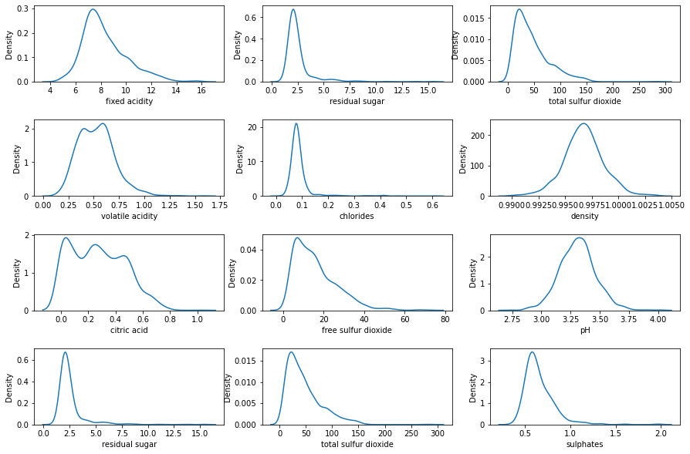
Density of the Combined Wine Color

Slide 5
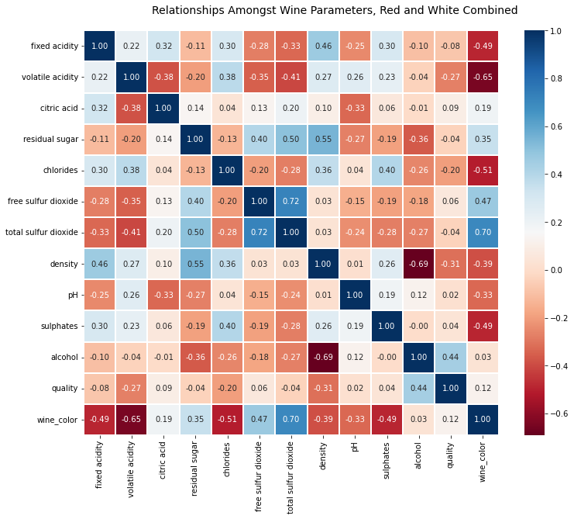
Correlation Heat Maps of the Exogenous Variables

Slide 6
Models Investigated
Order Logistic Model
Ordered Probit Model
Random Forest Generator (untuned)
Random Forest Generator Tuned

Slide 7
Ordinal Logit Model
Model picked because capable of regressing against and ordinal y.
Using the conventional statistics approach to select features our final model contained the following:
Volatile acidity
Residual Sugar
Free Sulfur Dioxide
Total Sulfur Dioxide
Density
pH
Sulphates
Alcohol
Wine Color
3/4 Intercept
4/5 Intercept
5/6 Intercept
6/7 Intercept
7/8 Intercept
8/9 Intercept

Slide 8
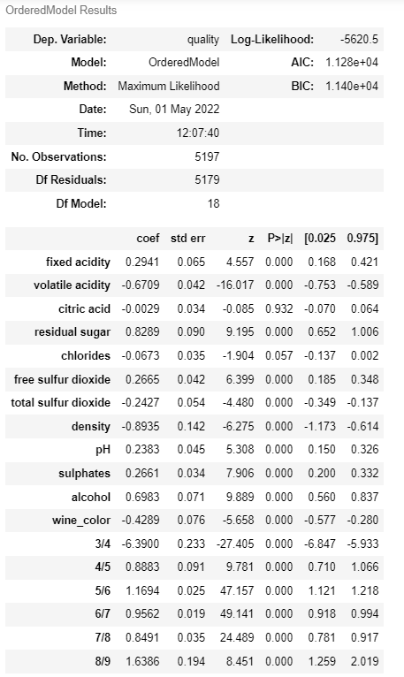
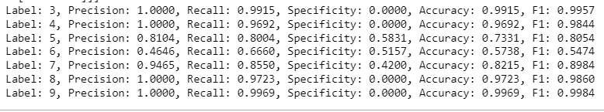
Summary of First Logit Model

Slide 9
Overall Fit for Logit Model 1
Overall this first model predicted the correct quality ~52% of the time
Additional Steps were taken with respect to removing weaker variables from the model.

Slide 10
Logit Model 2
In the second logit model we removed
fixed acidity (collinear with other acidity measures)
Chlorides (not a significant coefficient)
With these two adjustments accuracy improved to 53.6%

Slide 11
Ordered Probit
Rerunning the second model with a probit kernel didn’t improve the model meaningfully – accuracy was ~52%

Slide 12
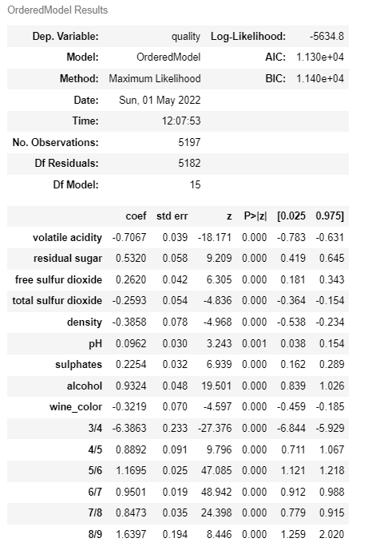
Second Logit Model Summary

Slide 13
Categorical Techniques
Using these categorical regression techniques have not provided robust predictive ability
Next we will examine the final model, a tuned random forest model

Slide 14
Tuned Random Forest
Using 5-fold cross validation and tuning the following hyperparameters using a deterministic search:
Max Depth
Max Features
Min Samples Leaf
Min Samples Split
N estimators
We find the best hyperparameter values are
Max Depth = 43
Max Features = Auto
Min Samples / Leaf =1
Min Samples Split =2
N estimators = 134

Slide 15
Final Results
Using the best hyperparameters the model improved dramatically to 64.5%

Slide 16
Areas for Additional Work
A second optimization should be done with additional hyperparameters.
Because the middle quality scores where not being predicted as well as the scores at either end, some consolidation and renaming of score values might improve the performance

Slide 17
Final Considerations on Model Usage
A model like this can be used to sample wine coming down the production line and use the model to get estimates on the quality of wine
Additional uses of this type of model would be in the area where materials need to be tested continuously

