Slide 1
1
RISC-V ISA Extension
Systolic Array Acceleration for Quantized Inference
Spike Modification
Randy Revaldo Pratama
阮金鴻
115165425

Slide 2
Outline
2
1.
Model
2.
Bottleneck Analysis
3.
ISA Extension and Architecture
4.
Result

Slide 3
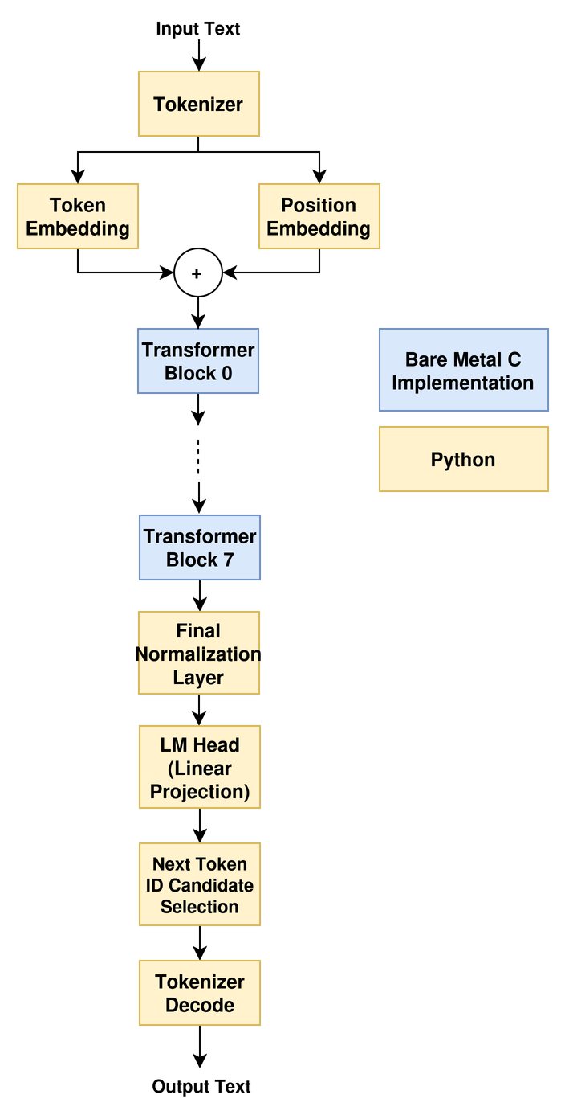
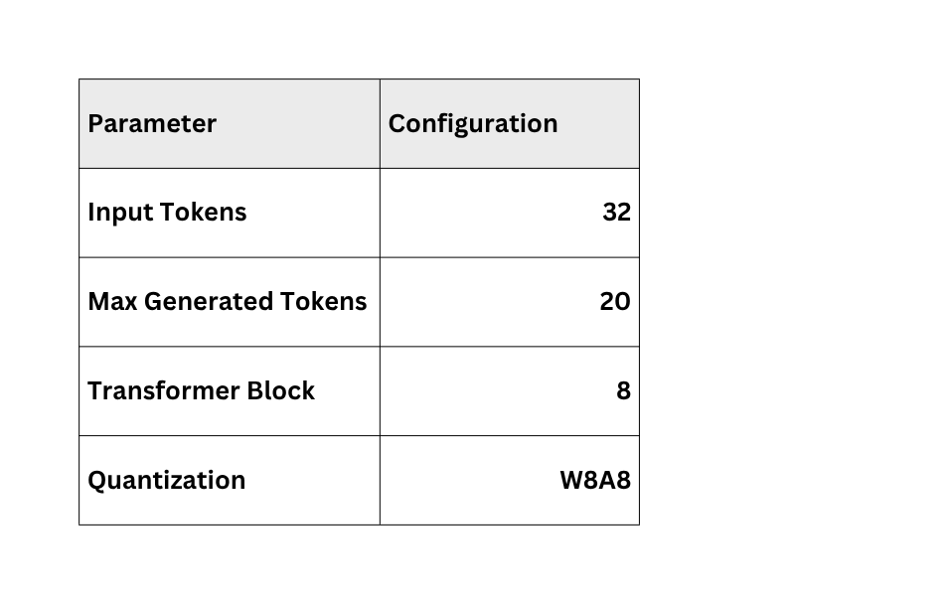
Model
3
This model is a TinyStories-3M Language Model, with architecture Based on GPT-NEO
TinyStories explores how small a language model can be while still generating coherent English, by training on simple children’s stories generated by GPT-3.5 and GPT-4.
Eldan, R., & Li, Y. (2023). TinyStories: How Small Can Language Models Be and Still Speak Coherent English? arXiv:2305.07759.

Slide 4
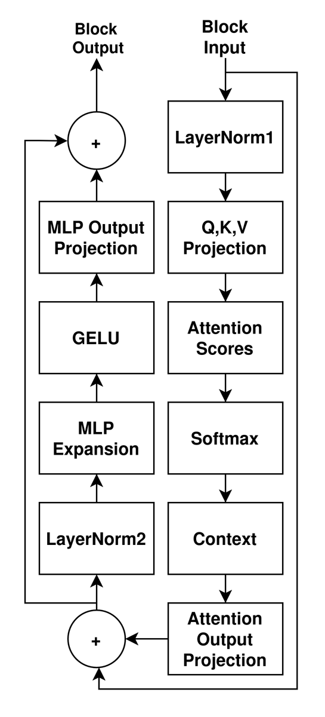
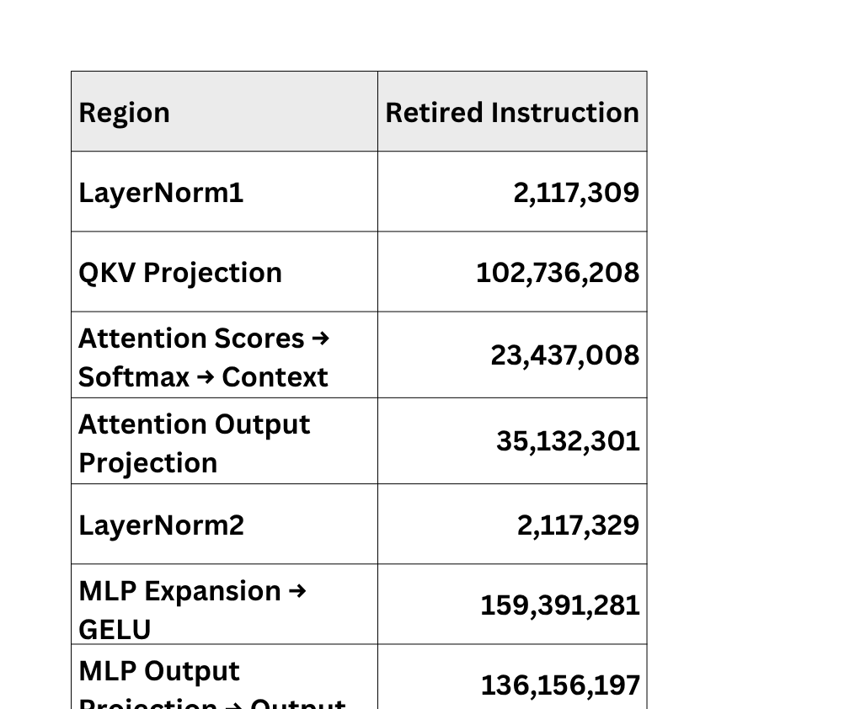
Bottleneck Analysis
4
Total Retired Instruction Across 8 Transformer Blocks
Inside Transformer Block
Requantization To INT8 is done after:
  LayerNorm1
  Q,K,V Projection
  Context
  Attention Output Projection
  LayerNorm2
  MLP Expansion
  GELU
  MLP Output Projection
  Final Addition

Slide 5
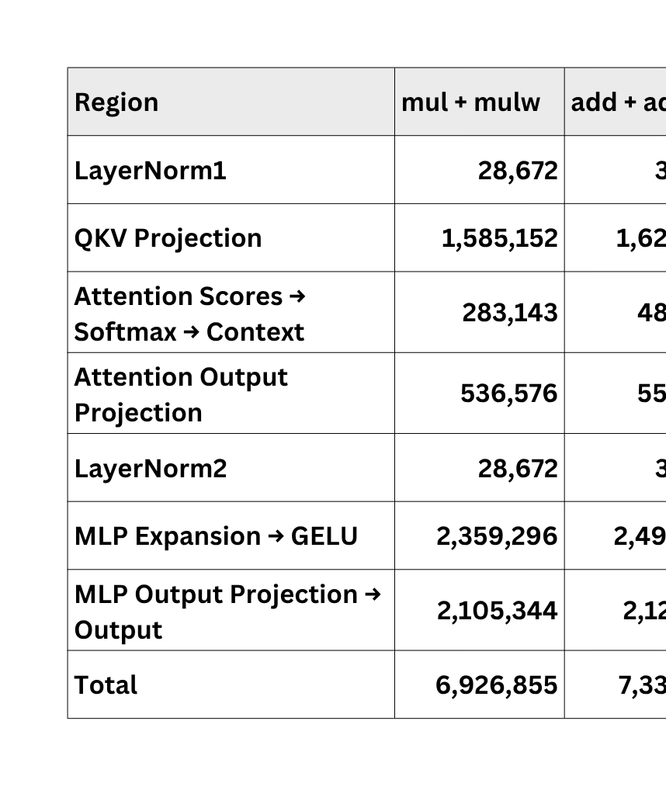
Bottleneck Analysis
5
Transformer Block 0 Retired Instruction Analysis
*Counted with the help of ChatGPT

Slide 6
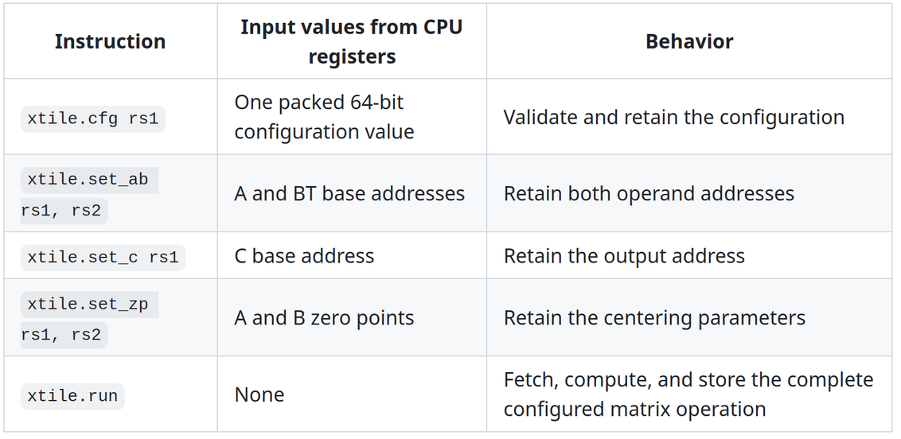
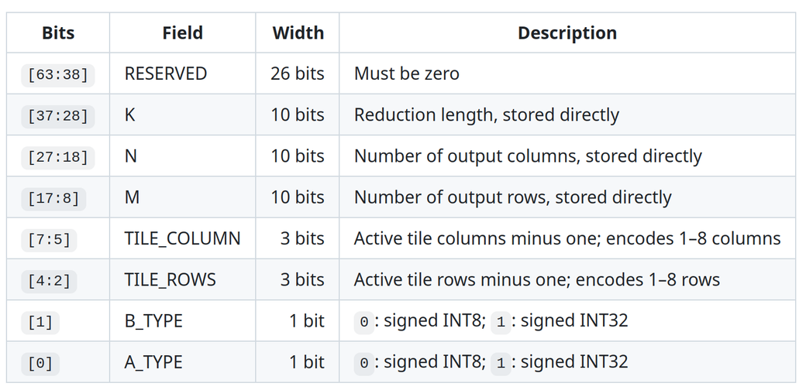
ISA Extension and Architecture
6
XTILE Instruction
Systolic array based instruction set for matrix multiplication accelerator
  Instruction Interface
  Configuration Register

Slide 7
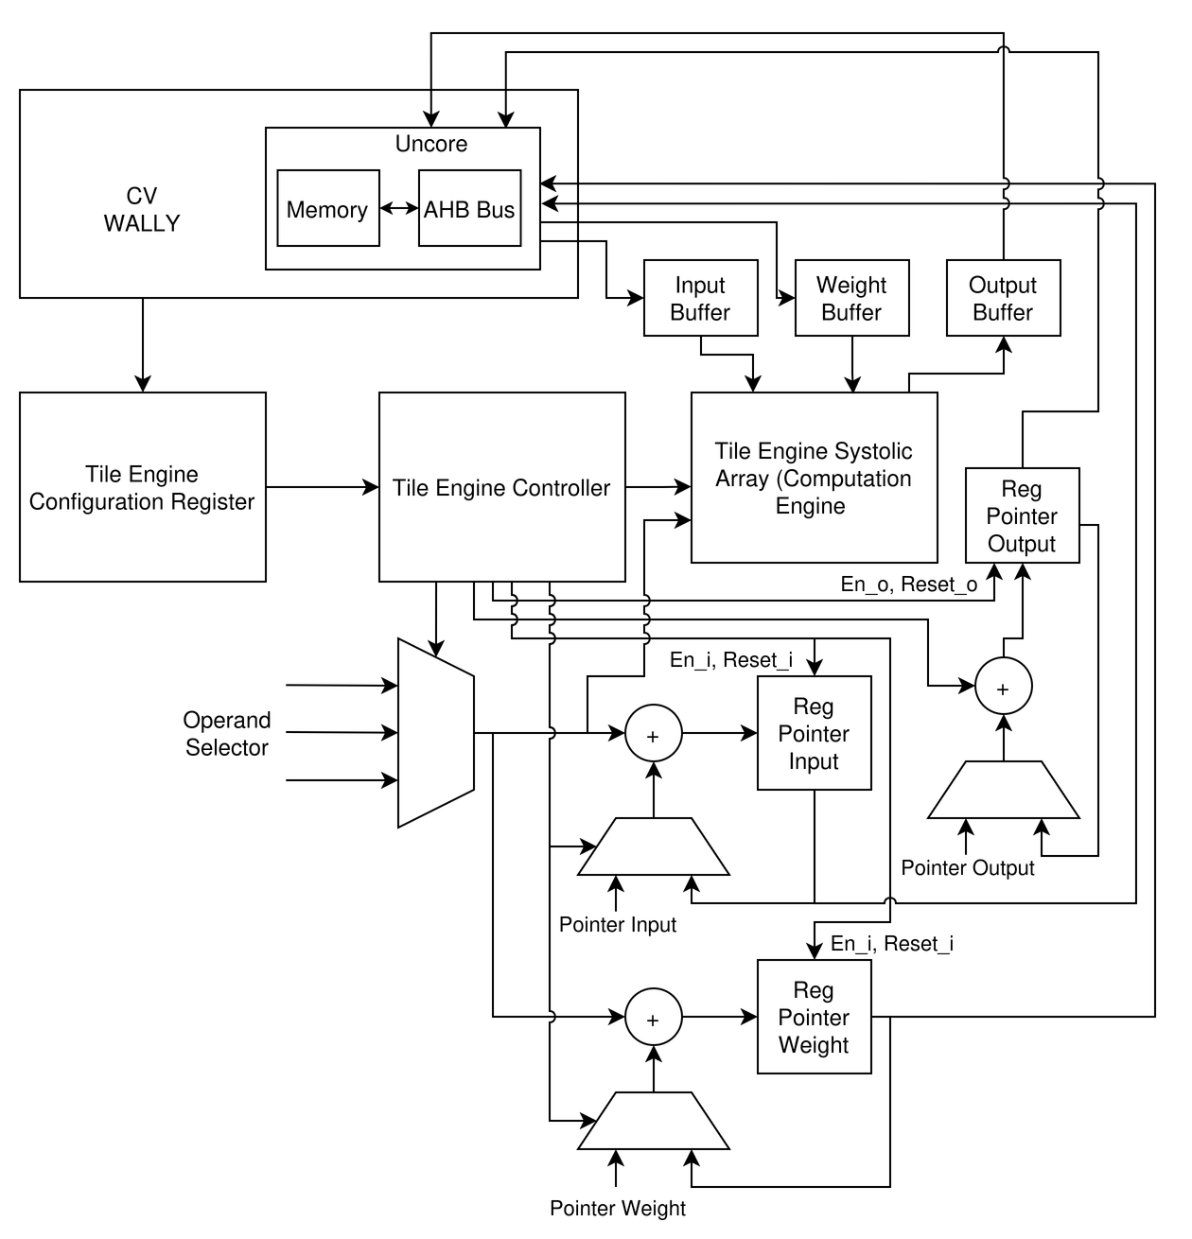
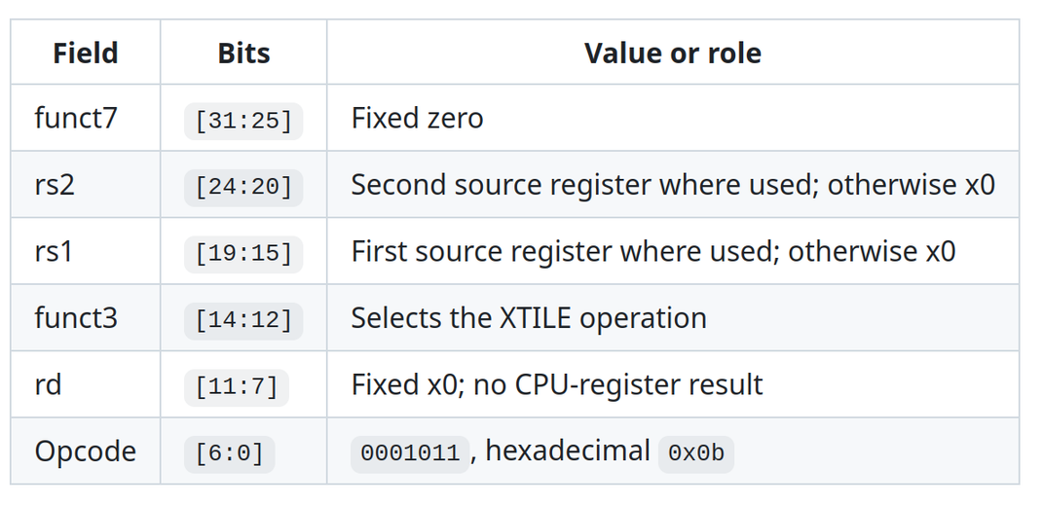
ISA Extension and Architecture
7
XTILE Instruction
  Overall Architecture
  Instruction Encoding
It uses custom-0 opcode space provided by RISC-V
*Not Yet Implemented

Slide 8
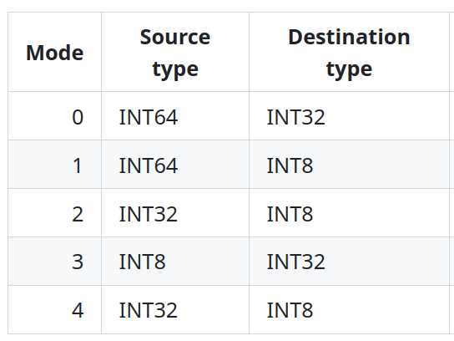
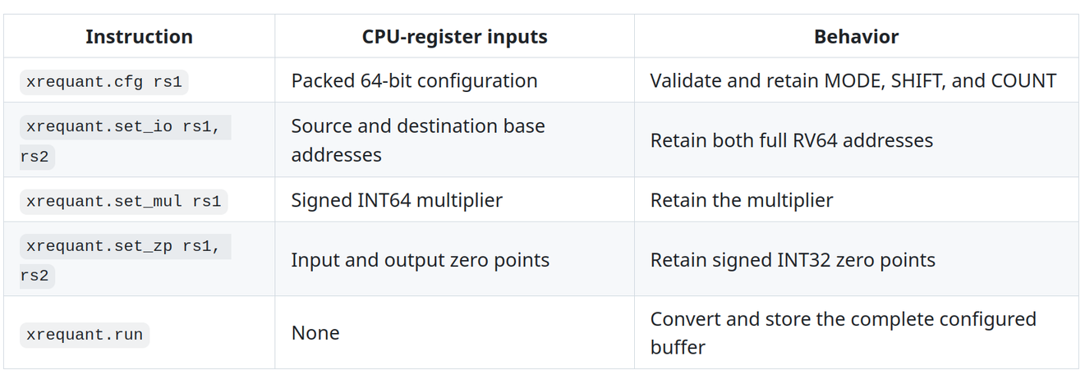
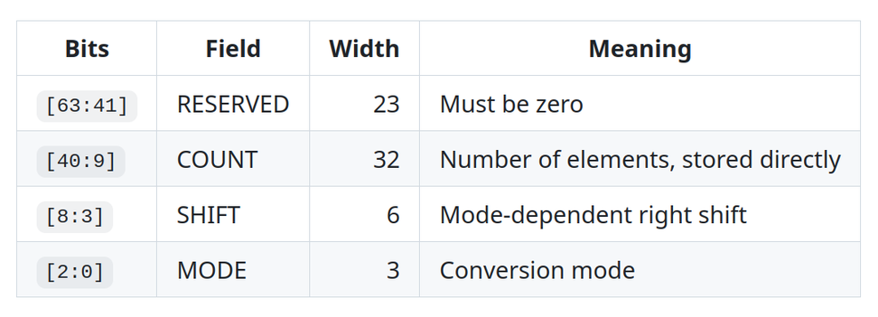


ISA Extension and Architecture
8
XREQUANT Instruction
Custom instruction set for the requantization
  Mode
  Instruction Interface
*Two-stage round-clamp
  Mode 0 - 3
*depends on each operation
  Configuration Register
  Mode 4
*Two-stage rounding was used in the bare-metal implementation to match the LiteRT reference model’s INT8 GELU output

Slide 9
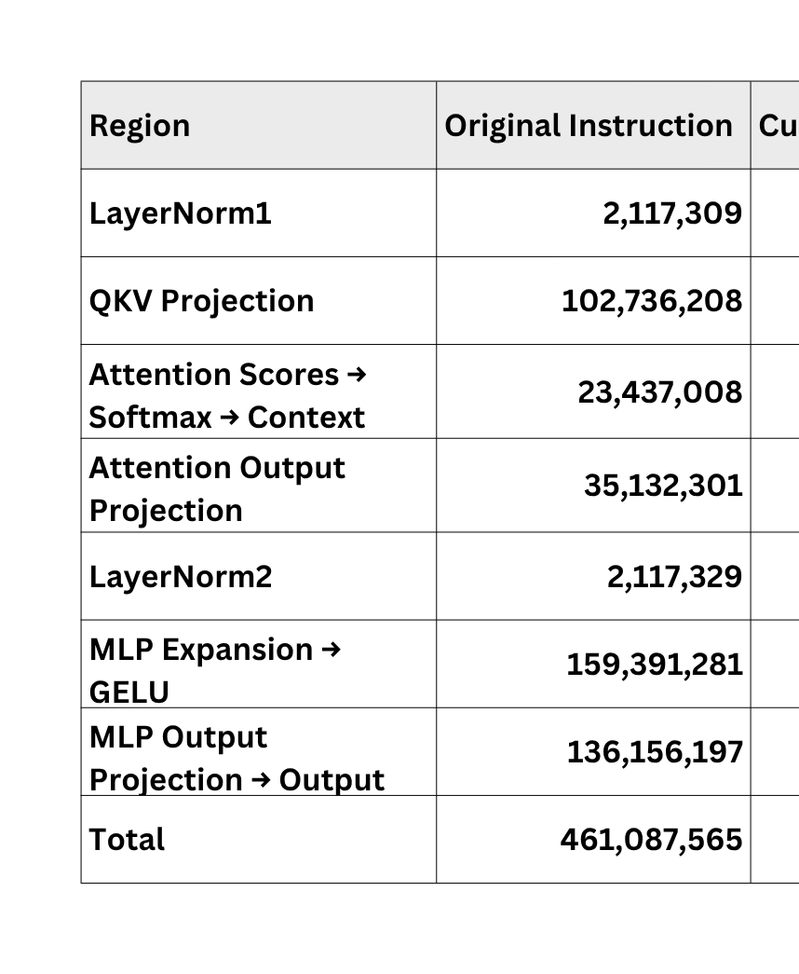
Result
9
Retired Instruction Reduction
*It does not mean the reduction in cycle, only reduction of the number of instructions
*Need adjustment for the matrix format to match the XTILE input format, so it mostly remains in scalar

Slide 10
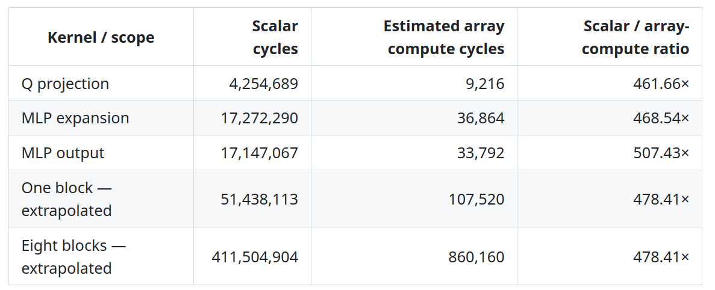

Result
10
Cycle Reduction Estimation
*Calculation helped by ChatGPT
  Only account for the systolic array with 8x8 Tiles
  Assume each PE has two multiplier stages followed by one accumulator stage ( 3 cycles )
  K = number of products accumulated for each output
  R = Row
  C = Column
  L = PE Cycles

Slide 11
11
Thank you

