Slide 1
Predictive Analytics with online data for wso2 machine learner with the support of ensemble method

Slide 2
Team Members
Herath H.M.H.R.
Pathinayake I.M.
Dias G.H.G.A.
Indujayani K.

Slide 3
Introduction
WSO2 Machine Learner has a versatile set of characteristics.
It can extract features from a dataset made available from a file system, Hadoop Distributed File System (HDFS) or WSO2 Data Analytics Server (DAS).
This data is passed on to the Machine Learner Core, which allows you to explore your datasets, pre-process your data and apply various machine learning algorithms to make sense out of it all.
Using Apache spark, it then analyzes and builds models with the chosen algorithms.
Recommendation engine capability allows you to provide product recommendations for users.

Slide 4
Research Problem
Although there are many products in the market which satisfy the some requirements most of them don’t address the following drawbacks
Use multiple visualizations to explore your data; scatter plots, histograms, Trellis charts, cluster diagrams and so on
Use feature engineering to pre-process data for better results
Easy Graphical User Interface for human friendly viewing

Slide 5
Research GAp

Slide 6
Objectives
The idea of incremental learning with streaming data focuses on two objectives.
Identifying patterns in the recent history
Updating the patterns with incoming data without catastrophic forgetting.
Apart from the above mentioned objectives the proposed research focus on the following objectives as well
Implement an ensemble method(s), to combine multiple algorithms.
Create a UI to include the end to end flow of training the algorithm.
Integrate it to the WSO2 Machine Learner

Slide 7
SPECIFIC OBJECTIVES
Designing an architecture for incremental learning and visualizations.
Creating the incremental learning component.
Creating interactive visualizations for incremental learning models
Allowing users to change parameters of the algorithms on the fly (during the incremental learning procedure) by analyzing the models.

Slide 8
Specific Objectives cont.
Implement ensemble method to combine multiple algorithms
Create a UI to include the end to end flow of training the algorithm.
Integrate it to the WSO2 Machine Learner.

Slide 9
Research Area
Data mining
uncovers relationships between measurable variables
Predictive Analytics – To predict future outcomes
surmises outcomes from measurable variables

Slide 10
Research Methodology.
In order to achieve the goals of the proposed project there are 5 major tasks to be completed. Those are,
Incremental learning component
Predictive model with streaming data
User enabled parameter changed of the algorithm on the fly
Data visualization component
Implement Ensemble methods.

Slide 11
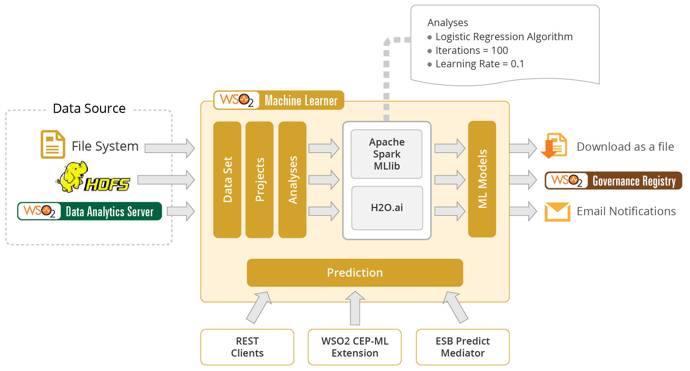
Design of the system

Slide 12
Tools and Techniques
Tools
Eclipse
Technologies
Machine Learning
Streaming data
Java
Scala
HTML 5
Java Script
Apache Spark

Slide 13
DESCRIPTION OF PERSONAL AND FACILITIES
Member | Component | Task
Herath H.M.H.R | Incremental Learning Component | Collect relevant data from data sources. Create interactive visualization for incremental learning model. Create the predictive model using Streaming linear regression algorithm. Change the parameters of the algorithm during the incremental learning procedure. Test the incremental learning component. Documentation.
Pathinayake I.M | Incremental Learning Component | Collect relevant data from data sources. Create interactive visualization for incremental learning model. Create the predictive model using k- means clustering algorithm. Change the parameters of the algorithm during the incremental learning procedure. Test the incremental learning component. Documentation.

Slide 14
Member | Component | Task
Dias G.H.G.A | Incremental Learning Component | Collect relevant data from data sources. Create interactive visualization for incremental learning model. Create the predictive model using Support vector machine algorithm. Change the parameters of the algorithm during the incremental learning procedure. Test the incremental learning component. Documentation.
Indujayani K | Ensemble Method Component | Collect relevant data from data sources.(relevant algorithms) Create a UI to include the end to end flow of training the algorithm. Create ensemble method to get the most accurate prediction. Testing. Documentation.

Slide 15
refErences
[1] [Online] Available: https://docs.wso2.com/display/GSoC/Project+Proposals+for+2016#ProjectProposalsfor2016-Proposal6:[ML]PredictiveanalyticswithonlinedataforWSO2MachineLearner [Accessed: February 29th, 2016]
[2] [Online]. Available: https://docs.wso2.com/display/ML110/Features [Accessed: February 29th, 2016]
[3] [Online]. Available: The Wall Street Journal, Thomas H. Davenport [Accessed: March 1st, 2016]
[4] [Online]. Available: http://arxiv.org/pdf/1412.5720.pdf [Accessed: March 1st, 2016]
[5] [Online]. Available: http://www.laits.utexas.edu/~anorman/BUS.FOR/course.mat/Alex/ [Accessed: March 3rd, 2016]
[6] [Online]. Available: Ensemble Learning, Martin Sewell [Accessed: March 8th , 2016]
[7] [Online]. Available: https://docs.wso2.com/display/GSoC/Project+Proposals+for+2016#ProjectProposalsfor2016-Proposal4:[ML]EnsembleMethodsSupportforWSO2MachineLearner [Accessed: March 8th, 2016]

Slide 16
Thank You!

