Slide 1
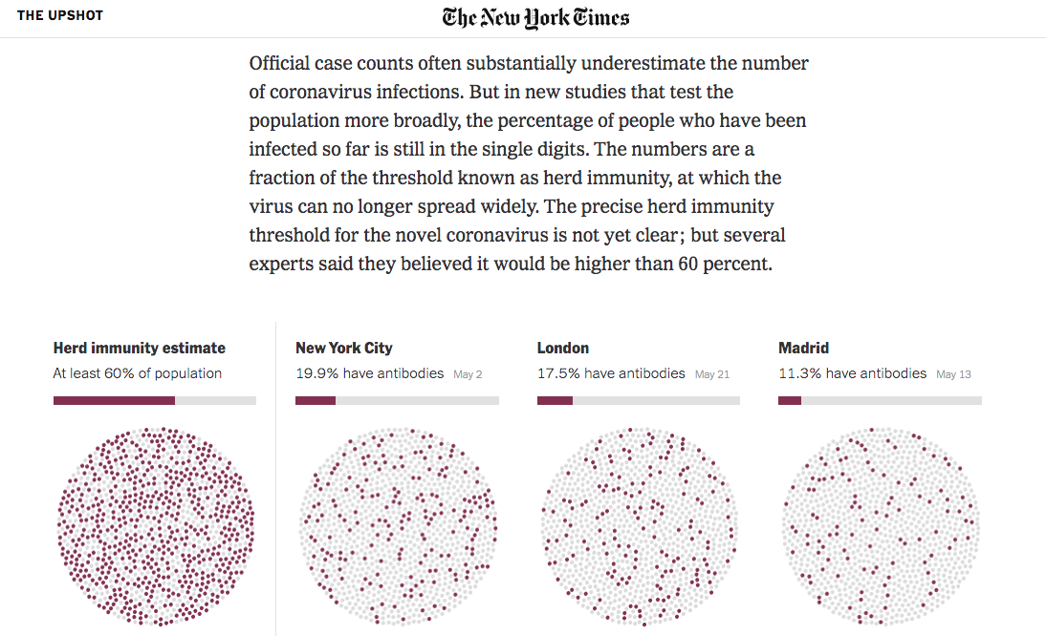
Presenting and storytelling with data
Randy Leonard
Digital frameworks
Northwestern University – Spring 2020
Github.com/randyleonard99/digitalframeworks-spring2020

Slide 2
Steps to a data story
Find data
Clean data
Analyze data
Present data

Slide 3
Storytelling forms
What have you seen on the web?

Slide 4
Storytelling forms
What have you seen on the air?

Slide 5
Storytelling forms
Alternative storytelling forms
Get people associating information with visuals
Delivers information in bite-sized chunks
Makes the news more accessible

Slide 6
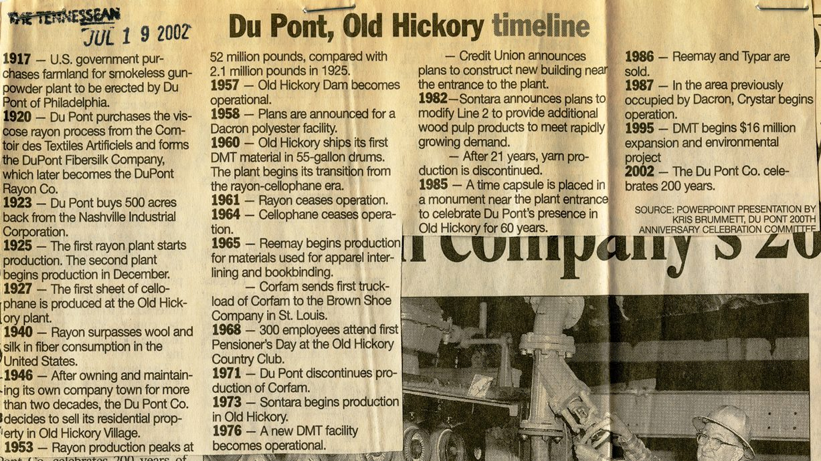
Storytelling forms
Alternative storytelling forms
They’re not new

Slide 7
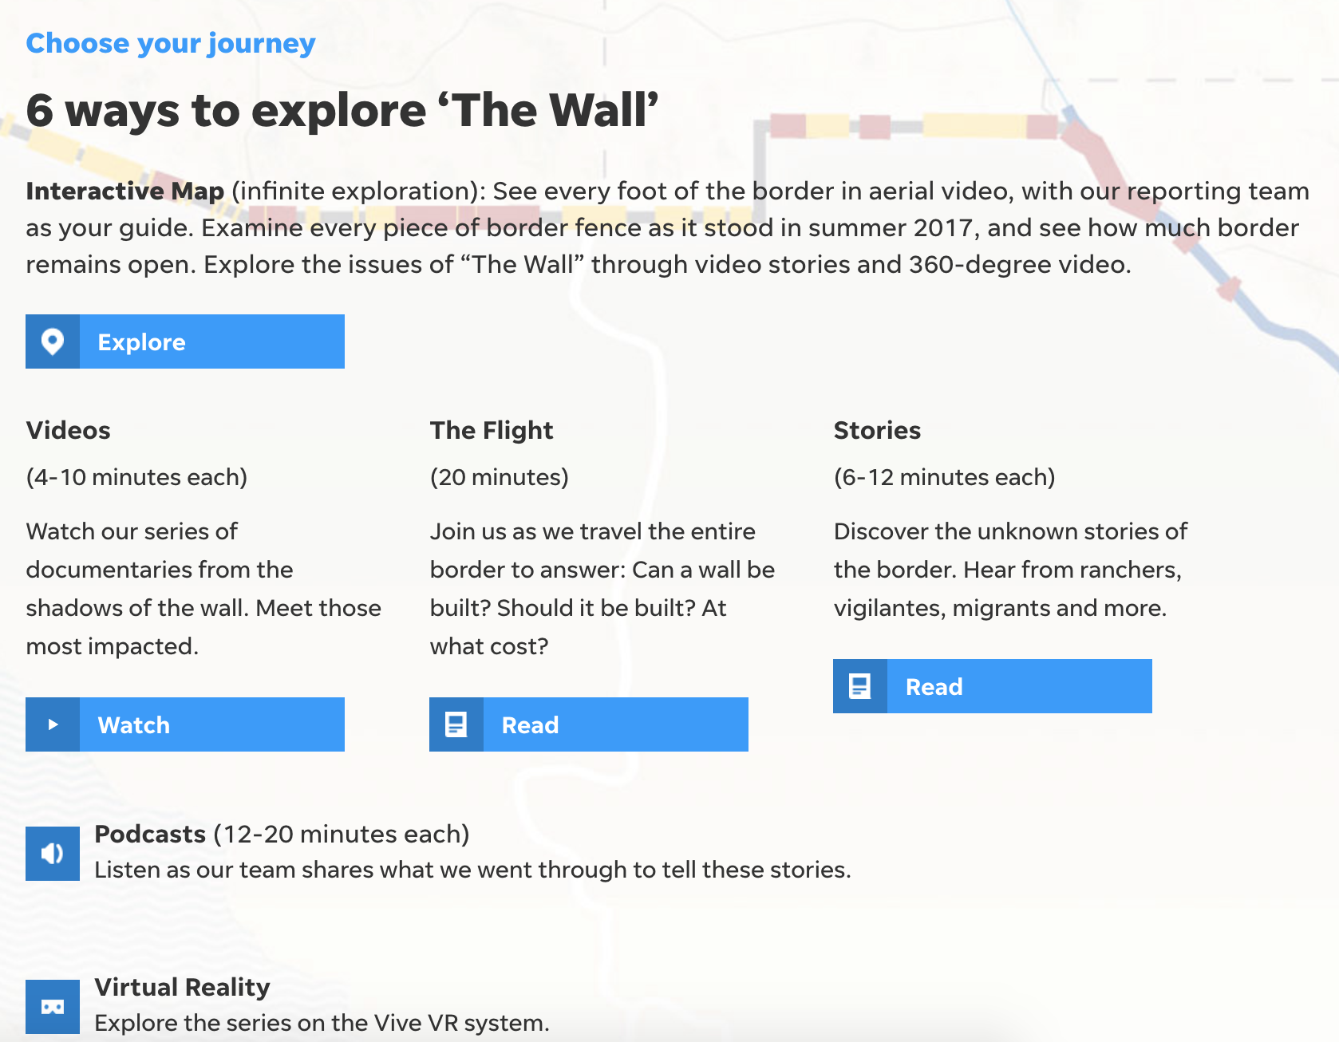
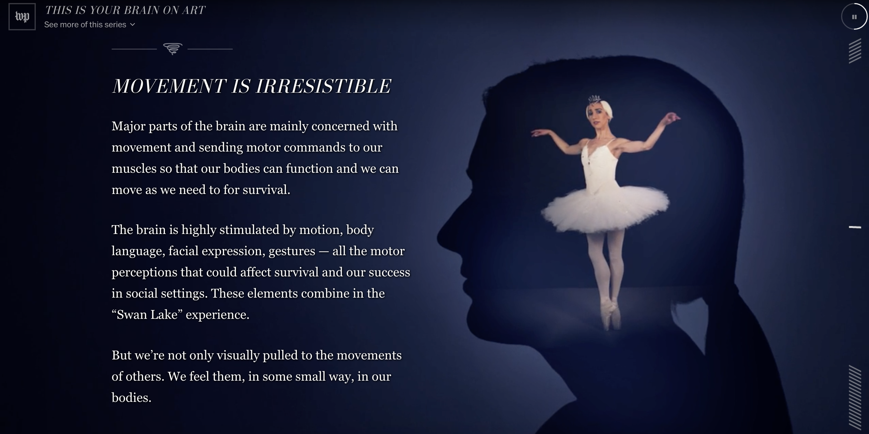
Storytelling forms
Can be data viz, but don’t have to be

Slide 8
Storytelling forms
Scrollytelling
Can make long text feel short, mesh photo/video and data visuals
https://graphics.reuters.com/INDIA-RIVER/010081TW39P/index.html
https://www.nytimes.com/interactive/2015/01/09/sports/the-dawn-wall-el-capitan.html?mtrref=vallandingham.me
https://graphics.reuters.com/ENVIRONMENT-PLASTIC/0100B275155/index.html

Slide 9
Storytelling forms
Small data to big data, or vice versa
Tell people a story, then give them option to explore
https://projects.fivethirtyeight.com/redistricting-maps/arkansas/#Proportional
https://graphics.wsj.com/medicare-billing/

Slide 10
Storytelling forms
Games
Entertaining way to interact with data
https://wamu.org/commuter-challenge/
https://www.270towin.com/

Slide 11
Storytelling forms
Exploring individual data points
https://www.washingtonpost.com/graphics/2018/national/mass-shootings-in-america/?utm_term=.d9db61664e3
https://www.washingtonpost.com/graphics/national/police-shootings/?itid=sf_

Slide 12
Storytelling forms
Broadcast
Find persons who story affects
https://www.youtube.com/watch?t=6&v=zIGLZpjqubM

Slide 13
Assignment
Tell me what more you want to cover for next week’s class:
https://forms.gle/LjCq8iVmVBfSm4tz7

