Slide 1
Ultra-low dose PET imaging using Bayesian
By Randyll Pandohie
STA 7348 - Bayesian Modeling and Computation

Slide 2
CONTENTS
1 Introduction - Background
2 Model, Goal, and Data Set
3 Bayesian Theory
4 Analysis

Slide 3
INTRODUCTION
The major challenge in medical imaging is obtaining an image without any significant information.
The images obtained may be corrupted by noise or artifacts during the process of acquisition and processing. Medical images poses signal dependent noises in which we cannot use conventional image processing

Slide 4
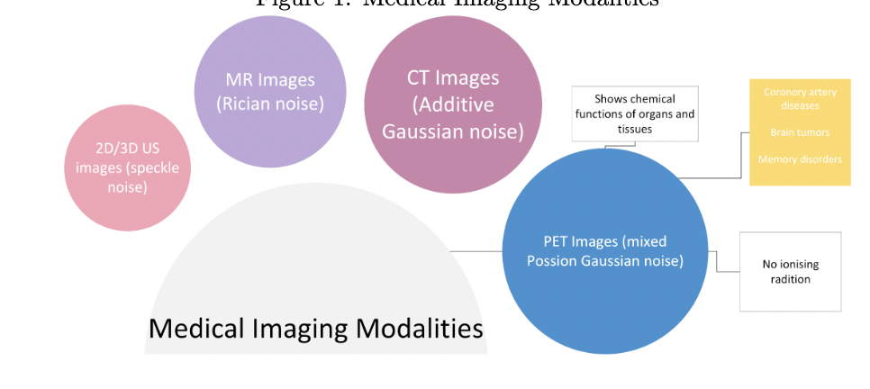
PET SCANS
Positron emission tomography or (PET) is a visualization tool used for the molecular pathway and is one of the most sensitive molecular imaging modalities presently in use for clinics and hospitals.
The major uses of PET images is identification of coronary artery disease, brain tumors and memory disorder

Slide 5
PET SCANS FEATURES
The PET images has mixed Poisson and Gaussian noise. It is characterized by a low Signal to Noise Ratio (SNR) and blurred edges.
PET image reconstruction and enhancements is an ill-posed inverse problem and the low dose PET imaging makes it even more challenging.

Slide 6
Model, Goal and Dataset
GOAL
The goal of this project was to create a Bayesian model to determine firstly the dosage levels and secondly apply a denoising technique. The desirable features of the medical imaging algorithm include the following: 1. Edge Preservation: Abnormalities are often caused by the mass replication of cells in the body. 2. Maintaining Structural Similarity 3. Speed and complexity: images should be computationally efficient and rend the computational results. 4. Tolerable data requirement: should be able to be easily generalized

Slide 7
Model, Goal and Dataset
Bayesian
The model that was selected was gamma prior, proposal poisson and posterior gamma poisson.
Based on the classification a denoising algorithm was applied: TV regularization coding and FISTA + TV regularization coding

Slide 8
Model, Goal and Dataset
DATASET
The training dataset contained .IMA files or slices of the PET image which contained 560 subjects of whole-body 18F-FDG PET imaging, acquired from Siemens Biograph Vision Quadra (n=230) and United Imaging uEXPLORER (n=330)
The test dataset included 50 subjects of low statistics scanned with Siemens Biograph Vision Quadra and United Imaging uEXPLORER.

Slide 9
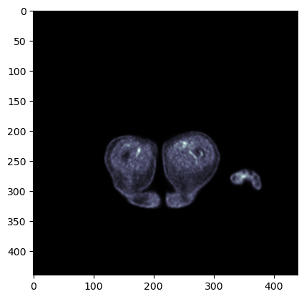
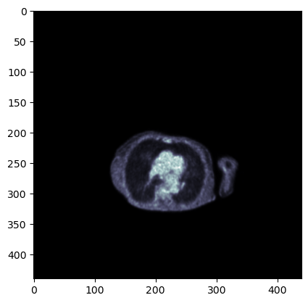
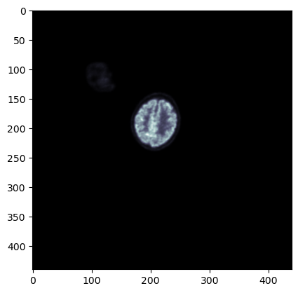
Model, Goal and Dataset
DATASET

Slide 10
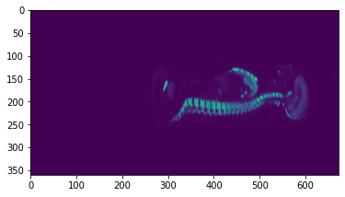
Model, Goal and Dataset
DATASET

Slide 11
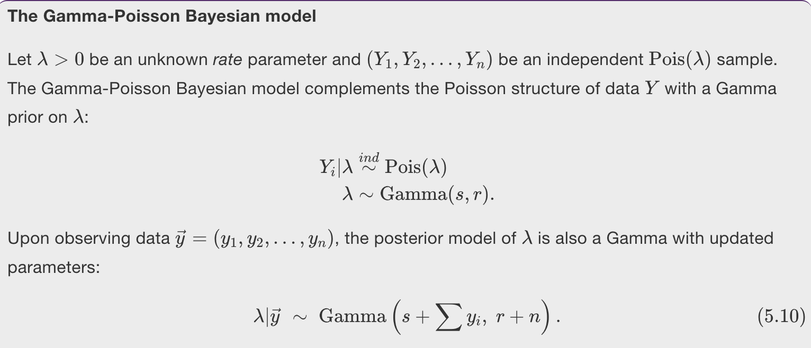
Bayesian Theory

Slide 12
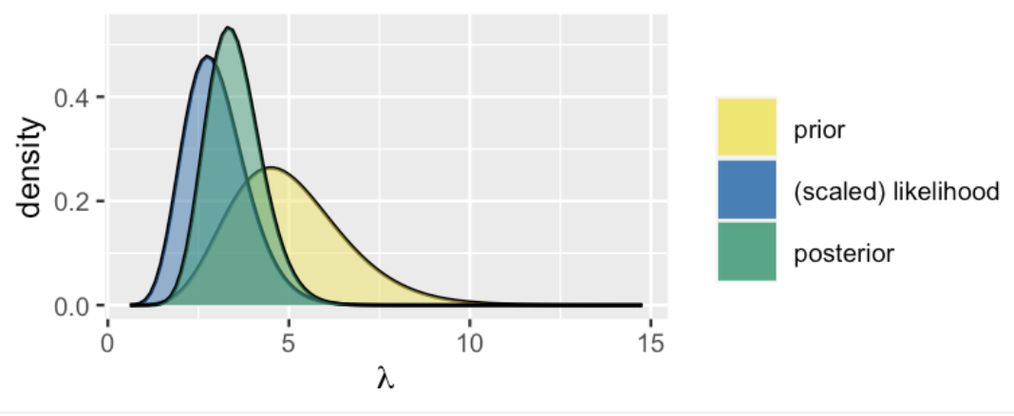
Bayesian Theory

Slide 13
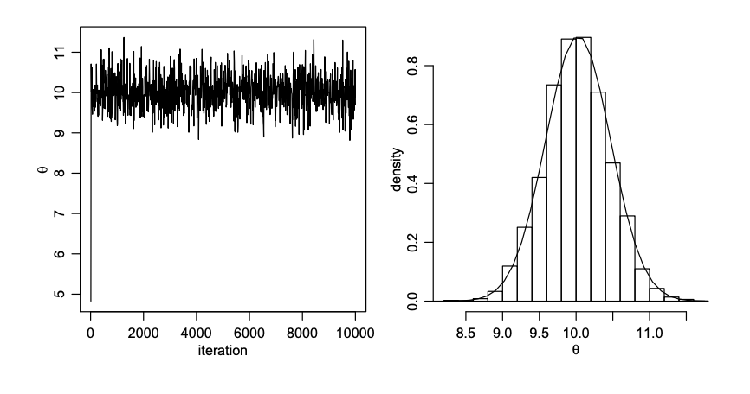
Bayesian Theory
Metropolis-Hastings algorithm

