Slide 1
Chest X-Ray Images (Pneumonia) Detection
By Randyll Pandohie
STA 6707 Multivariate Statistical Methods
Project Presentation

Slide 2
CONTENTS
1 Introduction
2 Model, Goals and Dataset
3 Multivariate Theory
4 Analysis
5 Results
6 Discussion
7 References

Slide 3
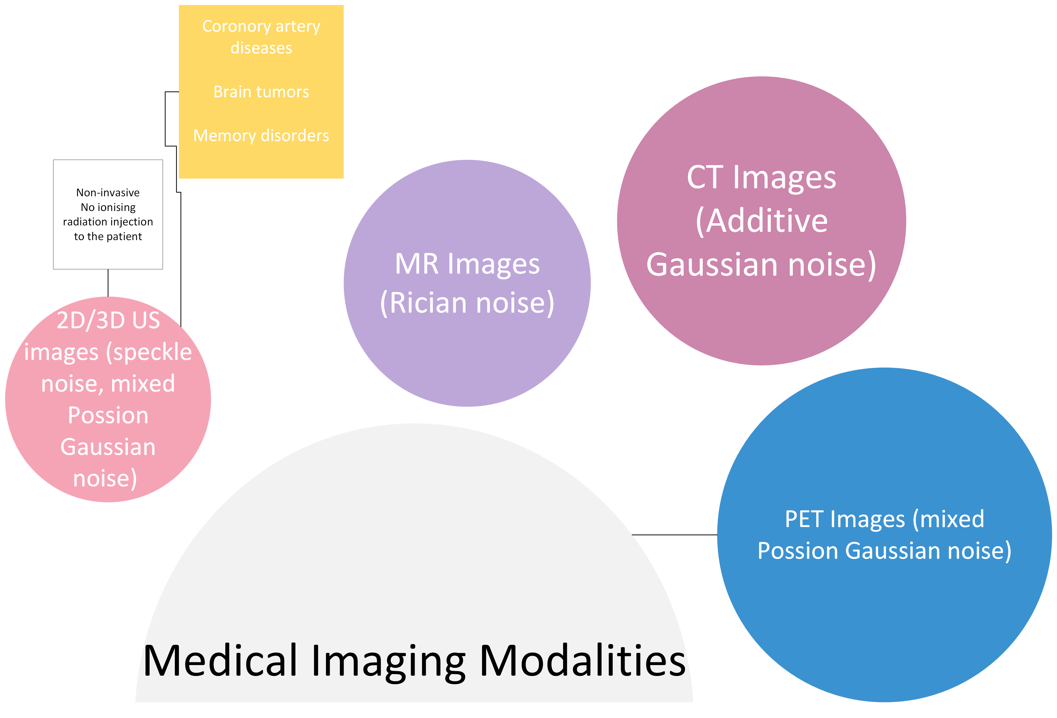
INTRODUCTION
The major challenge in medical imaging is obtaining an image without any significant information
The images obtained may be corrupted by noise or artifacts during the process of acquisition and processing.
Medical images poses signal dependent noises in which we cannot use conventional image processing.

Slide 4
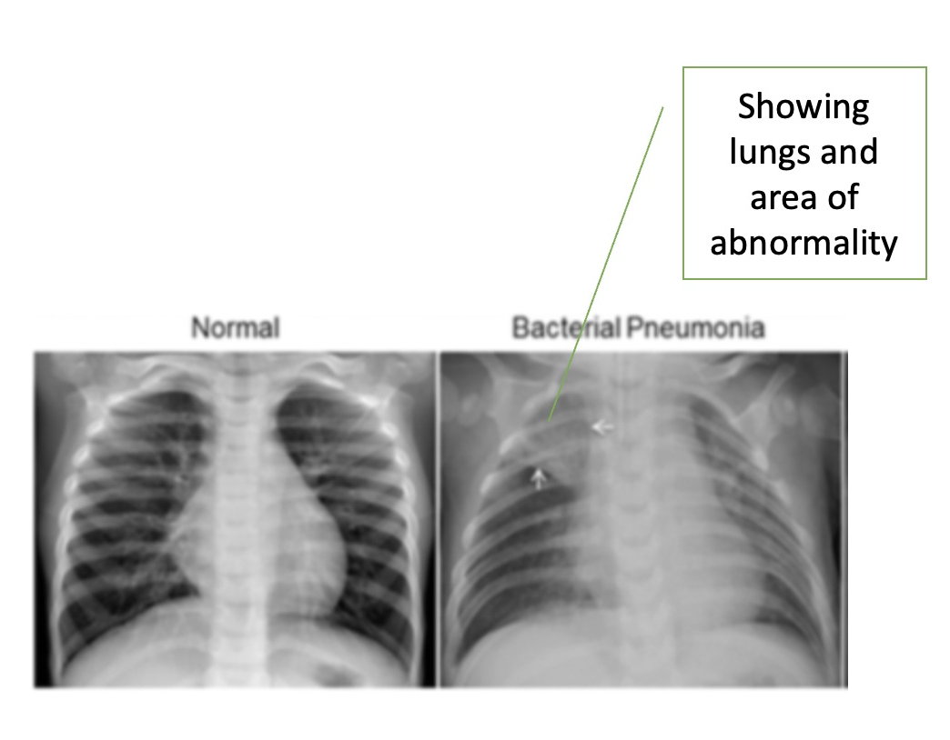
Statistical Problem
The Statistical problem is to reduce the dimensions of X-ray images to the form in which the data could predict pneumonia.

Slide 5
GOAL
The goal of this study is two fold using the X-ray images:
Predict and classify the images into normal or pneumonia
Using PCA to reduce the data dimensions in the dataset and determine the performance of the reduced dimensions

Slide 6
DATASET
The dataset provided was organized into 3 folders (train, test, val) and contains subfolders for each image category (Pneumonia/Normal). There are 5,863 X-Ray images (JPEG) and 2 categories (Pneumonia/Normal).Predict and classify the images into normal or pneumonia
The Chest X-ray images (anterior-posterior) were selected from retrospective cohorts of pediatric patients of one to five years old from Guangzhou Women and Children’s Medical Center, Guangzhou.
Notes:
For the analysis of chest x-ray images, all chest radiographs were initially reviewed for quality control by removing all low quality or unreadable scans. The diagnoses for the images were examined by two expert physicians before being cleared for being accepted into the dataset. In order to account for any classification errors, the evaluation set was also vetted by a third expert.

Slide 7
MULTIVARIATE THEORY
Principal Component Analysis
Normalize the data
Build the covariance matrix
Compute the eigenvectors and eigenvalues of the covariance matrix to identify the Principal Components
Feature Vector
Recast the data along the Principal Components Axes
Selected 95% as the value for the variance

Slide 8


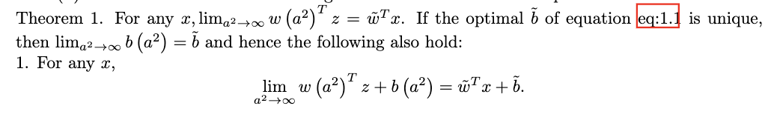
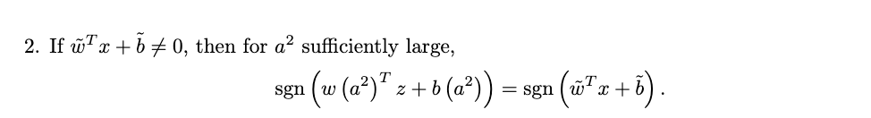
MULTIVARIATE THEORY
SVMs

Slide 9
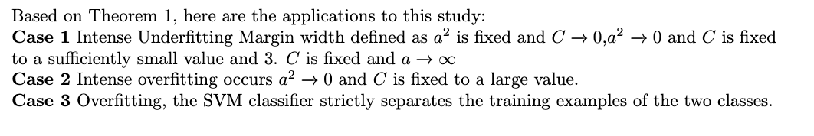
MULTIVARIATE THEORY
SVMs

Slide 10
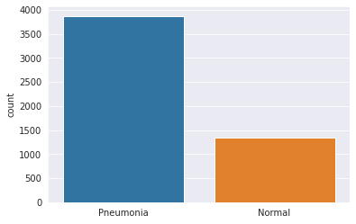
ANALYSIS
Imbalanced Dataset of pneumonia cases were higher
SVM In the first stage the SVM prediction was trained with the resized images. The size of the dimensions was 30,000 which is a large p value. This was performed using the wavelet or a customized kernel to show the use of the various kernels. The hyperparameters for C and a were tuned and were set at 10 and 0.1 respectively.
In the second stage the PCA algorithm described previously was utilized to reduce the number of dimensions.
Notes:
SVM

Slide 11
RESULTS
Non-PCA
30000 columns
20 s
95.88
PCA
30000 columns
5 s
95.11
Dimensions
Speed
Accuracy

Slide 12
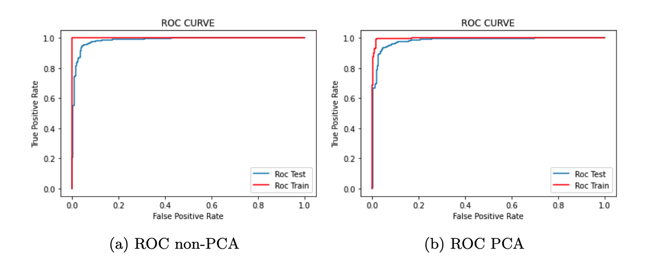
RESULTS

Slide 13
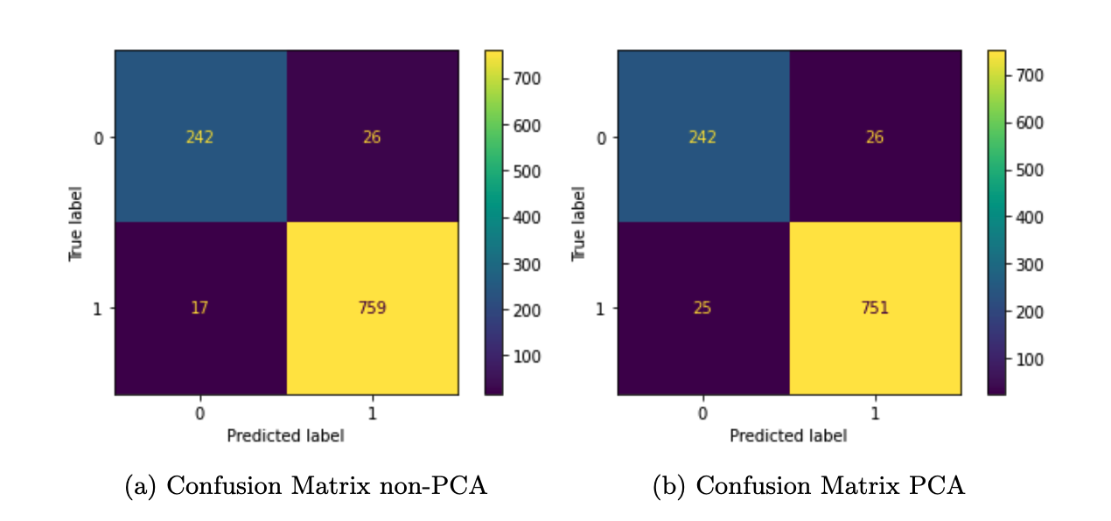
RESULTS

Slide 14
CONCLUSION
LIMITATION High dimensional data and large storage
Long runtime
FUTURE USES Diagnosis of severity
Covid-19 and abnormality detection
KERNEL Using wavelet Kernel for image processing
HYPERPARAMETER Looking at C for SVM and kernel parameter
The results of the experiment showed reduction in storage and computational needs when using PCA. The accuracy in prediction using SVMs with a customized wavelet kernel was over 95%.

Slide 15
REFERENCES
[1] Sameera V. Mohd Sagheer and Sudhish N. George. A review on medical image denoising algorithms. Biomedical Signal Processing and Control, 61:102036, 2020. [2] Daniel S. Kermany, Michael Goldbaum, Wenjia Cai, et al. Cell, 172(5):1122–1131.e9, Feb 2018. [3] Jing Hou, Dachao Lv, Yuexia Sun, Pan Wang, Qingnan Zhang, and Jan Sundell. Children’s respiratory infections in tianjin area, china: Associations with home environments and lifestyles. Int J Environ Res Public Health, 17(11), June 2020. [4] Bernhard Flury. Common Principal Components & Related Multivariate Models. John Wiley & Sons, Inc., USA, 1988. [5] Wolfgang Karl. H ̈ardle and Zdenˇek. Hl ́avka. Multivariate Statistics Exercises and Solutions. Springer Berlin Heidelberg, Berlin, Heidelberg, 2nd ed. 2015. edition, 2015. [6] Bernhard N. Flury and Walter Gautschi. An algorithm for simultaneous orthogonal transformation of several positive definite symmetric matrices to nearly diagonal form. SIAM Journal on Scientific and Statistical Computing, 7(1):169–184, 1986. [7] Dario Radeˇci ́c. Principal component analysis (pca) from scratch in python, Mar 2022. [8] Ian T Jolliffe and Jorge Cadima. Principal component analysis: a review and recent developments. Philos. Trans. A Math. Phys. Eng. Sci., 374(2065):20150202, April 2016. [9] Robert Hable. Asymptotic normality of support vector machine variants and other regularized kernel methods. Journal of Multivariate Analysis, 106:92–117, 2012. [10] Hsin-Hsiung Huang, Feng Yu, Xing Fan, and Teng Zhang. Robust regularized low-rank matrix models for regression and classification. CoRR, abs/2205.07106, 2022. [11] Moulay A. Akhloufi and Mohamed Chetoui. Chest XR COVID-19 detection. https: //cxr-covid19.grand-challenge.org/, August 2021. Online; accessed September 2021.

