Slide 1
3-4-2 OpenVPN

Slide 2
You Want a VPN
But a SIMPLE One
and IPsec is Not Simple
2-4-1 OpenVPN
Creative Commons: Attribution-NonCommercial-ShareAlike

Slide 3
OpenVPN
Open Protocol
Open Source Tools
Not Known to be Pwned by the NSA, GCHQ, …
2-4-1 OpenVPN
Creative Commons: Attribution-NonCommercial-ShareAlike

Slide 4
Easy to Install
Free Server(s)
Easy to Install
Free Clients
They Interoperate!
2-4-1 OpenVPN
Creative Commons: Attribution-NonCommercial-ShareAlike

Slide 5
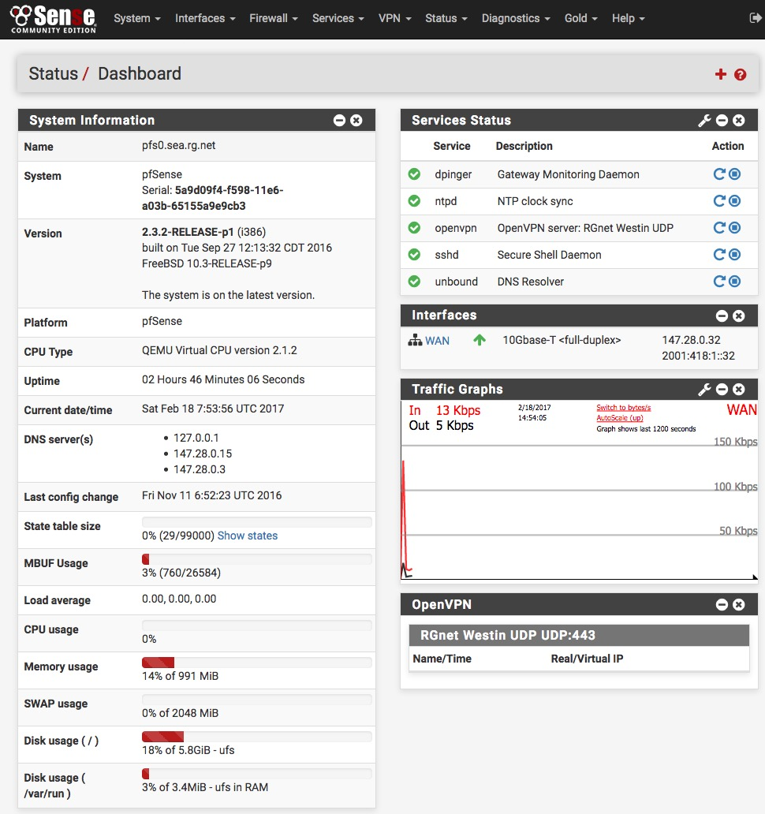
OpenVPN Server
pfSense
2-4-1 OpenVPN
Creative Commons: Attribution-NonCommercial-ShareAlike

Slide 6
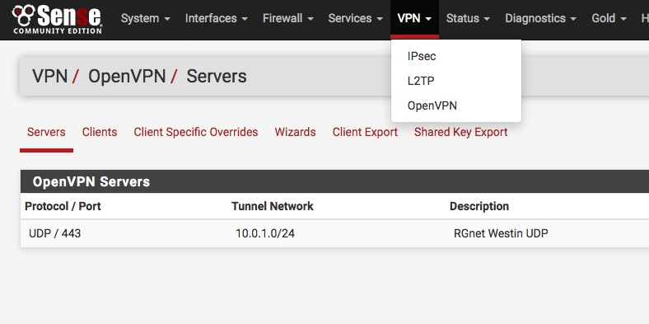
VPN Server
2-4-1 OpenVPN
Creative Commons: Attribution-NonCommercial-ShareAlike

Slide 7
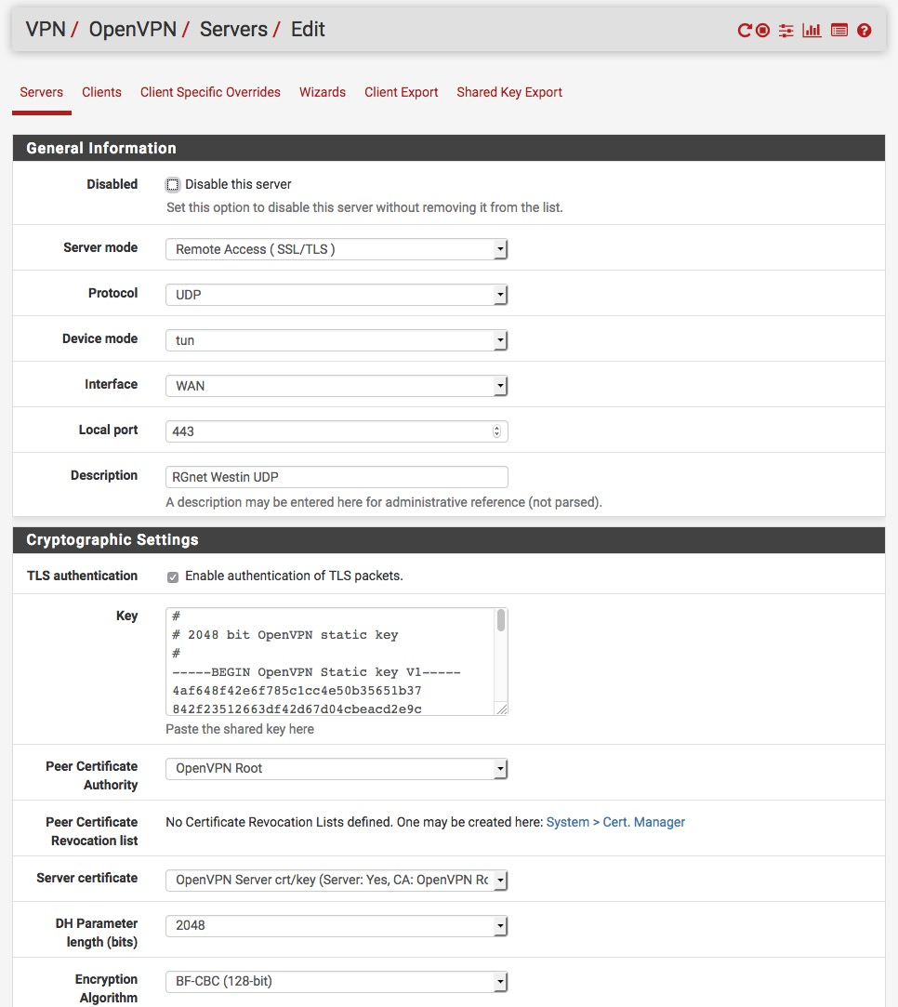
Configuration!
2-4-1 OpenVPN
Creative Commons: Attribution-NonCommercial-ShareAlike

Slide 8
Select a Client
http://psg.com/1.html
2-4-1 OpenVPN
Creative Commons: Attribution-NonCommercial-ShareAlike

Slide 9
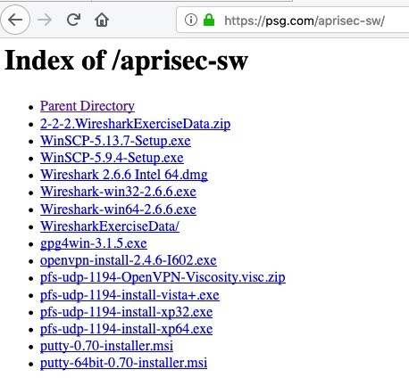
Or Get One Here
2-4-1 OpenVPN
Creative Commons: Attribution-NonCommercial-ShareAlike

Slide 10
OpenVPN Clients for Various Platforms
OpenVPN Community Client - Binaries for Windows, Source for other platforms.
OpenVPN For Android - Recommended client for Android
FEAT VPN For Android - For older versions of Android
OpenVPN Connect: Android (Google Play) or iOS (App Store) - Recommended client for iOS
Viscosity - Recommended GUI client for Mac OSX $$
Tunnelblick - Free client for OSX
2-4-1 OpenVPN
Creative Commons: Attribution-NonCommercial-ShareAlike

Slide 11
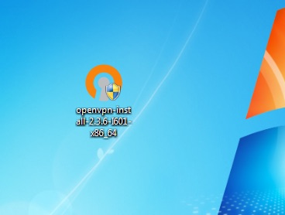
Download Installer
2-4-1 OpenVPN
Creative Commons: Attribution-NonCommercial-ShareAlike

Slide 12
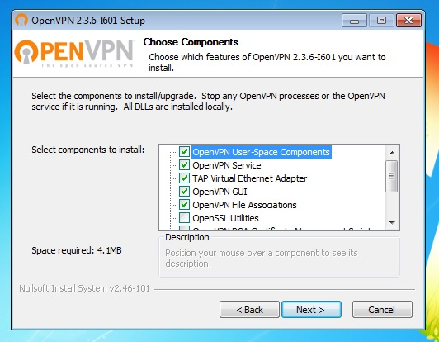
Run Installer
2-4-1 OpenVPN
Creative Commons: Attribution-NonCommercial-ShareAlike

Slide 13
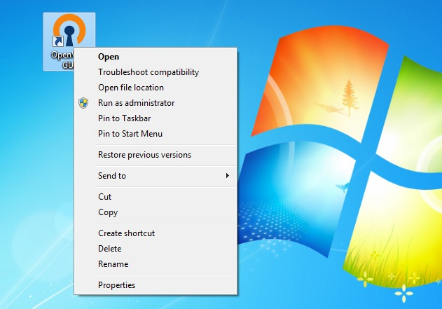
Set RunAsAdmin
So Client Can Install Routes
2-4-1 OpenVPN
Creative Commons: Attribution-NonCommercial-ShareAlike

Slide 14
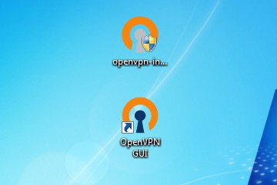
You Can Delete Installer
Open GUI (invisible)
2-4-1 OpenVPN
Creative Commons: Attribution-NonCommercial-ShareAlike

Slide 15
Get Credentials
MacOS
Windows Vista and later
(32-bit), Windows XP
(64-bit), Windows XP
2-4-1 OpenVPN
Creative Commons: Attribution-NonCommercial-ShareAlike

Slide 16
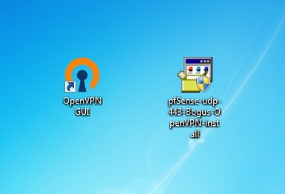
Execute Credential EXE
2-4-1 OpenVPN
Creative Commons: Attribution-NonCommercial-ShareAlike

Slide 17
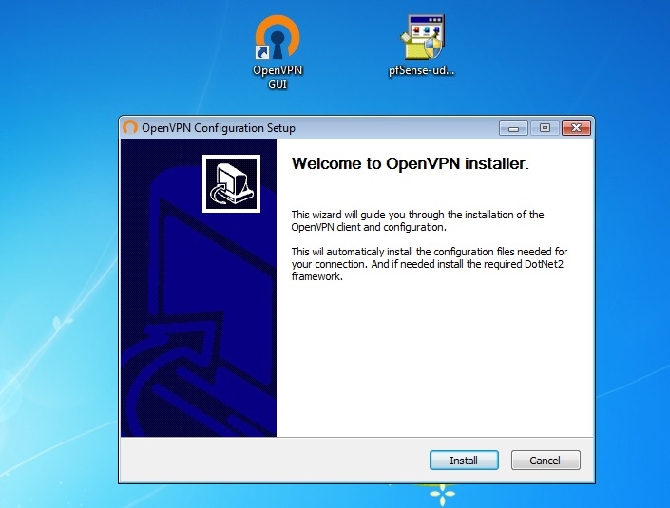
Install Credentials
2-4-1 OpenVPN
Creative Commons: Attribution-NonCommercial-ShareAlike

Slide 18
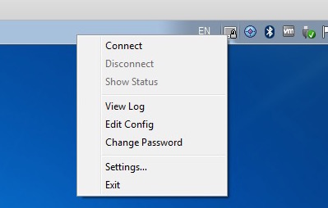
Connect
2-4-1 OpenVPN
Creative Commons: Attribution-NonCommercial-ShareAlike

Slide 19
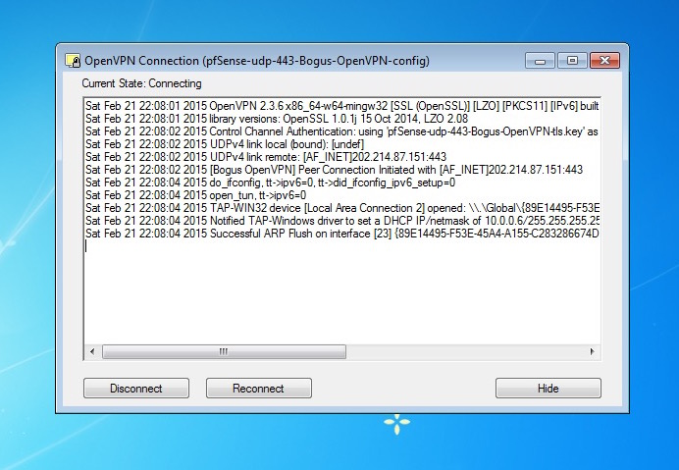
Connecting
2-4-1 OpenVPN
Creative Commons: Attribution-NonCommercial-ShareAlike

Slide 20
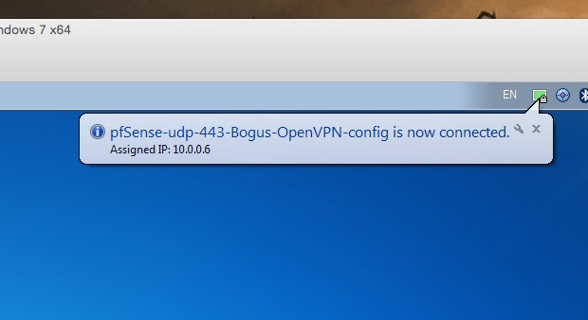
You’re Connected!
2-4-1 OpenVPN
Creative Commons: Attribution-NonCommercial-ShareAlike

Slide 21
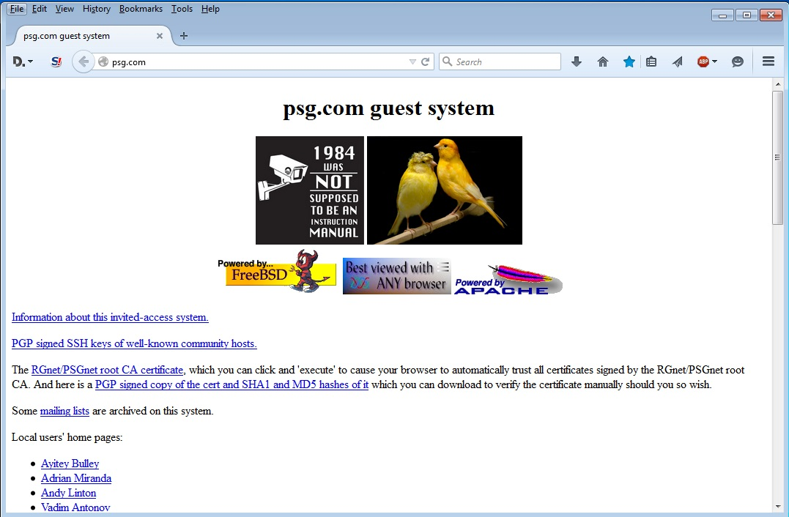
Try It – Browse
2-4-1 OpenVPN
Creative Commons: Attribution-NonCommercial-ShareAlike

Slide 22
But How Do You
Know It Works?
Is your traffic encrypted?
Use Wireshark!
Where are you?
traceroute psg.com

Slide 23
Without VPN
ryuu.rg.net:/Users/randy> traceroute psg.com
traceroute to psg.com (147.28.0.62), 64 hops max, 52 byte packets
1 1.144.dhcp.conference.apricot.net (220.247.144.1) 9.212 ms 1.477 ms 1.233 ms
2 134.75.14.41 (134.75.14.41) 28.347 ms 1.212 ms 1.426 ms
3 kreonet-dj-bb1-kreonet2-gr-bb2.daej.kreonet2.net (134.75.105.113) 1.369 ms 1.334 ms 1.210 ms
4 134.75.2.1 (134.75.2.1) 4.076 ms 3.990 ms 3.922 ms
5 134.75.5.210 (134.75.5.210) 3.963 ms 4.002 ms 4.001 ms
6 203.234.255.165 (203.234.255.165) 4.161 ms 4.031 ms 4.370 ms
7 112.174.85.21 (112.174.85.21) 4.004 ms
112.174.85.29 (112.174.85.29) 4.167 ms
112.174.85.17 (112.174.85.17) 5.151 ms
8 112.174.83.142 (112.174.83.142) 5.129 ms
112.174.83.106 (112.174.83.106) 4.748 ms
112.174.83.90 (112.174.83.90) 4.878 ms
9 112.174.87.122 (112.174.87.122) 162.453 ms 196.357 ms 182.862 ms
10 sl-mpe51-sea-.sprintlink.net (144.224.113.125) 136.197 ms 176.248 ms 136.314 ms
11 144.232.0.108 (144.232.0.108) 171.518 ms 186.838 ms 204.470 ms
12 144.232.9.62 (144.232.9.62) 210.499 ms 132.683 ms 172.015 ms
13 psg.com (147.28.0.62) 167.441 ms 159.632 ms 187.141 ms
Boo Hiss !
No Reverse DNS
2-4-1 OpenVPN
Creative Commons: Attribution-NonCommercial-ShareAlike

Slide 24
With VPN
ryuu.psg.com:/Users/presenter> traceroute psg.com
traceroute to psg.com (147.28.0.62), 64 hops max, 52 byte packets
1 10.0.1.1 (10.0.1.1) 1773.479 ms 103.112 ms 103.036 ms
2 202.214.87.130 (202.214.87.130) 104.809 ms 104.118 ms 103.963 ms
3 210.138.9.201 (210.138.9.201) 109.969 ms 105.199 ms 103.556 ms
4 tky009ipgw11.iij.net (58.138.112.53) 104.284 ms 106.700 ms 104.392 ms
5 tky009bb01.iij.net (58.138.112.157) 104.760 ms 104.872 ms 105.114 ms
6 sea001bb00.iij.net (58.138.88.230) 236.930 ms 239.763 ms *
7 six (206.81.80.23) 237.853 ms 237.146 ms 237.147 ms
8 147.28.0.62 (147.28.0.62) 216.686 ms 211.543 ms 210.681 ms
2-4-1 OpenVPN
Creative Commons: Attribution-NonCommercial-ShareAlike

