Slide 1

Movie Database -University Edition-
Milstone 3
Gary Ho | Chufan Luo | Ethan Kung|Randy Rizo |

Slide 2
Background
Students enrolled in film and television programs produce films throughout the semester as part of their coursework. Students who aspire to be film directors/writers and/or actors (or work in other areas of the entertainment industry) are trained in various film techniques and other practices. Students are then able to apply these film techniques in actual films, in the form of student films.

Slide 3
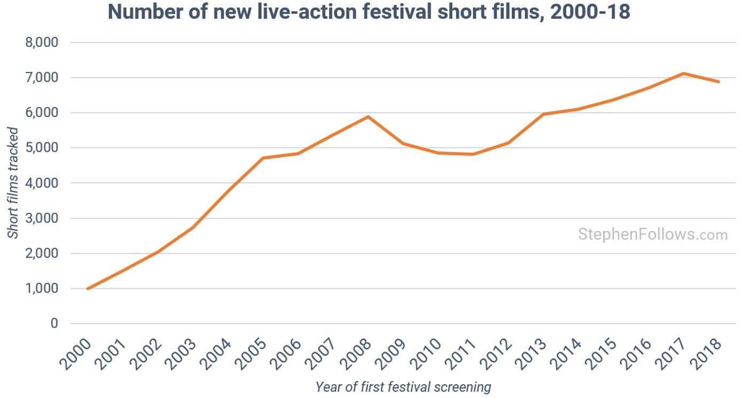
Studies show that the number of short films at festivals has steadily increased over the last two decades.
How many of us know of these short films and where to find them? What do others think about them?

Slide 4
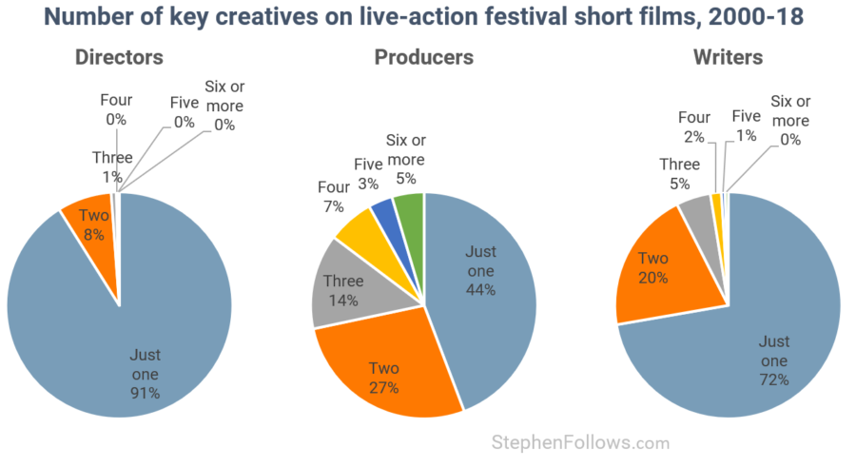
The chart below demonstrates that most of students short-film have just one writer, one producer, and one director per given short film.

Slide 5
Problem
How do we simultaneously provide a platform for student films to gain exposure through reviews and ratings while also allowing for potential connections between other student creatives (writers and actors)?
How do we create a way for others to discover new movies and view what movies other users like?

Slide 6
Solution
A movie database specifically engineered to serve academic institutions and their student created films.
This database will contain information on movies, writers, actors and users and their respective rating and review of the movies.
Each Movie will be associated with a school, a writer, genre, and actors/ actresses.
Create queries in our data base that help users access information on movies.

Slide 7
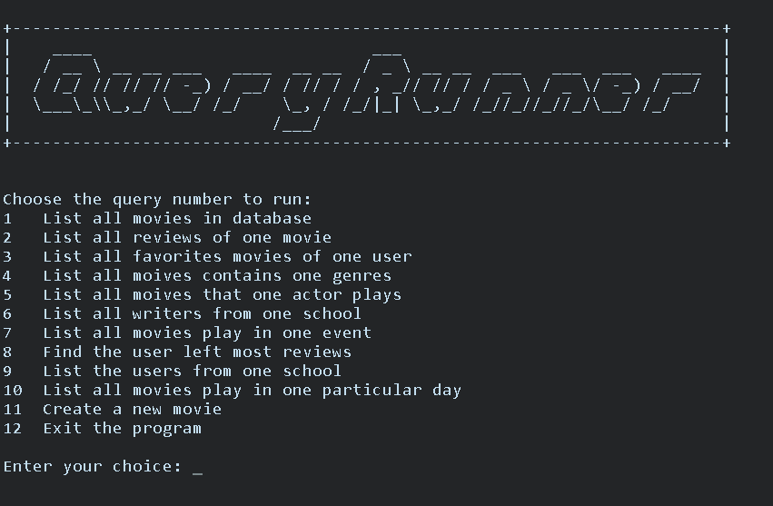
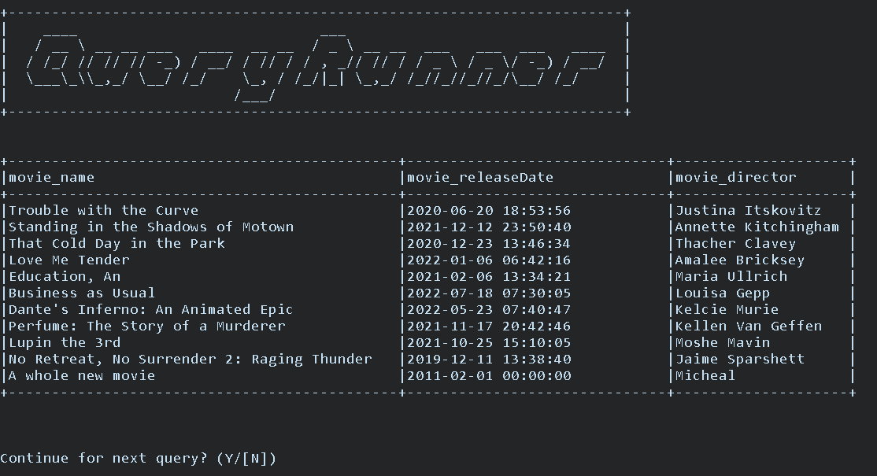
Console Mode
Choose Query
Show results

Slide 8
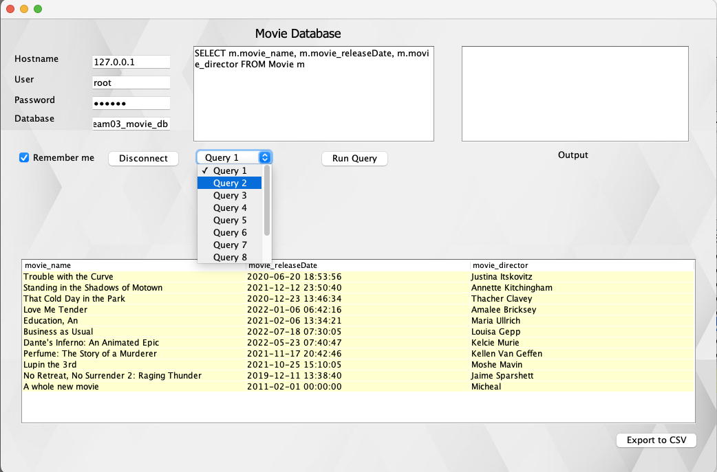
GUI Mode
Record
user info
Data can be saved to csv file

Slide 9
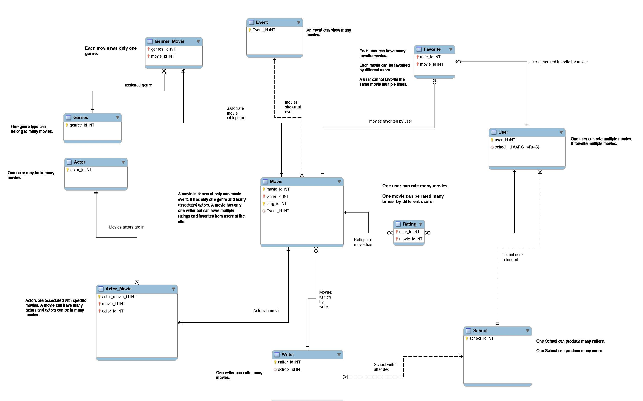
External Diagram

Slide 10
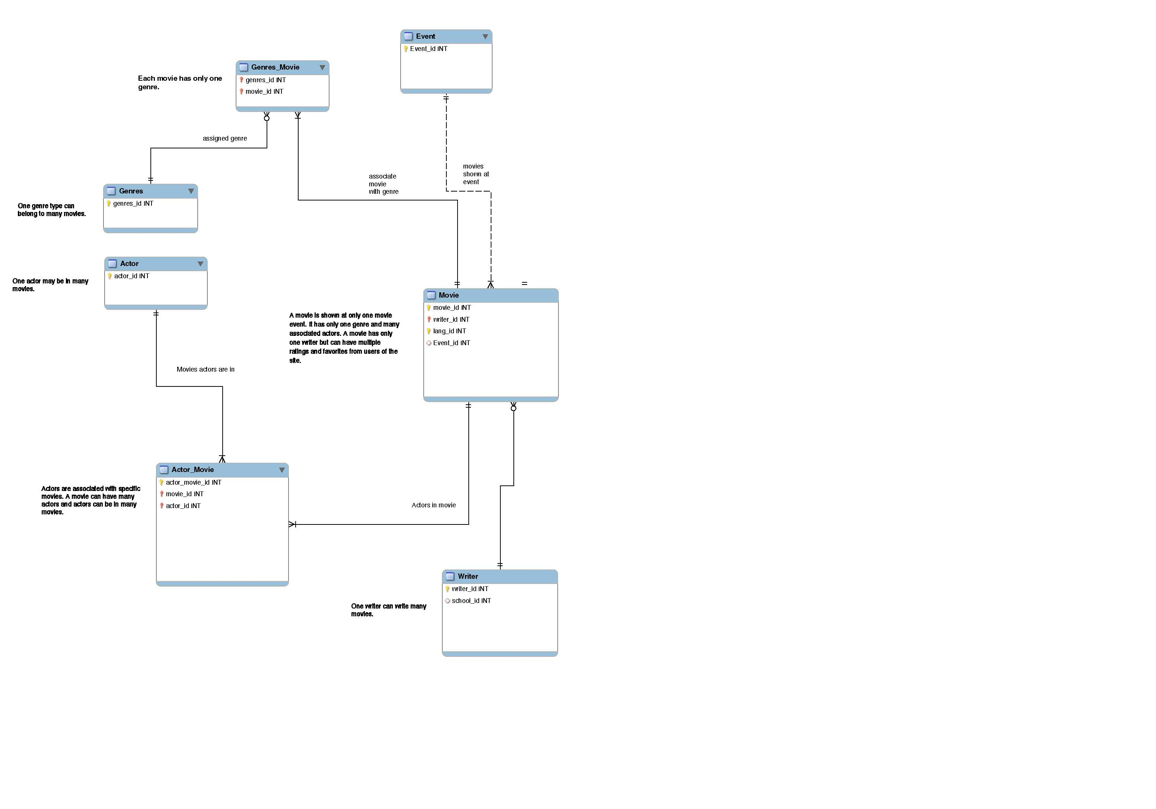

Slide 11
