Slide 1
Team Epsilon
Team Members:
∙ Thomas Zachry ∙ Diane Chin ∙ Randy Thien Cao ∙ Charlie Pan ∙ Shayan Raza

Slide 2
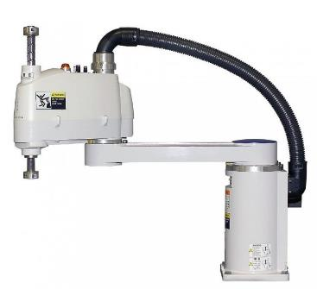
Project :
Scara Robot

Slide 3
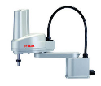
Vision
To create SCARA, Selective Compliance Assembly Robot Arm or Selective Compliance Articulated Robot Arm, to methodologically arrange components by: category, size, weight, shape, color, or other criteria, in a agile, expeditious, and optimum manner at or above industry standards.

Slide 4
Mission
Our mission is to use the following to produce a successful product:
computer vision
efficient algorithms
Economical Physical Design including :
Lightweight and Cost efficient Materials
High Strength Alloys

Slide 5
Success
Success Criteria includes :
A working SCARA that is as fast and accurate as industry standard or better.
Ability to perform arithmetic decisions.
Ability to utilize Computer Vision technology with precision and accuracy.
Ability to perform all these tasks within the budgetary constraints and in scheduled time.

Slide 6
Sprint goals
Progress on Project Charter
Research existing SCARAs
Skeletal Design Planning
Decide on what hardware components to use
Version Control Setup and Configuration
GitHub

Slide 7
Sprint backlog
Task | Mon | Tue | Wed | Thur | Fri
Project Charter Progress | 1 | 1 | 1 | 1 | 1
Existing SCARA research |  | 2 |  | 2 | 1
Skeletal Design research/planning |  | 2 | 2 | 4
Version Control Setup | 2 | 2

