Slide 1



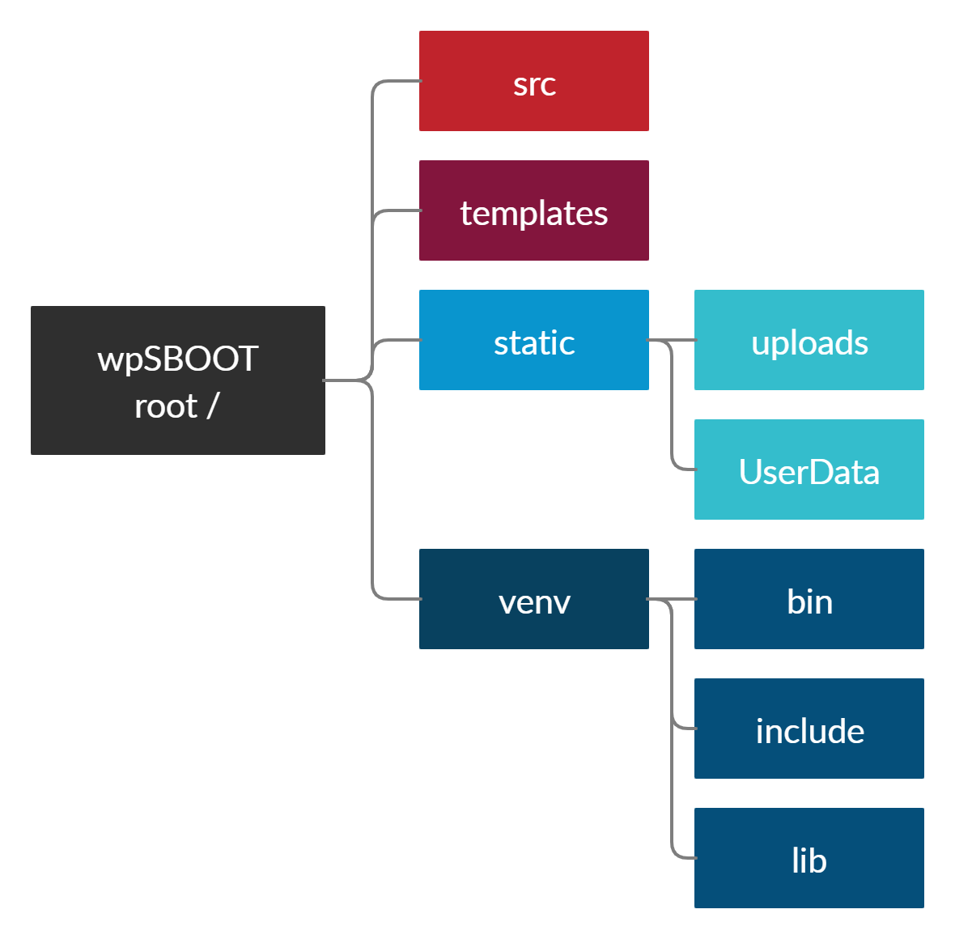
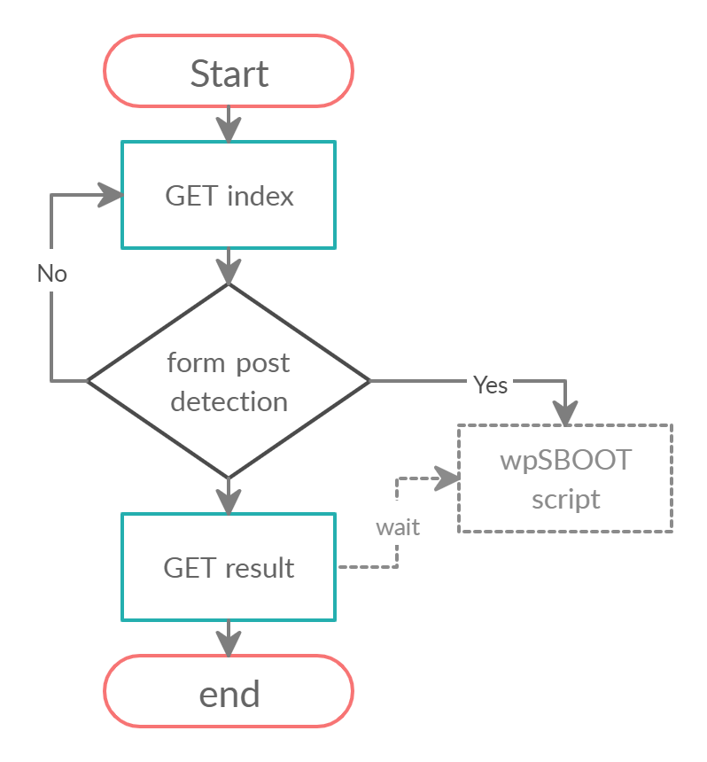
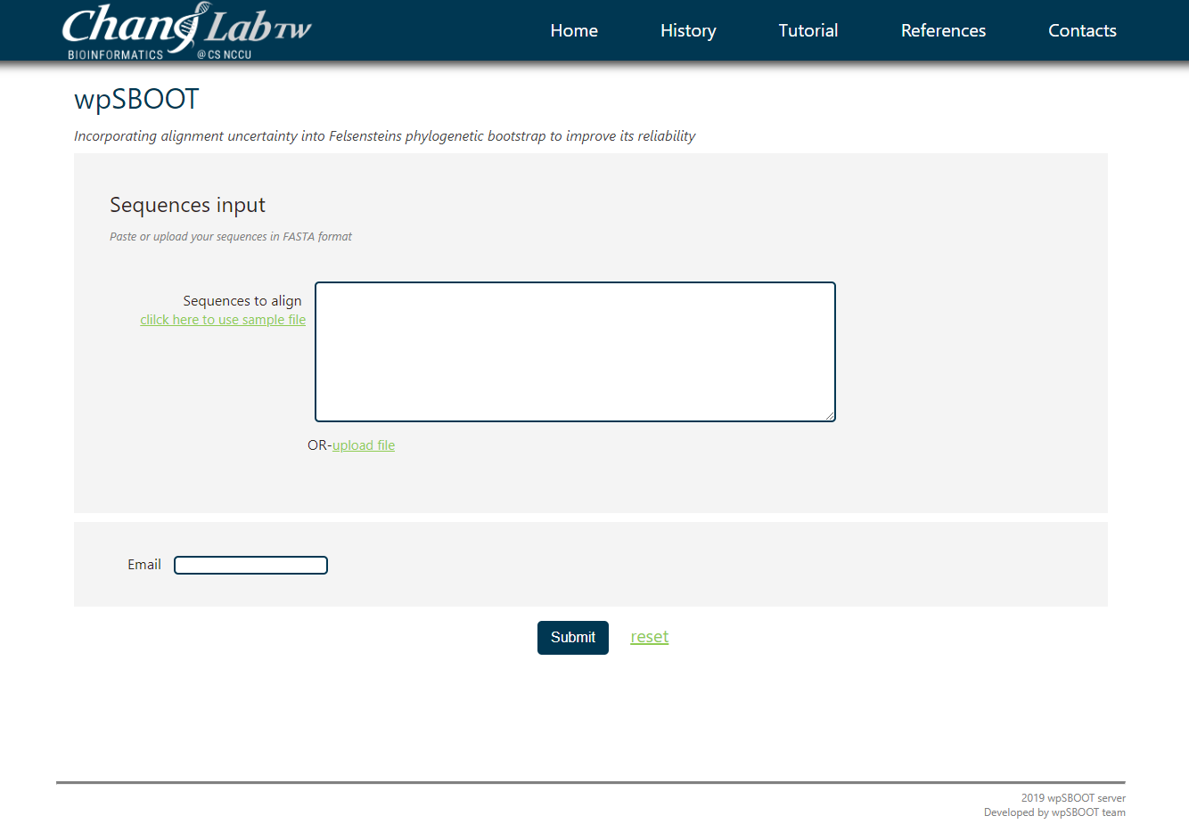
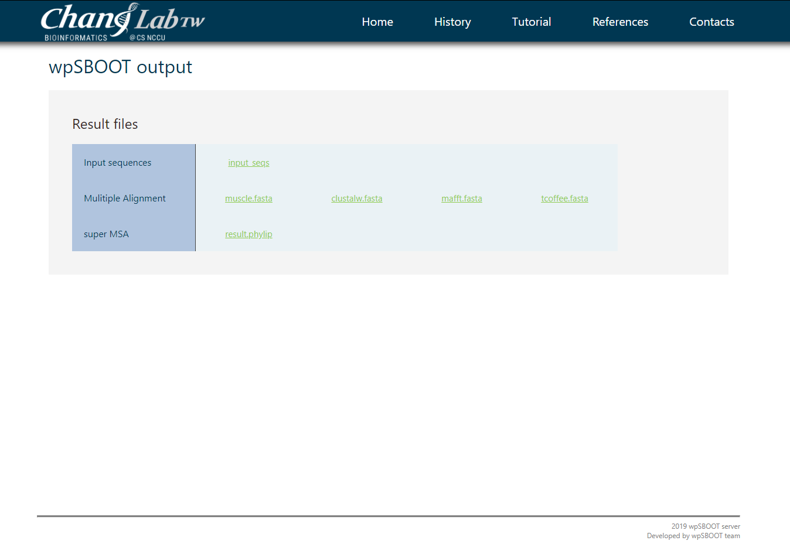
Using Python Flask to build a website on cloud server
Chun-Ren Xu, Jia-Ming Chang
Computer Science, National Chengchi University, Taipei, Taiwan; 105703055@nccu.edu.tw
Abstract
Flask is a micro-framework with no dependencies to external libraries. Since it is light and little dependency to update and watch for security bugs, we decide to build a website using Flask to provide our wpSBOOT method¹, which improved Phylogenetic Bootstrap reliability.
Material & Methods
Linux environment setup :
To implement our project, we use Ubuntu 16.04 ,and we also need several developing tools and some modules which is used in our service. i.e., BioPerl, nginx , Git, alignment tools(tcoffee, mafft, muscle, clustalw), and the directory structure in Fig.1.
Python environment setup
To use Flask build up web service, we need those Packages and Modules below :
Virtualenv
Flask
Flask-Mail
Flask-Script
Flask-Uploads
Flask-WTF
Jinja2
uwsgi
Werkzeug
WTForms
Flask is a web framework that offers tools, libraries, and technologies suitable for building a web application. This web application can come in the form of web pages, blogs, or even an extensive web-based calendar app or a commercial site.
Main components of Flask
Werkzeug is a utility library meant for usage with the Python language. Mostly, it is a Web Server Gateway Interface or WSGI app that can create software items for request, response, or utility functions.
Jinja is a template engine for Python programming purposes, and it resembles the Django web frameworks templates.
Fig.1: web server directory structure
uwsgi
WSGI : A Python spec that defines a standard interface for communication between an application or framework and an application/web server.
uWSGI : An application server container that aims to provide a full stack for developing and deploying web applications and services. The main component is an application server that can handle apps of different languages. It communicates with the application using the methods defined by the WSGI spec, and with other web servers over a variety of other protocols. This is the piece that translates requests from a conventional web server into a format that the application can process.
uwsgi : A fast, binary protocol implemented by the uWSGI server to communicate with a more full-featured web server. This is a wire protocol. It is the preferred way to speak to web servers that are proxying requests to uWSGI.
Development & testing :
wpSBOOT script : it usd to accept sequences input, and calling alignment tools to produce MSAs. At last, it calls concatenate.pl to concatenate all MSAs into a series of all MSAs(Super-MSA^{)1.}
Website develop
Purpose : providing the web service of wpSBOOT to client
Website flowchart (see Fig.2.)
Deploy : Configure Nginx to pass web requests to the socket using uwsgi protocol.
Fig.2: website flowchart
Result
Reference
1. Chang,J.-M. et al. ( 2019). Incorporating alignment uncertainty into Felsenstein’s phylogenetic bootstrap to improve its reliability. Bioinformatics, btz082
2. techbridge (2017) python web Flask tutorial. URL : https://blog.techbridge.cc/2017/06/03/python-web-flask101-tutorial-introduction-and-environment-setup/
3. Justin Ellingwood(2015). How To Set Up uWSGI and Nginx to Serve Python Apps on Ubuntu 14.04. URL : https://www.digitalocean.com/community/tutorials/how-to-set-up-uwsgi-and-nginx-to-serve-python-apps-on-ubuntu-14-04#definitions-and-concepts

