Slide 1
Karel J Robot
OOP approach to learning computer science
“Its study involves development of the ability to abstract the essential features of a problem and its solution, to reason effectively in the abstract plane, without confusion by a mass of highly relevant detail.” (C. Hoare)

Slide 2
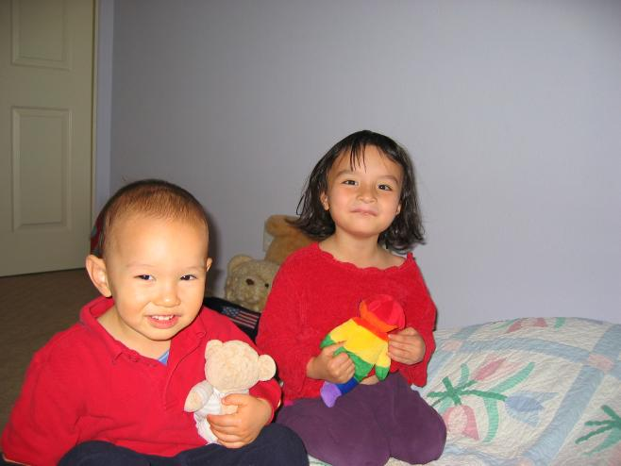
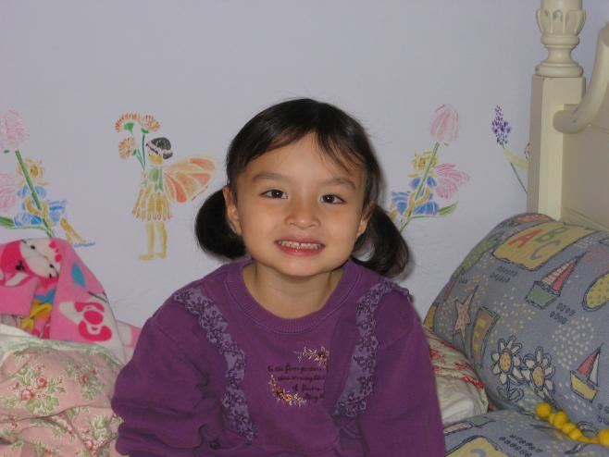


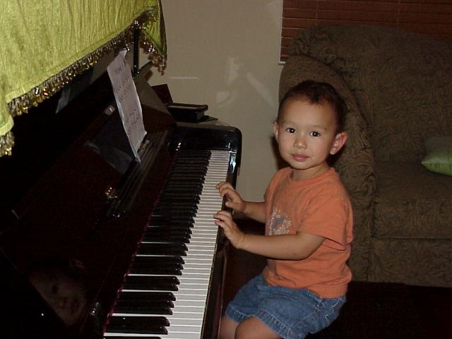

Slide 3

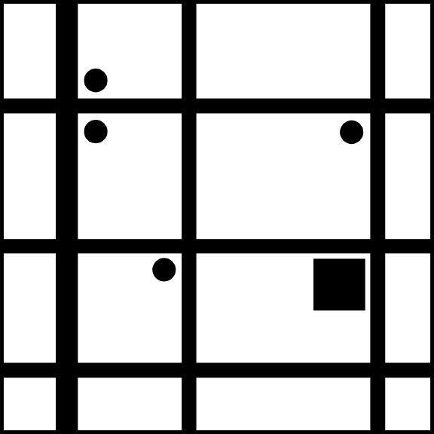
Karel J (the Robot)
Robot World
  A flat plane of streets (east-west) and avenues (north-south)
Streets
Corner (many robots may occupy)
Avenues

Slide 4
Karel’s World (cont’d)
Contains Beepers and Walls
Beepers
  May be picked up, carried, and placed again
  May place several on a corner and they don’t interfere with Robot movement

Slide 5
Robot Capabilities
Move
Turn
Sense surroundings
  hear beepers (on same corner)
  Determine direction it is facing
Pick up, carry, and put down beepers
Turn itself off

Slide 6
Karel-Werke
Factory - Builds the robots
  Standard model
  Write a spec for a new model
    Extension of an existing base model
Factory – Delivers the robots
“factories”
(auf Deutsch)

Slide 7
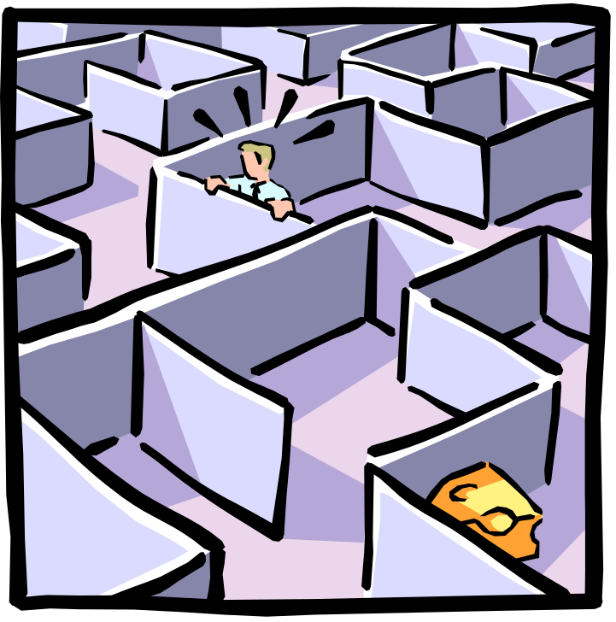
Tasks & Situations
Examples
  Move to a corner (3rd St. & 5th Ave.)
  Run a race
  Escape from a maze
  Find a beeper and
  deliver it to the origin

