Slide 1
Project Title: Campus Buddy: An Automated GUI Chatbot for College Campuses
Made by Jai Rane

Slide 2
Index
1. Project Submission Report Details
2. Project Objective & Description
3. Technologies Used
4. Screenshots with Explanation
5. Project Links
6. Conclusion & Summary

Slide 3
1. PROJECT SUBMISSION REPORT DETAILS
Student Credentials
Project Title: Campus Buddy: A Graphical UI Assistant for Student Onboarding
Student Name: Jai Rane
Program: Lenovo LEAP NextGen Scholar Program Internship
Course / Batch: Artificial Intelligence / June 2026
Submission Date: 13/05/2026

Slide 4
2. Project Objective & Description
Objective: To streamline information access for newly admitted students and visiting parents during the hectic college admissions and orientation periods.
Description: This project is a desktop-based, interactive graphical application designed to automate answers to high-frequency, repetitive queries. The chatbot provides immediate, automated assistance regarding admission criteria, fee timelines, library hours, hostel locations, and administrative helpline contacts. By using a clean button-driven dashboard, the application eliminates human typing errors and ensures smooth context navigation.

Slide 5
3. Technologies Used
Python 3.12: The primary programming language utilized to write the backend state engine and conditional execution logic.
Tkinter Library: Python's built-in interface framework used to design the layout, application windows, text boxes, and action buttons.
VS Code (Visual Studio Code): The Integrated Development Environment (IDE) used to write, compile, and run the Python code.
Object-Oriented Event Handling: Implemented via trigger buttons and lambda bindings to cleanly switch text outputs on user click actions.

Slide 6
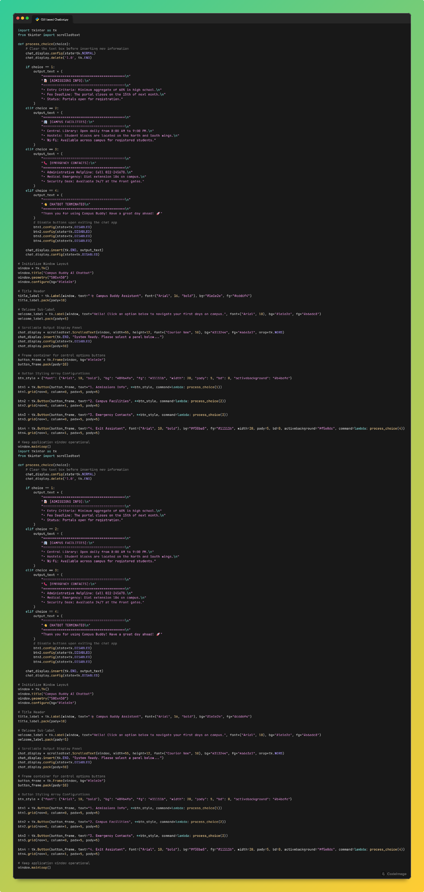
4. Screenshots with Explanation
1. Code Screenshot 1

Slide 7
4. Screenshots with Explanation
1. Code Screenshot 2

Slide 8
4. Screenshots with Explanation
1. Code Screenshot 3

Slide 9
4. Screenshots with Explanation
1. Code Screenshot 4

Slide 10
4. Screenshots with Explanation
1. Code Screenshot 5

Slide 11
4. Screenshots with Explanation
1. Code Screenshot 6

Slide 12
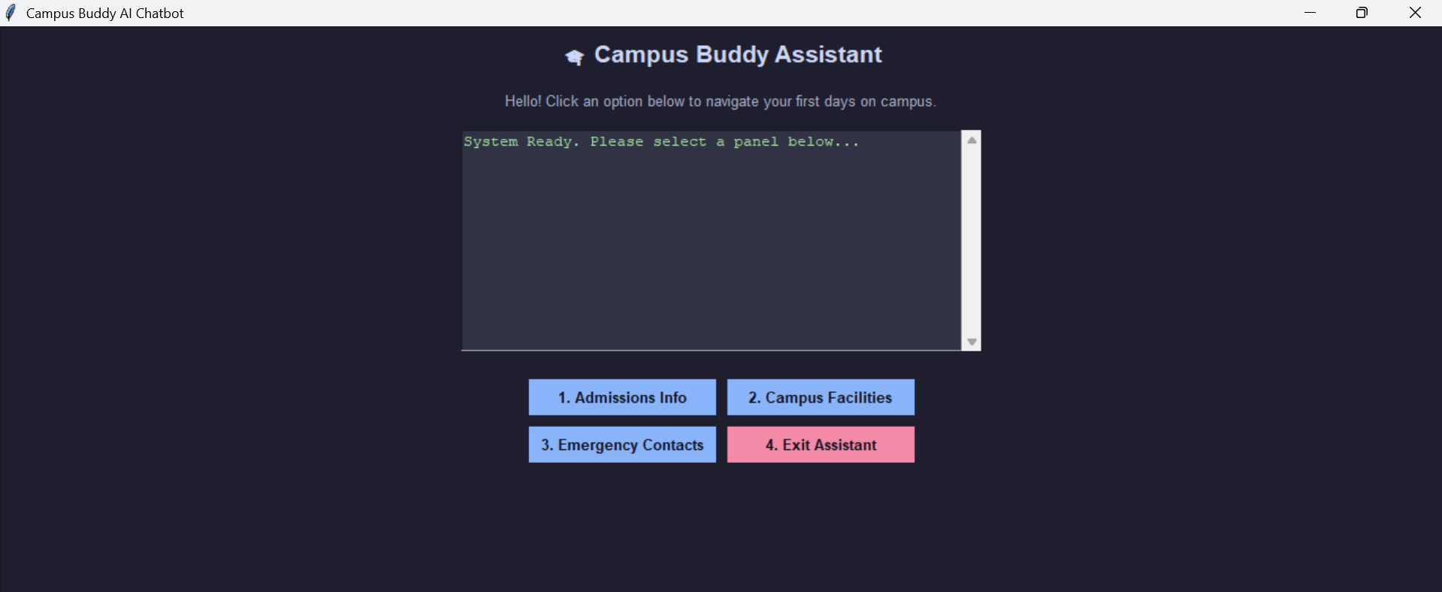
4. Screenshots with Explanation
2. Output 2.1

Slide 13
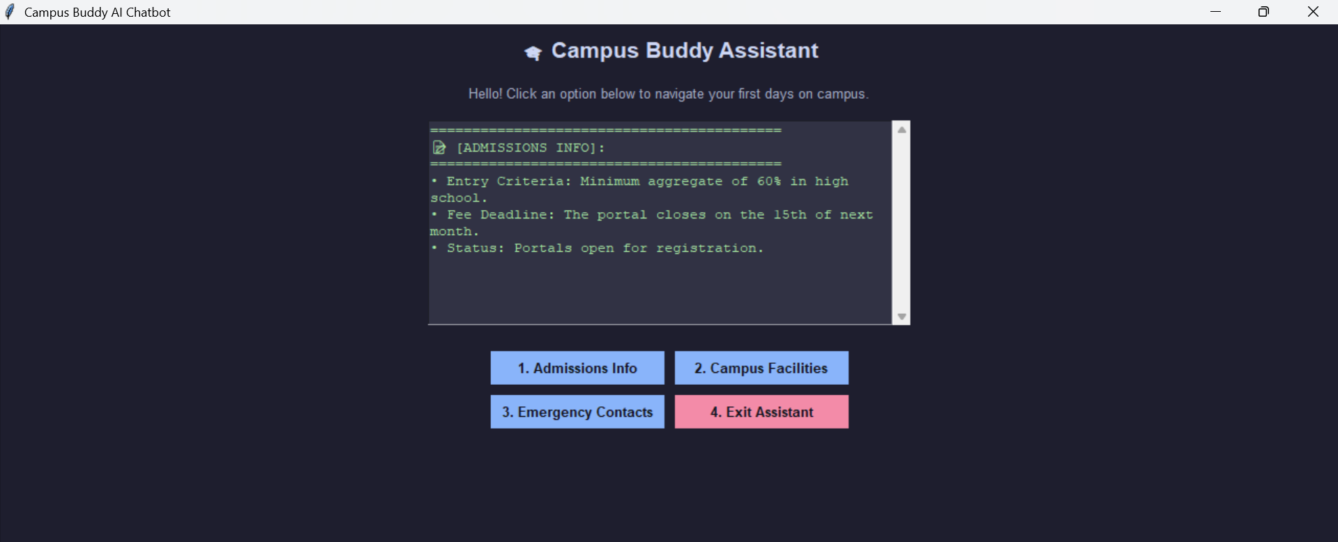
4. Screenshots with Explanation
2. Output 2.2

Slide 14
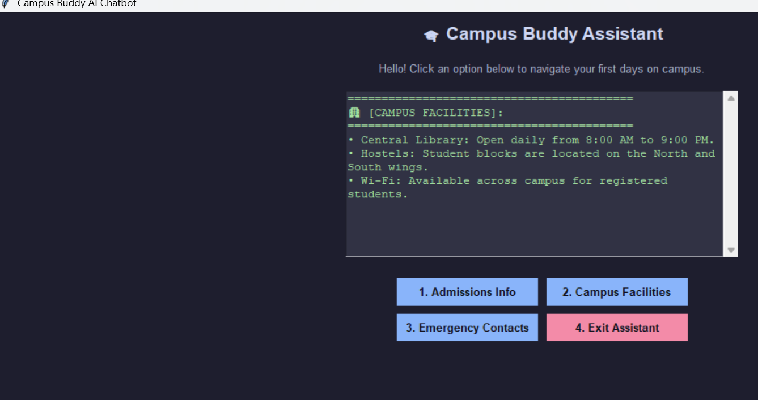
4. Screenshots with Explanation
2. Output 2.3

Slide 15
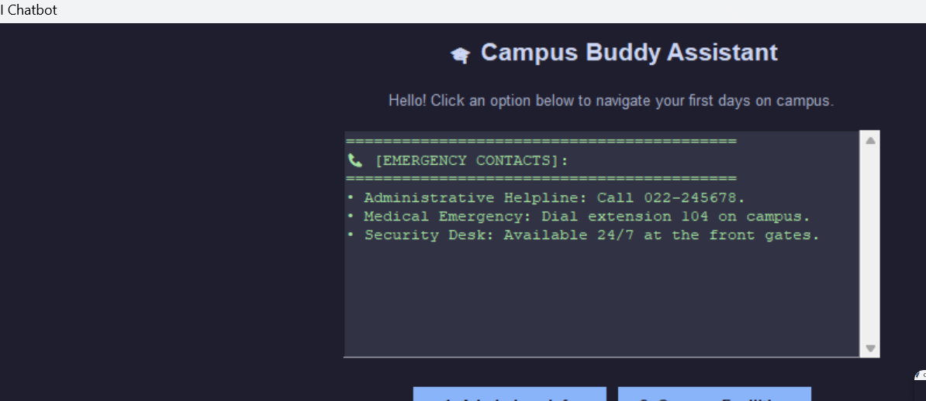
4. Screenshots with Explanation
2. Output 2.4

Slide 16
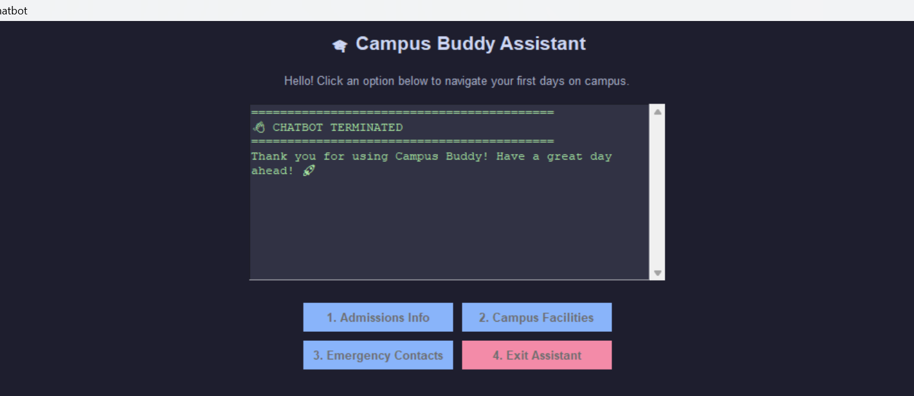
4. Screenshots with Explanation
2. Output 2.5

Slide 17
5. Project Links
Github Link: https://github.com/ranejai954/lenovo-ai-internship-prerequisite-milestone-5-assignment-chatbot
Development Platform: Visual Studio Code IDE Local Environment.

Slide 18
6. Conclusion & Summary
Project Outcomes: The project successfully demonstrates the creation of a working desktop graphical user interface (GUI) application that tracks user clicks and returns appropriate contextual statements. The chatbot handles layout allocation frames cleanly and avoids loop crashes by handling user exits gracefully.
Key Learnings:
GUI Frameworks: Learned how to create visual elements, window geometry sizes, and layout frames using Python's native Tkinter tools.
State Control Logic: Mastered event-driven programming, learning how to change on-screen components immediately when a user triggers buttons.
Interface Accessibility: Discovered that a button-driven GUI provides a much cleaner, error-free user experience compared to an open-ended terminal command box.

