Slide 1
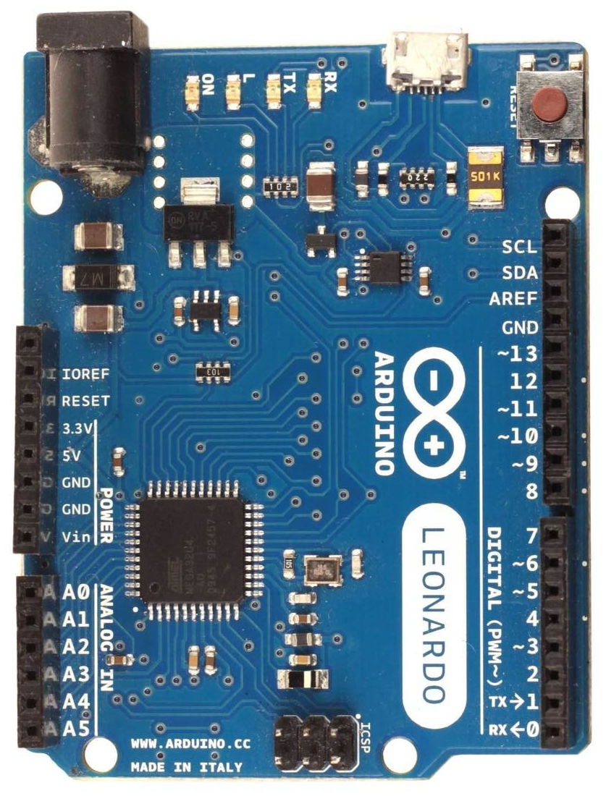
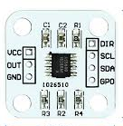
Wiring diagram for AS5600 magnetic encoder (only valid for firmware with option “w”)
Arduino Leonardo, Micro or ProMicro
AS5600 - i²C 12bit magnetic angle sensor
The chip has a few modes for configuring its resolution (noise) and response time. In wheel firmware v24X it is set by default to the best resolution (low noise) mode, where it has a 2.2ms response time. Keep the magnet at (3-5)mm from sensor for optimal performance. You may mount magnet either on the wheel or motor shaft, firmware can detect multiple turns. Default CPR is 4096.
Arduino AS5600
5V VCC
GND GND and DIR
2 SDA (i²C data)
CLK (i²C clock)
none GPO
none OUT
You can set angle direction by
connecting DIR pin to:
GND - clockwise, or
VCC - counterclockwise
Leave GPO pin unconnected
it has an internal pull-up to VCC.
Shorting it to GND switches the
chip in programming mode B,
where it will not send any i²C data.
AS5600 pcb

