Slide 1
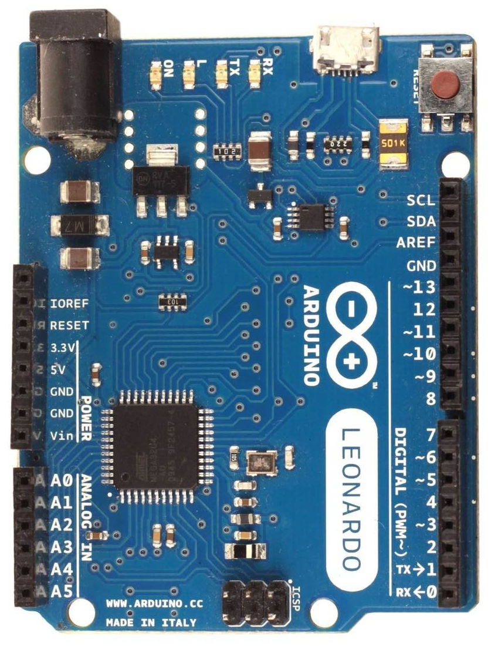
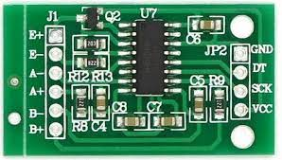
Wiring diagram for HX711 chip and load cell (only valid for firmware with option “l”)
if nothing is happening with the brake
pedal, you may try to swap A- and A+
wires on the load cell, because your
load cell may output a reversed voltage
it is recommended to use a shielded cable
between HX711 and a load cell in order to
reduce signal noise as much as possible
LC HX711 Arduino
VCC 5V
GND GND
DT 4
SCK 5
red E+
black E-
white A+
green A-
Arduino Leonardo, Micro or ProMicro
red
E+
green
white
A-
A+
E-
you can set HX711 in 80Hz
mode by manually soldering
pin 15 to VCC, some traces
may need cutting to avoid
shorting, so please be careful
black
LC - 4 wire load cell (full bridge)

