Slide 1
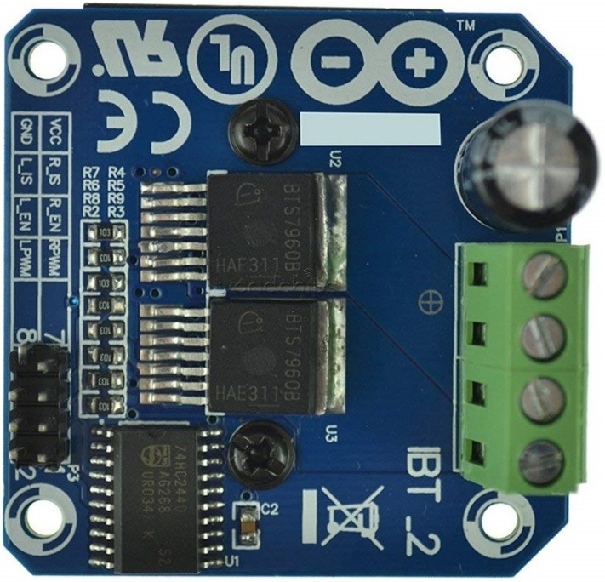
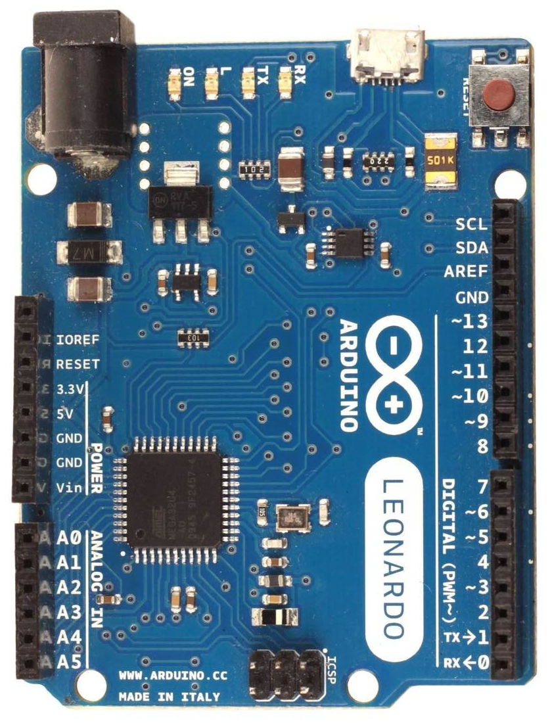
Wiring diagram for single H-bridge motor driver (valid for PWM± mode, with 1 FFB axis, v250)
Arduino Leonardo, Micro or ProMicro
BTS7960 or any other 2 channel H-bridge
motor driver with PWM inputs
Arduino BTS7960 (pin)
GND GND (8)
9 LPWM (2)
10 RPWM (1)
[1] Standard pinouts:
5V VCC (7), R_EN (3), L_EN (4)
[2] Advanced pinouts (fw-v24X only):
5V VCC(7)
R_EN (3), L_EN (4)
[3] Wiring trick pinout:
none VCC (7), R_EN (3), L_EN (4)
BTS7960 pin description:
B+, B- DC power supply input (5.5-27)V
M+, M- DC motor output (max 300W)
GND common ground, VCC digital power supply
R_EN(3), L_EN(4) motor (PWM) enable pins
R_IS(5), L_IS(6) are current shunt outputs
that may be used for monitoring
current load at each channel, but you
have to connect a shunt resistor to each
[1]
B-
B+
M+
M-
[3]
[2]
If your motor is very hard to turn
by hand when there is no PWM
signal input, then you may
try the pinout [2] or [3].
[3] shorting BTS pins VCC, R_EN, L_EN
together and leave them floating!
floating means not connected
anywhere (no voltage on them)
R_IS(5), L_IS(6)
Vout
(0-5)V -> (0-43)A
Note - there are 3 ways to connect motor (PWM) enable pins:
[1] standard pinout (motor always ON)
[2] advanced pinout (motor OFF when PWM is 0, only in fw-v24X)
[3] wiring trick pinout (back EMF is used to switch motor ON/OFF, use with extreme caution)
1k

