Slide 1
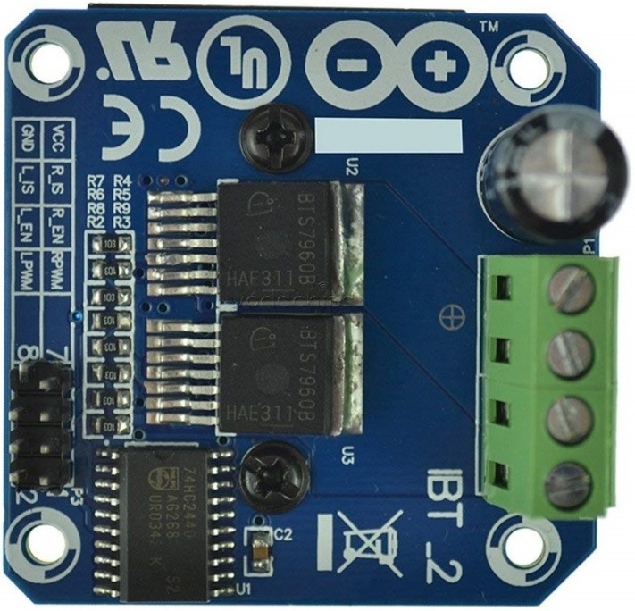
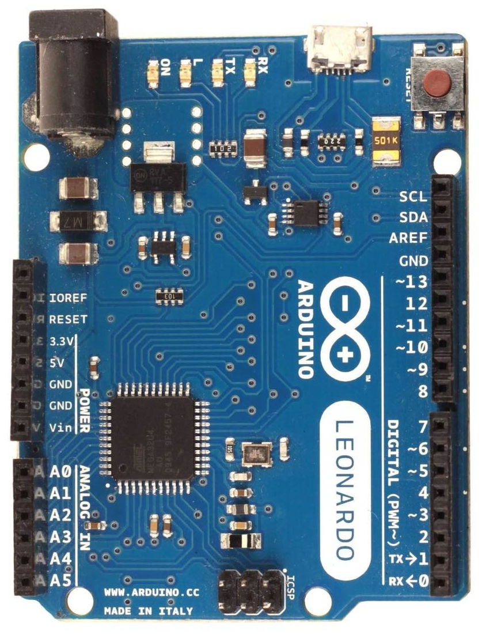
Wiring diagram for double H-bridge motor driver (valid for 2CH PWM± mode, with 2 FFB axis in v250b)
Arduino Leonardo, Micro or ProMicro
BTS7960 or any other 2 channel H-bridge
motor driver with PWM inputs
Arduino xBTS7960 (pins) for xFFB: left/right
GND GND (8)
9 LPWM (2)
10 RPWM (1)
5V VCC (7), R_EN (3), L_EN (4)
yBTS7960 (pins) for yFFB: down/up
GND GND (8)
5 LPWM (2)
11 RPWM (1)
5V VCC (7), R_EN (3), L_EN (4)
B-
B+
Mx+
Mx-
xFFB motor
Firmware v250b has xFFB and yFFB and
4 channel PWM output, so you must use
2CH PWM+- mode and two BTS7960 drivers
each driver is connected to its PWM+- channels
each motor will reproduce 1-axis FFB output
Force directions:
xFFB positive force should move right
xFFB negative force should move left
yFFB positive force should move up
yFFB negative force should move down
PWM channels:
1st PWM+- channels on pins D9, D10
2nd PWM+- channels on pins D5, D11
B-
B+
My+
My-
yFFB motor

