Slide 1
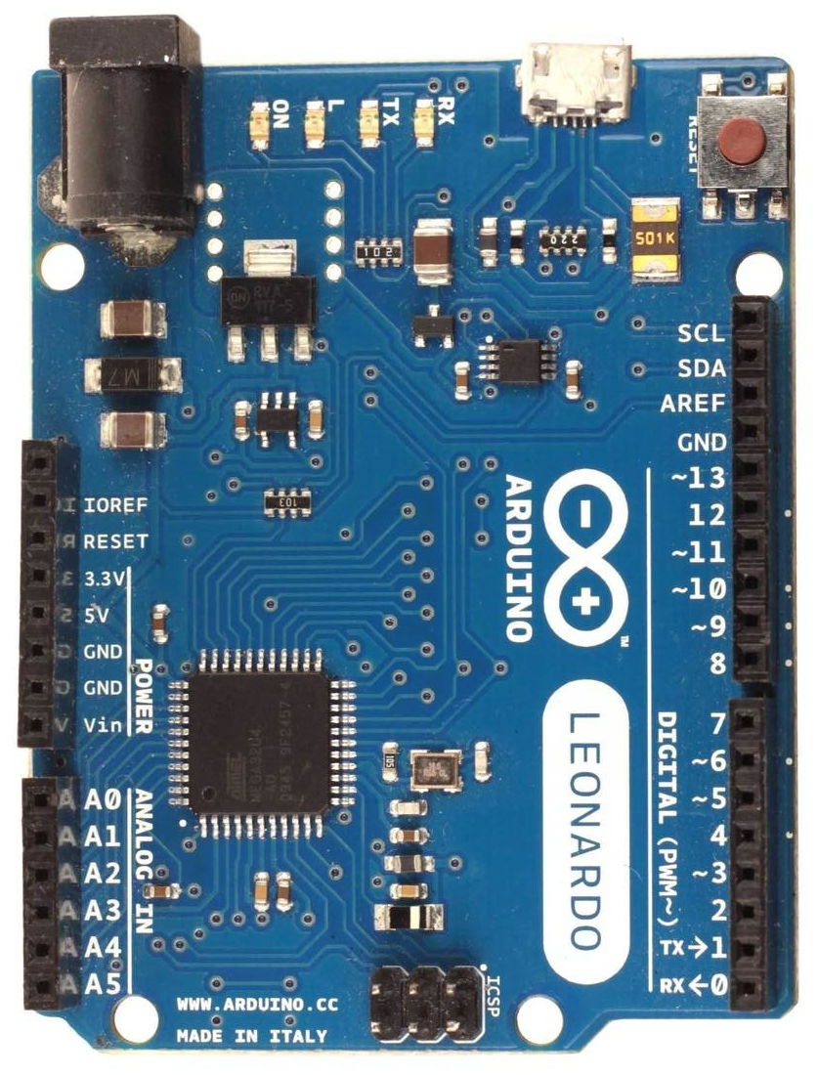
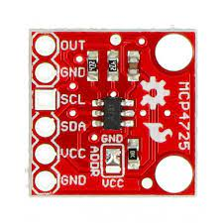
Wiring diagram for external DAC’s (only valid for firmware with option “g”, in 2CH DAC0-50-100 mode)
Arduino Leonardo, Micro or ProMicro
output (0-5)V for y-axis FFB
2x twisted pair
or shielded cables
output (0-5)V for x-axis FFB
DAC1
0x61
yFFB
DAC0 - ADDR pin to GND
i²C address 0x60 is for x-force
DAC1 - ADDR pin to VCC
i²C address 0x61 is for y-force
Analog output direction:
0V - negative force
2.5V - zero force
5V - positive force
DAC0
0x60
xFFB
Arduino MCP4725
5V VDD
GND GND
2 SDA (i²C data)
3 CLK (i²C clock)
MCP4725
external i²C 12bit DAC

