Slide 1
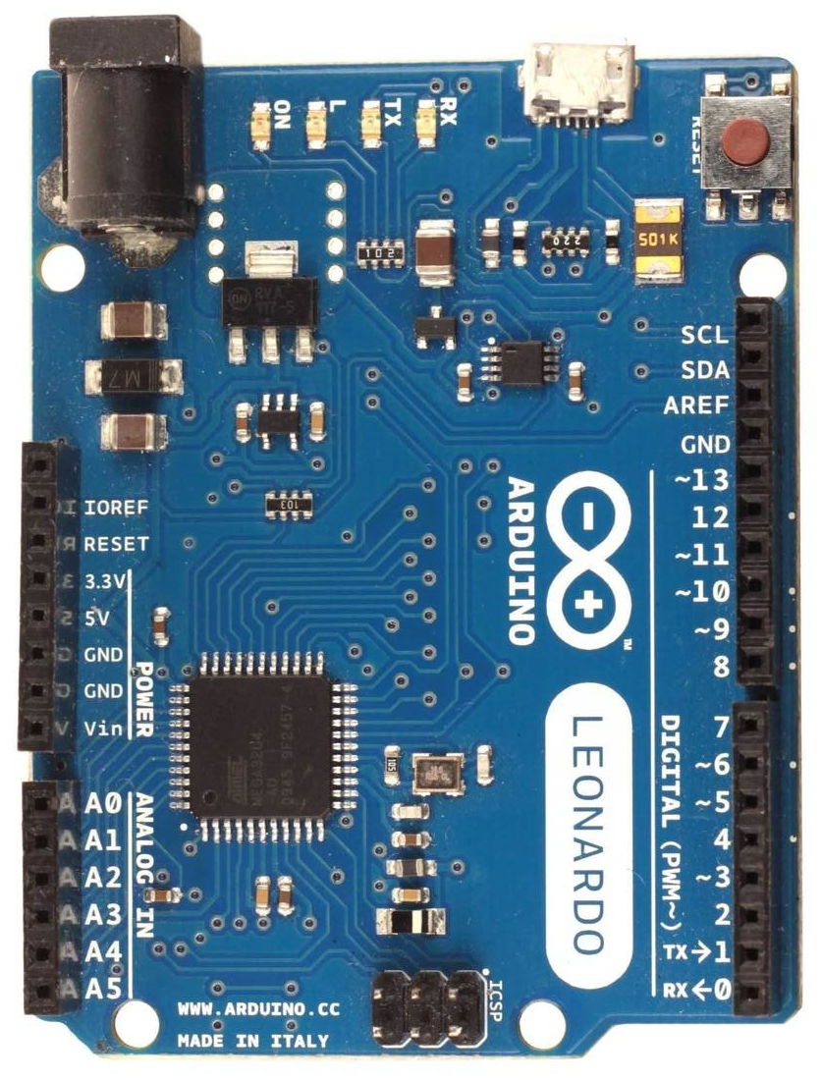
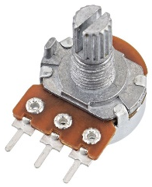
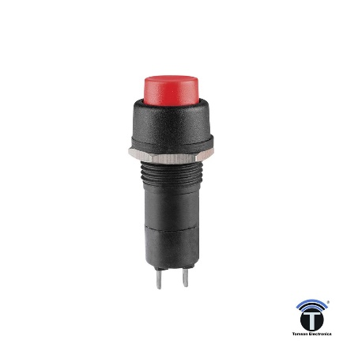
Wiring diagram for analog XY shifter (only valid for firmware with option “f”)
Arduino Leonardo or Micro only
a
c
1023
1
3
5
7
10k linear pots
Y
e
pot0
pot1
neutral gear (no button)
1
2
d
3
2
6 (r)
8 (r)
A4
A5
4
0
X
1023
b
button0 for
reverse gear
Arduino XY shifter
5V 5V (pot0,1 pin 3)
GND GND (pot0,1 pin 1)
A4 X position (pot0 pin2)
A5 Y position (pot1 pin2)
4, A3* button0 (push switch)
*when load cell is enabled (firmware option “l”),
note that button0 is at pin A3 instead
or A3*
in order to activate a reverse gear
you need to press this switch and
shift into last gear which
can be 6th or 8th depending
on the shifter configuration

