Slide 1
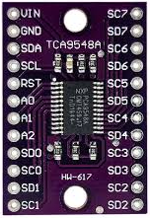
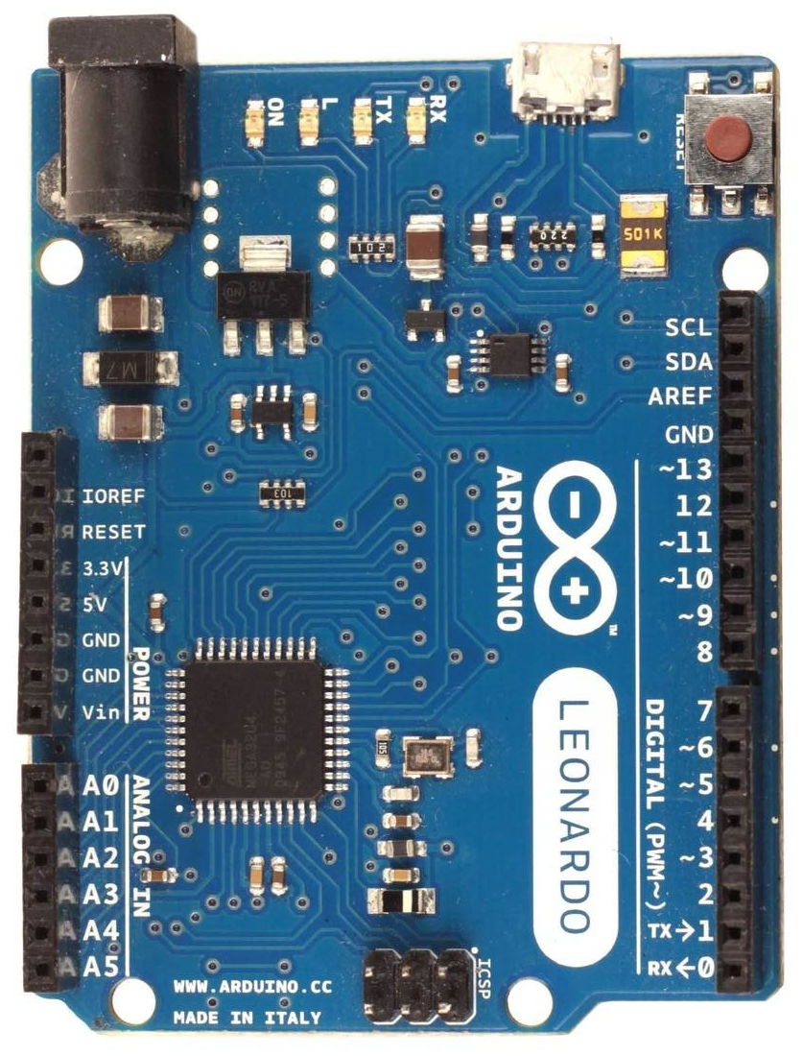
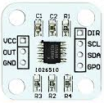
Wiring diagram for double AS5600 magnetic encoder (only valid for firmware v250 and later with options “b” + “w” + “u”)
i²C multiplexer
TCA9548A
Arduino Leonardo, Micro or ProMicro
An i²C multiplexer chip like TCA9548A gives us a possibility to connect eight i²C devices with the same address to a single host bus. Two output i²C bus channels (0 and 1) are used to connect two AS5600 magnetic encoders with the same address (0x36). Firmware takes care of channel switching and reading of an individual angle values, which are then processed with multiturn feature and used as 2-axis input (X and Y).
AS5600x
AS5600y
Arduino TCA9548A AS5600x AS5600y
5V VCC VCC VCC
GND GND GND, DIR GND, DIR
SDA
CLK
SD0 SDA
SC0 SCL
SD1 SDA
SC1 SCL

