Slide 1
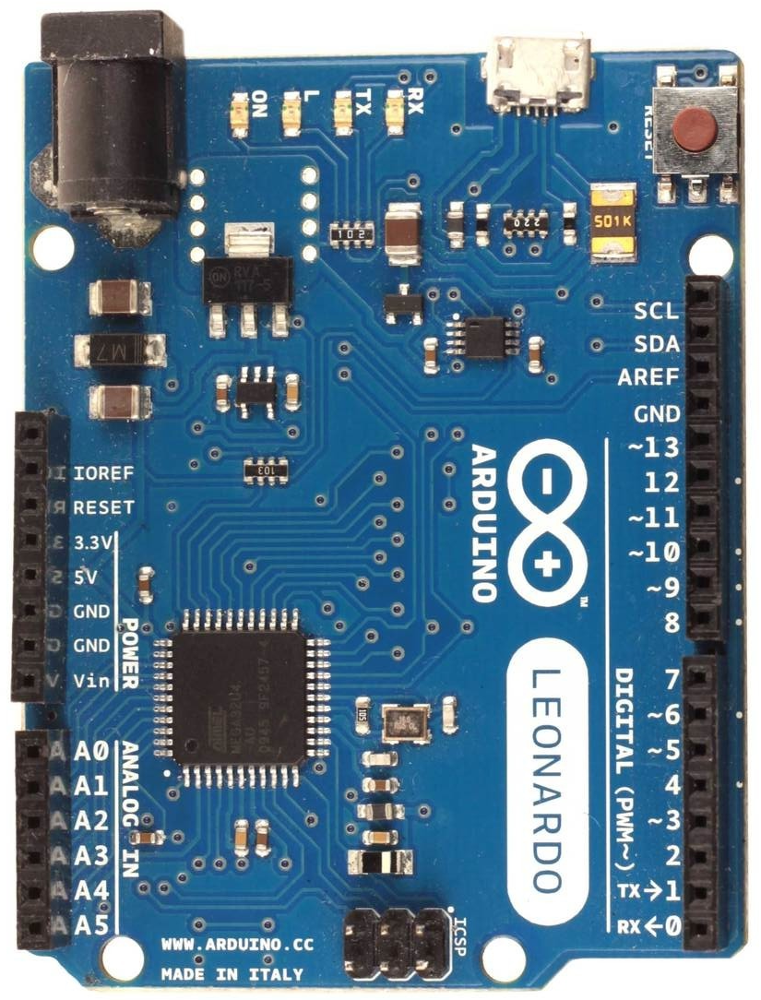
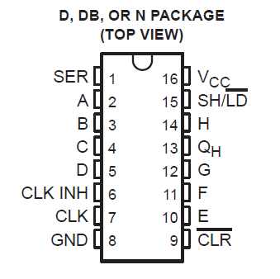
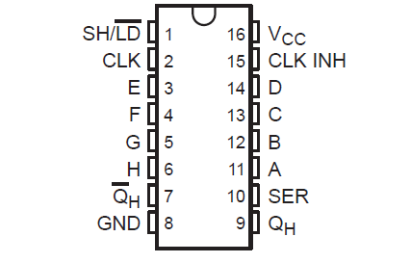
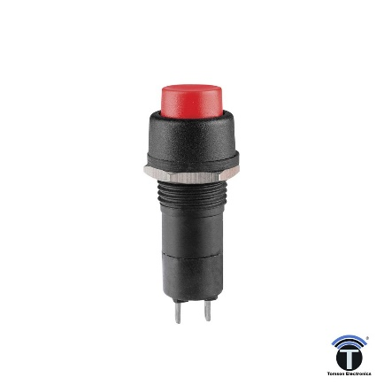
This pinout is valid for firmware v250 and latter with options “n” + ”r” only
Arduino Leonardo (as wheelbase) -> 3x chips SN74ALS166 (as button box)
Leonardo SN74ALS166, all 3 chips
GND -> GND (8), CLK INH (6)
5V -> V_{CC} (16), CLR (9)
6 (DT_SR) -> Q_{H} (13)(only on 1st chip)
7 (CLK_SR) -> CLK (7)
8 (PL_SR) -> SH/LD (15)
8 push buttons per chip on pins:
A, B, C, D, E, F, G, H
button logic: on - GND, off - 5V
SN74ALS166N
You may also use other shift register chips like SN74HC165, however note a slightly different pinout. This one has an inverted data output pin Q_{H} instead of a CLR pin. You should leave it unconnected and use other pins in a similar way as shown for SN74ALS166. For an inverted button logic, you may use Q_{H} instead of Q_{H}.
1st
2nd
3rd
*R_{pullup}
SN74HC165N
100k
24x push buttons - when pressed, it should short its two contacts to GND
(*optional pullup resistor is recommended to prevent flickering of buttons)

