Slide 1
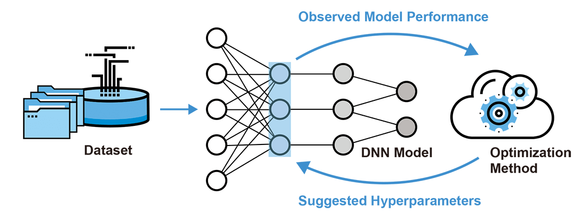
source: https://www.gigabyte.com/

