Slide 1

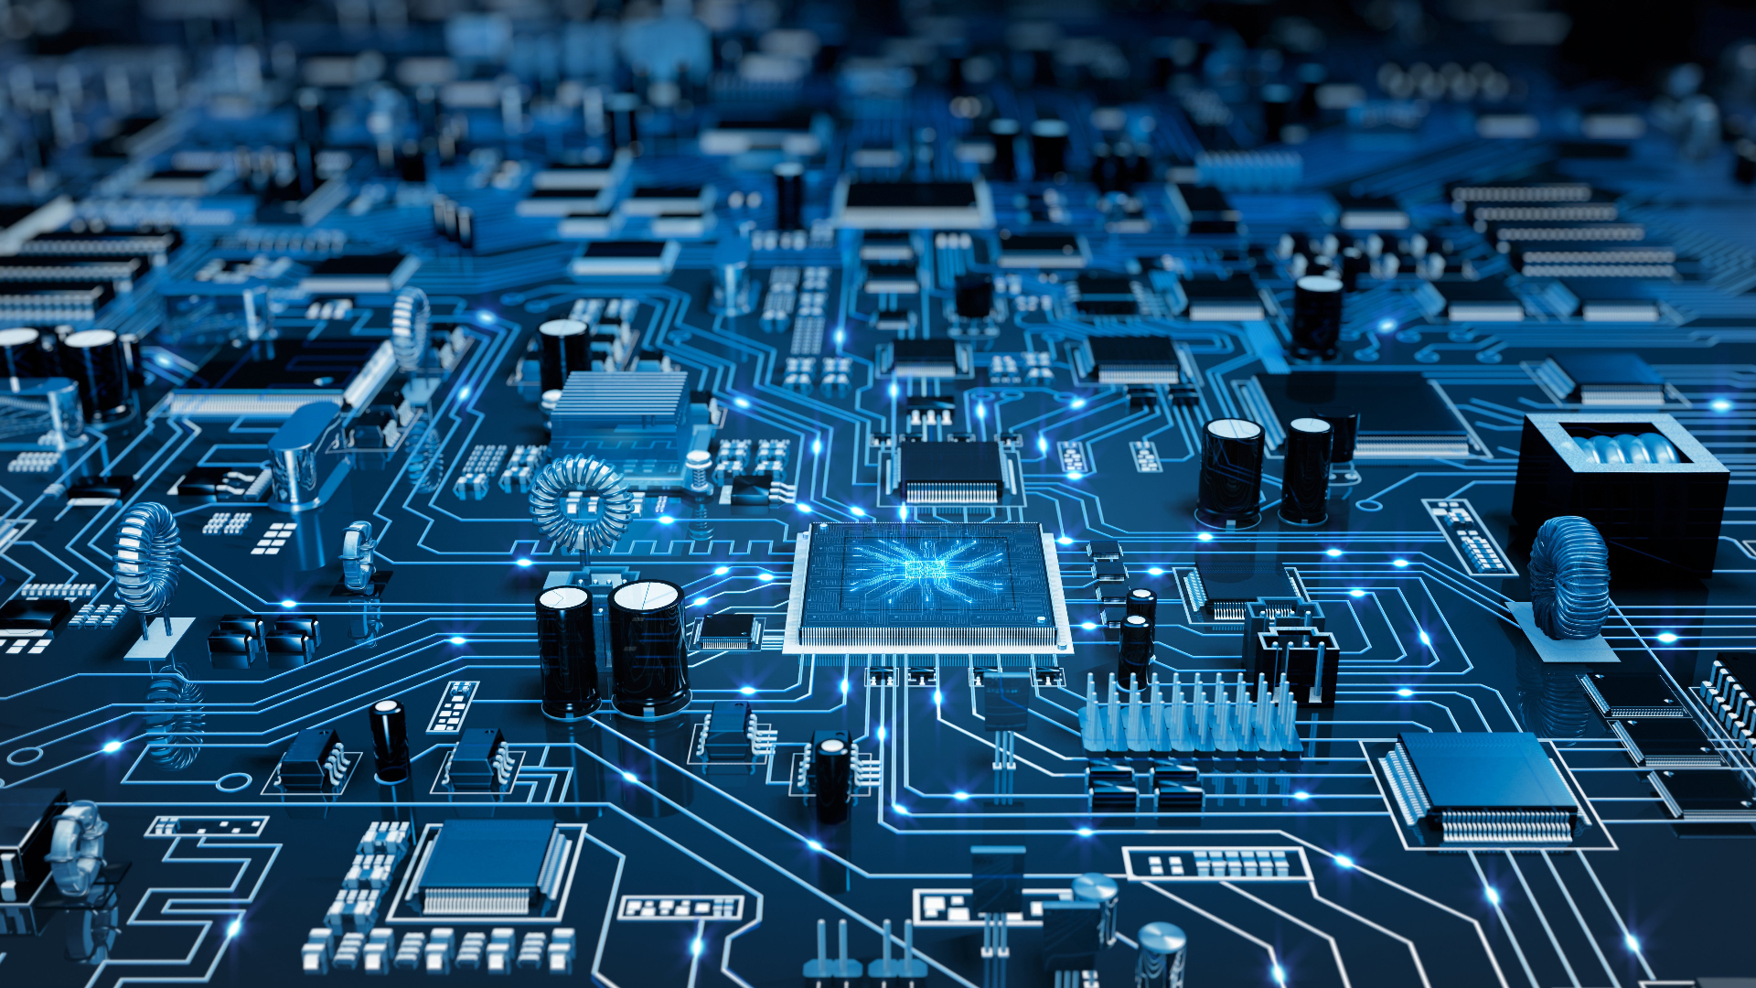
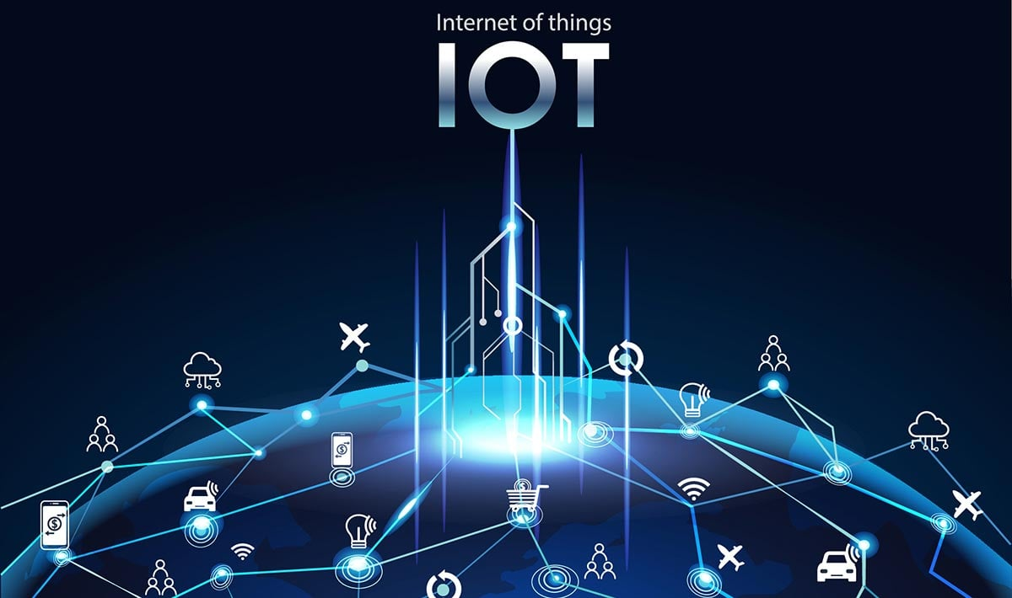
THE INTERNET OF THINGS ______________
Designed By |
| Khan. Subhaan

Slide 2
| Content Included |
What is the Internet of Things?
A Brief history about IOT
What technologies enable IOT?
What is its impact?
What would be its impact on the future?

Slide 3
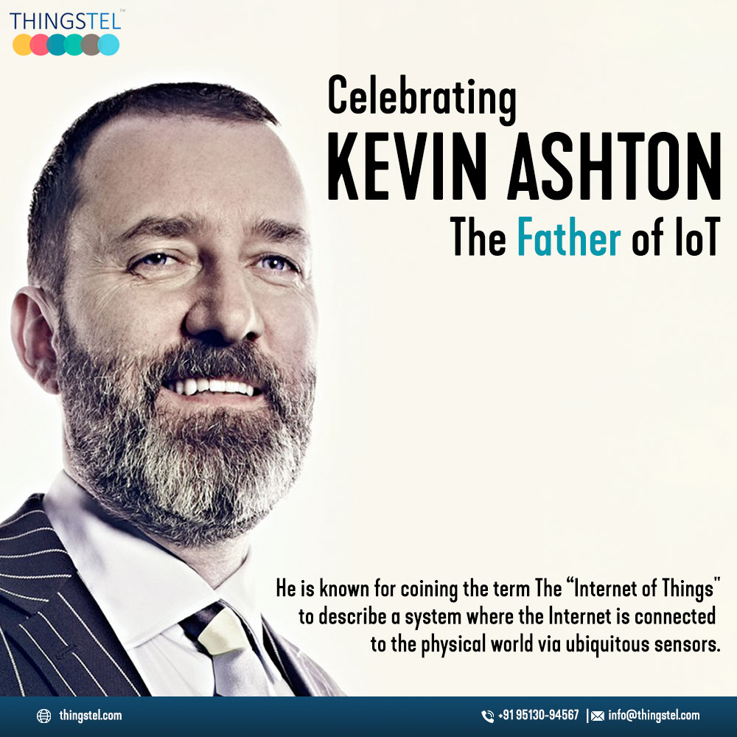
| A Brief History about The Internet of Things
In the mid-1990s the Internet extended those capabilities globally, and researchers and technologists began exploring ways that humans and machines could better connect. In 1997 British technologist Kevin Ashton, cofounder of the Auto-ID Center at MIT, began exploring a technology framework, radio-frequency identification (RFID), that would allow physical devices to connect via microchips and wireless signals, and it was in a speech in 1999 that Ashton coined the phrase “the Internet of Things.”
Within a few years smartphones, cloud computing, advancements in processing power, and improved software algorithms had created a framework for collecting, storing, processing, and sharing data in a more robust way. At the same time, sophisticated sensors appeared that could measure motion, temperature, moisture levels, wind direction, sound, light, images, vibrations, and numerous other conditions, along with the ability to pinpoint a person or a device through geolocation
The IoT continues to evolve. Today it supports an array of use cases, including artificial intelligence used for ultrasophisticated simulations, sensing systems that detect pollutants in water supplies, and systems that monitor farm animals and crops. For example, it is now possible to track the location and health of animals and to apply remotely optimal levels of water, fertilizer, and pesticides to crops

Slide 4
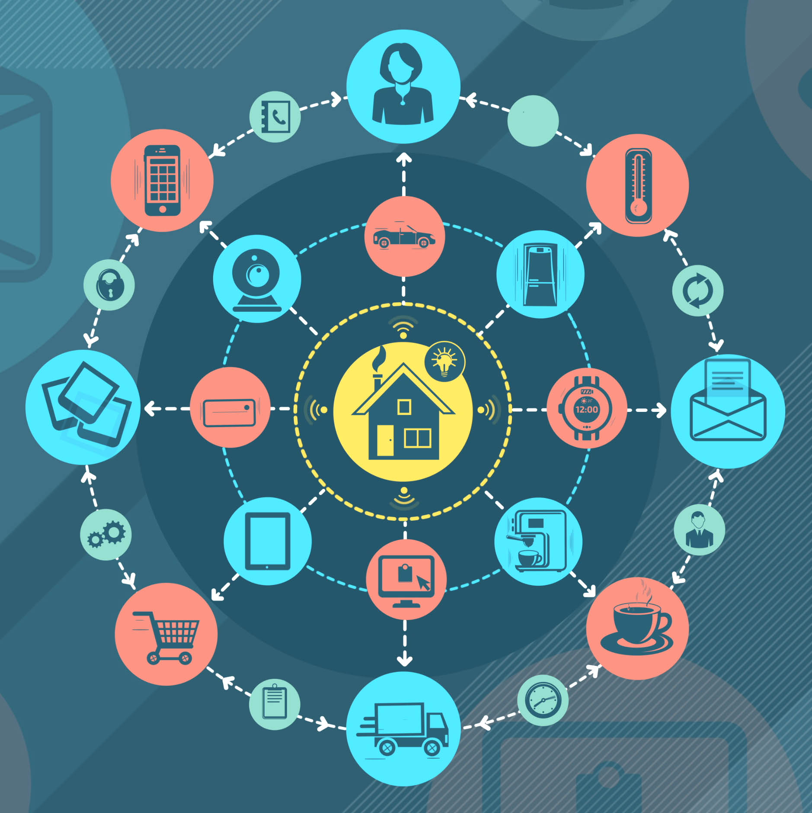
| What is The Internet of Things?
The internet of things, or IoT, is a network of interrelated devices that connect and exchange data with other IoT devices and the cloud. IOT devices are typically embedded with technology such as sensors and software and can include mechanical and digital machines and consumer objects
Increasingly, organizations in a variety of industries are using IoT to operate more efficiently, deliver enhanced customer service, improve decision-making and increase the value of the business
With IoT, data is transferable over a network without requiring human-to-human or human-to-computer interactions.

Slide 5
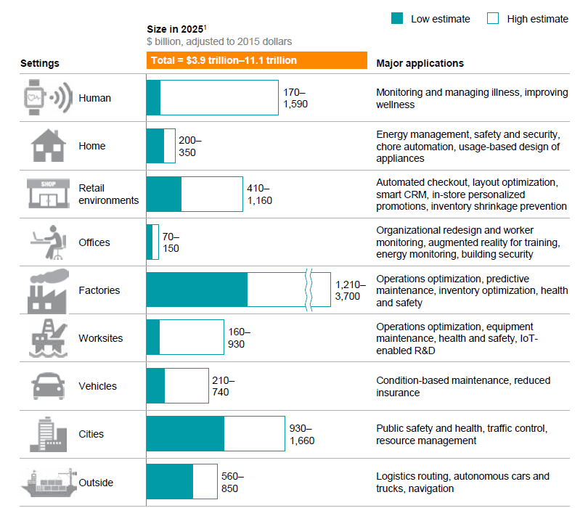
| Technologies That Enable IOT
Wireless Sensor Networks (WSNs) Any IoT solution needs some sort of wireless sensor network to acquiesce physical data and conditions. This sensor network set typically consists of sensors, gateways, and internet connectivity
Environmental IoT sensors | Temperature sensor, Humidity sensor, Light sensor, pressure sensor
Motion detection sensors | Proximity sensors, accelerometer, PIR sensors, Ultrasound sensors
Industrial sensors | Vibration sensor, Gyroscope, Pressure sensor, Gas sensor, and Viscosity sensor
Cloud Computing
Cloud computing is the next step of IoT-enabling technologies that follow once the data is sent to the cloud. Cloud computing includes database schema, server configurations, data analysis, big data, and various sets of tools that can bring insights out of collected IoT data. Being among the enabling technologies for IoT, cloud computing typically consists of a user interface application through which users can access and visualize an IoT solution. Such products can be offered as Software-As-A-Service as part of IoT-enabling techniques on the software side.
Network Protocol and infrastructure
Network protocols and infrastructure are unavoidable vital aspects of IoT. Therefore communication technologies are among the key IoT-enabling technologies. Communication technologies such as non-cellular (Zigbee, Wi-Fi, LoRaWAN, Radio frequency identification) and cellular networks can be the key for such sensor networks to connect and transmit data. Network infrastructure also includes various topologies, data encryptions, data compression, and hardware configurations. These network solutions parameters enable IoT technologies for the internet of things

Slide 6
| Some of the Impacts of The IOT
Manufacturing | IoT enables smart factories with connected machines and sensors, facilitating predictive maintenance, improved efficiency, and real-time monitoring of production processes.
Healthcare | IoT devices and wearables enable remote patient monitoring, personalized medicine, and efficient healthcare delivery. They can track vital signs, medication adherence, and provide early warnings for potential health issues.
Agriculture | IoT-based solutions provide farmers with real-time information about soil moisture, weather conditions, and crop health. This data helps optimize irrigation, fertilization, and pest control, leading to increased crop yields.
Transportation and Logistics | IoT-enabled tracking and monitoring systems improve fleet management, optimize routes, enhance supply chain visibility, and ensure timely delivery of goods.
Smart Cities | Iot Enables cities to optimize resource utilization, improve public services, and enhance sustainability. Smart street lighting, waste management, traffic control, and parking systems are examples of IoT implementations in smart cities.

Slide 7
| The Internet of Things In The Future
One of the most significant trends in IoT is the move towards edge computing. This involves processing data on the device itself, rather than sending it to the cloud for analysis. Edge computing can help to reduce latency, improve reliability, and enhance privacy and security. As a result, we can expect to see more and more IoT devices with built-in edge computing capabilities in the coming years. According to a recent report by Gartner, by 2025, 75% of enterprise-generated data will be created and processed at the edge.
While the ability to connect physical objects and devices introduces increased efficiencies and, in some cases, cost savings, scaling up those connection points and networks creates greater possibilities, though not without some great risks and challenges. For example, a smart car that connects with a smartphone can already integrate mapping, entertainment, voice commands, and other functions that transform the vehicle into a computer on wheels, but a network of connected vehicles and infrastructure could potentially allow vehicles not only to avoid crashes while driving but also to “see” around corners and avoid collisions with a bicyclist or a pedestrian. In addition, sensors in bridges, tunnels, roads, and other infrastructure could indicate when repairs are necessary or when failure is imminent. Putting such innovations into practice, however, can be challenging. Current autonomous vehicles, for example, are already burdened with safety concerns and susceptibility to hacker
Finally, one emerging trend in IoT is the use of blockchain technology to enhance security and privacy. By using blockchain, data from IoT devices can be stored in a decentralized, tamper-proof ledger, making it more secure and less vulnerable to hacking. Blockchain can also help to protect user privacy by enabling data to be shared only with authorized parties.

Slide 8
| Page References
https://www.britannica.com/science/Internet-of-Things
https://www.techtarget.com/iotagenda/definition/Internet-of-Things-IoT
https://www.knowledgehut.com/blog/web-development/iot-future#frequently-asked-questions
https://www.oracle.com/za/internet-of-things/what-is-iot/

