Slide 1

STOCK PRICE PREDICTION
Presented by:
Aditya Pawar (pawar.ad@husky.neu.edu)
Dhairya Jaiswal (jaiswal.d@husky.neu.edu)
Ranga Chari (vinjamuri.r@husky.neu.edu)

Slide 2
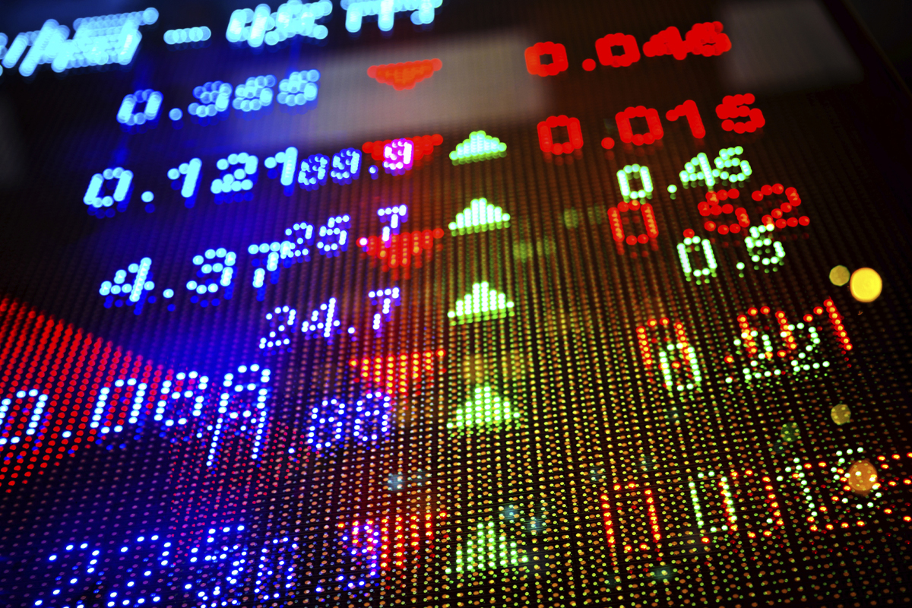

Slide 3

INTRODUCTION:
Predicting the stock price trend by interpreting the seemly chaotic market data has always been an attractive topic to both investors and researchers.
Among those popular methods that have been employed, Machine Learning techniques are very popular due to the capacity of identifying stock trend from massive amounts of data that capture the underlying stock price dynamics.

Slide 4
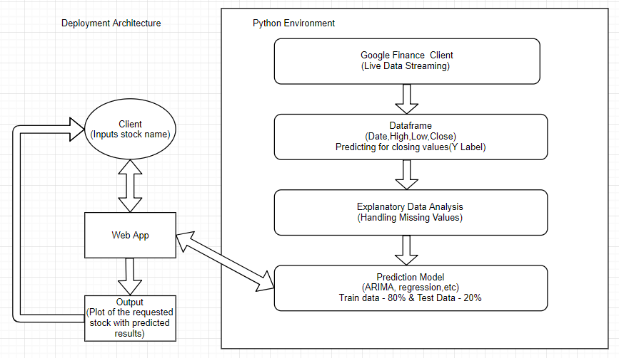
OBJECTIVE & WORK FLOW:
The main objective of the dissertation is to examine the important and potential factors/predictors that could impact the stock market and develop a system for the investors and researchers in stock prediction.

Slide 5
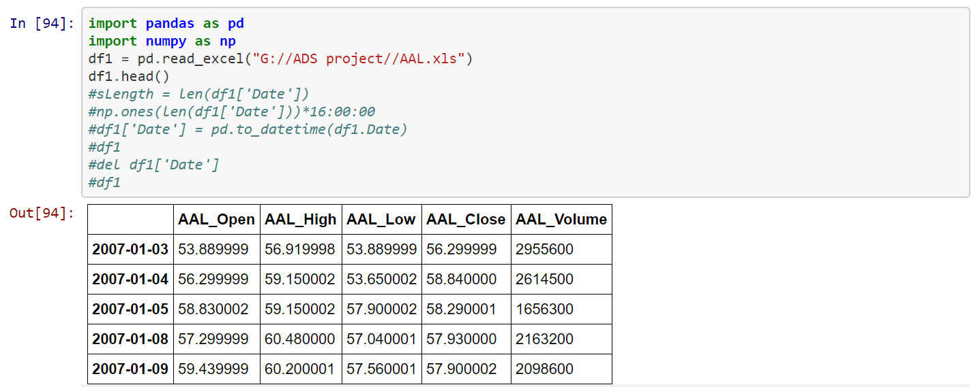
Dataset:
Here are the highlights and word definitions of the column names so as any reader can take as reference to understand how to read stocks:
1. Open: The price at the beginning of the trading day
2. High: The highest price the stock reached during the day
3. Low: The lowest price the stock reached during the day
4. Close: The final closing price of the stock for the day which becomes the opening price for the next day.
5. Volume: Volume is the number of shares that have been traded that is sold or brought throughout the day. It is important to understand Volume: A stock with low volume is thinly traded as it lacks liquidity, i.e., it would be difficult to buy or sell the stocks of that company easily. Similarly, if there is a stock that has a volume higher or more than the average trade-off dealing in this case can be volatile as the price fluctuation would be drastic and quick.
6. Adjust Closing Price: An adjusted closing price is a stock’s closing price on a given day of trading that has been amended to include any distribution and corporate actions that occur before the next day opening. The adjusted closing price is a useful tool when examining historical returns because it gives analyst an accurate representation of the firm’s equity value beyond the simple market price.It includes the corporate actions such as stock splits, dividends/distribution, and right offerings.

Slide 6
Explanatory Data Analysis and Handling Missing Values:
So, we are using Google finance module/package to update our dataset with new stock data on a daily basis but our original dataset had a time column attributing 4’O Clock closing time and another adjusted closing volume column which have been dropped because the new data being appended by the google finance package does not have these columns.

Slide 7
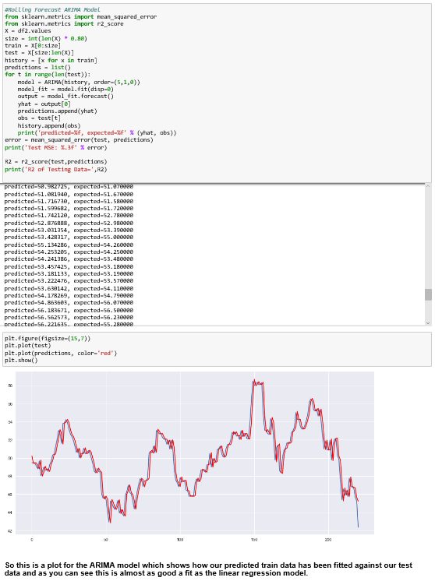
ARIMA MODEL
ARIMA is an acronym that stands for AutoRegressive Integrated Moving Average. It is a class of model that captures a suite of different standard temporal structures in time series data.
RED LINE – Prediction
BLUE LINE - Testing

Slide 8
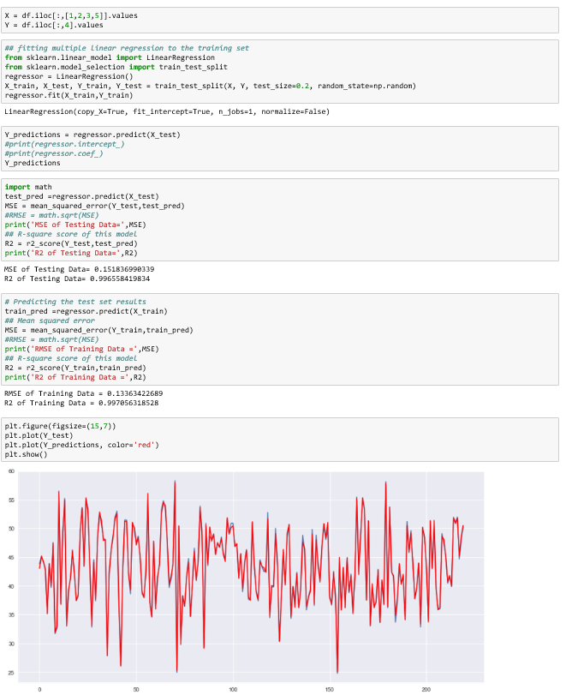
LINEAR REGRESSION MODEL
Linear regression is a statistical approach for modelling relationship between a dependent variable with a given set of independent variables. Linear regression models are a good starting point for regression tasks. Such models are popular because they can be fit very quickly and are very interpretable.
As we can see from the plot this is a very good fit and when compared to the rest of our models our conclusion is that this is the best fit.
RED LINE – Prediction
BLUE LINE - Testing

Slide 9
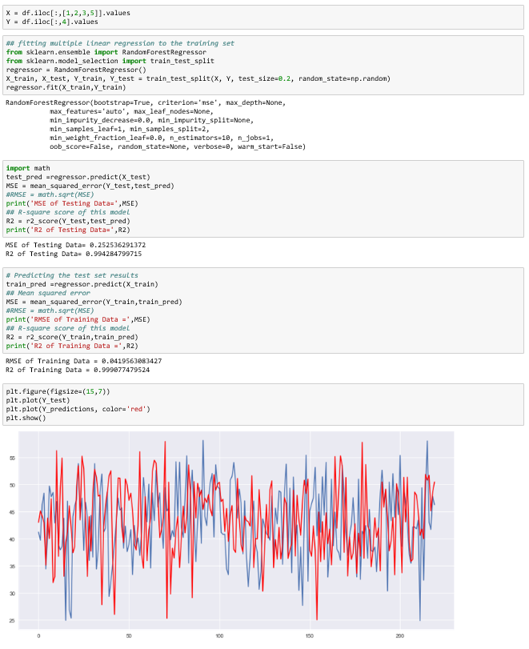
RANDOM FOREST MODEL:
Random forests or random decision forests are an ensemble learning method for classification, regression and other tasks, that operate by constructing a multitude of decision trees at training time and outputting the class that is the mode of the classes (classification) or mean prediction (regression) of the individual trees. Random decision forests correct for decision trees' habit of overfitting to their training set.
So this is a plot for Random Forest model which shows how our predicted train data has been fitted against our test data and as you can see from the graph the prediction data which is represented by the red outline doesn't fit so well with the test data so we may conclude at a glance that Random forest is not such a good fit.
RED LINE – Prediction
BLUE LINE - Testing

Slide 10
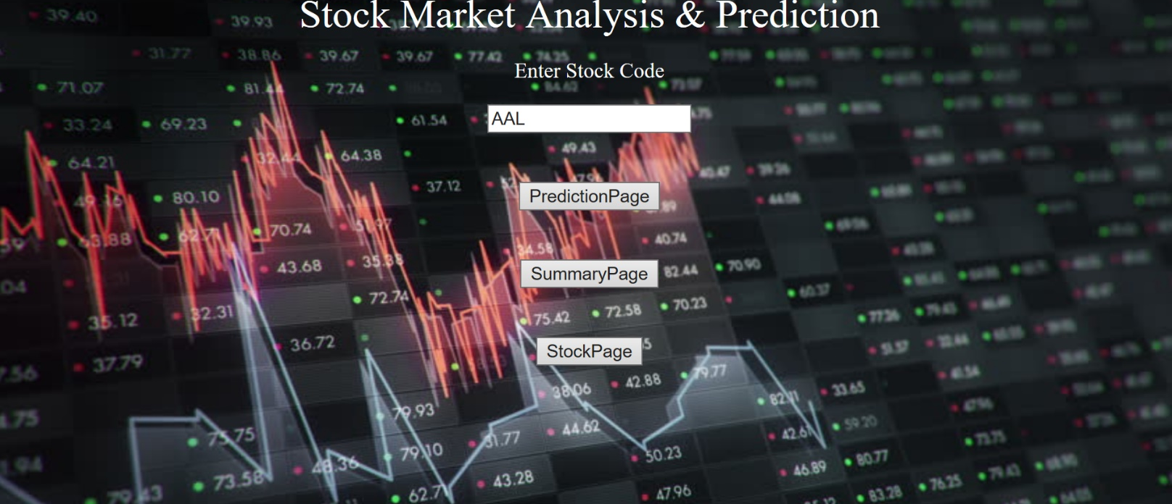
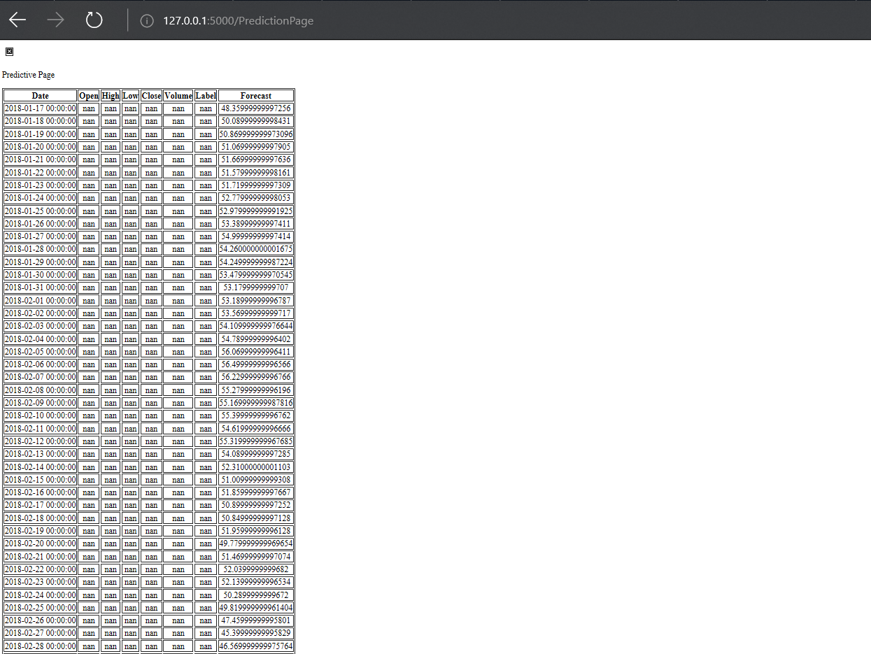
FLASK APP & UI
app.py is our main flask application which calls all the other functions and html pages to run our app. A basic flask app requires a templates folder which contains our html pages.
We have the main page for our web app where we can input the company name and then check the forecasting values by clicking on the prediction page button.
The second page is our prediction page which shows the predicted stock forecast values for the selected company.

Slide 11
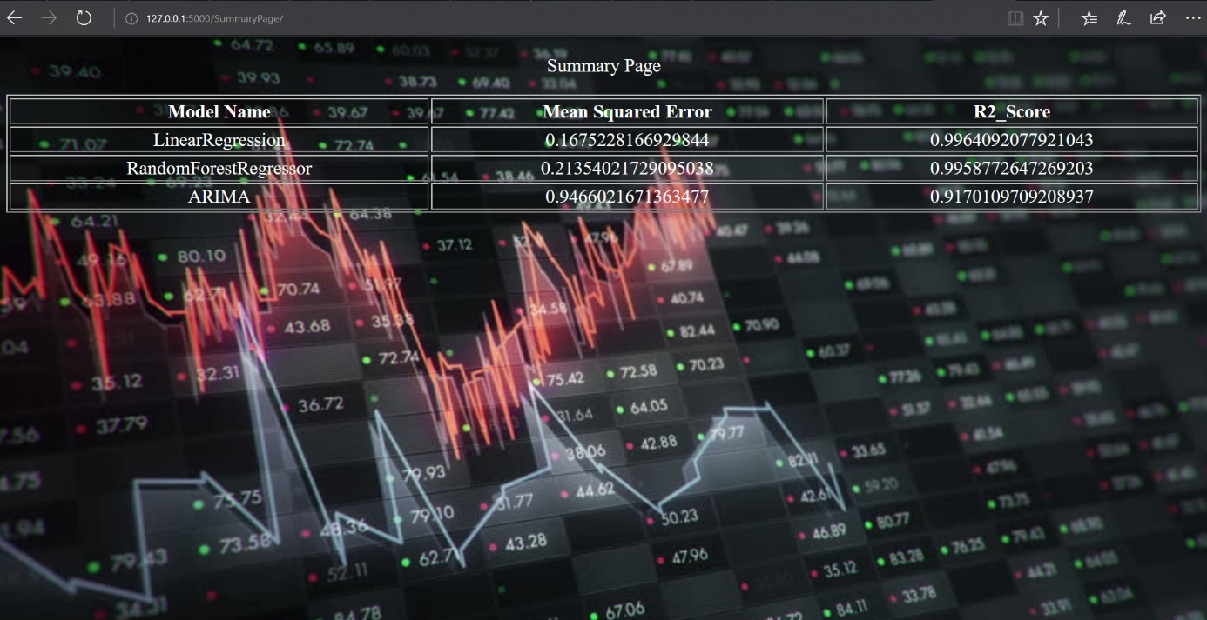
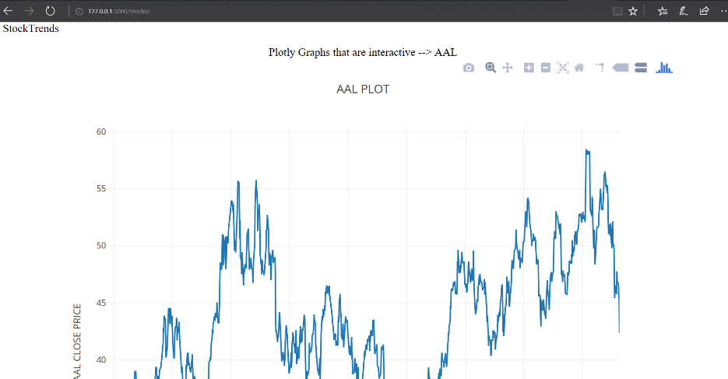
Models Implemented & Their Result:
Model Results:
This is our summary metrics page which is showing how the models performed on the basis of R2 and RMSE scores.
Finally, we have our stock page which has been integrated with plotly to show interactive graphs.

Slide 12

CONCLUSION:
By using this web application people can access any stock registered under NYSE and analyze the live stock price along with predictive forecasting with 99% accuracy which will eventually help them in making long term investments and avoid losses.
EC2 Instance of the app¶
ec2-54-86-196-157.compute-1.amazonaws.com

