Slide 1
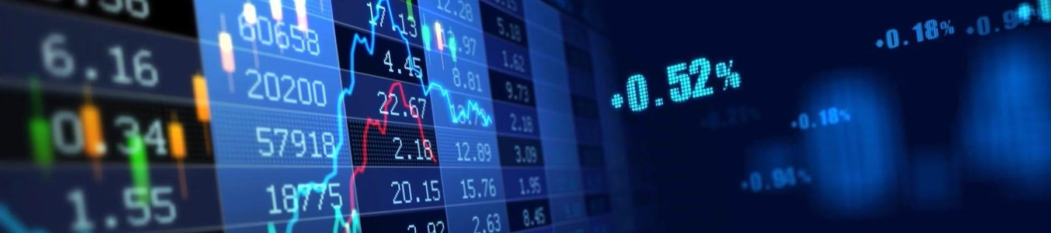

STOCK PRICE FORECASTING
TEAM 11
Aditya Pawar
Dhairya Jaiswal
Ranga Chari

Slide 2
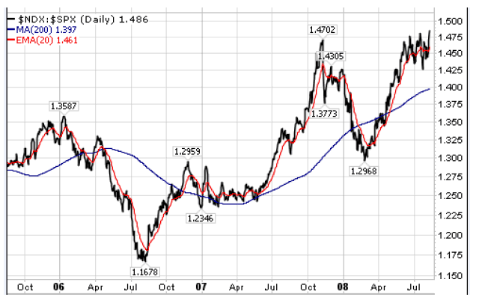
Overview
Stock price forecasting is one of the most important area in todays data science field as it helps in determining the future value of a companies stock or other financial instrument traded on exchange. Depending on how well the prediction algorithms work it could yield a significant profit for the public/investors.

Slide 3
Goals
To provide insightful decision-making trends for public which would be profitable in near as well as the long run.
Changing demands of stock value during the day.
Factors affecting the high and low value of stock prices.
Date, Open, High, Low, Close, Volume, OpenInt
Other conditions that may influence the stock pricing.
Offering an interactive UI that lets the user read the description of a particular company’s data and also provides them future prediction values on a daily and weekly basis.
Predict various high and low values as per day trends because of various influential trading factors(Like companies acquiring or merging with other companies).

Slide 4
USE CASES:
Giving foresight to investors to make the right decisions and avoid making a loss.
Knowing upfront highs and lows in stock trends.
DATA Set Source:
STOCK DATA - https://www.kaggle.com/borismarjanovic/price-volume-data-for-all-us-stocks-etfs/data

Slide 5
PROCESS OUTLINE
Data Preprocessing, Data Cleaning, handling missing values
Exploratory Data Analysis
Study of time series approach and select the best models for prediction.
Study of Unsupervised approaches like logistic regression, ARIMA(Auto Regressive Intensive Moving Average) for prediction.
Design of a pipeline and system to implement this approach and discussion on the system’s capabilities
Deploy the Model on Azure/AWS or Google Cloud Computing Platform
Build a web application to demonstrate the prediction results and detailed analysis of selected stock value for a company.

