Slide 1


Sentiment Analysis of News/Social Media feeds on Stock Market
Vinyas Kaushik T R
Ranga Chari .V

Slide 2


Slide 3

Problem Statement
Predicting the stock price trend by interpreting the seemly chaotic market data has always been an attractive topic to both investors and researchers. Among those popular methods that have been employed, Machine Learning techniques are very popular due to the capacity of identifying stock trend from massive amounts of data that capture the underlying stock price dynamics.

Slide 4




Twitter Sentiment Analysis
Set up pipeline, and get the sentiment score for each sentence as integer
0 = Very Negative
1 = Negative
2 = Neutral
3 = Positive
4 = Very Positive
Collecting the tweets using Keywords
Filter the Tweets received

Slide 5


Spark time-series methodology
Feature extraction and load into RDD
Training the data using ARIMA model and forecasting the output- Using Spark ML
Preprocessing and cleaning the data – Using SCALA
Parse data into desired format and visualize the data –Using D3.js

Slide 6
Goals Achieved
The main challenge would be showcasing how Twitter feeds affect the stock values (Using 3 companies)
Prediction ranges : 1) Small gain or lose(Small change 2%) 2) Neutral (No Change in Stock value) 3) Large gain or lose (Large change 10%)
Reactive Application! Used PLAY framework. We were also able to compute to suggest to predict future trends for the particular stock.

Slide 7
Design Implementation & Technologies used: Spark Streaming Spark Mllib Scala Play Framework
Web
Stock Data
Data Ingestion
Spark Streaming/Kafka
Spark Streaming/Kafka
Analysis
Sentiment Analysis (Scores)
Time Series Analysis (Scores)
Stock Market Data & New Feeds
Twitter
Scores
Small Gain/Lose
Large Gain/Lose
Neutral

Slide 8

Use Cases
1. Giving foresight to consumers to make the right decisions and avoid making a loss, by selecting the company and the system will return the prediction.
2. Decisions would be based on how the news/ Social feeds have responded to that particular stock
3. User-friendly application, where the user can sign up/log in and then can check stock values.

Slide 9

Technologies used
1. PLAY framework
2. SPARK time series algorithm
3. Twitter Sentiment Analysis
4. AKKA framework
5. SCALA
6. D3.js
7. Python

Slide 10
Data Source
Used Quandl api to ingest data using python.
Use Twitter api do data ingestion using spark-streaming
Kaggle Data source for stock value
We trained the model with the data of 5 companies and 10000 rows

Slide 11
Time Line
1s^{t} Week
Complete data ingestion and Exploratory analysis done
2nd Week
Implement Machine Learning Algorithms to do Sentiment analysis and generate score
3rd Week
Implement Machine Learning Algorithms to do Time series analysis and generate score, to combine both scores and do analysis of the trends
Testing and Documentation
4th Week

Slide 12
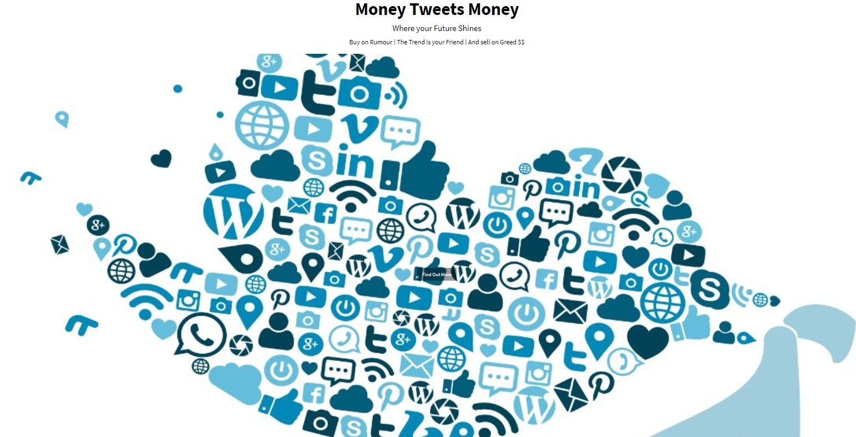
Screenshots– Home page

Slide 13
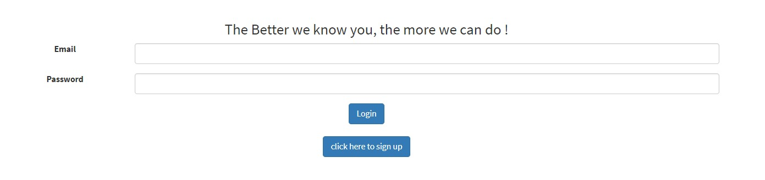
LOGIN Page

Slide 14
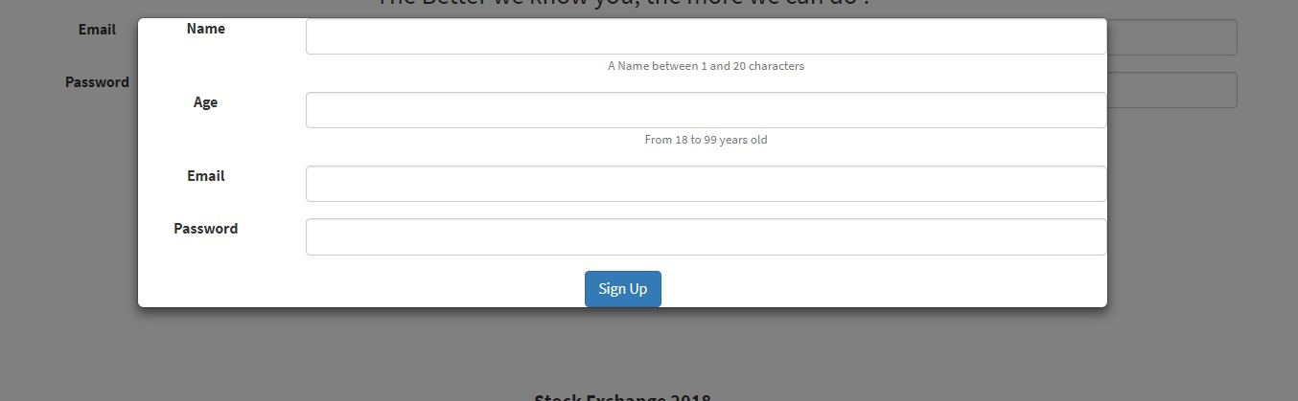
Sign-up page

Slide 15
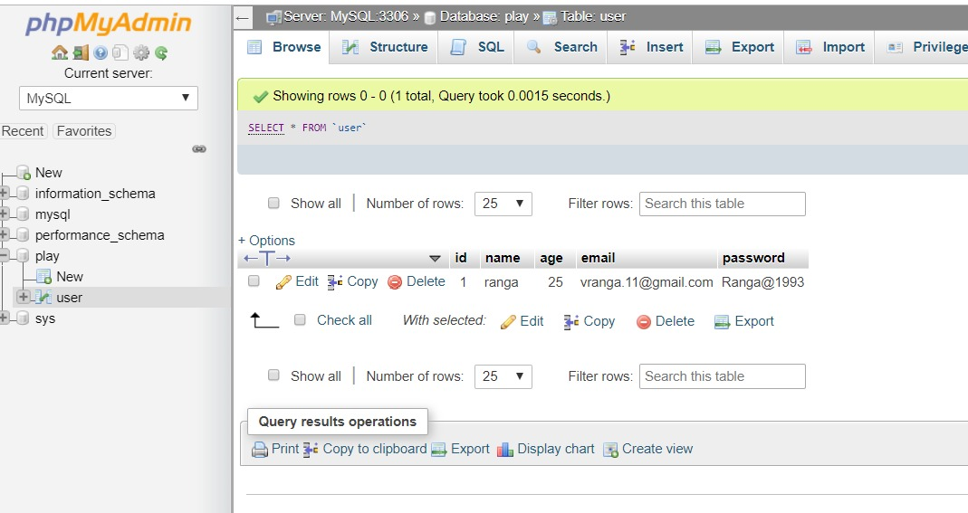
Database connection

Slide 16
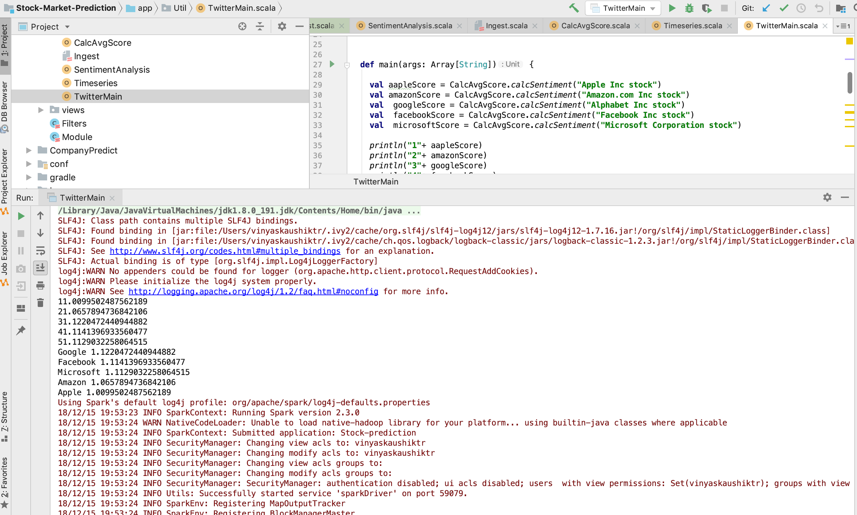
Screen Shots of the Code Run

Slide 17
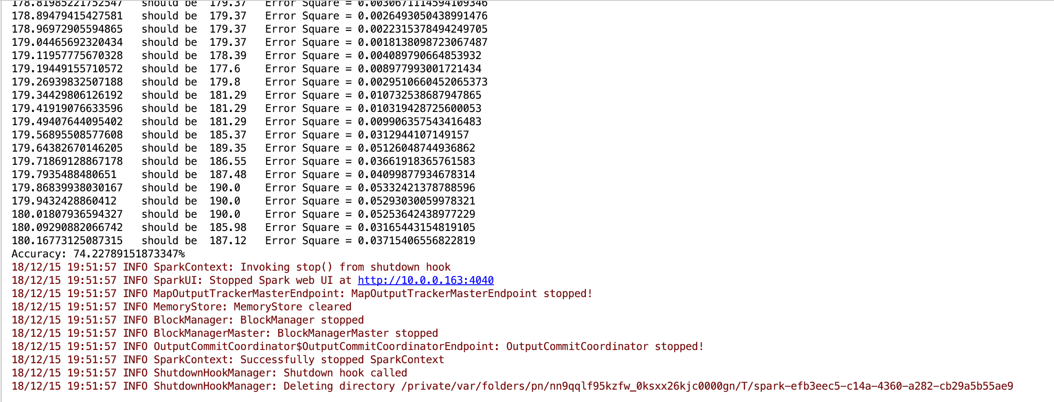
Accuracy Score AND RMSE Values

Slide 18
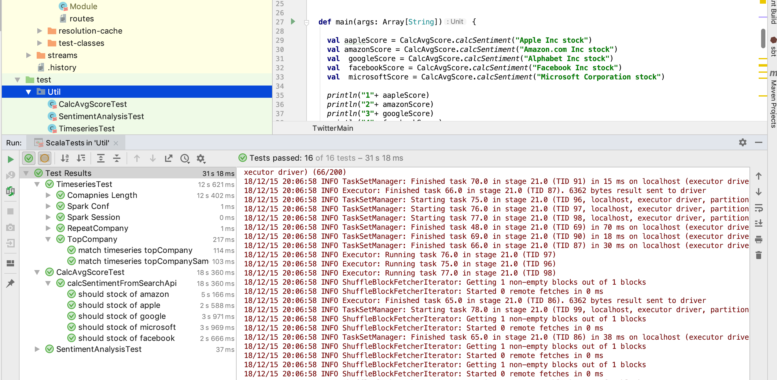
Test CAses

Slide 19
Acceptance Criteria:
Achieved a 74% Accuracy score for model prediction.
Thank You

