Slide 1
IBM University Engagement Project Submission
“Exploring the Power of Agentic AI with IBM Granite and IBM Bob”

Slide 2

Project Tile – [HealthGenie AI]
Domain of Project – [Healthcare / … ]
Faculty Name | Recent Passport Photo | Email ID | Mobile number [WhatsApp]
K.Siva Ranganath |  | rangacse12@gmail.com | 9959657428
Recommended font style and size: Font Style: Arial Font Size (Heading): 28
Font Size (Content): 20
Recommended font style and size: Font Style: Arial Font Size (Heading): 28
Font Size (Content): 20

Slide 3
Problem Statement -
Problem Statement : Personalized Healthcare Recommendation Engine
The Challenge
Healthcare recommendations are often generic and fail to account for an individual's unique health profile, lifestyle, medical history, and wellness goals. People struggle to make informed decisions about diet, exercise, preventive care, and chronic disease management due to fragmented health information and a lack of personalized guidance. As a result, many individuals are unable to maintain healthy habits, detect risks early, or effectively manage existing health conditions
The Objective
Build an AI-powered Personalized Healthcare Recommendation Engine that provides customized health insights, wellness plans, and preventive care recommendations for individuals, caregivers, and healthcare professionals. The solution should:
Personalized Health Recommendations
Generate tailored recommendations based on age, gender, lifestyle, medical history, family history, fitness level, and health goals.
Suggest personalized diet, exercise, sleep, and stress-management plans.
Health Data RAG Retrieval
Retrieve and summarize healthcare information from trusted medical and nutritional knowledge sources.
Provide evidence-based recommendations and explanations for users.
Health Monitoring & Feedback
Allow users to log health metrics such as weight, blood pressure, glucose levels, physical activity, sleep patterns, and symptoms.
Deliver real-time feedback and actionable insights based on tracked data.
Preventive Healthcare Focus
Identify potential health risks and recommend preventive measures.
Support chronic disease management for conditions such as diabetes, hypertension, obesity, cardiovascular diseases, and thyroid disorders.

Slide 4
Proposed Solution -
Proposed Solution: AI-Powered Nutrition Agent
The proposed solution is a multi-agent AI-powered Nutrition Agent built using IBM Bob, IBM watsonx.ai, and Granite Models to provide personalized, real-time dietary guidance. The system addresses challenges in diet planning, nutrition tracking, and preventive healthcare through an intelligent, modular architecture.
At its core, the solution uses a Retrieval-Augmented Generation (RAG) pipeline to fetch accurate nutritional data from trusted sources such as USDA and WHO datasets. This data is embedded and stored in a vector database, enabling the system to retrieve and summarize food nutrition details (calories, macros, vitamins) using Granite models.
The system consists of four key agents:
Nutrition Knowledge Agent retrieves and summarizes nutritional information using RAG.
Diet Recommendation Agent generates personalized meal plans based on user inputs such as age, health conditions, dietary preferences, and fitness goals.
Health Advisory Agent provides preventive health suggestions, including disease-specific diets (e.g., diabetes-friendly or heart-healthy plans).
Food Log & Feedback Agent allows users to log meals via text, voice, or images and delivers instant nutritional analysis with actionable feedback.
The solution includes a user-friendly dashboard (built with Streamlit or React) that visualizes daily and weekly nutrient intake, highlights deficiencies, and tracks progress toward health goals.
IBM Bob is used to orchestrate agent workflows, while watsonx.ai ensures scalable model deployment, embeddings, and AI governance. Granite models power reasoning, summarization, and personalization.
Overall, this solution delivers an end-to-end intelligent nutrition assistant that promotes healthier lifestyles through personalized insights, real-time feedback, and preventive healthcare recommendations.

Slide 5
Problem Statement -
Problem Statement : Personalized Healthcare Recommendation Engine
The Challenge
Healthcare recommendations are often generic and fail to account for an individual's unique health profile, lifestyle, medical history, and wellness goals. People struggle to make informed decisions about diet, exercise, preventive care, and chronic disease management due to fragmented health information and a lack of personalized guidance. As a result, many individuals are unable to maintain healthy habits, detect risks early, or effectively manage existing health conditions
The Objective
Build an AI-powered Personalized Healthcare Recommendation Engine that provides customized health insights, wellness plans, and preventive care recommendations for individuals, caregivers, and healthcare professionals. The solution should:
Personalized Health Recommendations
Generate tailored recommendations based on age, gender, lifestyle, medical history, family history, fitness level, and health goals.
Suggest personalized diet, exercise, sleep, and stress-management plans.
Health Data RAG Retrieval
Retrieve and summarize healthcare information from trusted medical and nutritional knowledge sources.
Provide evidence-based recommendations and explanations for users.
Health Monitoring & Feedback
Allow users to log health metrics such as weight, blood pressure, glucose levels, physical activity, sleep patterns, and symptoms.
Deliver real-time feedback and actionable insights based on tracked data.
Preventive Healthcare Focus
Identify potential health risks and recommend preventive measures.
Support chronic disease management for conditions such as diabetes, hypertension, obesity, cardiovascular diseases, and thyroid disorders.

Slide 6
Technology Used
IBM Bob platform -For designing and orchestrating multi-agent workflows visually
IBM Grainte model - for eg – ibm-granite-3-2-8b – For natural language understanding, reasoning, and personalization
IBM Cloud – It provides the infrastructure to build, deploy, and scale the Nutrition Agent efficiently. IBM Cloud enables a reliable, secure, and scalable environment for deploying the Nutrition Agent.
IBM Watsonx.ai - For model deployment, embeddings, and AI governance
Vector Database (FAISS/Chroma) – For RAG-based nutritional data retrieval

Slide 7
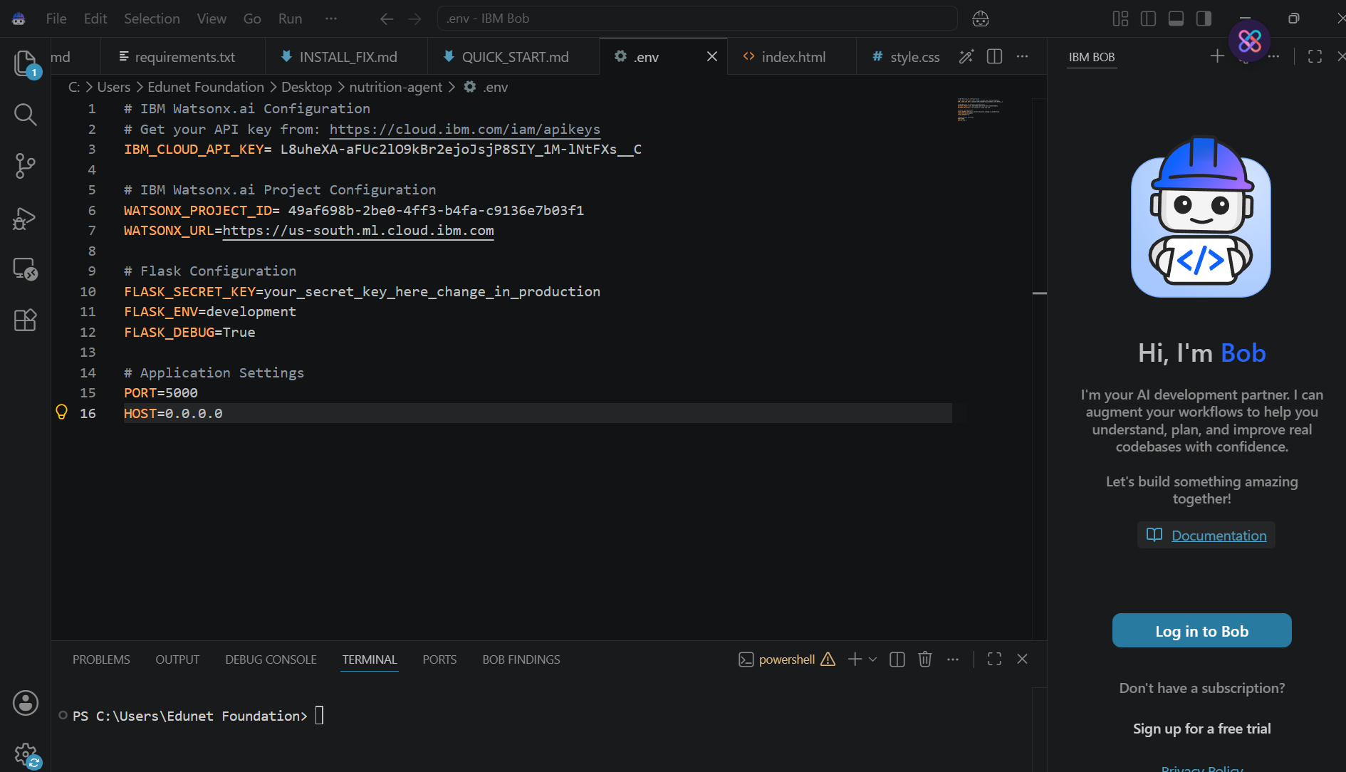
Required Files created using IBM bob -
App.py
Requirements.txt
Style.css
.env
Index.html

Slide 8
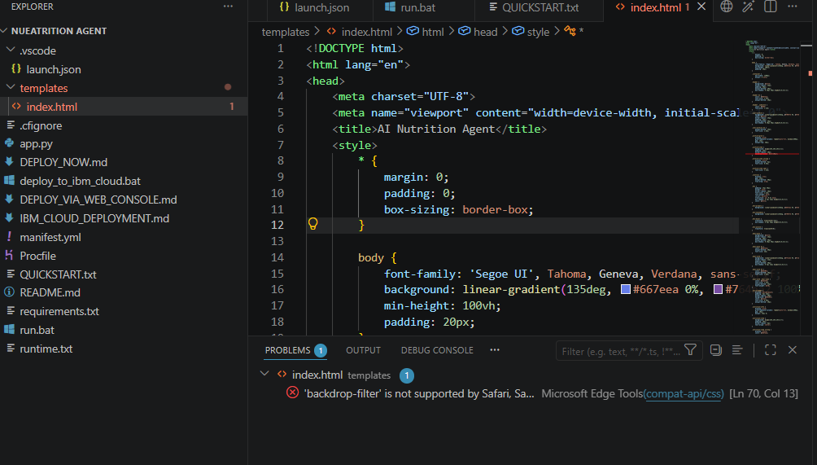
IBM Bob Screenshots:

Slide 9
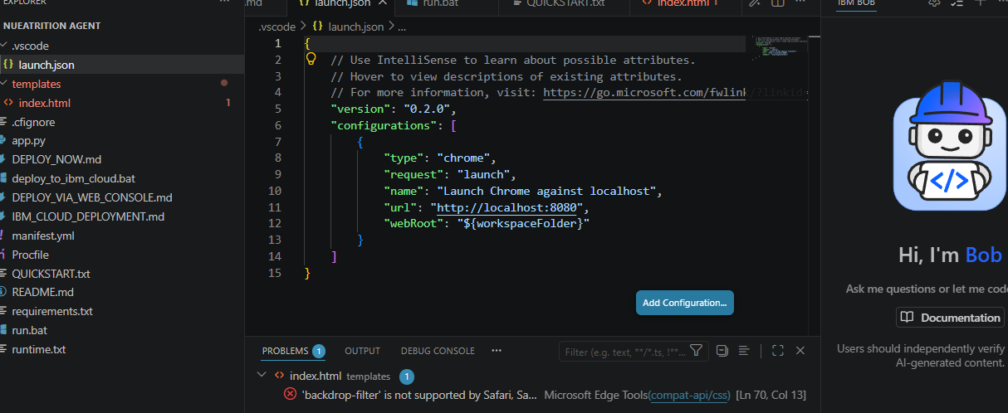

Slide 10
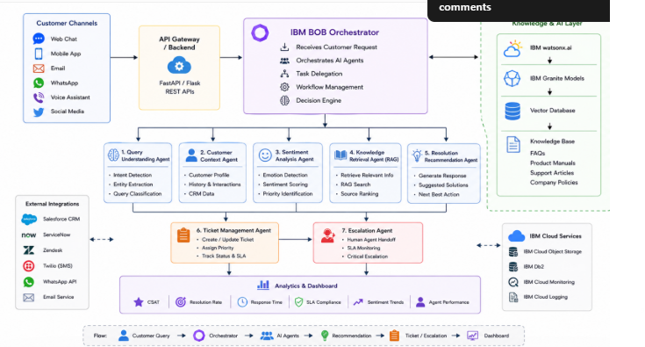
Architecture blueprint for IBM bob:

Slide 11

Role of Agentic AI in the solution
Role of Agentic AI in Personalized Healthcare Recommendation Engine Agentic AI enables the Personalized Healthcare Recommendation Engine to function as an intelligent, autonomous healthcare assistant rather than a simple question-answering chatbot. Using IBM watsonx.ai and IBM Granite Models, it coordinates multiple specialized agents to deliver personalized healthcare guidance, preventive care recommendations, and continuous health monitoring.
Each agent performs a specific role—such as analyzing health profiles, retrieving medical knowledge, generating personalized healthcare recommendations, monitoring health metrics, and assessing potential health risks—while working collaboratively. This multi-agent approach ensures efficient task execution, accurate decision-making, and comprehensive healthcare support.
Agentic AI also brings context awareness, understanding user-specific information such as age, gender, medical history, lifestyle habits, existing health conditions, fitness levels, and wellness goals to generate highly personalized recommendations. This enables the system to provide tailored guidance for nutrition, exercise, sleep, stress management, and disease prevention.

Slide 12


Token Usage
11,761 token are used
Before Prompt
After the Prompt
·
·
·

Slide 13
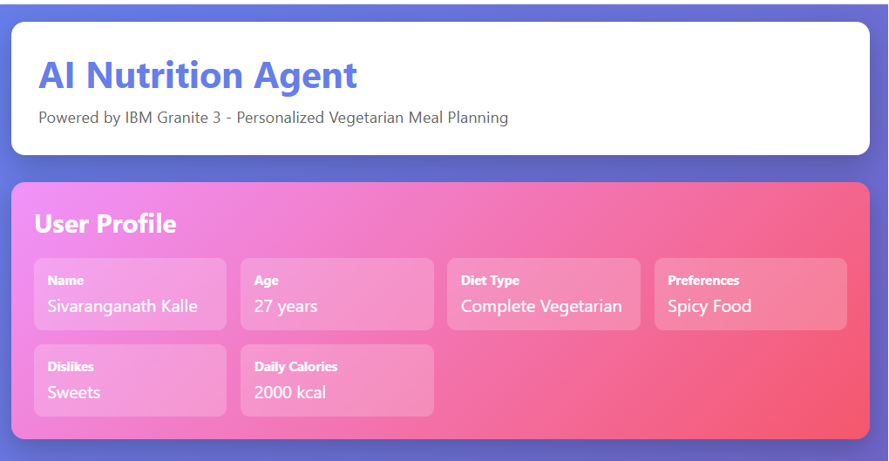

Slide 14
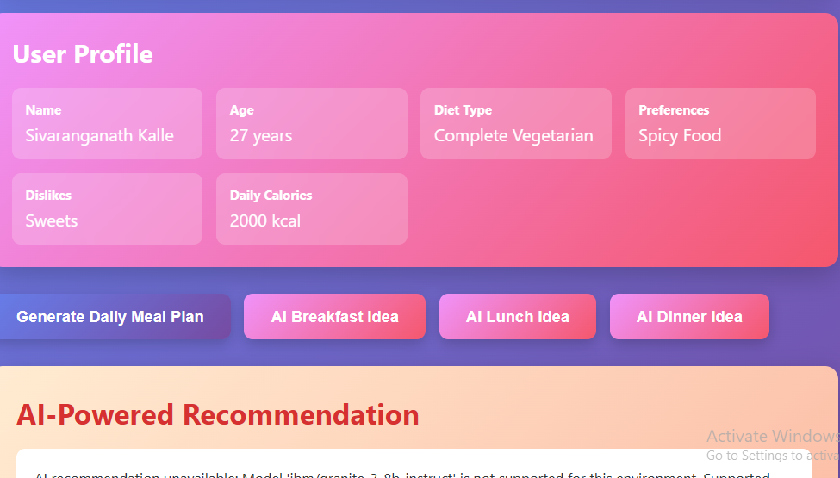
Project Output Screenshot
Please put IBM Bob output screenshots with 2-3 prompts.
You can take 2-3 more slides for each screenshot
·
·
·

Slide 15
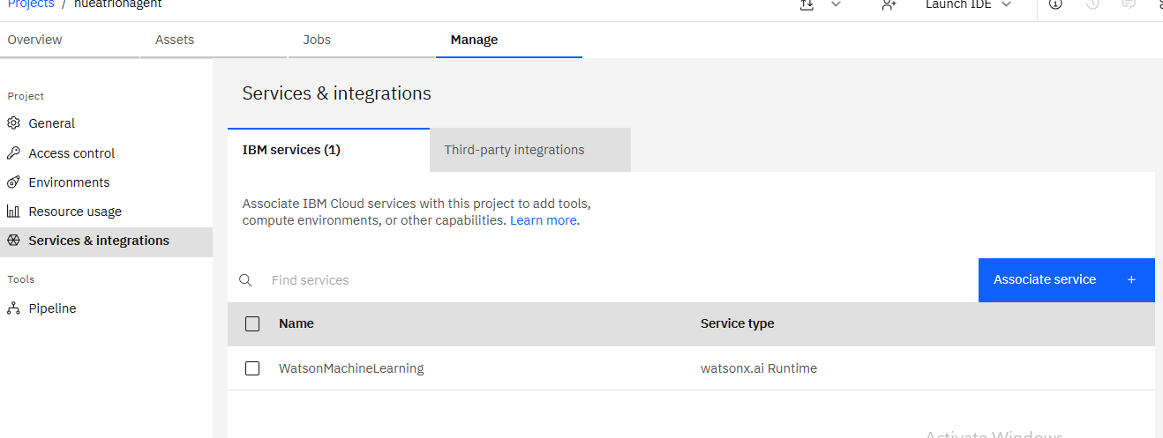

Slide 16
Novelty and Uniqueness
The AI-Powered Agentic Customer Support and Resolution Engine goes beyond traditional chatbots by leveraging Agentic AI, Retrieval-Augmented Generation (RAG), and IBM Granite Models to deliver intelligent, context-aware, and autonomous customer support. Its key innovations include:
1. Multi-Agent AI Architecture
Unlike conventional support systems that rely on a single chatbot, this solution employs multiple specialized AI agents that collaborate to understand customer queries, retrieve relevant knowledge, analyze sentiment, generate personalized responses, and manage ticket escalation. This modular architecture improves efficiency, scalability, and response accuracy.
2. Context-Aware Personalized Support
The platform maintains customer context across interactions by considering previous conversations, purchase history, account details, and support records. This enables highly personalized and consistent responses, eliminating the need for customers to repeat information.

Slide 17
Git Hub Link
· Please create public github repository (Enable Add README button while creating repository) with format –
Please test and Paste the working Github URL –
Make sure you have Uploaded following three files into your github repository 1) All Agent relevant files of IBM Cloud , 2) yourproblemstatement.pdf file 3) your projectpresntation.pptx file 4)any other files
·
·
·

Slide 18
Future Scope
Generative AI-Powered Personal Health Coach
Future enhancements can transform the solution into an intelligent personal health coach powered by IBM Granite Models and Agentic AI. The system will proactively guide users through personalized wellness journeys, set health goals, monitor progress, and continuously adapt recommendations to maximize health outcomes.
Advanced Preventive Healthcare Ecosystem
The platform can evolve into a complete preventive healthcare ecosystem that combines nutrition, fitness, mental wellness, disease risk prediction, medication management, and continuous health monitoring. This holistic approach can help users proactively manage their health and improve long-term quality of life.
·
·
·

Slide 19
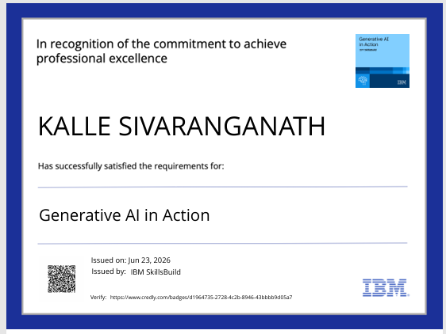
Certificates Earned:
Please add your credly certificate

Slide 20
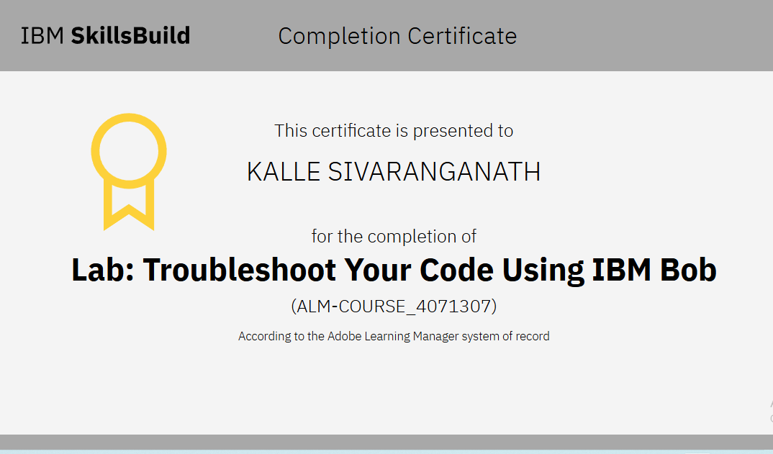
Certificates Earned:​
Add your IBM BOB Certificate

Slide 21
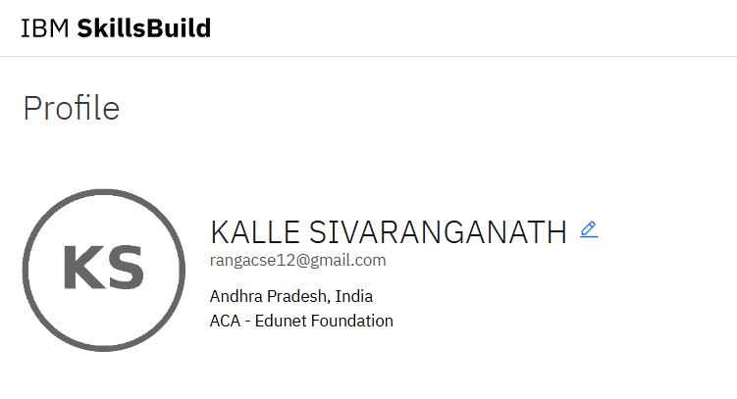

Slide 22


